Slide 1
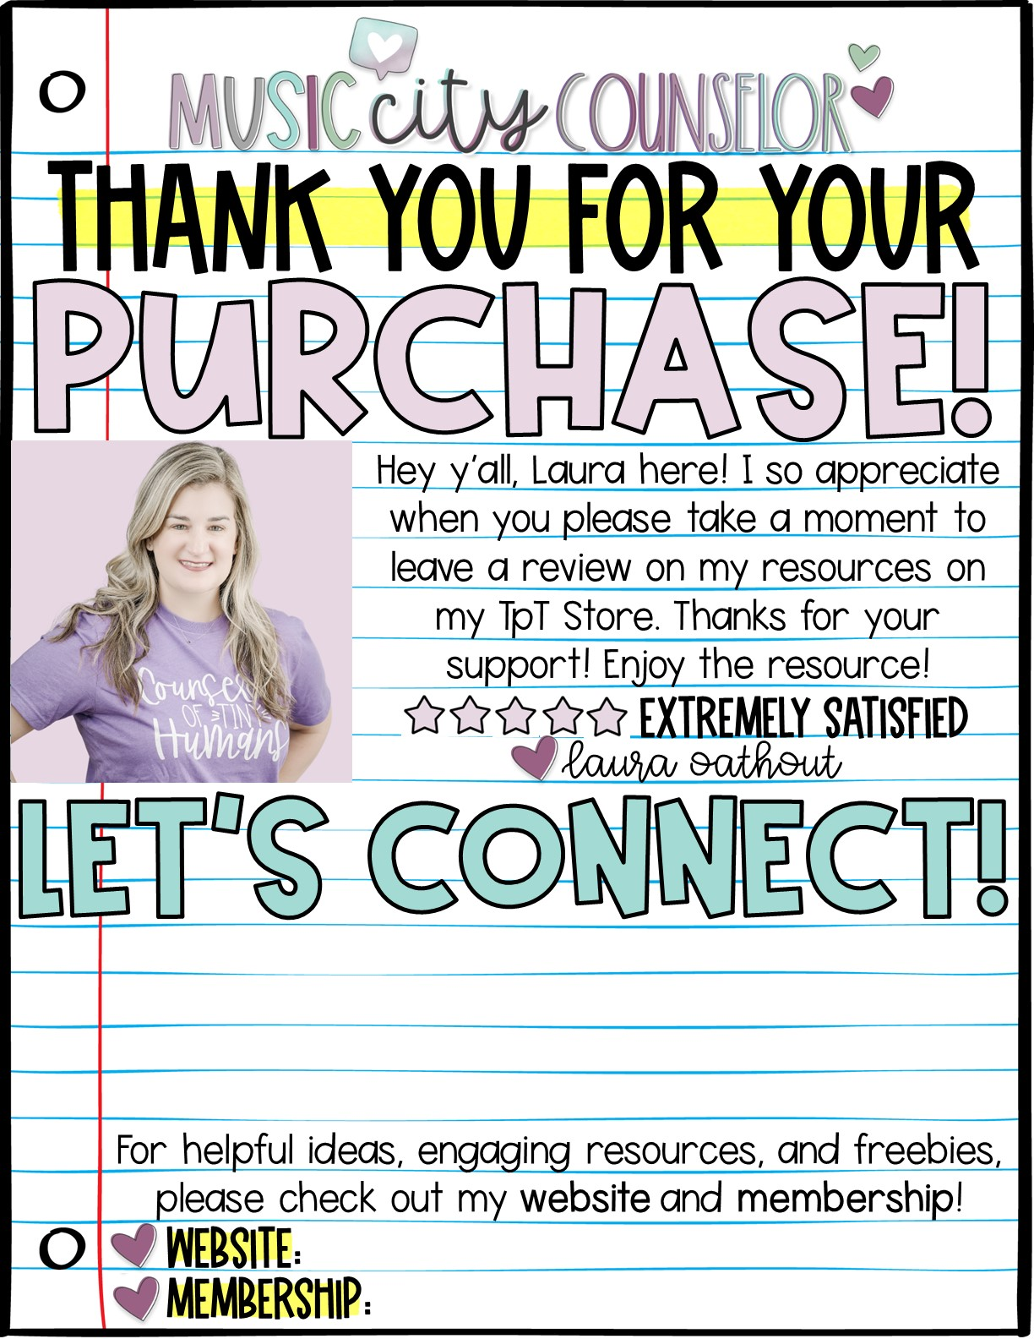





www.musiccitycounselor.com
www.counselorcollab.com

Slide 2
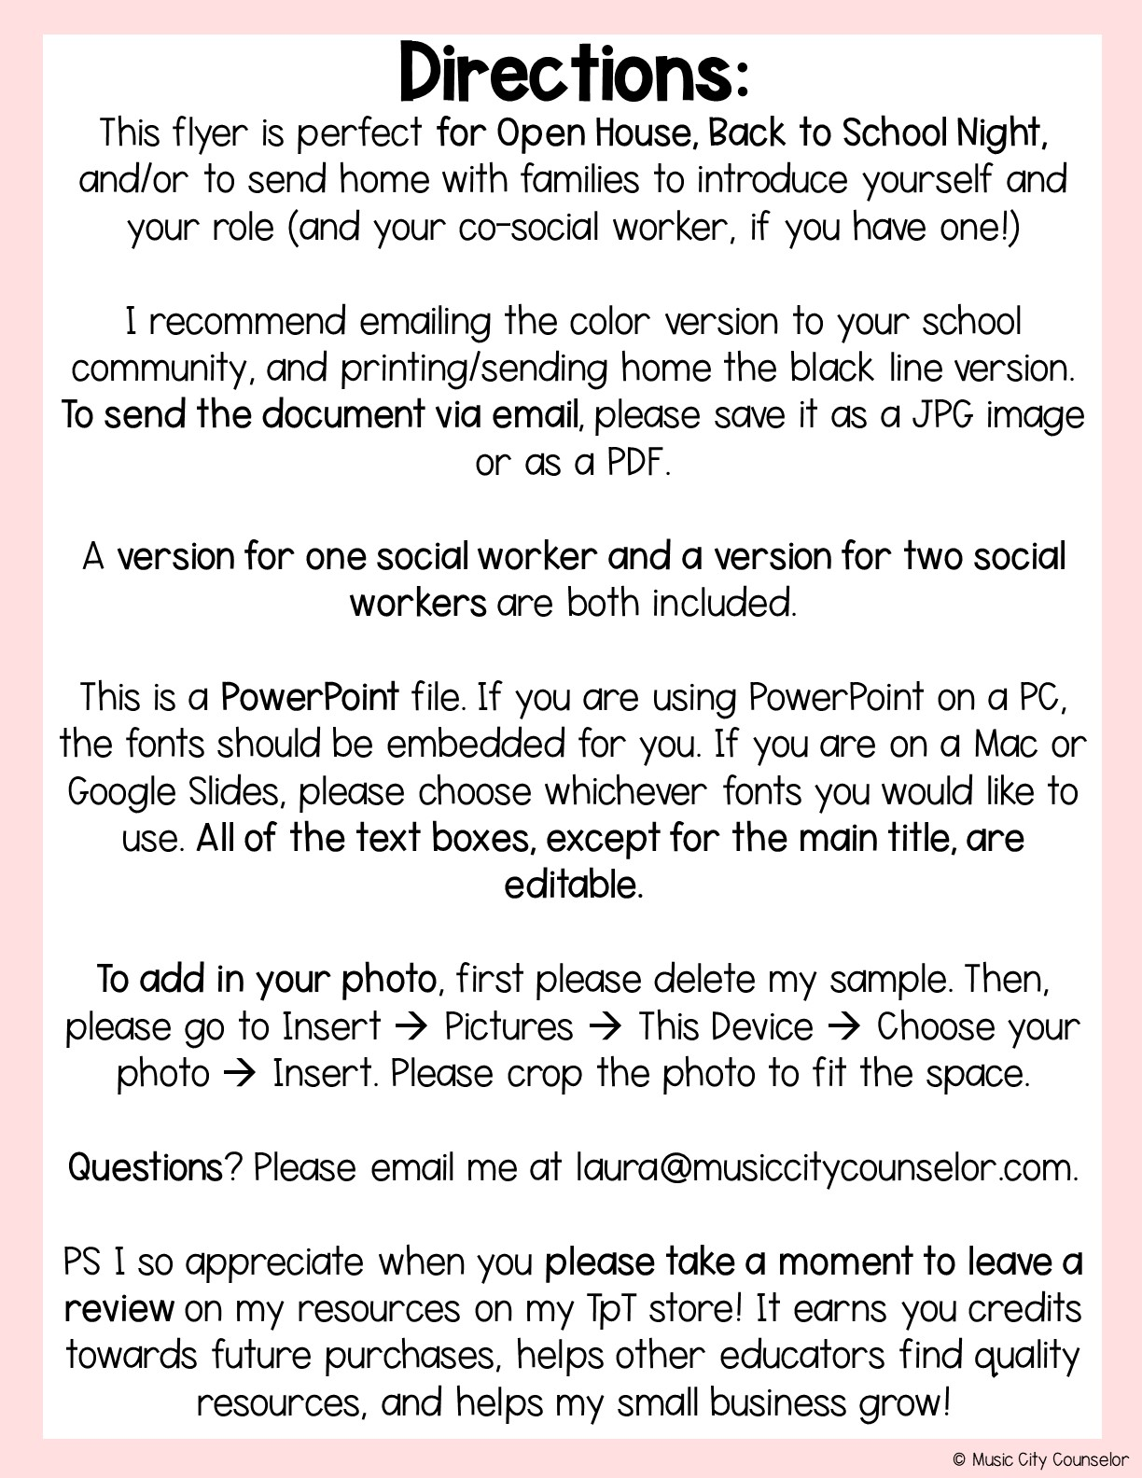

Slide 3
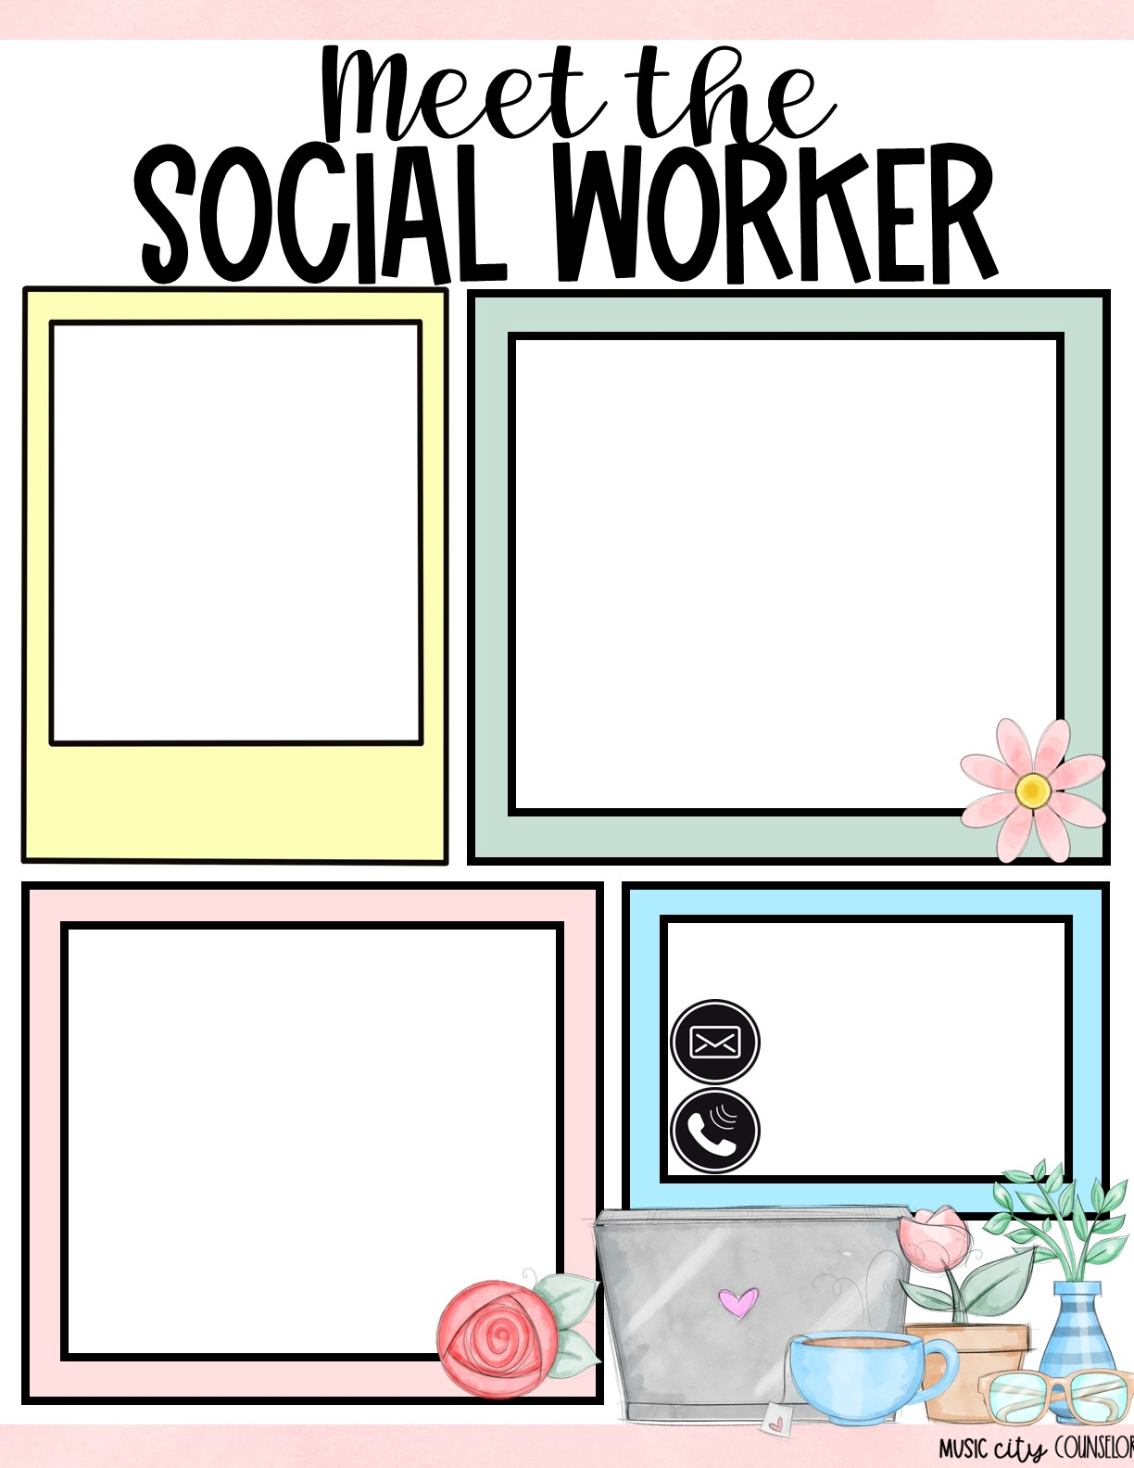

All about me
Type here
Mrs. laura oathout
How I can help
Let’s connect!
Type here
Type here
Type here

Slide 4
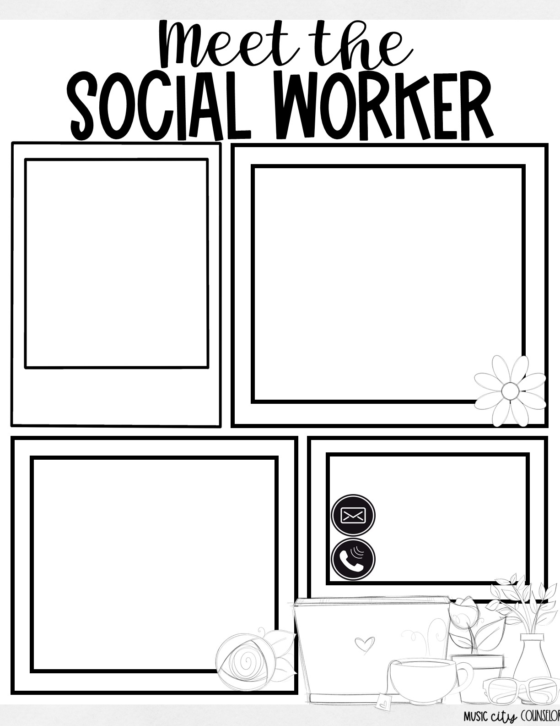
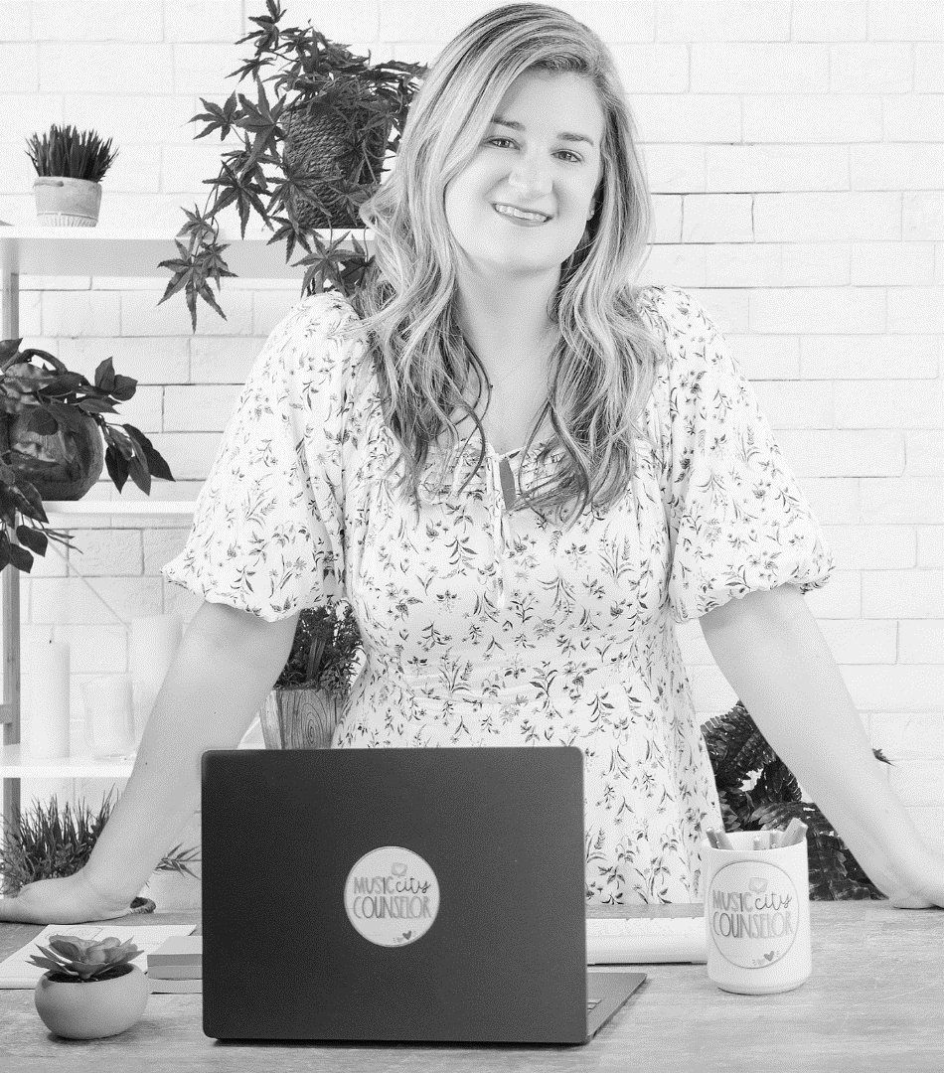
All about me
Type here
Mrs. laura oathout
How I can help
Let’s connect!
Type here
Type here
Type here

Slide 5
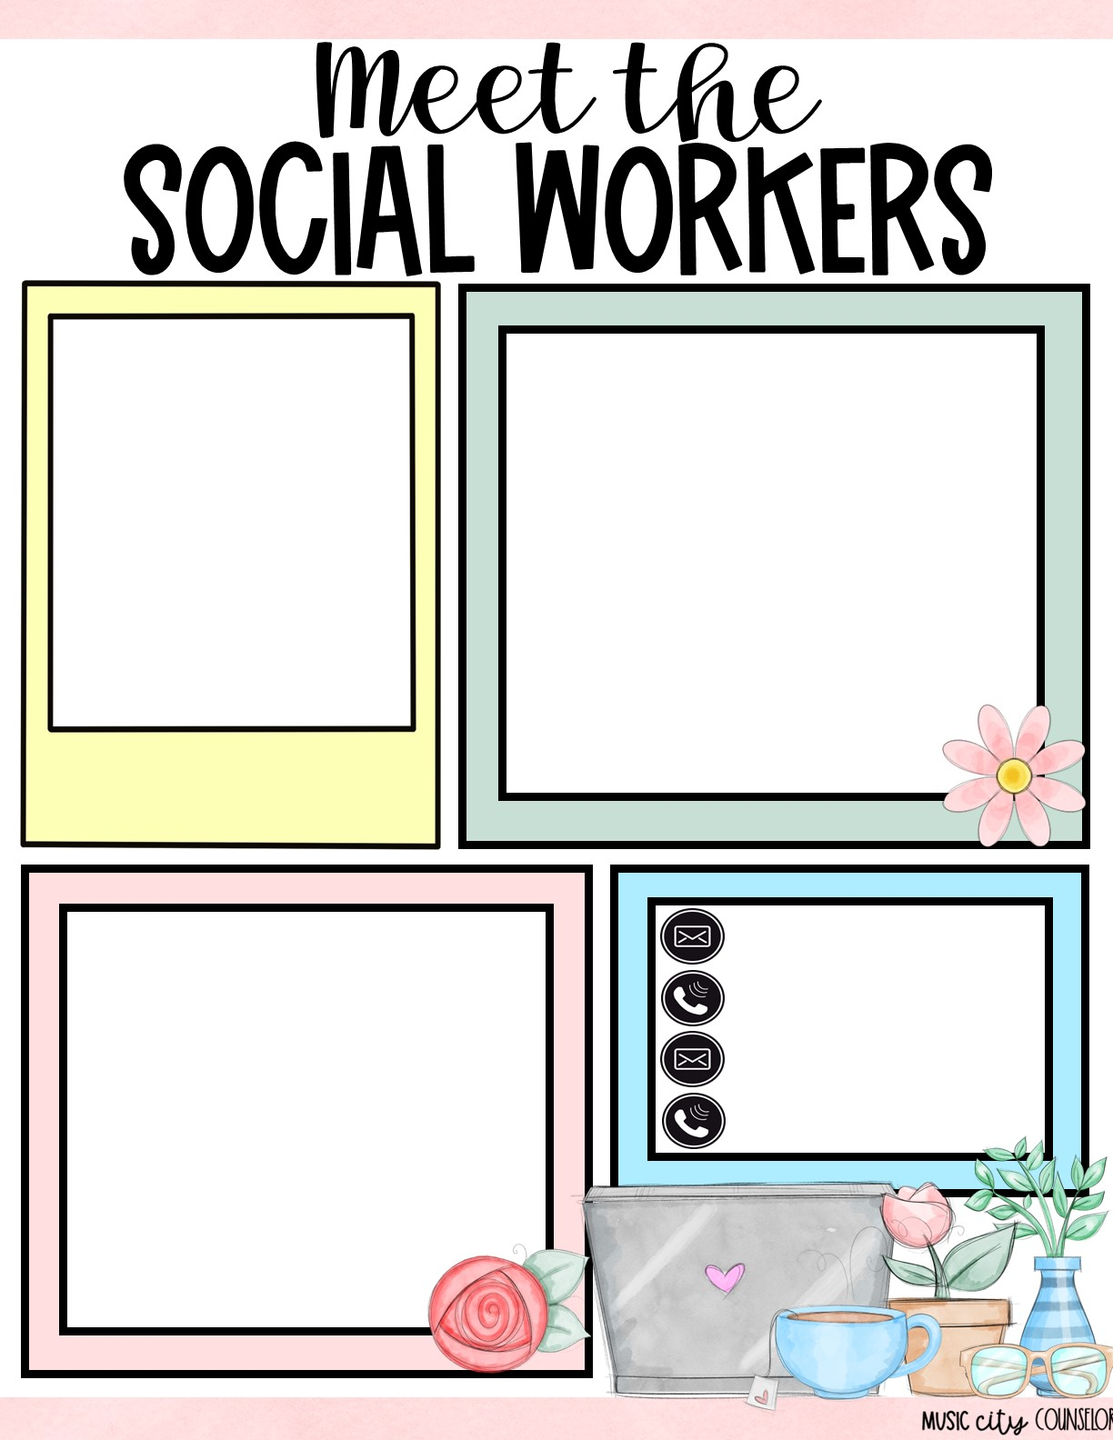
All about us
Type here
Mrs. laura Oathout
& mrs. carly smith
How we can help
Type here
Type here
Type here
Type here
Type here

Slide 6
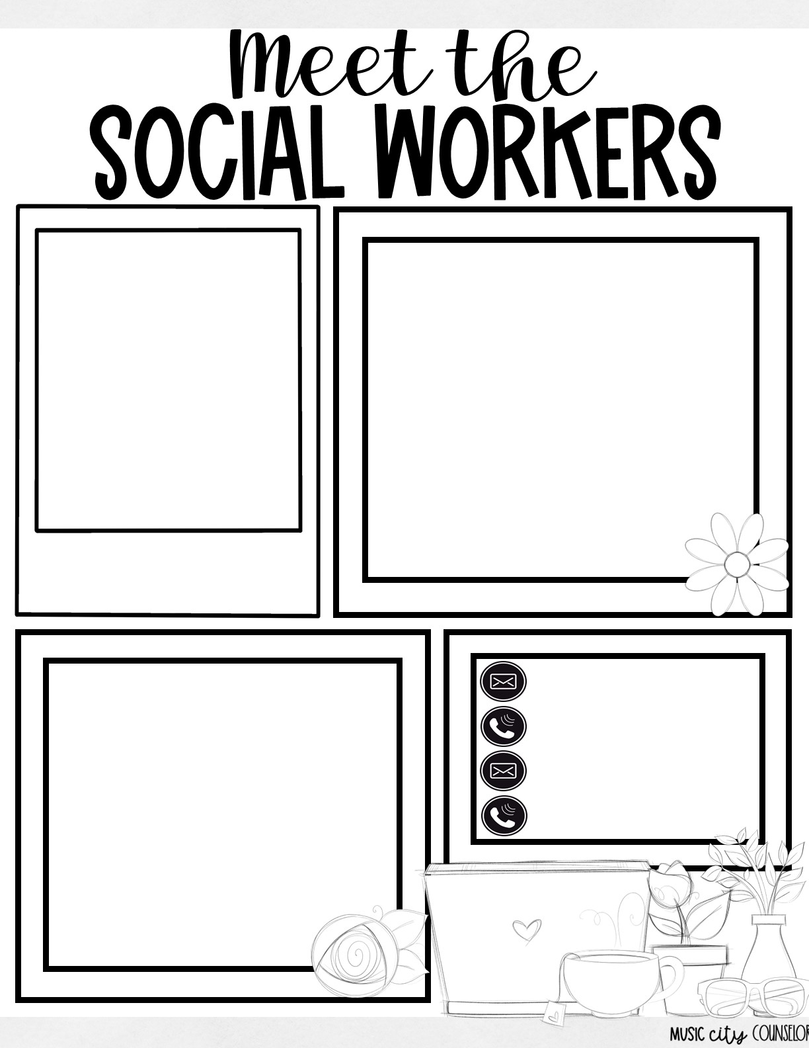
All about us
Type here
Mrs. laura Oathout
& mrs. carly smith
How we can help
Type here
Type here
Type here
Type here
Type here

Slide 7
