Slide 1
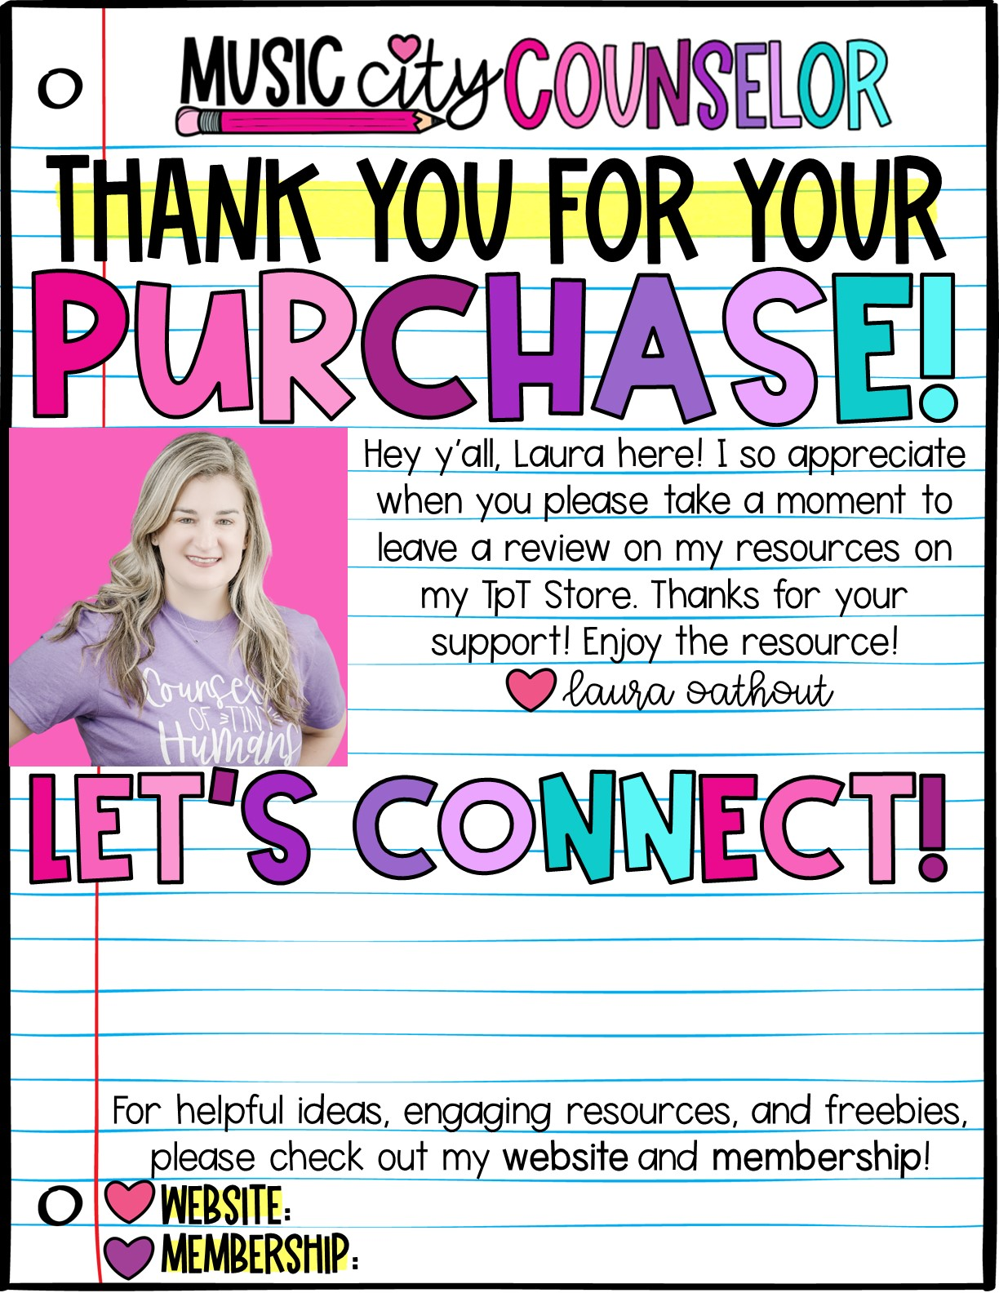





www.musiccitycounselor.com
www.counselorcollab.com

Slide 2
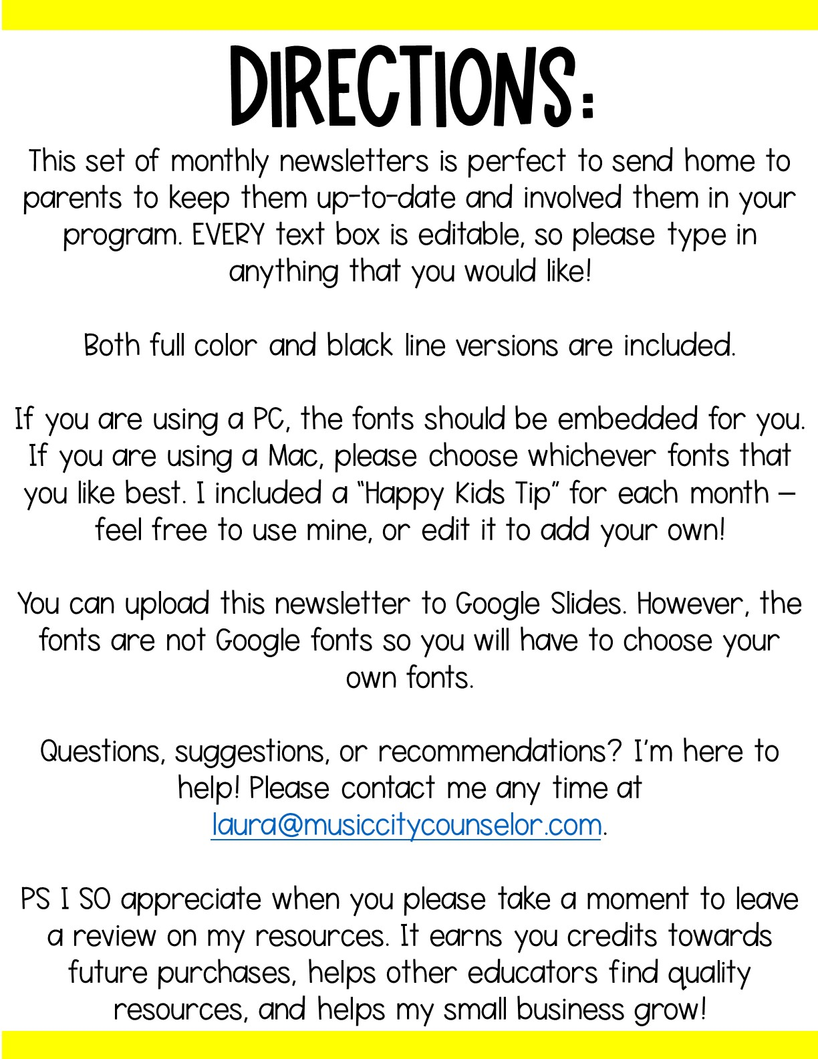

Slide 3


Slide 4
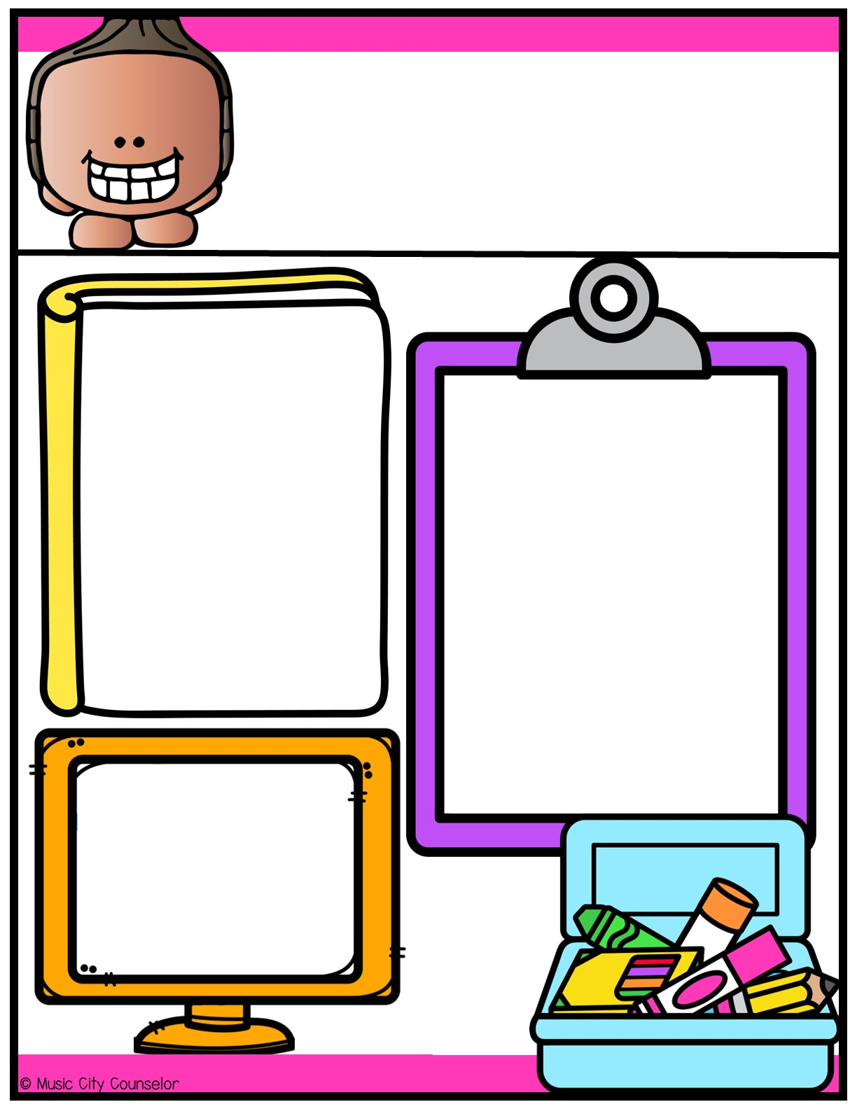



Counseling
Newsletter
Happy kids tip:
Establish a routine.
August
Children thrive on routine. Set regular schedules for bedtime, meals, and homework.
Consistency provides a sense of security
and predictability
that make children feel safe and secure.
Monthly Focus:
Type here
Let’s Connect!
Mrs. Laura Oathout
Type here
Type here

Slide 5
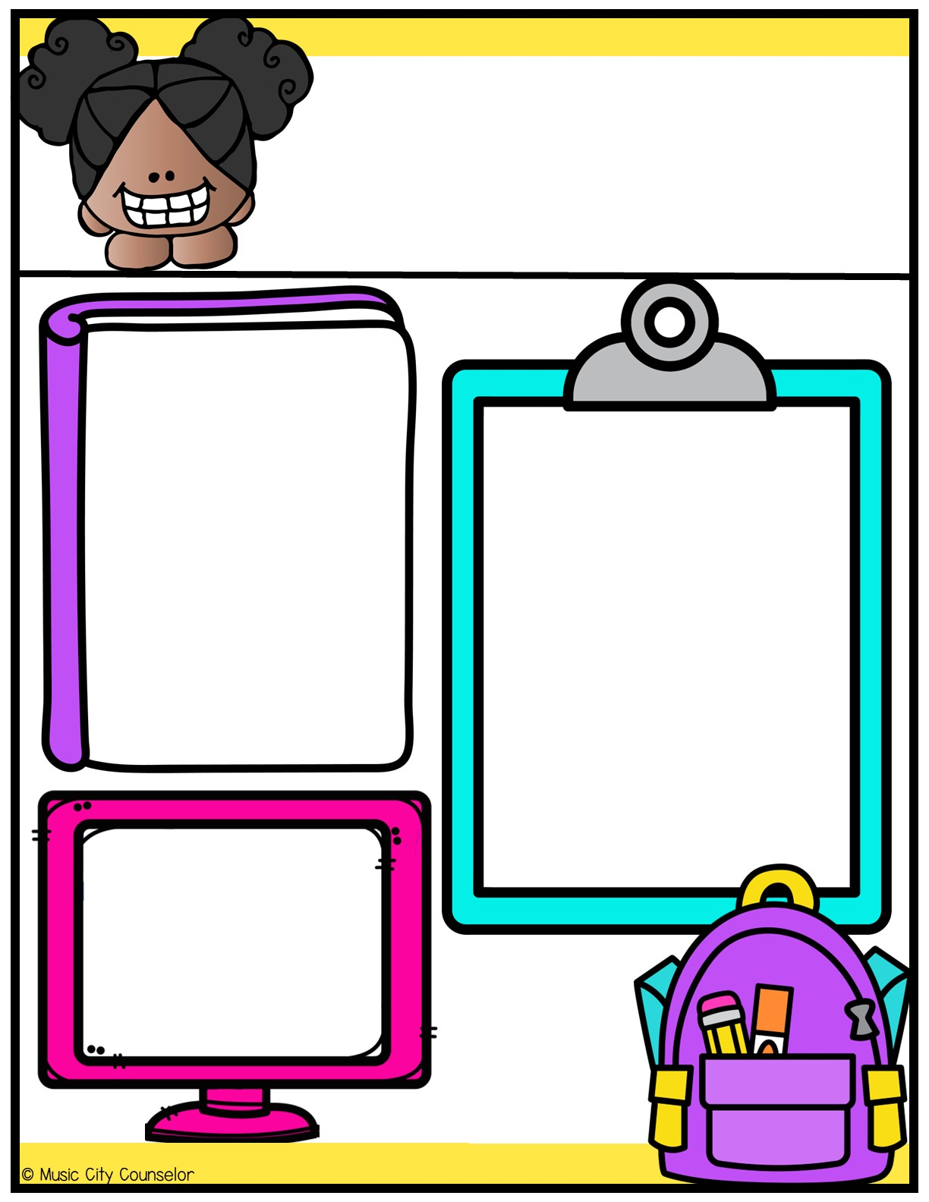
Counseling
Newsletter
Happy kids tip:
Be an active listener.
September
Give your child your full attention when they open up to you. Encourage them to openly express their thoughts and feelings. Ask questions. This fosters trust and grows your bond.
Monthly Focus:
Type here
Let’s Connect!
Mrs. Laura Oathout
Type here
Type here

Slide 6
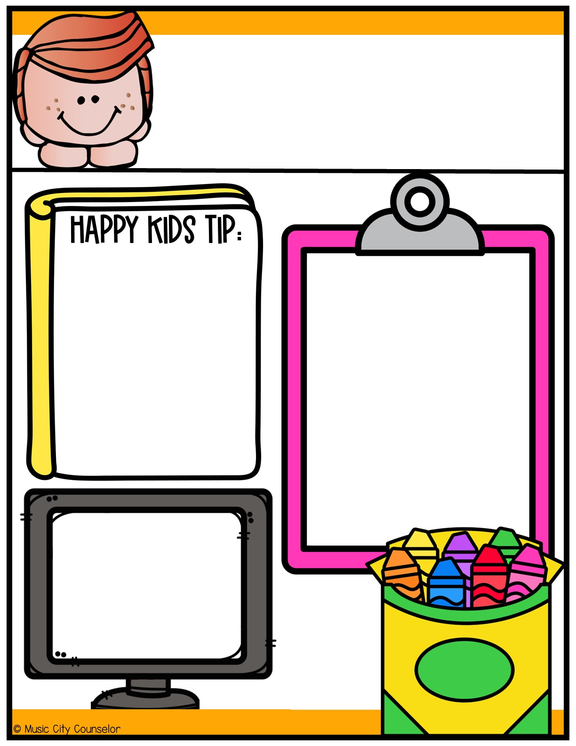
Counseling
Newsletter
Get involved in school.
October
Stay informed about your child's school activities, attend parent-teacher meetings, and communicate with their teachers. Volunteer! This shows your child that education is a priority.
Monthly Focus:
Type here
Let’s Connect!
Mrs. Laura Oathout
Type here
Type here

Slide 7
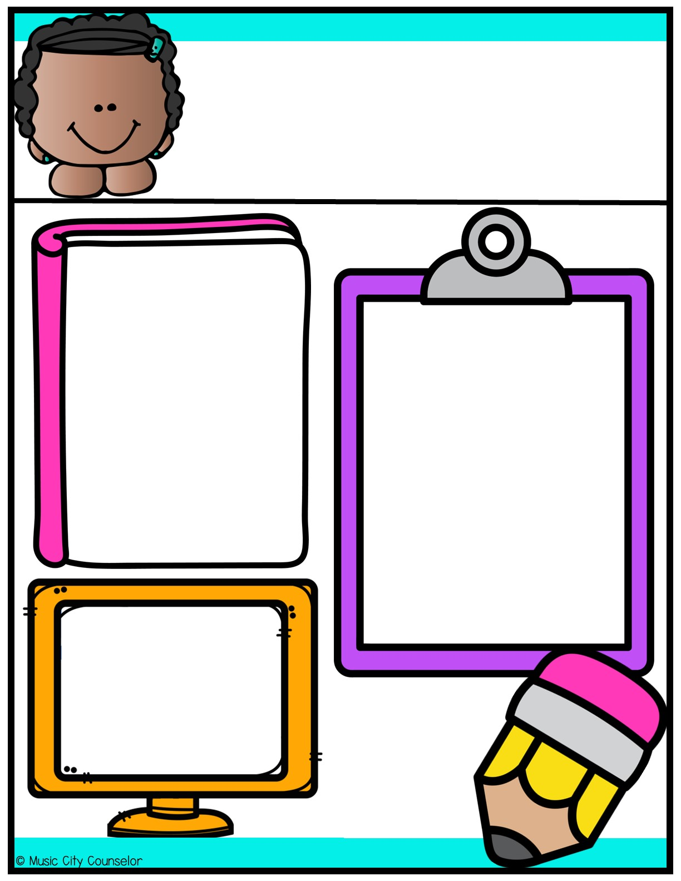
Counseling
Newsletter
Happy kids tip:
Limit screen time.
November
Monitor and limit screen time to 1-2 hours per day. Encourage outdoor and imaginative play. Consider ways your child can earn screen time.
Monthly Focus:
Type here
Let’s Connect!
Mrs. Laura Oathout
Type here
Type here

Slide 8
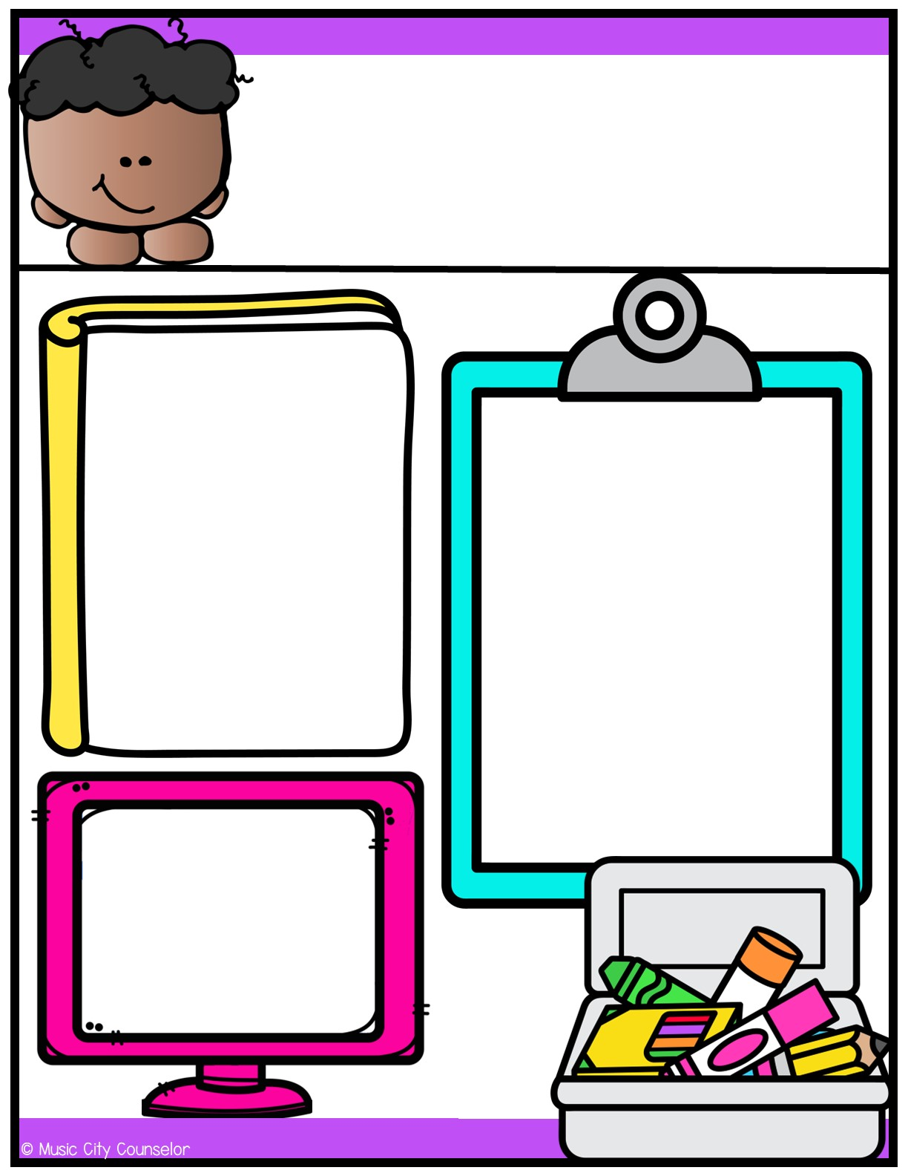
Counseling
Newsletter
Happy kids tip:
Encourage reading.
December
Promote a love for reading. Read together for 15 minutes each day. Provide access to age-appropriate books and visit the local library regularly.
Monthly Focus:
Type here
Let’s Connect!
Mrs. Laura Oathout
Type here
Type here

Slide 9
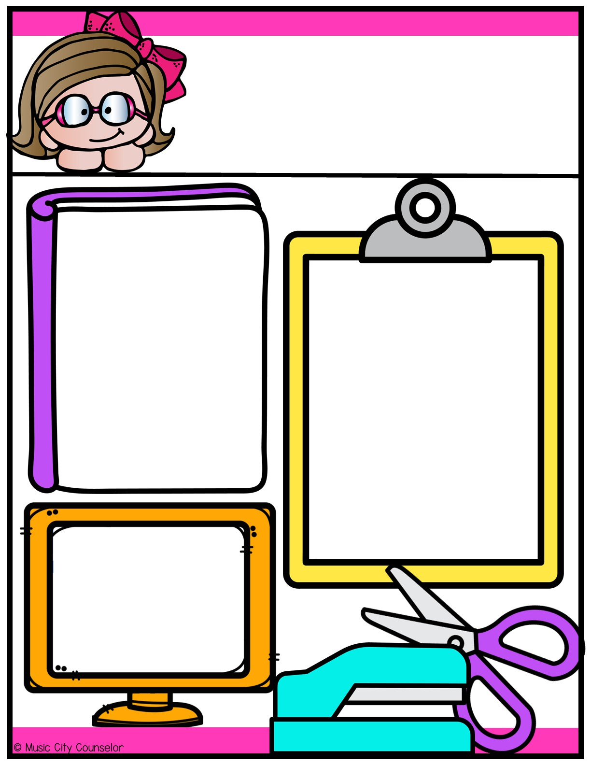
Counseling
Newsletter
Happy kids tip:
Set realistic expectations.
January
Understand age-appropriate behaviors and set expectations accordingly. Your child is learning and growing every day, so
try to be patient and
help them learn from
their mistakes!
Monthly Focus:
Type here
Let’s Connect!
Mrs. Laura Oathout
Type here
Type here

Slide 10
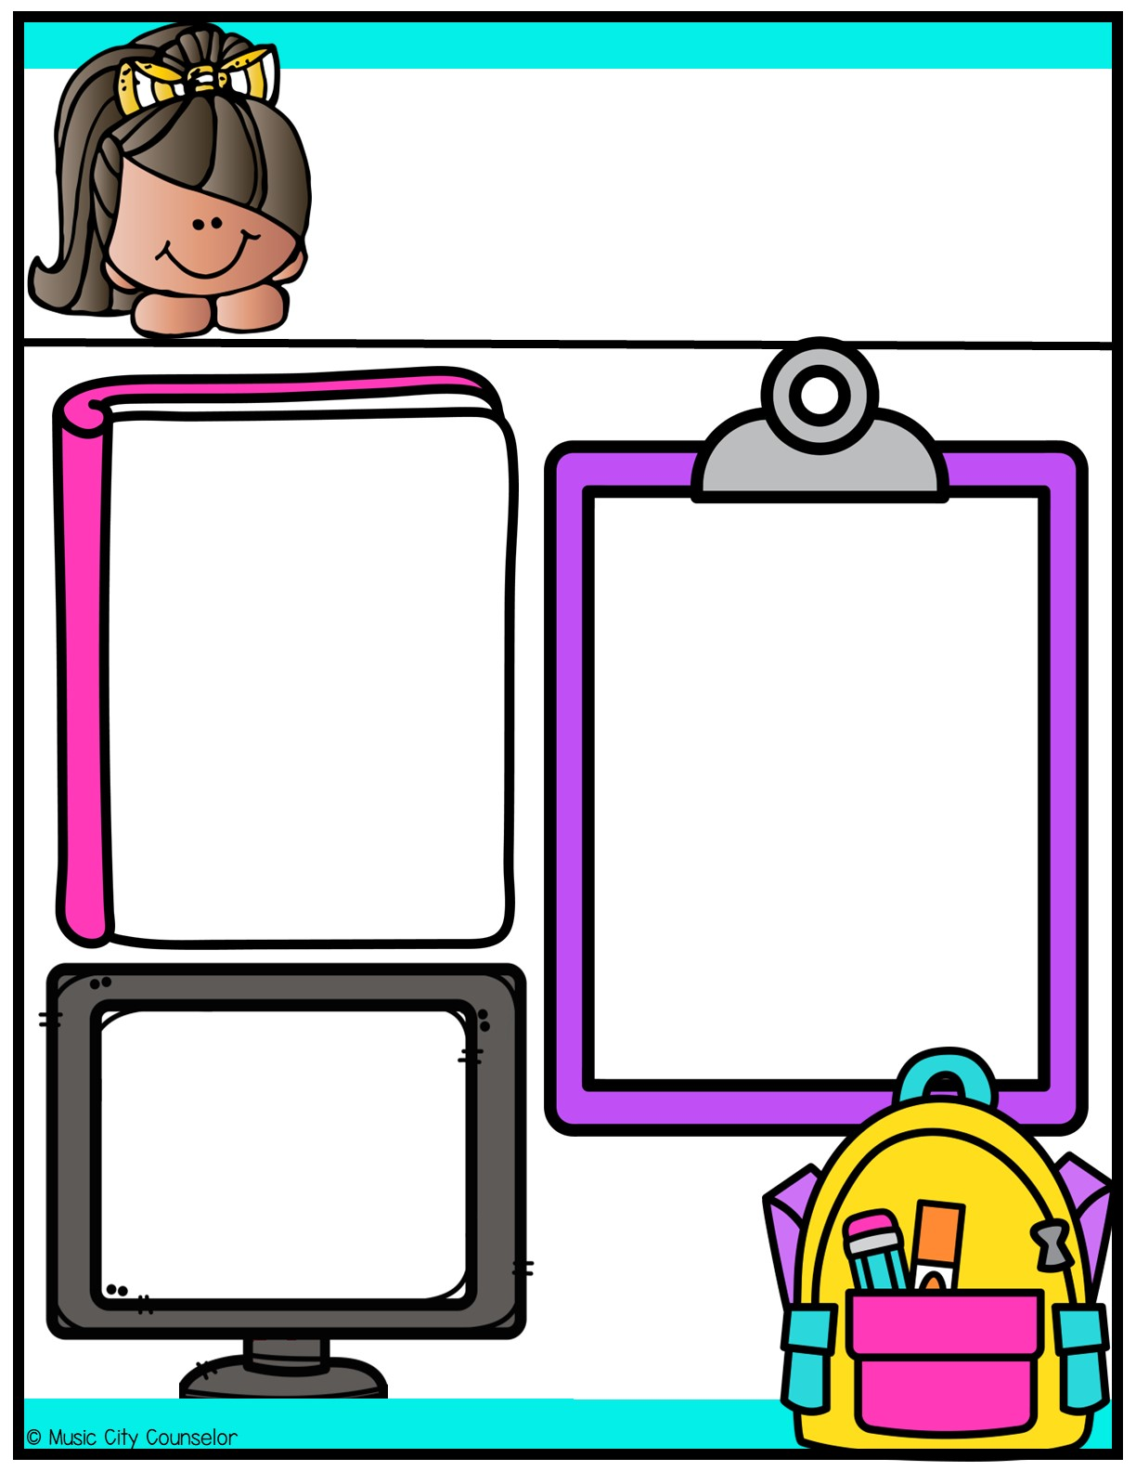
Counseling
Newsletter
Happy kids tip:
Problem-solving skills.
February
Help your child develop problem-solving and decision-making
skills. Encourage them to think through challenges and find solutions on their own. Remember that mistakes help them learn!
Monthly Focus:
Type here
Let’s Connect!
Mrs. Laura Oathout
Type here
Type here

Slide 11
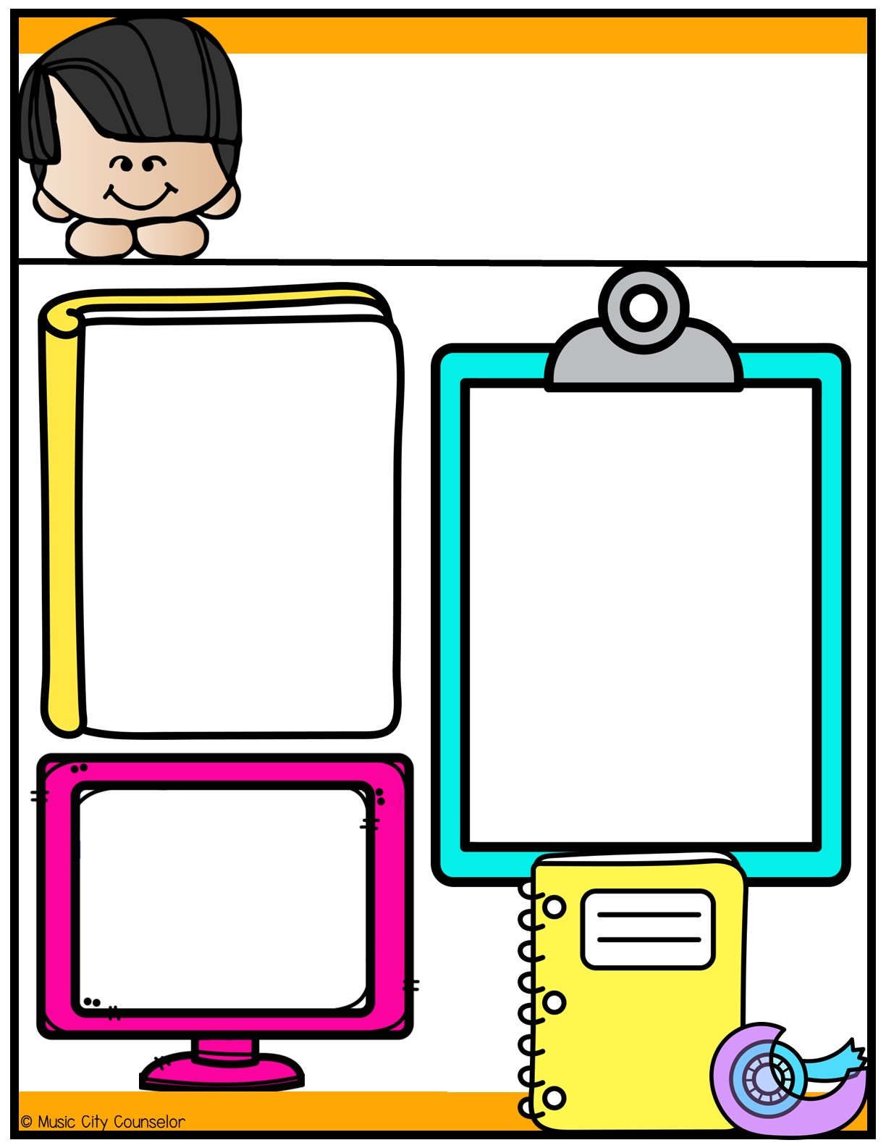
Counseling
Newsletter
Happy kids tip:
Promote independence.
March
Allow your child to take on age-appropriate responsibilities, like packing their school bag or helping with simple chores. This fosters self-confidence and independence. And teaches critical life skills!
Monthly Focus:
Type here
Let’s Connect!
Mrs. Laura Oathout
Type here
Type here

Slide 12
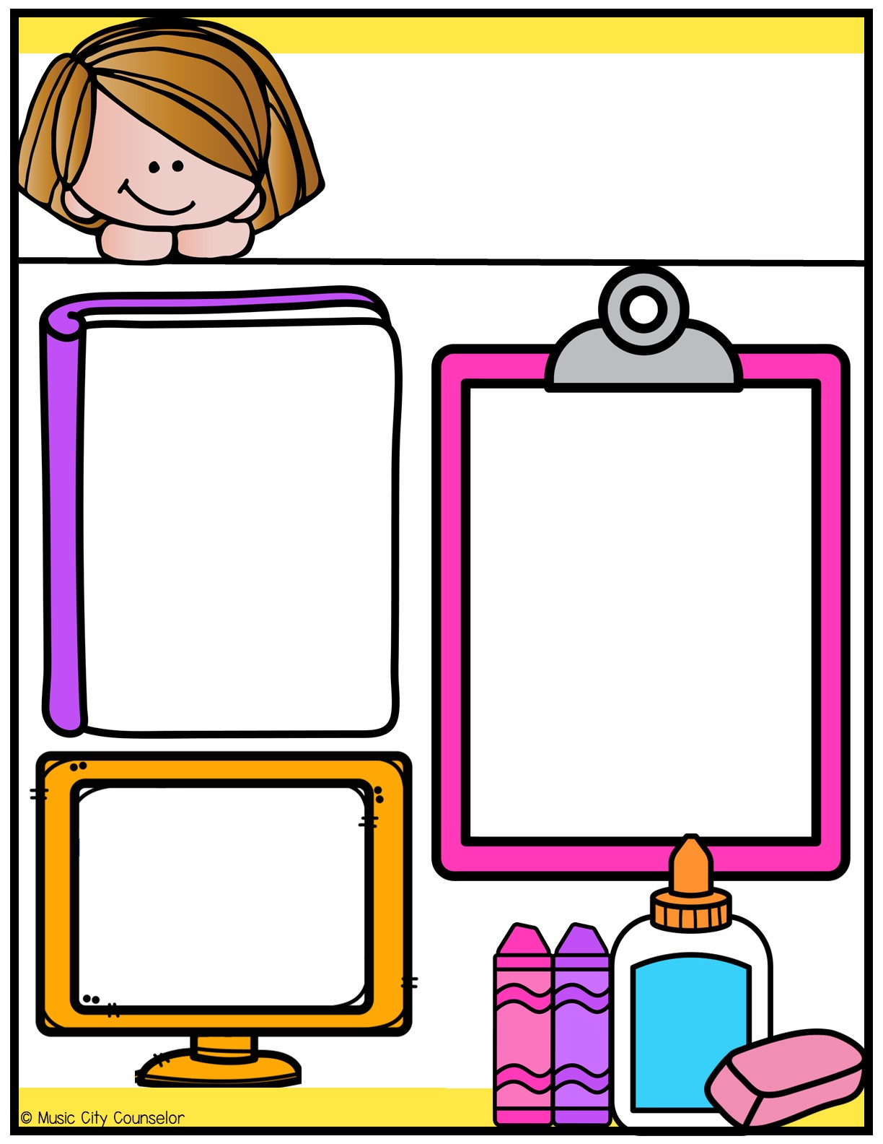
Counseling
Newsletter
Happy kids tip:
Emotional intelligence (EQ).
April
Help your child identify, understand, and manage their emotions. Teach them how to express their feelings in a healthy and constructive way. Model healthy coping skills for them.
Monthly Focus:
Type here
Let’s Connect!
Mrs. Laura Oathout
Type here
Type here

Slide 13
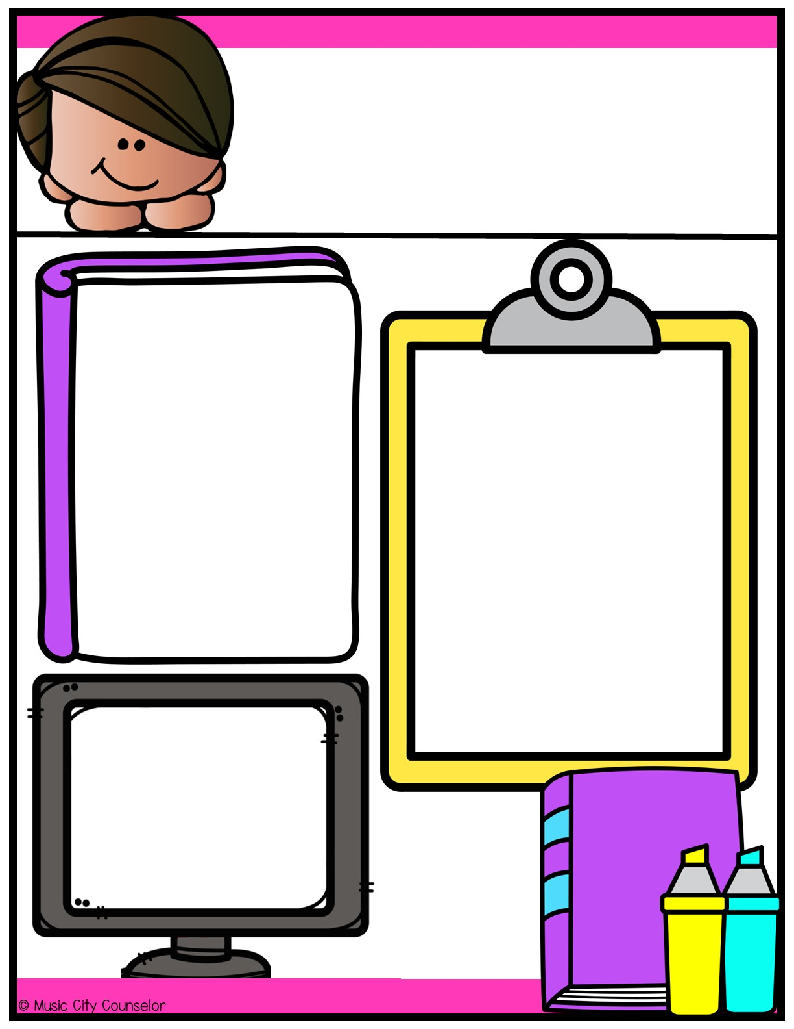
Counseling
Newsletter
Happy kids tip:
Quality family time.
May
Dedicate time for family activities. Play games, go for walks, or engage in hobbies together. Strong family bonds provide emotional support and a safe place for children to develop and grow.
Monthly Focus:
Type here
Let’s Connect!
Mrs. Laura Oathout
Type here
Type here

Slide 14
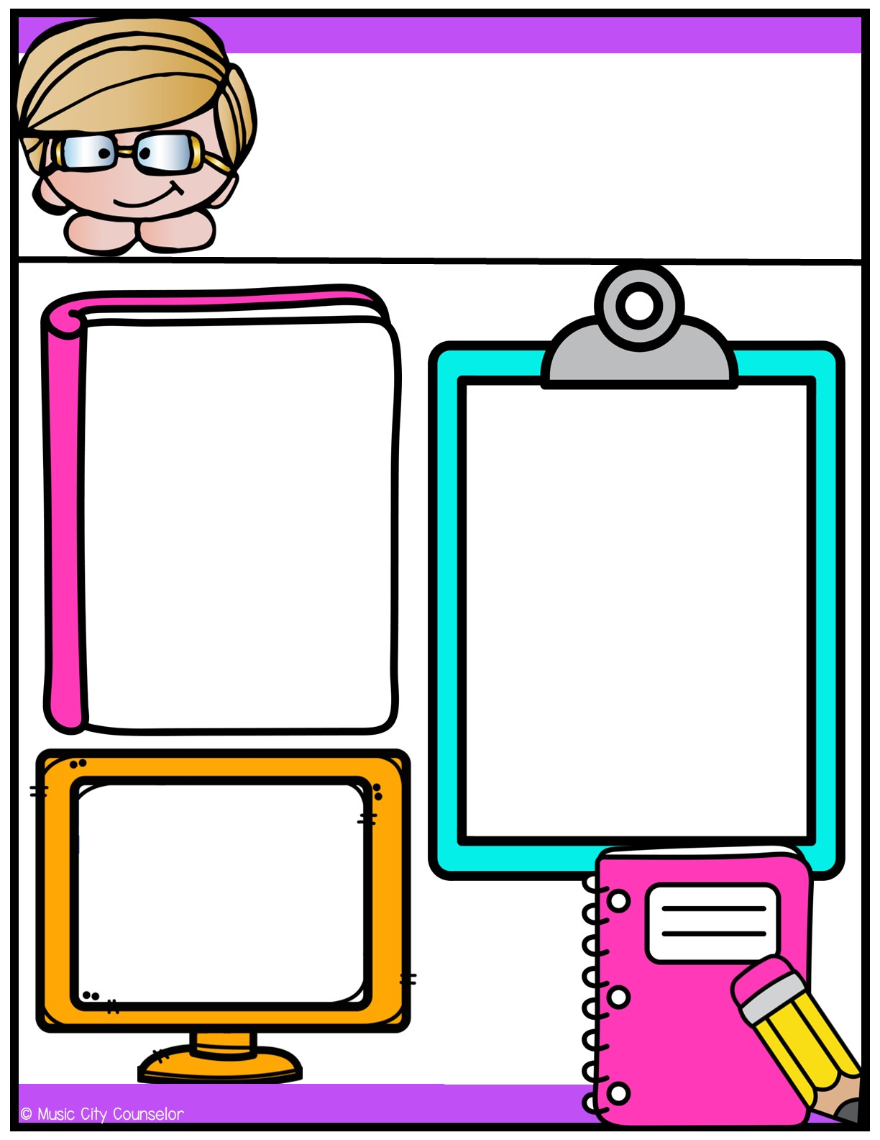
Counseling
Newsletter
Happy kids tip:
Respect individuality.
June
Recognize and respect your child's unique interests, talents, and personality. Allow them to explore their passions and hobbies. Encourage them to express themselves!
Monthly Focus:
Type here
Let’s Connect!
Mrs. Laura Oathout
Type here
Type here

Slide 15


Slide 16
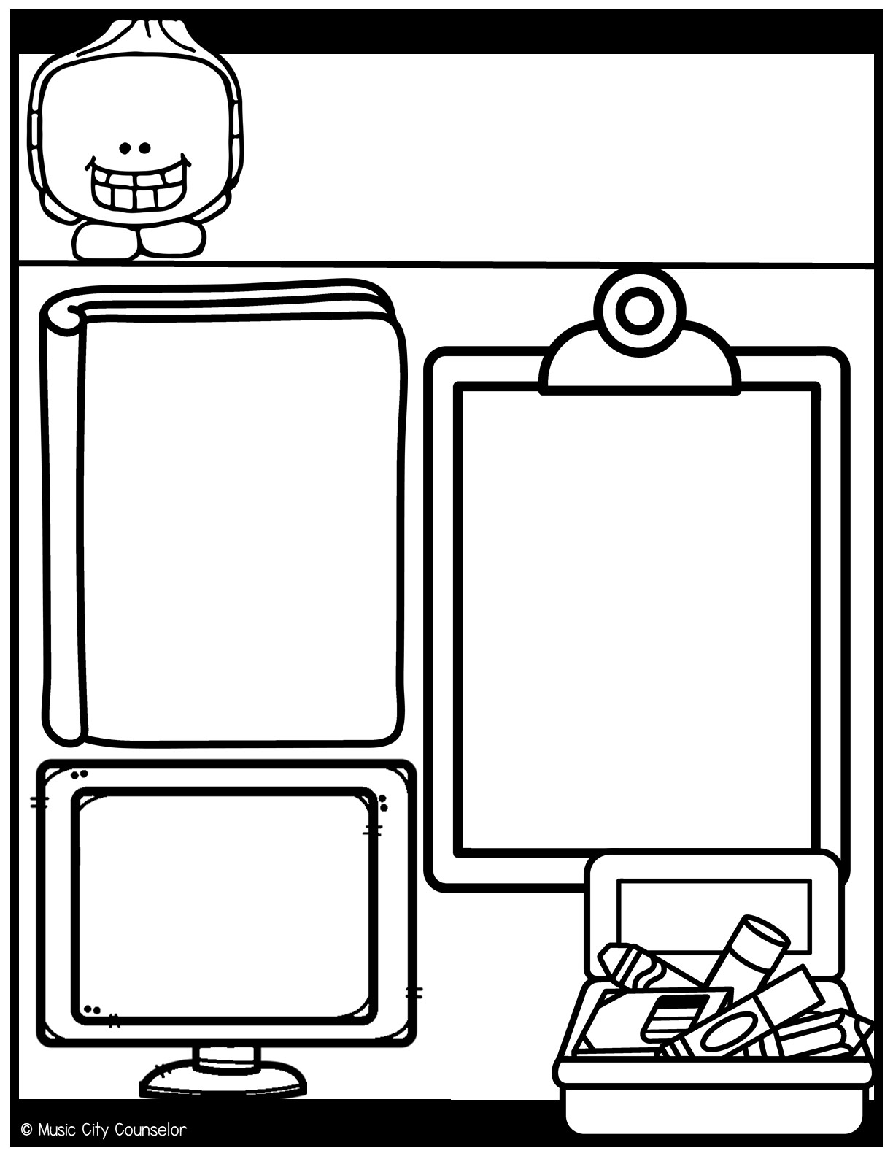
Counseling
Newsletter
Happy kids tip:
Establish a routine.
August
Children thrive on routine. Set regular schedules for bedtime, meals, and homework.
Consistency provides a sense of security
and predictability
that make children feel safe and secure.
Monthly Focus:
Type here
Let’s Connect!
Mrs. Laura Oathout
Type here
Type here

Slide 17
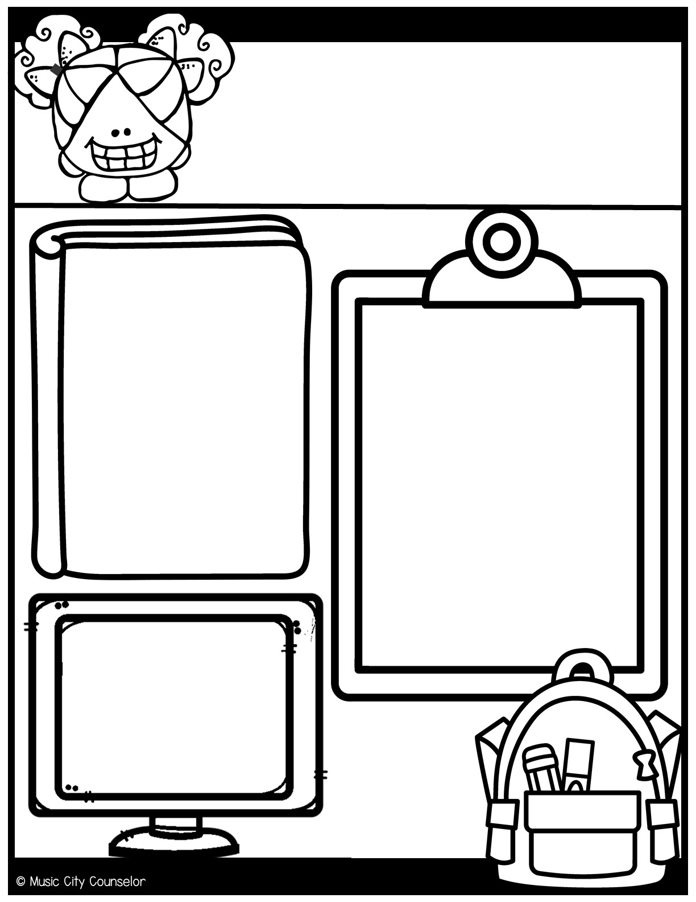
Counseling
Newsletter
Happy kids tip:
Be an active listener.
September
Give your child your full attention when they open up to you. Encourage them to openly express their thoughts and feelings. Ask questions. This fosters trust and grows your bond.
Monthly Focus:
Type here
Let’s Connect!
Mrs. Laura Oathout
Type here
Type here

Slide 18
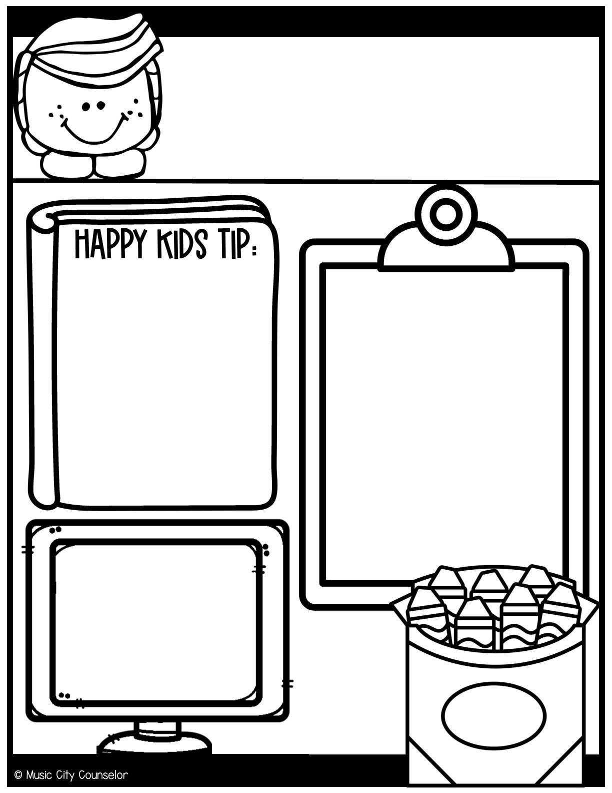
Counseling
Newsletter
Get involved in school.
October
Stay informed about your child's school activities, attend parent-teacher meetings, and communicate with their teachers. Volunteer! This shows your child that education is a priority.
Monthly Focus:
Type here
Let’s Connect!
Mrs. Laura Oathout
Type here
Type here

Slide 19
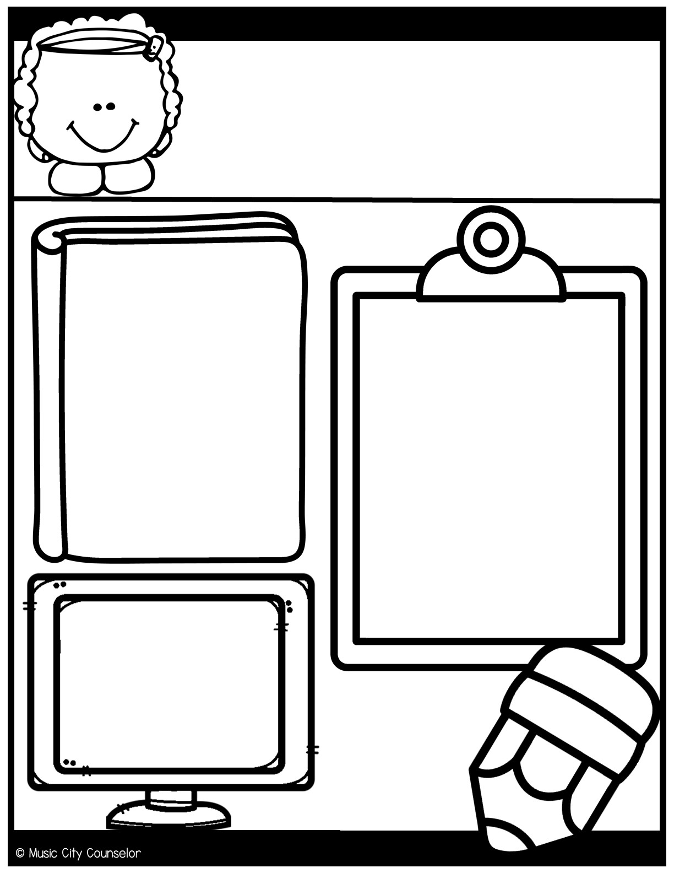
Counseling
Newsletter
Happy kids tip:
Limit screen time.
November
Monitor and limit screen time to 1-2 hours per day. Encourage outdoor and imaginative play. Consider ways your child can earn screen time.
Monthly Focus:
Type here
Let’s Connect!
Mrs. Laura Oathout
Type here
Type here

Slide 20
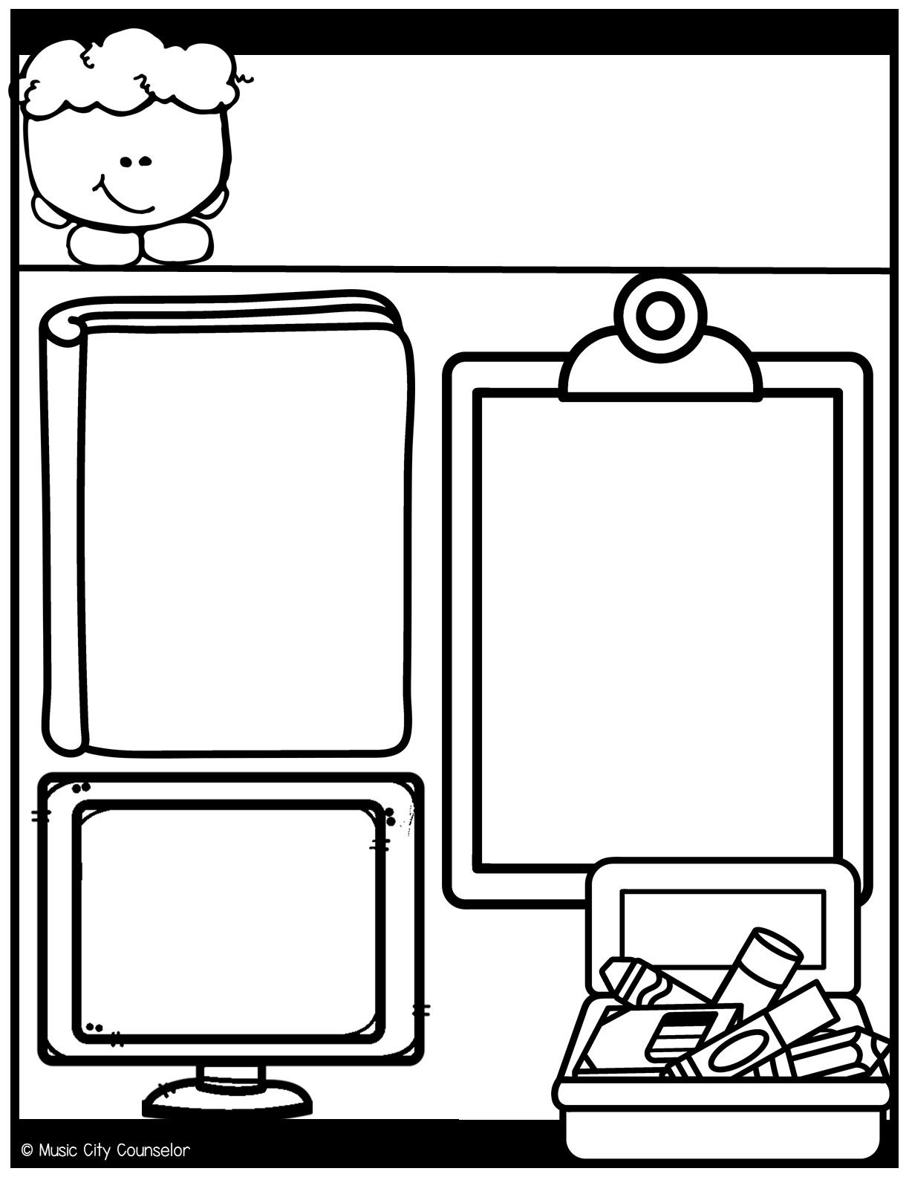
Counseling
Newsletter
Happy kids tip:
Encourage reading.
December
Promote a love for reading. Read together for 15 minutes each day. Provide access to age-appropriate books, and visit the library regularly.
Monthly Focus:
Type here
Let’s Connect!
Mrs. Laura Oathout
Type here
Type here

Slide 21
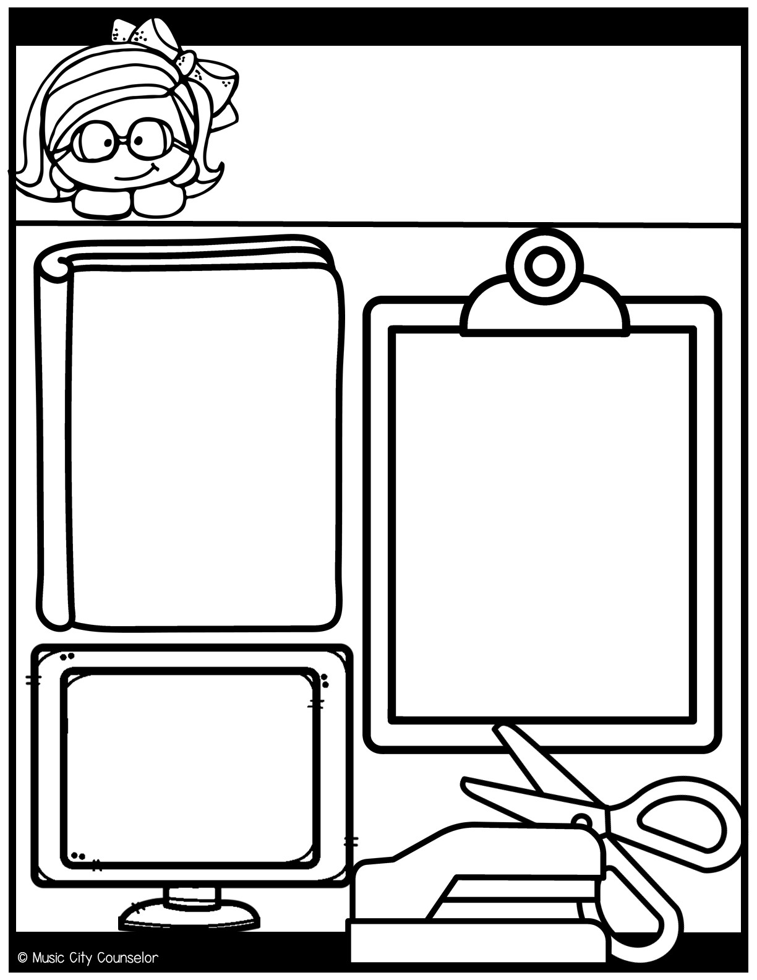
Counseling
Newsletter
Happy kids tip:
Set realistic expectations.
January
Understand age-appropriate behaviors, and set expectations accordingly. Your child is learning and growing every day, so
try to be patient and
help them learn from
their mistakes!
Monthly Focus:
Type here
Let’s Connect!
Mrs. Laura Oathout
Type here
Type here

Slide 22
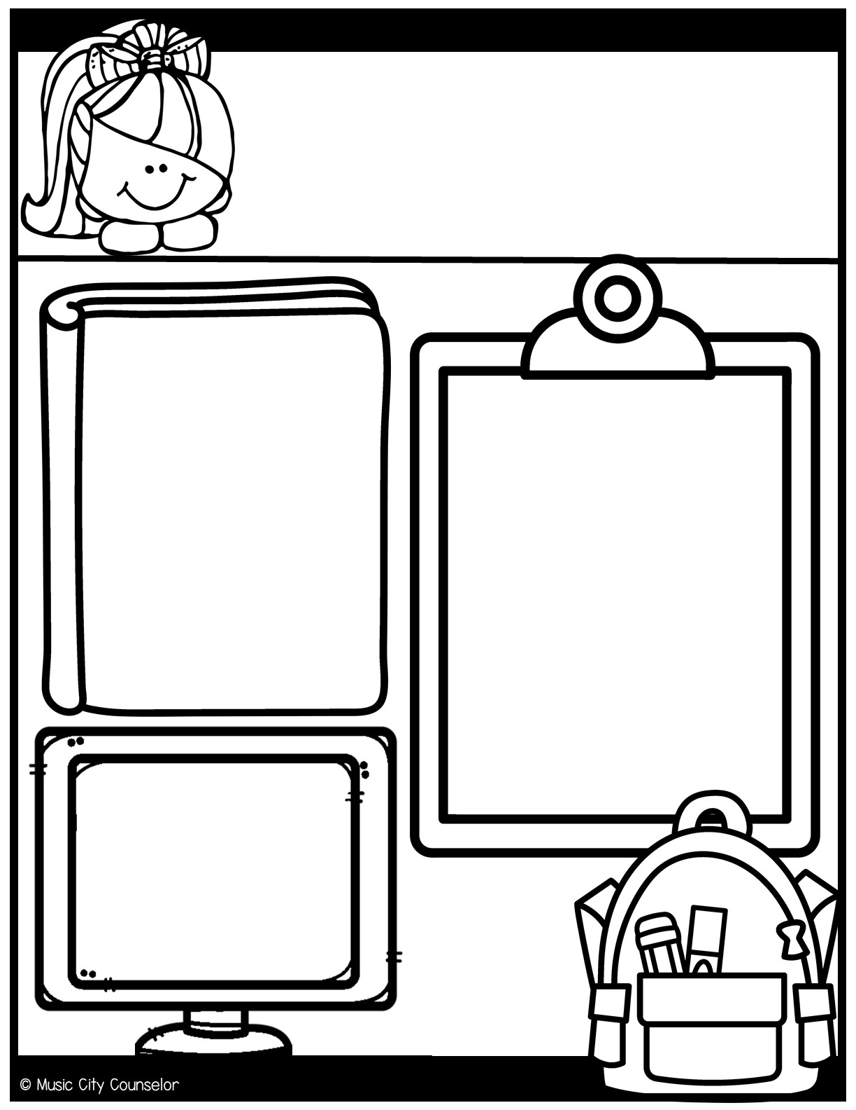
Counseling
Newsletter
Happy kids tip:
Problem-solving skills.
February
Help your child develop problem-solving and decision-making
skills. Encourage them to think through challenges and find solutions on their own. Remember that mistakes help them learn!
Monthly Focus:
Type here
Let’s Connect!
Mrs. Laura Oathout
Type here
Type here

Slide 23
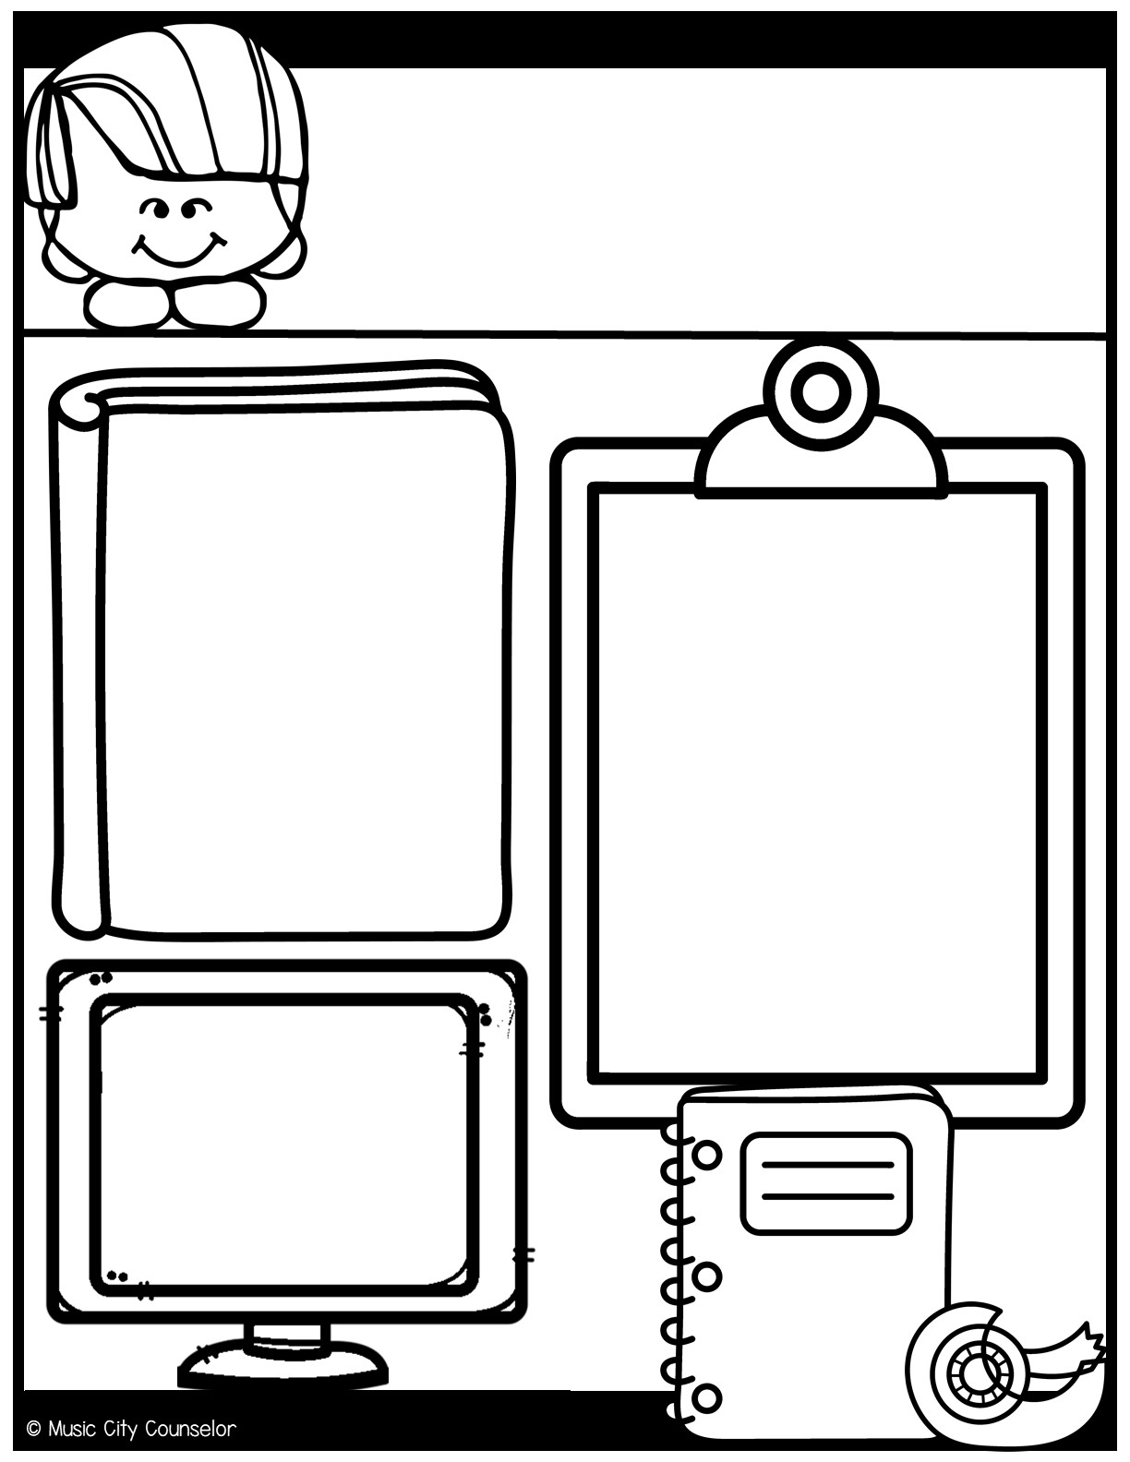
Counseling
Newsletter
Happy kids tip:
Promote independence.
March
Allow your child to take on age-appropriate responsibilities, like packing their school bag or helping with simple chores. This fosters self-confidence and independence. And teaches critical life skills!
Monthly Focus:
Type here
Let’s Connect!
Mrs. Laura Oathout
Type here
Type here

Slide 24
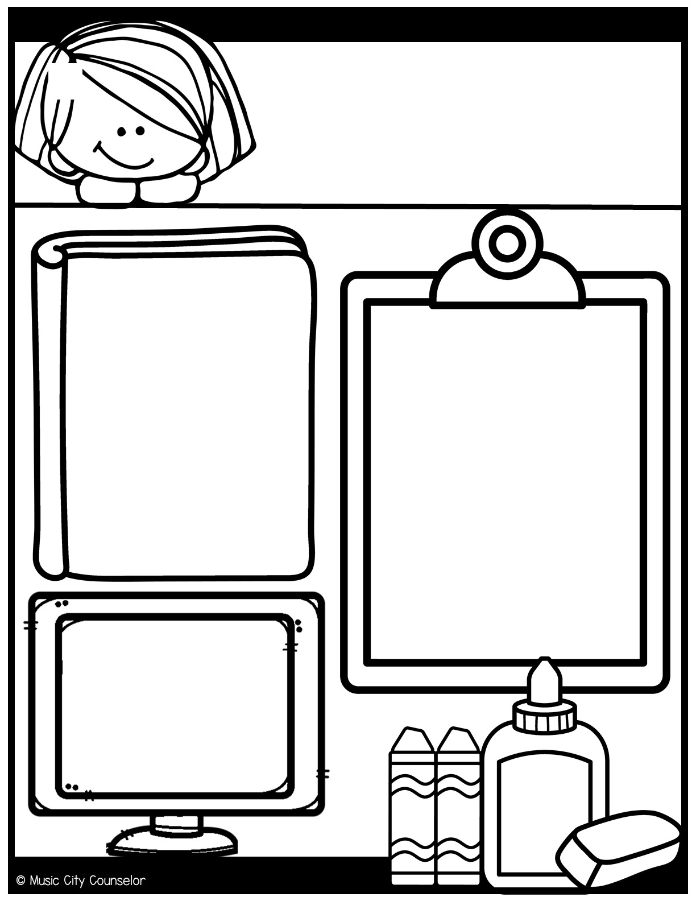
Counseling
Newsletter
Happy kids tip:
Emotional intelligence (EQ).
April
Help your child identify, understand, and manage their emotions. Teach them how to express their feelings in a healthy and constructive way. Model healthy coping skills for them.
Monthly Focus:
Type here
Let’s Connect!
Mrs. Laura Oathout
Type here
Type here

Slide 25
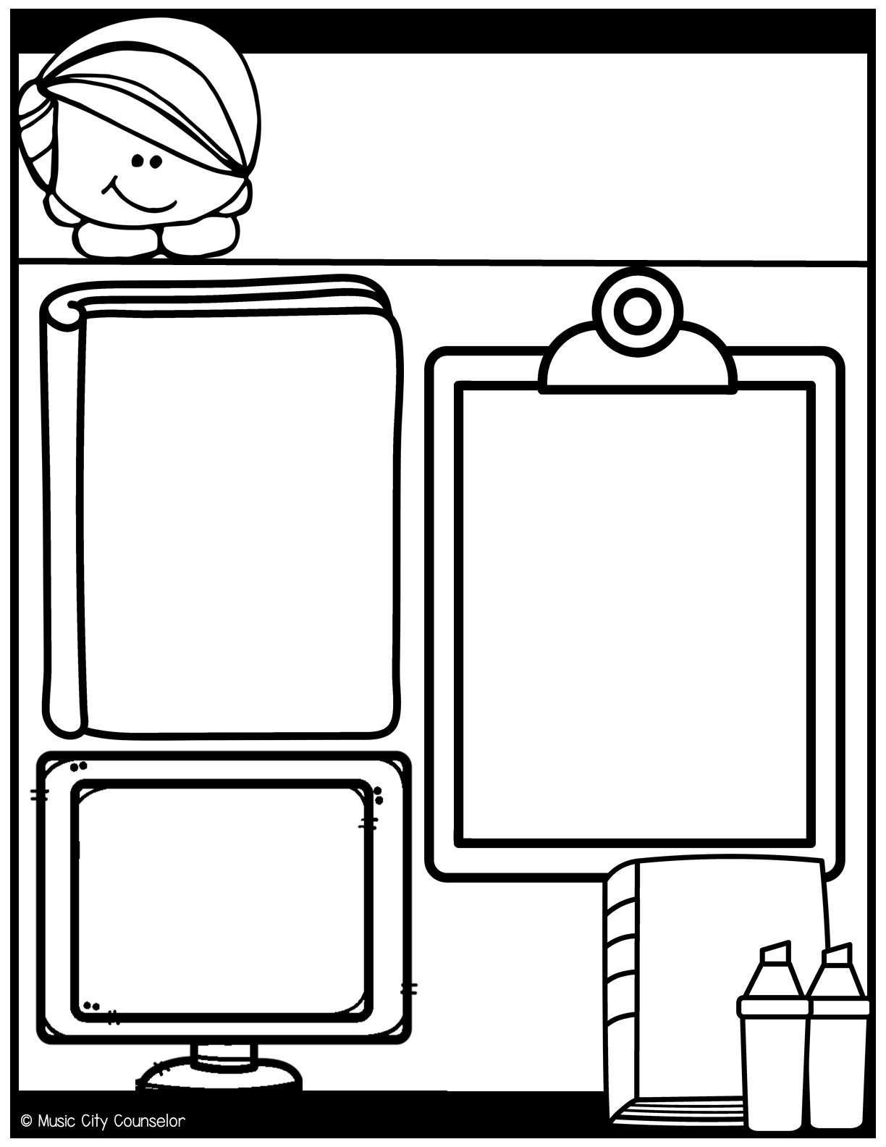
Counseling
Newsletter
Happy kids tip:
Quality family time.
May
Dedicate time for family activities. Play games, go for walks, or engage in hobbies together. Strong family bonds provide emotional support and a safe place for children to develop and grow.
Monthly Focus:
Type here
Let’s Connect!
Mrs. Laura Oathout
Type here
Type here

Slide 26
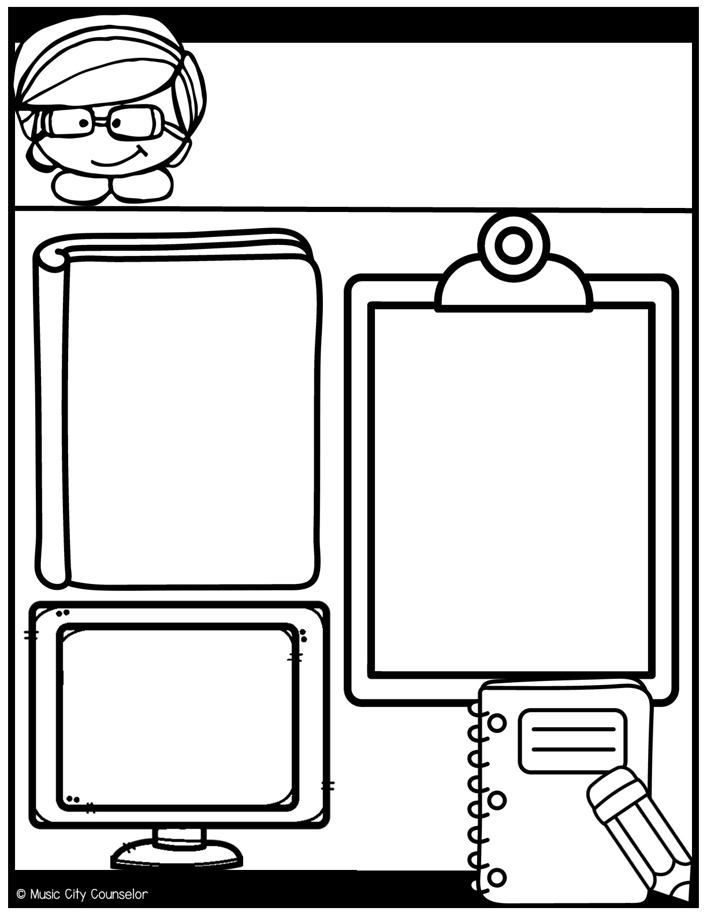
Counseling
Newsletter
Happy kids tip:
Respect individuality.
June
Recognize and respect your child's unique interests, talents, and personality. Allow them to explore their passions and hobbies. Encourage them to express themselves!
Monthly Focus:
Type here
Let’s Connect!
Mrs. Laura Oathout
Type here
Type here

Slide 27
