Slide 1






www.musiccitycounselor.com
www.counselorcollab.com

Slide 2
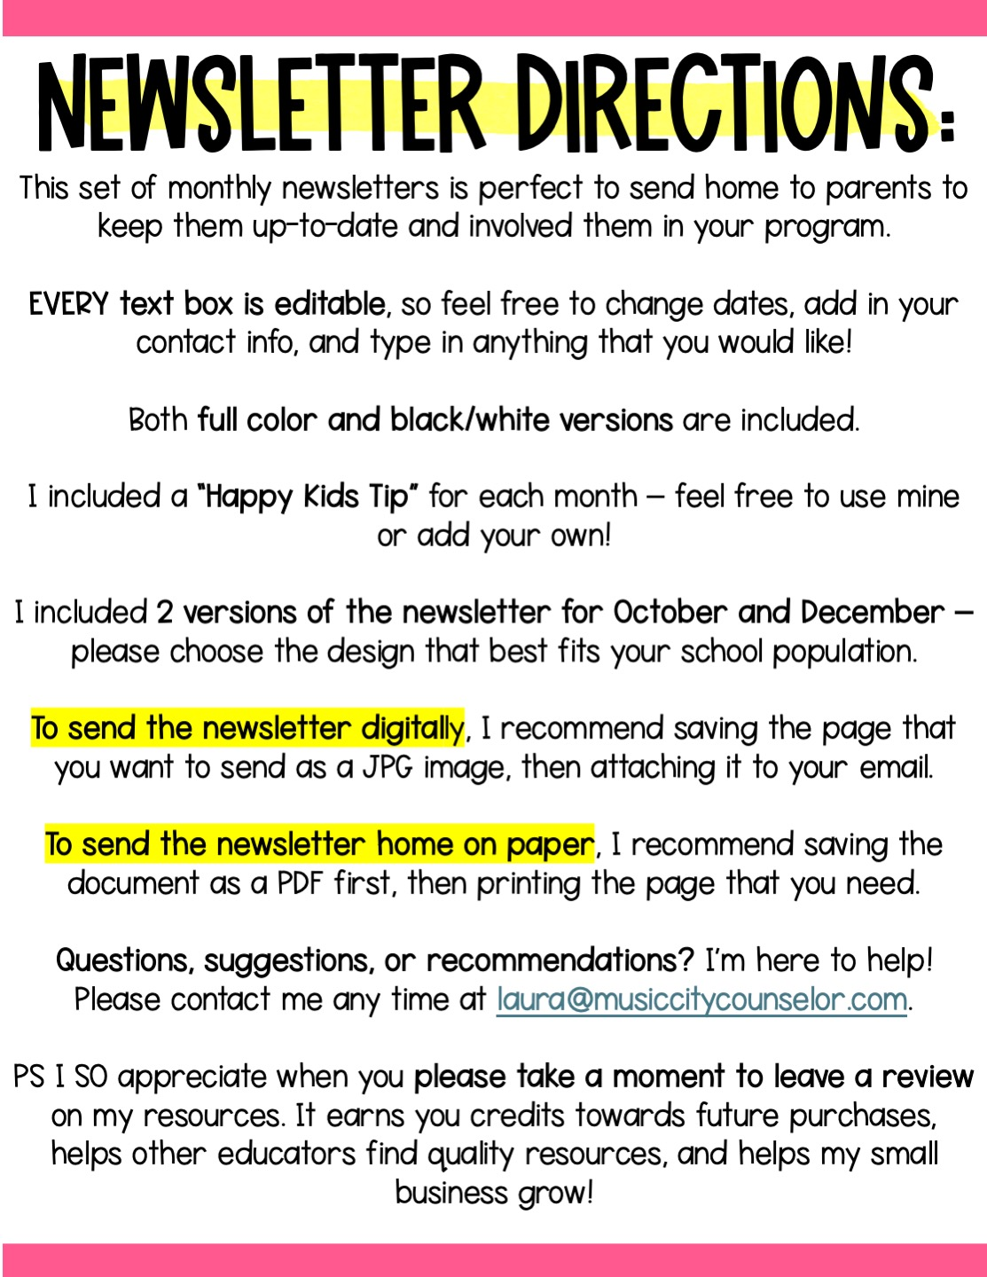

Slide 3


Slide 4
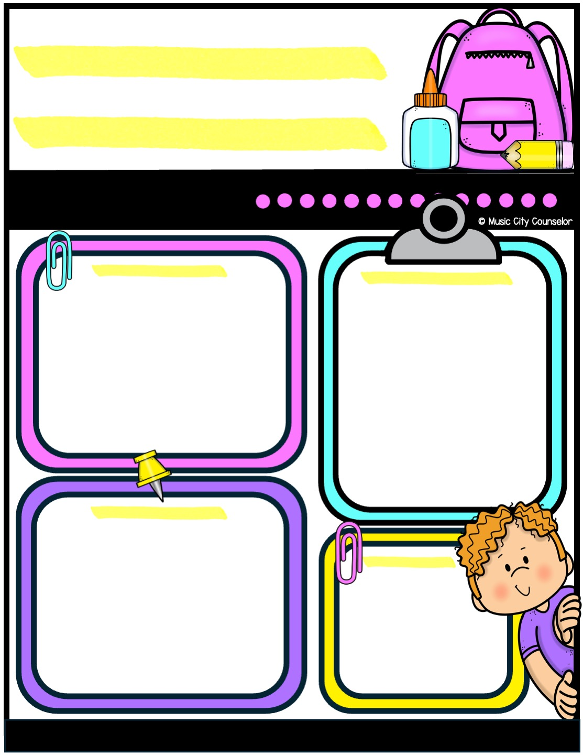


Counseling
newsletter
august 2024
Monthly focus
Upcoming events
Type here
Type here
Happy kids tip
Back-to-school season is an exciting time! To help your child transition smoothly, establish a consistent bedtime and morning routine to set them up for success. Stay involved by checking backpacks for important notices and helping your child stay organized. Most importantly, talk with your child daily about their experiences to show your support and stay connected.
reminders
Type here
Mrs. Laura Oathout
615-392-5930, ext. 102
laura.oathout@wcs.edu

Slide 5
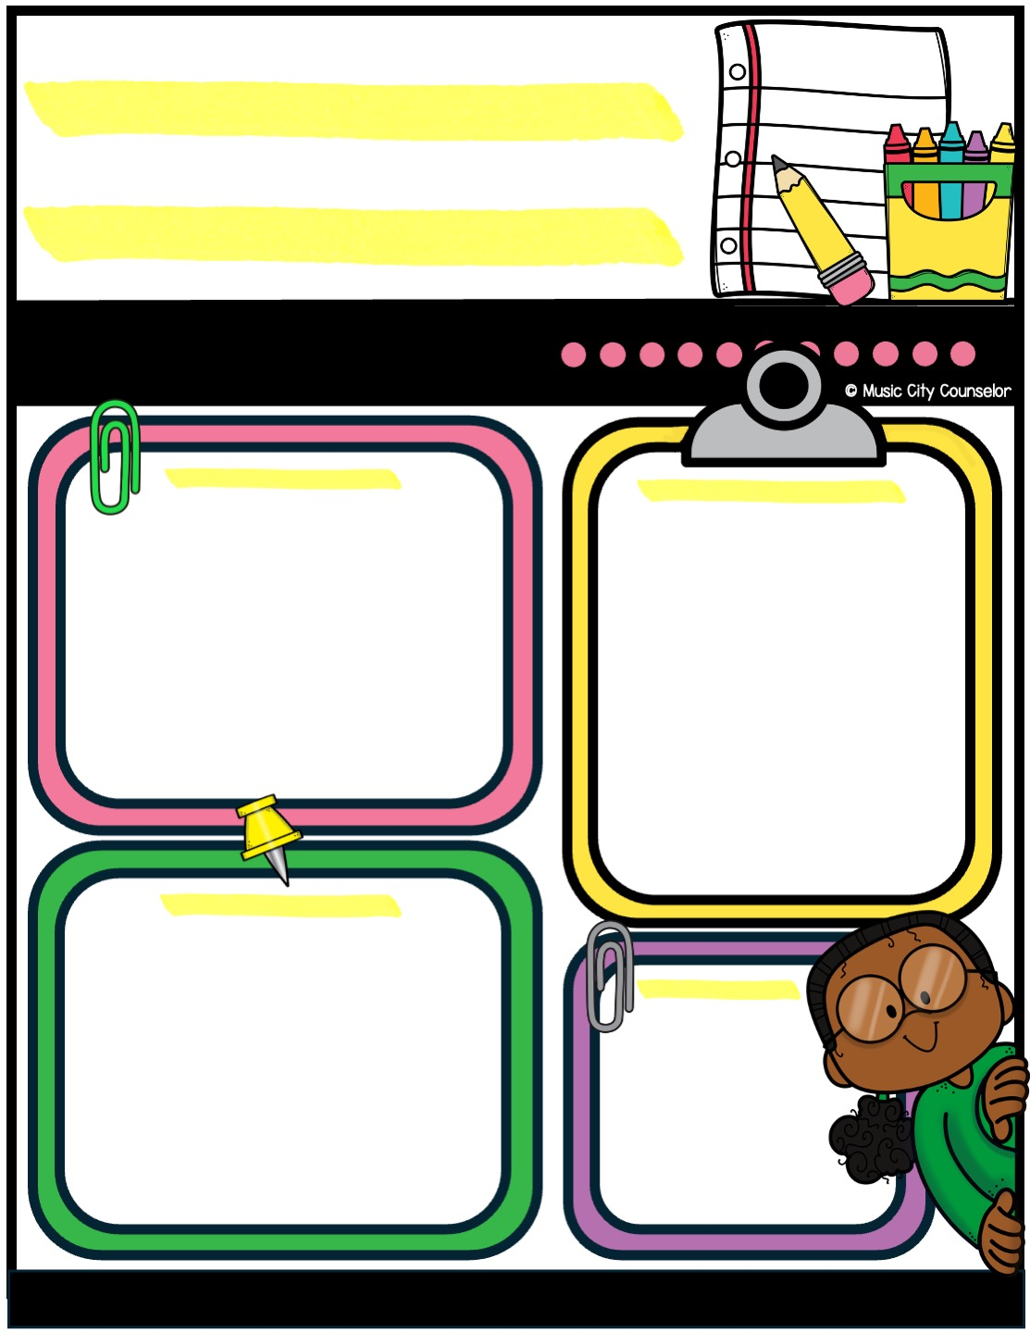
Counseling
newsletter
September 2024
Monthly focus
Upcoming events
Type here
Type here
Happy kids tip
Reading with your child is one of the most valuable things you can do to support their learning and growth. It helps build their vocabulary, improve comprehension, and spark their imagination. Sharing a book together also creates a special bonding time and shows your child that reading is fun and important. Even just 15 minutes a day can make a big difference in their academic success and love of learning!
reminders
Type here
Mrs. Laura Oathout
615-392-5930, ext. 102
laura.oathout@wcs.edu

Slide 6
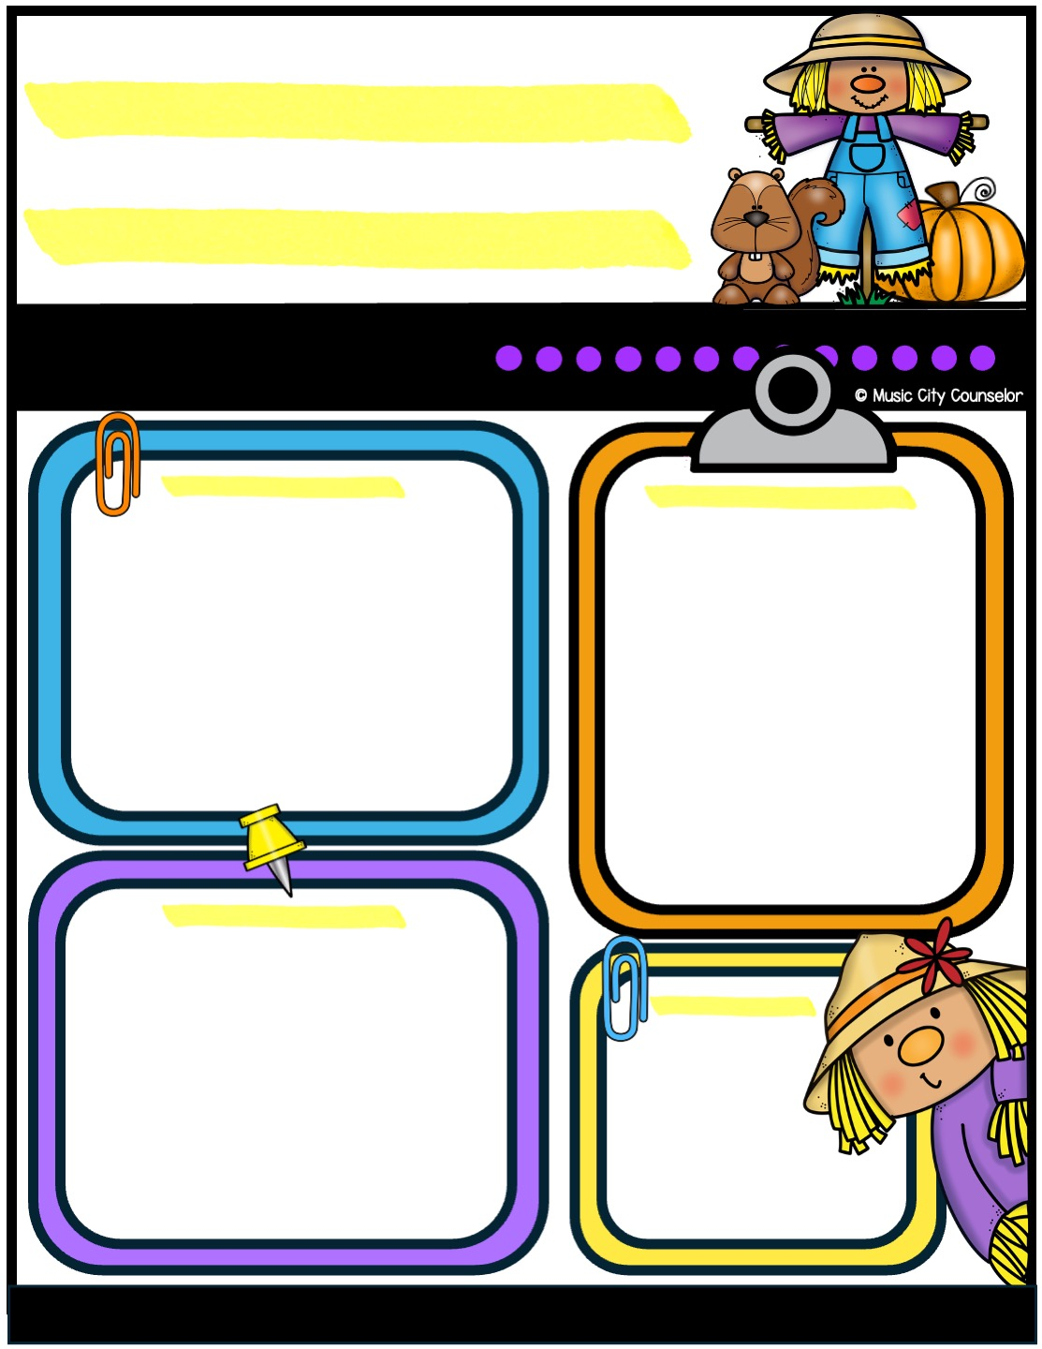
Counseling
newsletter
october 2024
Monthly focus
Upcoming events
Type here
Type here
Happy kids tip
Halloween is a fun and exciting time, but safety comes first! Make sure costumes fit properly and are visible in the dark—adding reflective tape or glow sticks can help. Always accompany young children while trick-or-treating and stick to well-lit, familiar neighborhoods. Remind your child to only visit homes with the porch light on and avoid eating any treats until they’ve been inspected.
reminders
Type here
Mrs. Laura Oathout
615-392-5930, ext. 102
laura.oathout@wcs.edu

Slide 7
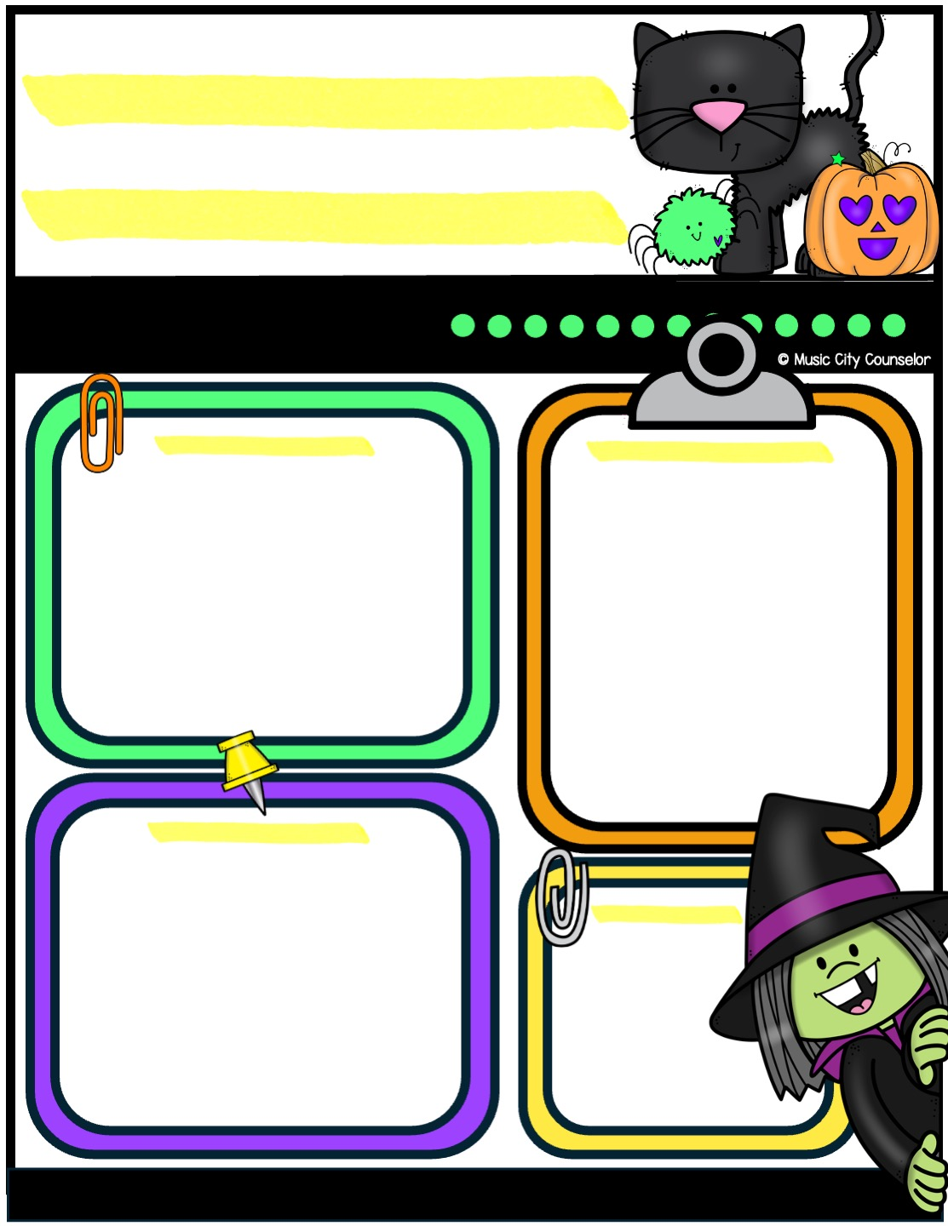
Counseling
newsletter
october 2024
Monthly focus
Upcoming events
Type here
Type here
Happy kids tip
Halloween is a fun and exciting time, but safety comes first! Make sure costumes fit properly and are visible in the dark—adding reflective tape or glow sticks can help. Always accompany young children while trick-or-treating and stick to well-lit, familiar neighborhoods. Remind your child to only visit homes with the porch light on and avoid eating any treats until they’ve been inspected.
reminders
Type here
Mrs. Laura Oathout
615-392-5930, ext. 102
laura.oathout@wcs.edu

Slide 8
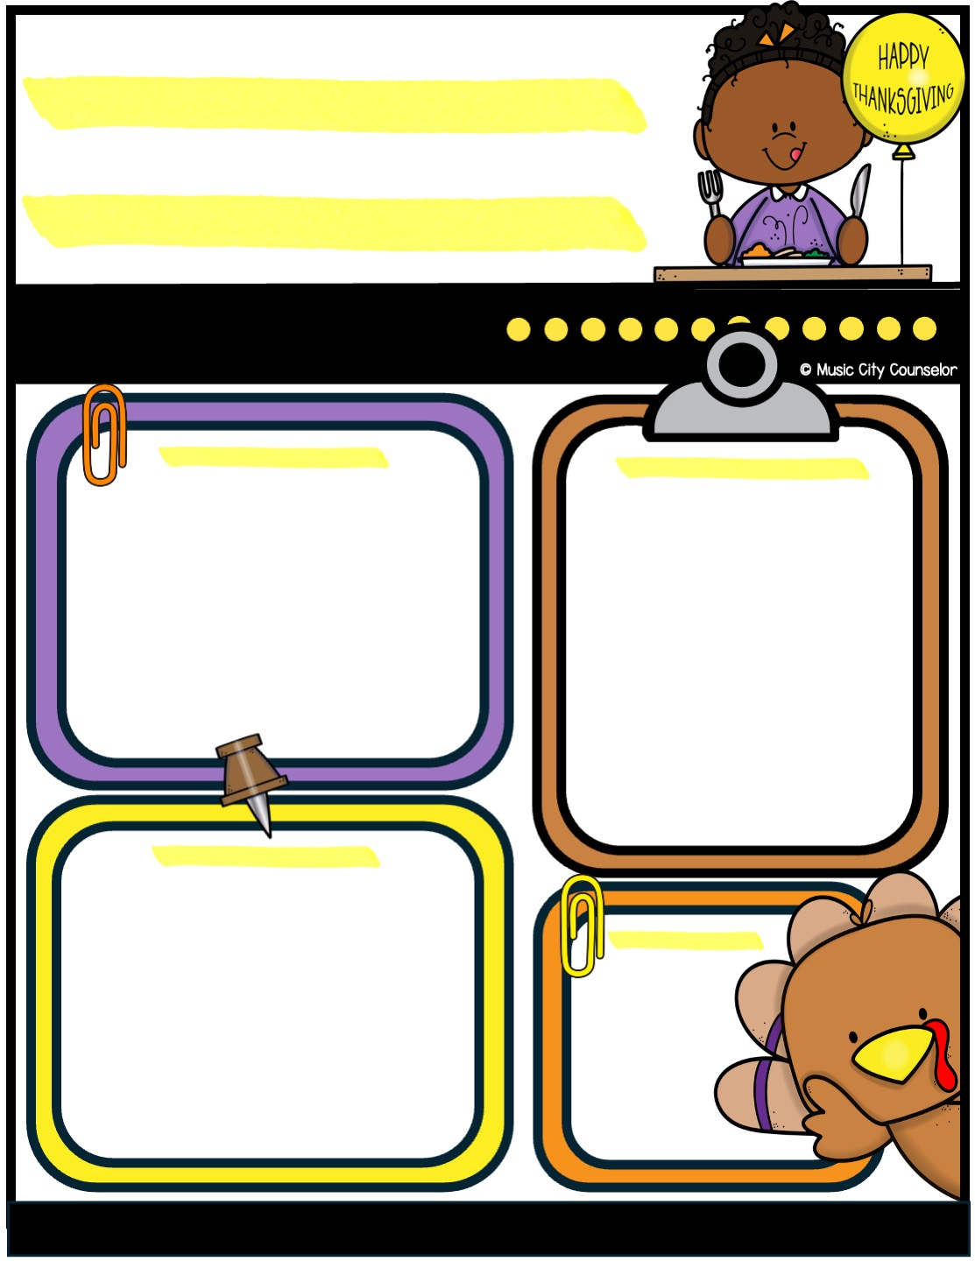
Counseling
newsletter
november 2024
Monthly focus
Upcoming events
Type here
Type here
Happy kids tip
Thanksgiving is a wonderful time to create lasting family memories! Encourage everyone to share what they’re grateful for around the dinner table to foster gratitude and connection. Involve your kids in simple tasks like setting the table or preparing a dish to make them feel included. Spend quality time together by playing games, watching a holiday movie, or going for a walk after your meal.
reminders
Type here
Mrs. Laura Oathout
615-392-5930, ext. 102
laura.oathout@wcs.edu

Slide 9
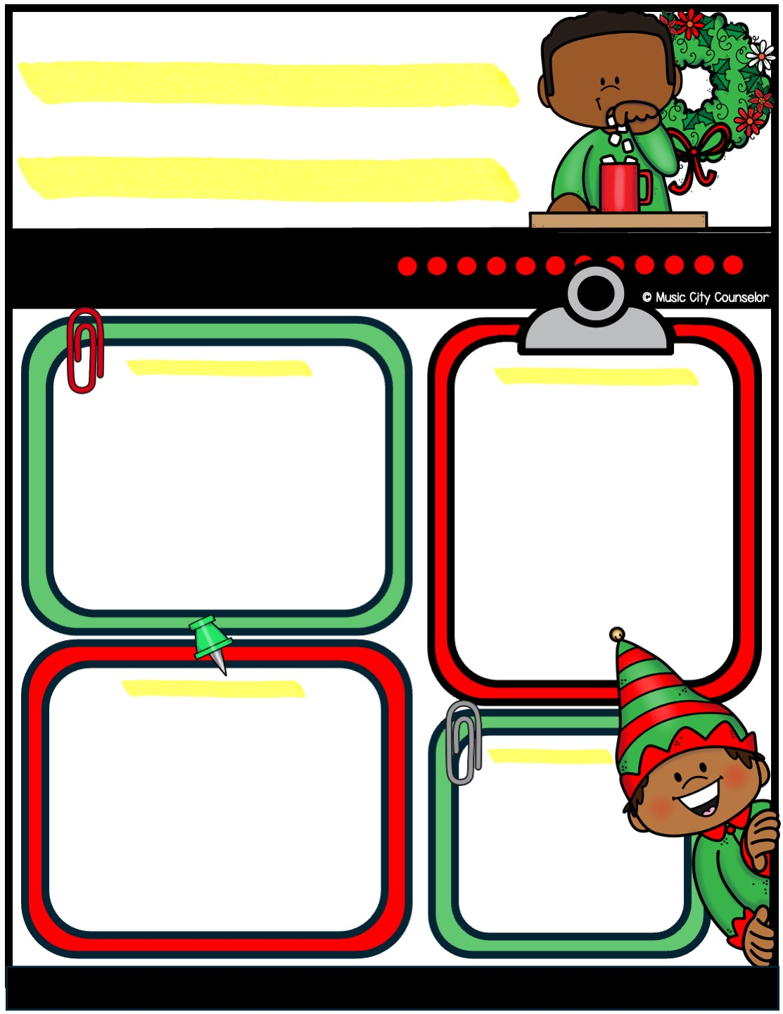
Counseling
newsletter
december 2024
Monthly focus
Upcoming events
Type here
Type here
Happy kids tip
Winter holidays are a perfect time to create special family traditions! Whether it’s baking cookies, decorating together, or reading holiday stories, find activities that bring everyone joy. Take time to enjoy the magic of the season with simple moments like a family movie night, a drive to see holiday lights, or even a snowball fight. Encourage your child to give back by helping others, fostering kindness and gratitude.
reminders
Type here
Mrs. Laura Oathout
615-392-5930, ext. 102
laura.oathout@wcs.edu

Slide 10
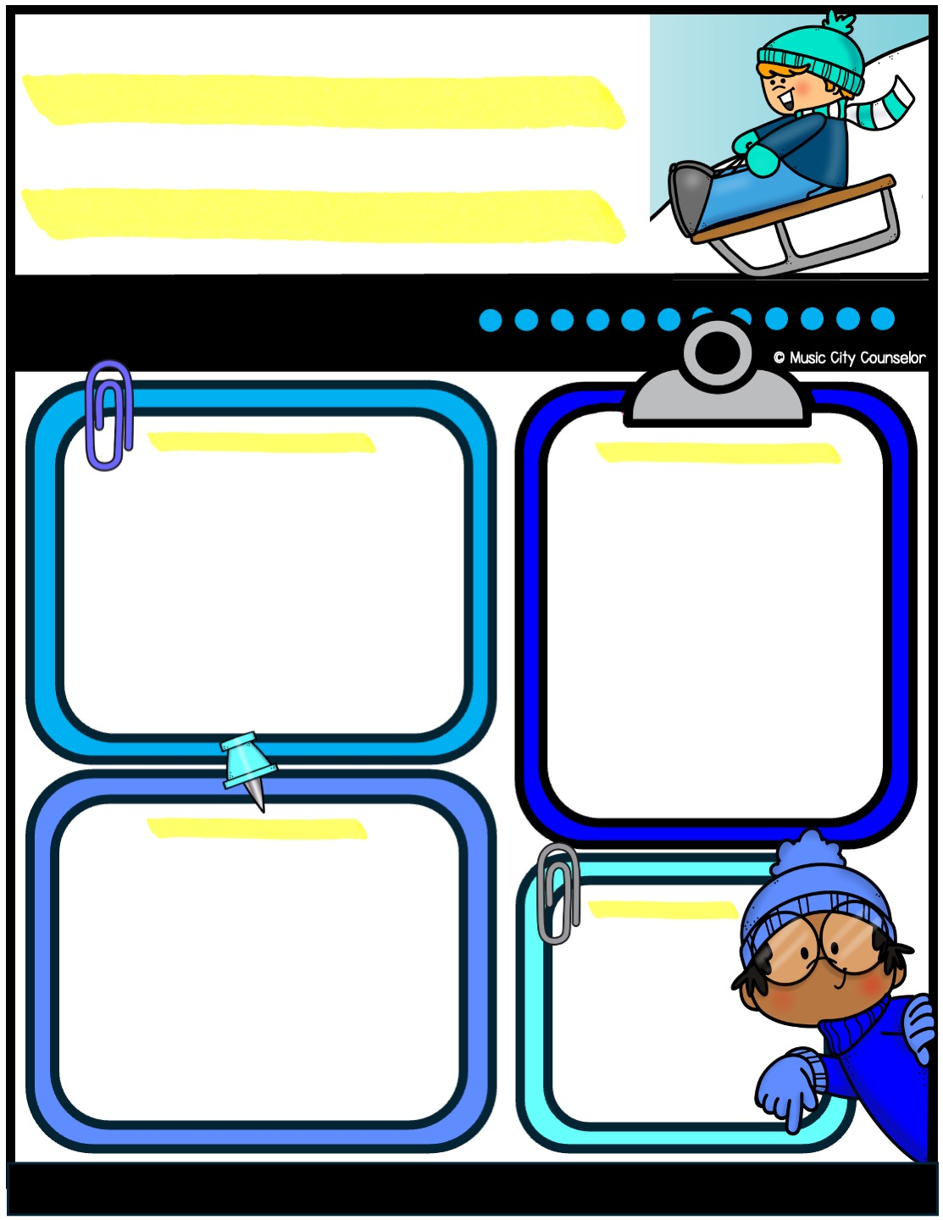
Counseling
newsletter
december 2024
Monthly focus
Upcoming events
Type here
Type here
Happy kids tip
Winter holidays are a perfect time to create special family traditions! Whether it’s baking cookies, decorating together, or reading holiday stories, find activities that bring everyone joy. Take time to enjoy the magic of the season with simple moments like a family movie night, a drive to see holiday lights, or even a snowball fight. Encourage your child to give back by helping others, fostering kindness and gratitude.
reminders
Type here
Mrs. Laura Oathout
615-392-5930, ext. 102
laura.oathout@wcs.edu

Slide 11
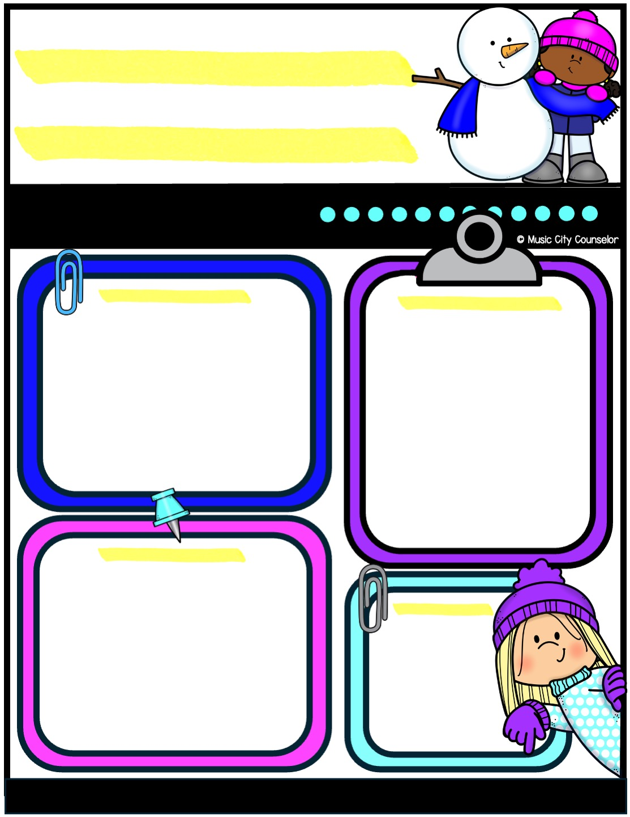
Counseling
newsletter
january 2025
Monthly focus
Upcoming events
Type here
Type here
Happy kids tip
The new year is a great time to teach kids about goal setting and personal growth! Sit down as a family and talk about what your child hopes to accomplish, whether it’s learning a new skill, improving in school, or being more helpful at home. Keep goals simple, specific, and achievable to help build their confidence. Write them down and celebrate progress along the way.
reminders
Type here
Mrs. Laura Oathout
615-392-5930, ext. 102
laura.oathout@wcs.edu

Slide 12
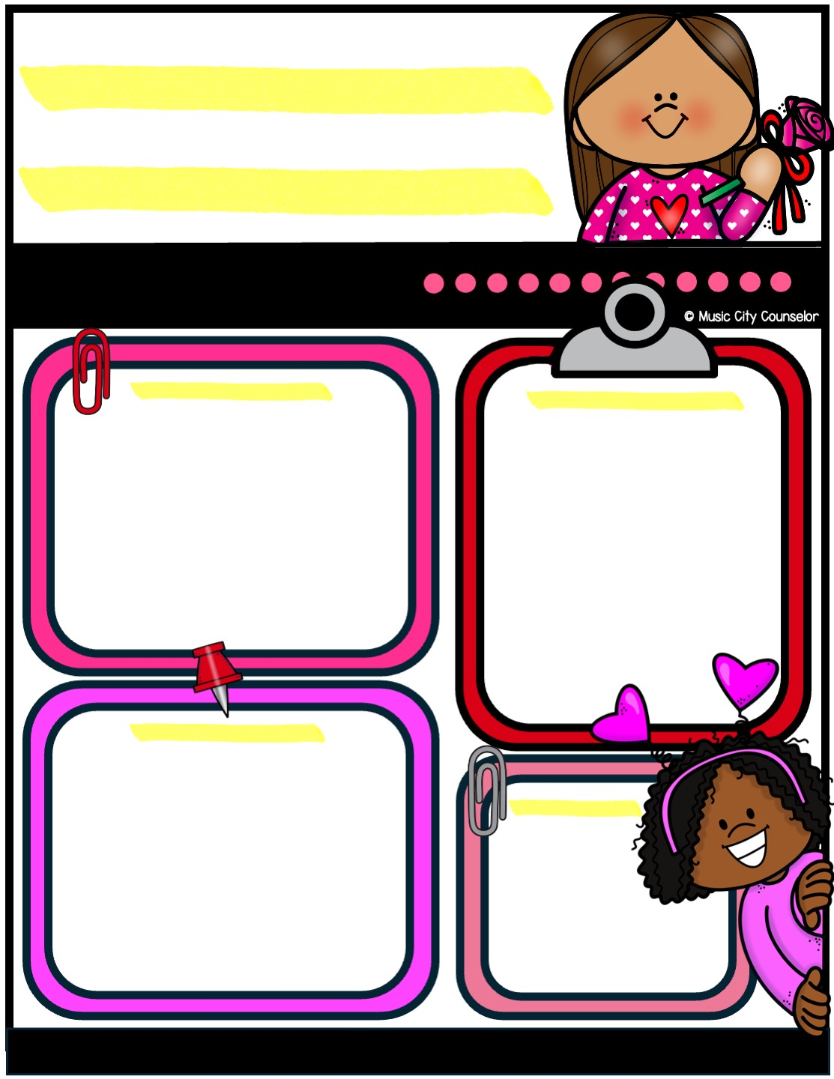
Counseling
newsletter
february 2025
Monthly focus
Upcoming events
Type here
Type here
Happy kids tip
Mindfulness can be a powerful tool to help children manage stress and stay focused. Encourage your child to take a few deep breaths when they’re feeling overwhelmed or to pay attention to the sounds, smells, and sights around them to bring them into the moment. Simple activities like coloring, listening to calming music, or practicing gratitude can also help them stay present.
reminders
Type here
Mrs. Laura Oathout
615-392-5930, ext. 102
laura.oathout@wcs.edu

Slide 13
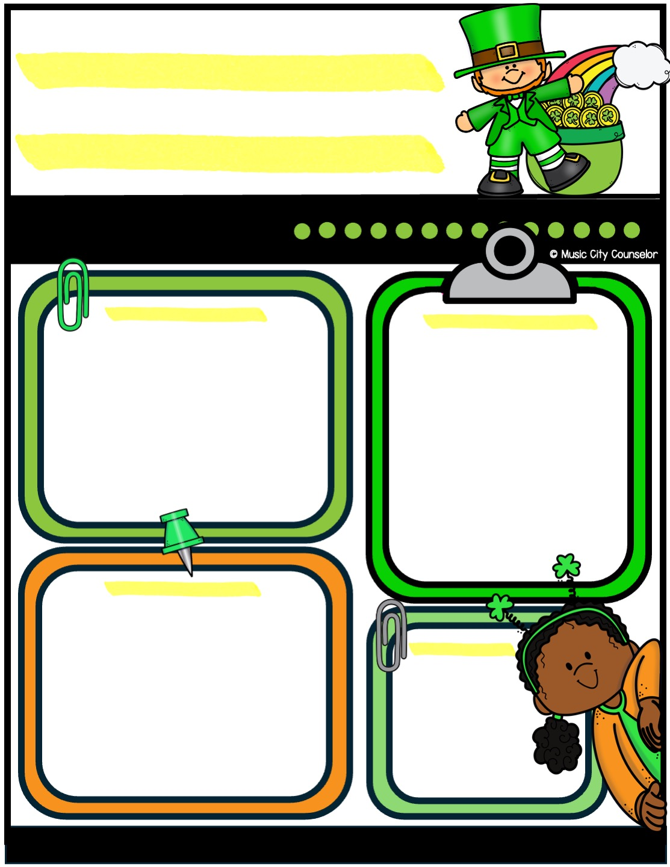
Counseling
newsletter
march 2025
Monthly focus
Upcoming events
Type here
Type here
Happy kids tip
Bullying can have a big impact on children, so it’s important to talk openly with your child about kindness and respect. Encourage them to share their feelings and let them know they can always come to you if they’re having a problem. Teach them how to stand up for themselves and others in a safe, confident way. If bullying happens, work closely with teachers and school staff to address the situation.
reminders
Type here
Mrs. Laura Oathout
615-392-5930, ext. 102
laura.oathout@wcs.edu

Slide 14
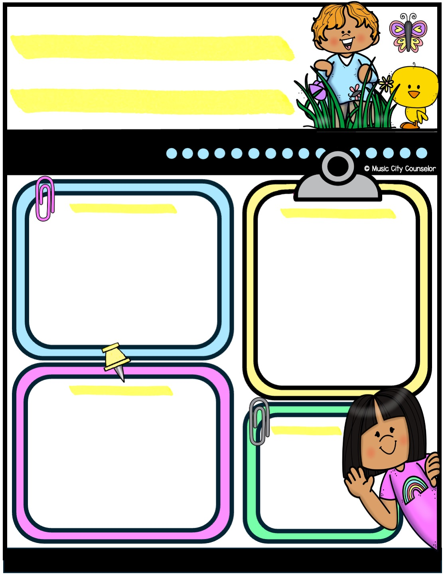
Counseling
newsletter
april 2025
Monthly focus
Upcoming events
Type here
Type here
Happy kids tip
Helping your child make friends is an important part of their social and emotional growth. Encourage them to be kind, share, and show interest in others to build connections. Role-play conversations or ways to join group activities to boost their confidence. Remind them that making friends takes time and that being a good friend is just as important as finding one.
reminders
Type here
Mrs. Laura Oathout
615-392-5930, ext. 102
laura.oathout@wcs.edu

Slide 15
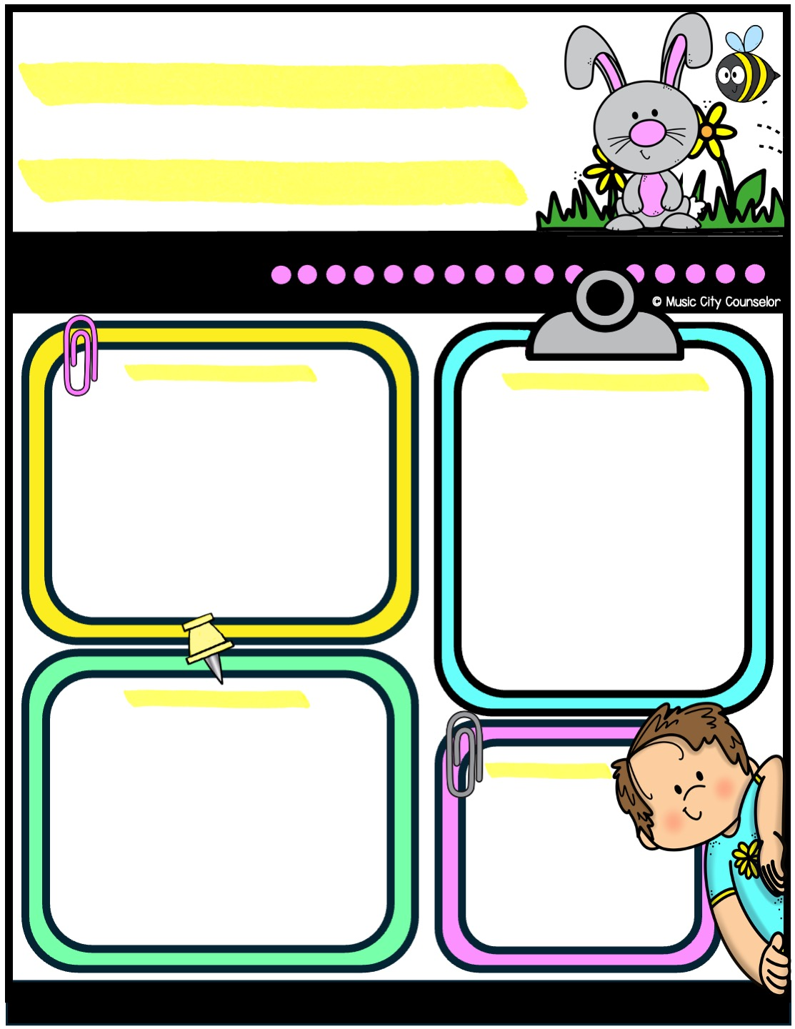
Counseling
newsletter
may 2025
Monthly focus
Upcoming events
Type here
Type here
Happy kids tip
Anxiety is a common experience for children as they navigate new challenges and emotions. If your child seems anxious, listen to their feelings without judgment and reassure them that it’s okay to feel this way. Teach coping skills like deep breathing, drawing, or taking small breaks to calm their mind. Consistent routines and open communication can also help them feel secure. If their anxiety feels overwhelming, don’t hesitate to reach out for support.
reminders
Type here
Mrs. Laura Oathout
615-392-5930, ext. 102
laura.oathout@wcs.edu

Slide 16
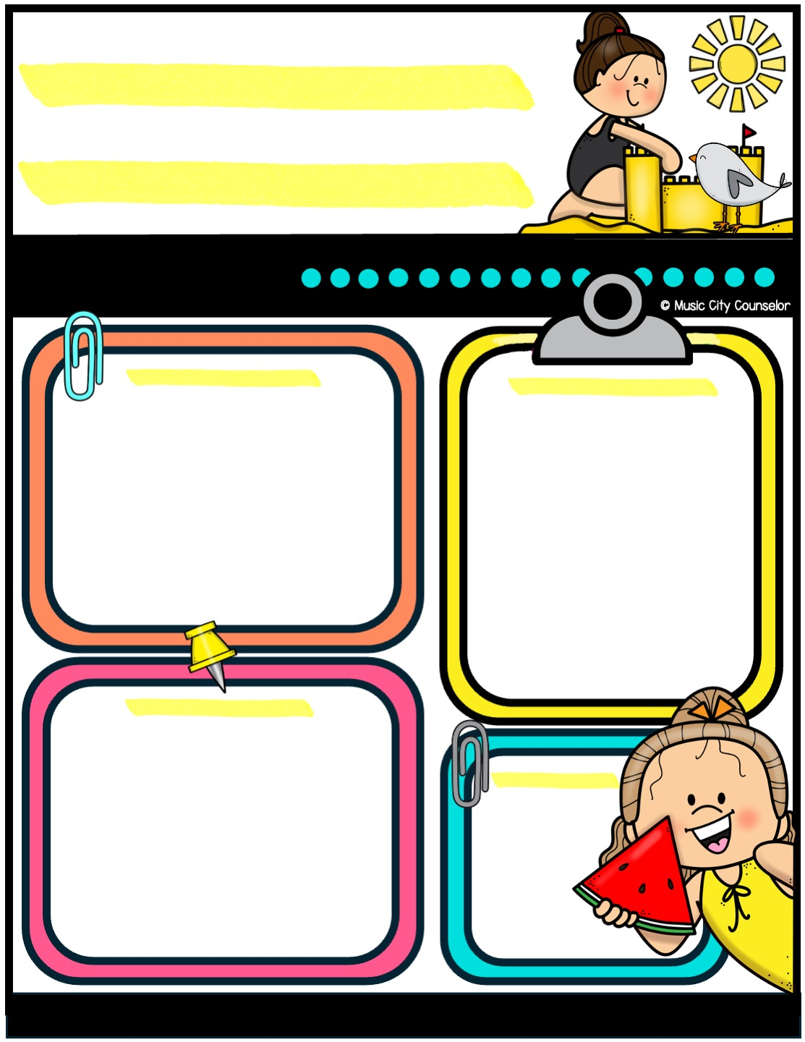
Counseling
newsletter
june 2025
Monthly focus
Upcoming events
Type here
Type here
Happy kids tip
Summer is a time for fun, but safety always comes first! Remind your child to drink plenty of water, wear sunscreen, and take breaks in the shade to stay cool. Supervise water activities closely, ensuring your child knows basic water safety rules. When biking or skating, make sure they wear a helmet. Encourage your child to stay aware of their surroundings and practice safety wherever they go.
reminders
Type here
Mrs. Laura Oathout
615-392-5930, ext. 102
laura.oathout@wcs.edu

Slide 17


Slide 18
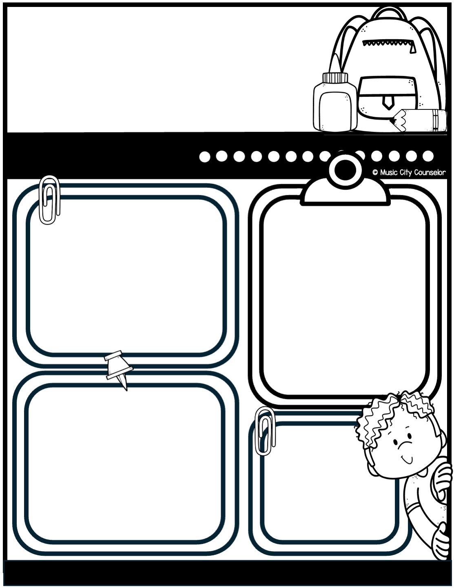
Counseling
newsletter
august 2024
Monthly focus
Upcoming events
Type here
Type here
Happy kids tip
Back-to-school season is an exciting time! To help your child transition smoothly, establish a consistent bedtime and morning routine to set them up for success. Stay involved by checking backpacks for important notices and helping your child stay organized. Most importantly, talk with your child daily about their experiences to show your support and stay connected.
reminders
Type here
Mrs. Laura Oathout
615-392-5930, ext. 102
laura.oathout@wcs.edu

Slide 19
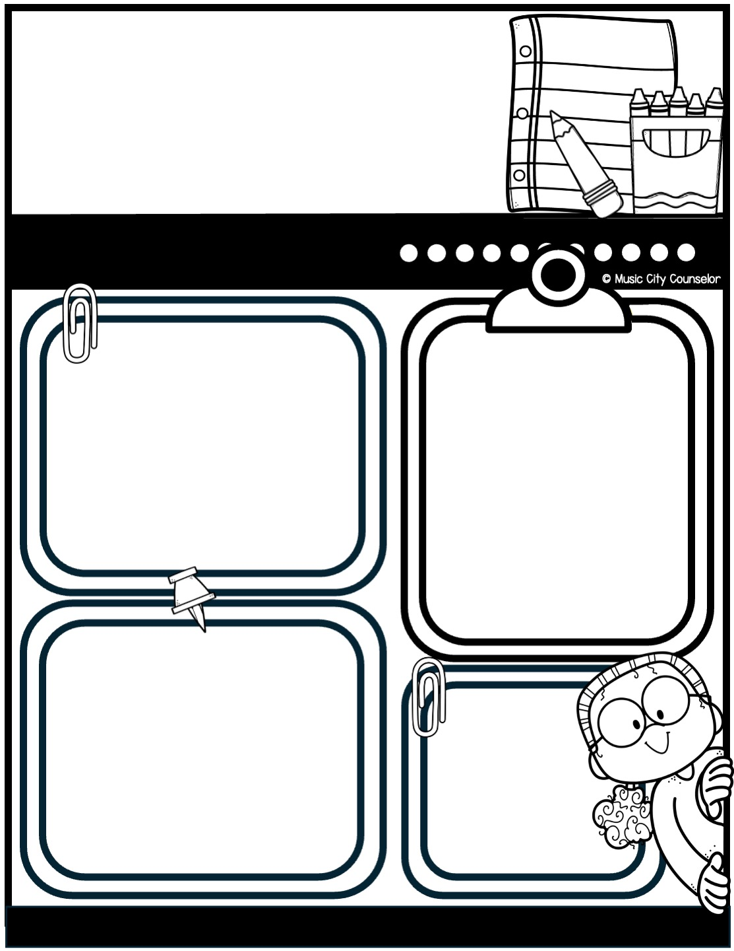
Counseling
newsletter
September 2024
Monthly focus
Upcoming events
Type here
Type here
Happy kids tip
Reading with your child is one of the most valuable things you can do to support their learning and growth. It helps build their vocabulary, improve comprehension, and spark their imagination. Sharing a book together also creates a special bonding time and shows your child that reading is fun and important. Even just 15 minutes a day can make a big difference in their academic success and love of learning!
reminders
Type here
Mrs. Laura Oathout
615-392-5930, ext. 102
laura.oathout@wcs.edu

Slide 20
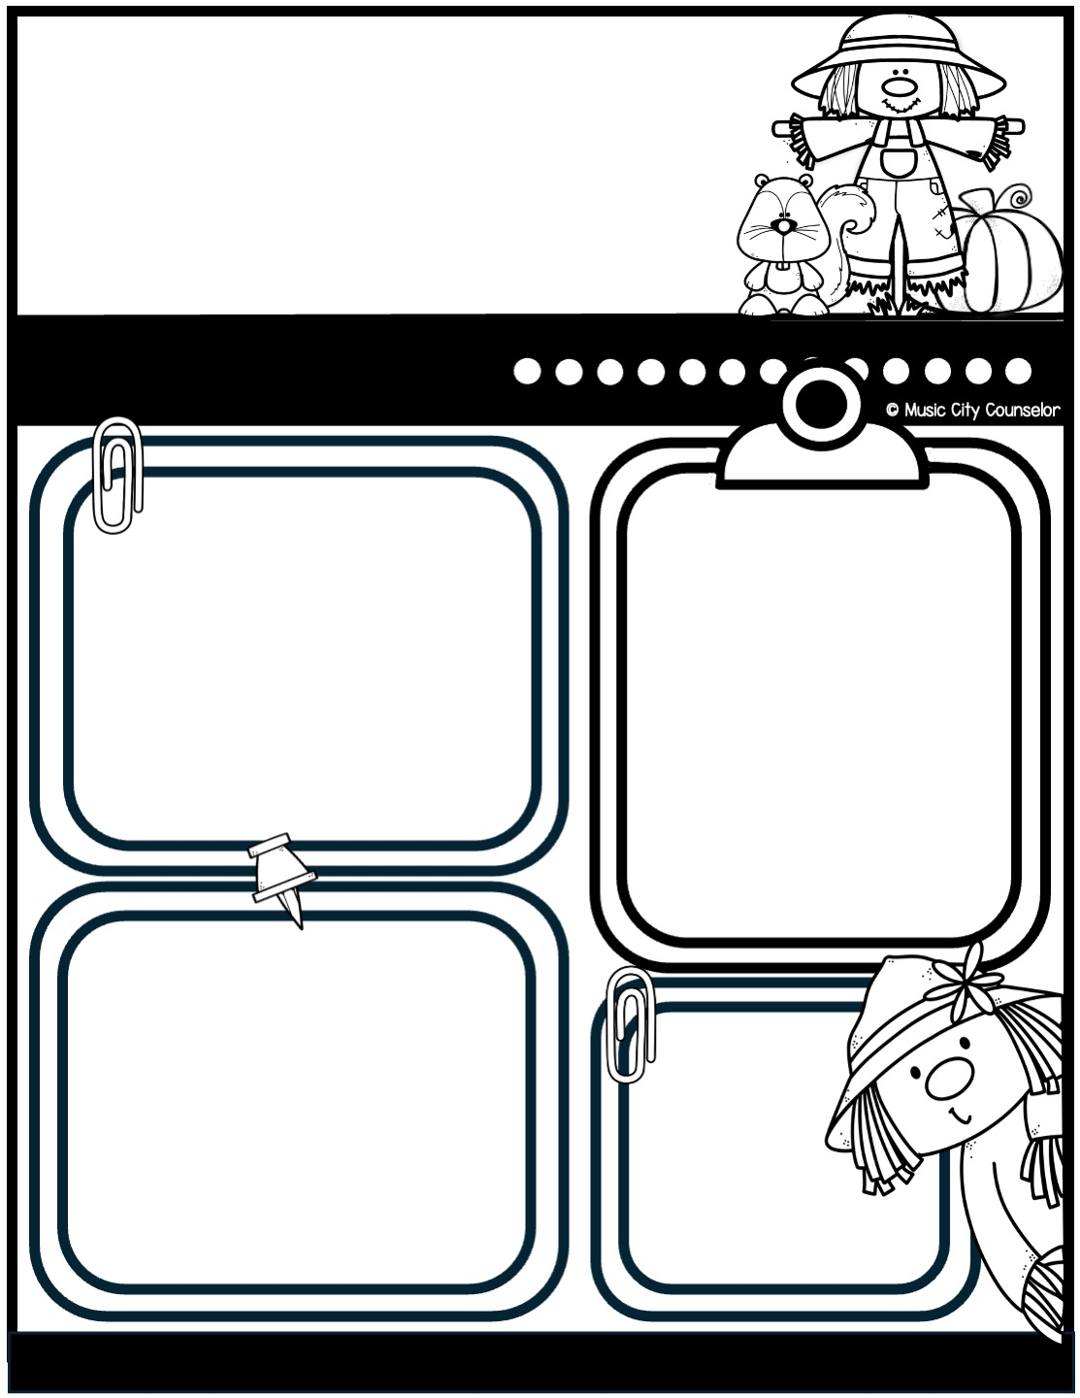
Counseling
newsletter
october 2024
Monthly focus
Upcoming events
Type here
Type here
Happy kids tip
Halloween is a fun and exciting time, but safety comes first! Make sure costumes fit properly and are visible in the dark—adding reflective tape or glow sticks can help. Always accompany young children while trick-or-treating and stick to well-lit, familiar neighborhoods. Remind your child to only visit homes with the porch light on and avoid eating any treats until they’ve been inspected.
reminders
Type here
Mrs. Laura Oathout
615-392-5930, ext. 102
laura.oathout@wcs.edu

Slide 21
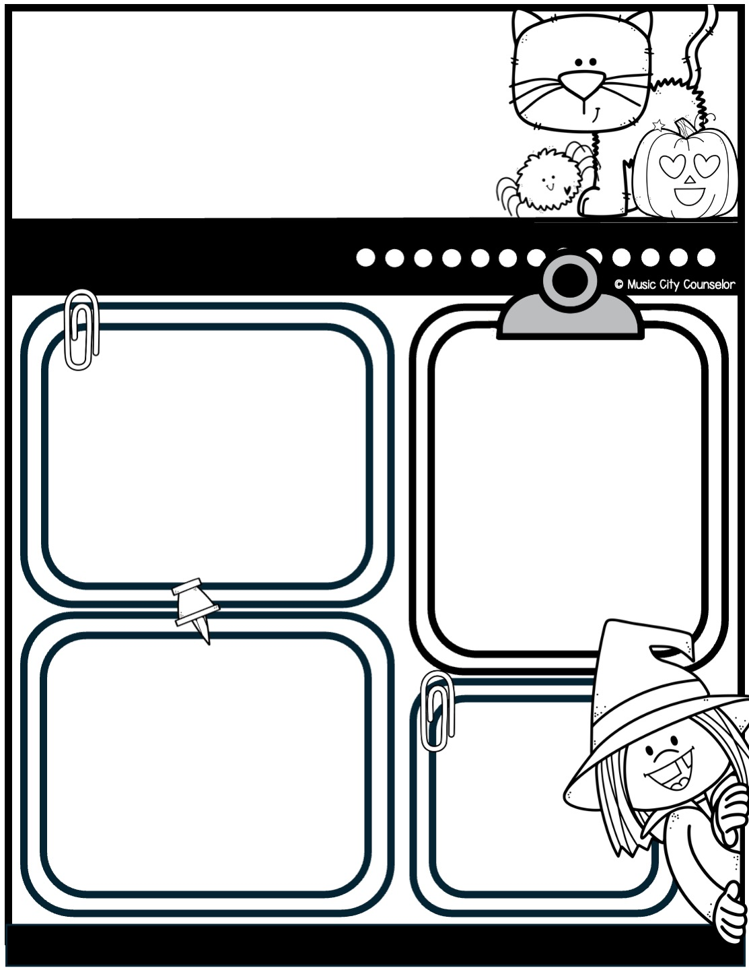
Counseling
newsletter
october 2024
Monthly focus
Upcoming events
Type here
Type here
Happy kids tip
Halloween is a fun and exciting time, but safety comes first! Make sure costumes fit properly and are visible in the dark—adding reflective tape or glow sticks can help. Always accompany young children while trick-or-treating and stick to well-lit, familiar neighborhoods. Remind your child to only visit homes with the porch light on and avoid eating any treats until they’ve been inspected.
reminders
Type here
Mrs. Laura Oathout
615-392-5930, ext. 102
laura.oathout@wcs.edu

Slide 22
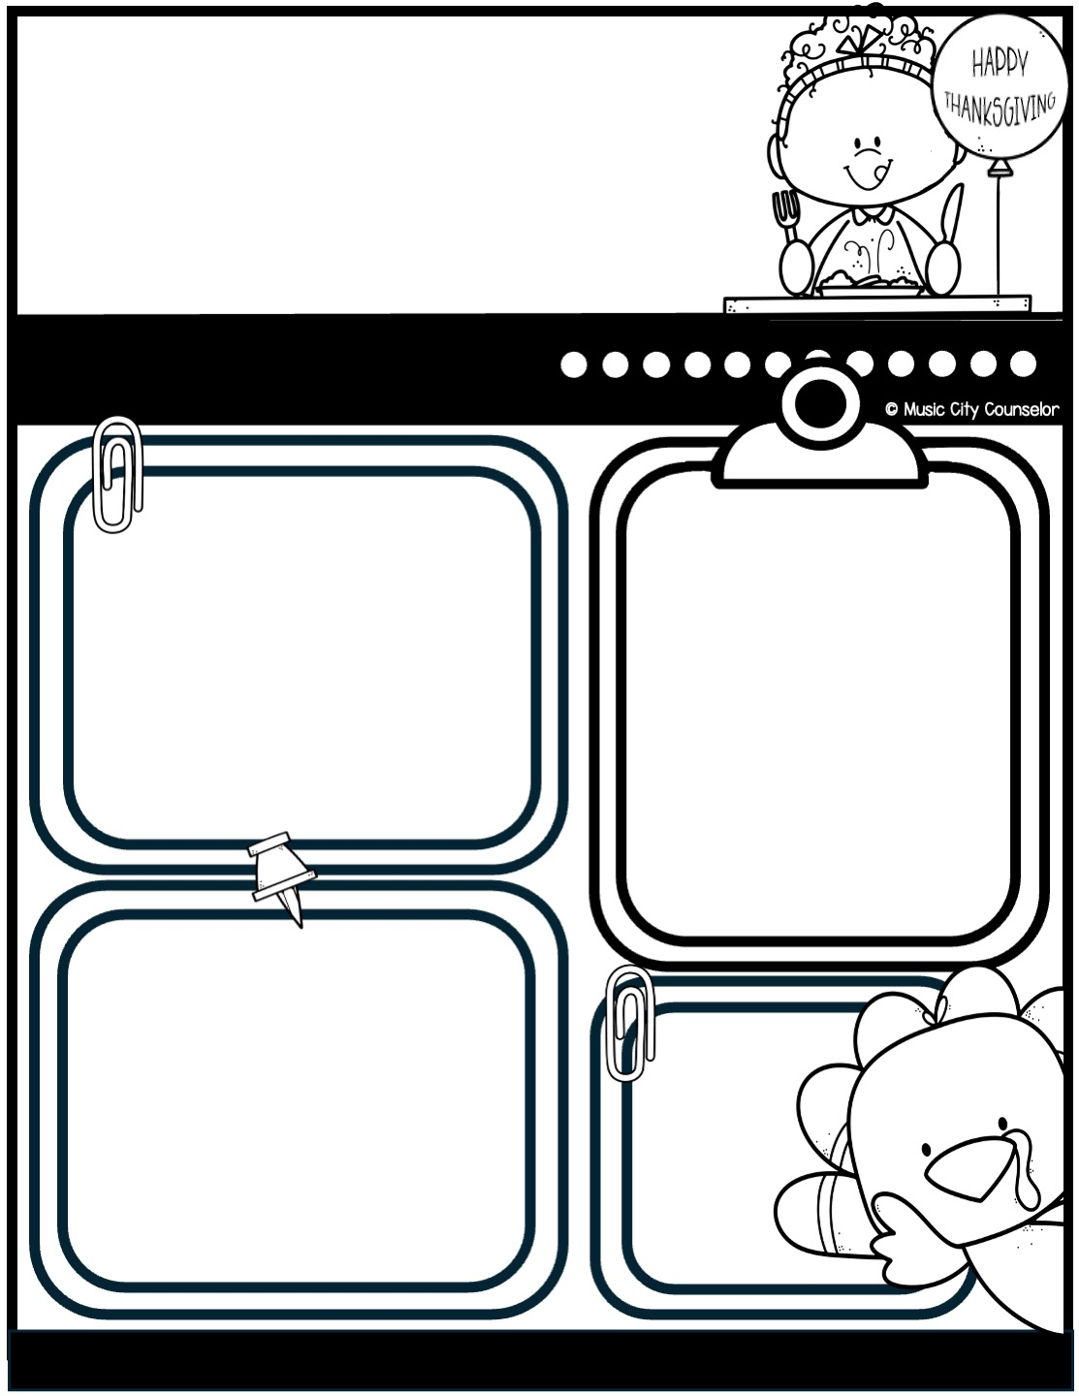
Counseling
newsletter
november 2024
Monthly focus
Upcoming events
Type here
Type here
Happy kids tip
Thanksgiving is a wonderful time to create lasting family memories! Encourage everyone to share what they’re grateful for around the dinner table to foster gratitude and connection. Involve your kids in simple tasks like setting the table or preparing a dish to make them feel included. Spend quality time together by playing games, watching a holiday movie, or going for a walk after your meal.
reminders
Type here
Mrs. Laura Oathout
615-392-5930, ext. 102
laura.oathout@wcs.edu

Slide 23
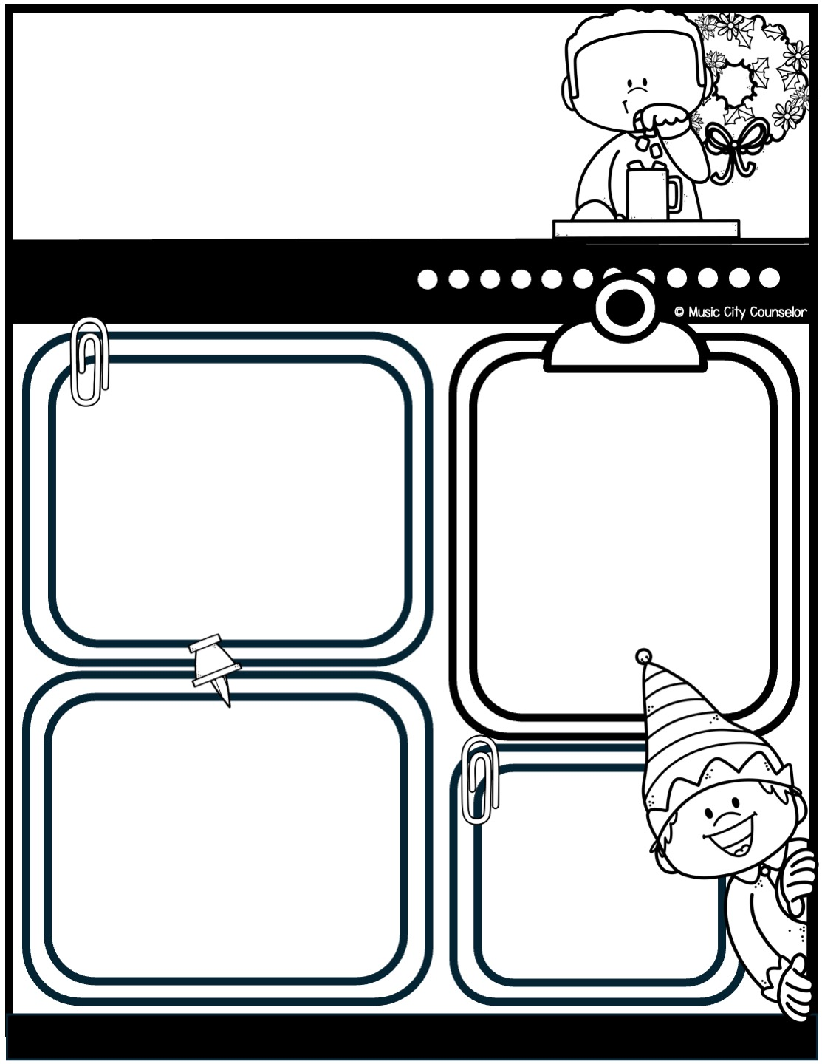
Counseling
newsletter
december 2024
Monthly focus
Upcoming events
Type here
Type here
Happy kids tip
Winter holidays are a perfect time to create special family traditions! Whether it’s baking cookies, decorating together, or reading holiday stories, find activities that bring everyone joy. Take time to enjoy the magic of the season with simple moments like a family movie night, a drive to see holiday lights, or even a snowball fight. Encourage your child to give back by helping others, fostering kindness and gratitude.
reminders
Type here
Mrs. Laura Oathout
615-392-5930, ext. 102
laura.oathout@wcs.edu

Slide 24
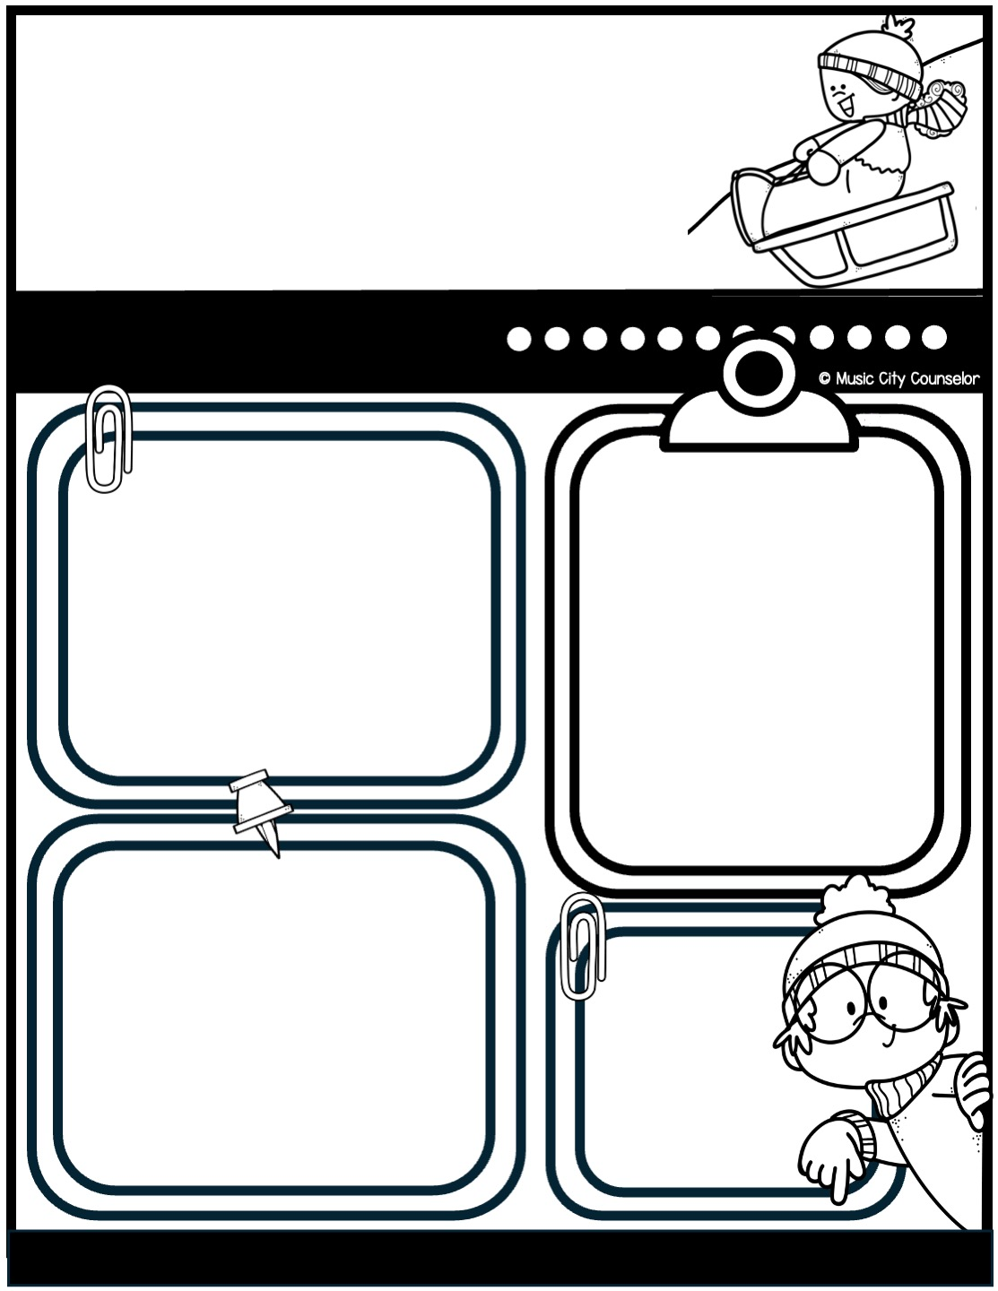
Counseling
newsletter
december 2024
Monthly focus
Upcoming events
Type here
Type here
Happy kids tip
Winter holidays are a perfect time to create special family traditions! Whether it’s baking cookies, decorating together, or reading holiday stories, find activities that bring everyone joy. Take time to enjoy the magic of the season with simple moments like a family movie night, a drive to see holiday lights, or even a snowball fight. Encourage your child to give back by helping others, fostering kindness and gratitude.
reminders
Type here
Mrs. Laura Oathout
615-392-5930, ext. 102
laura.oathout@wcs.edu

Slide 25
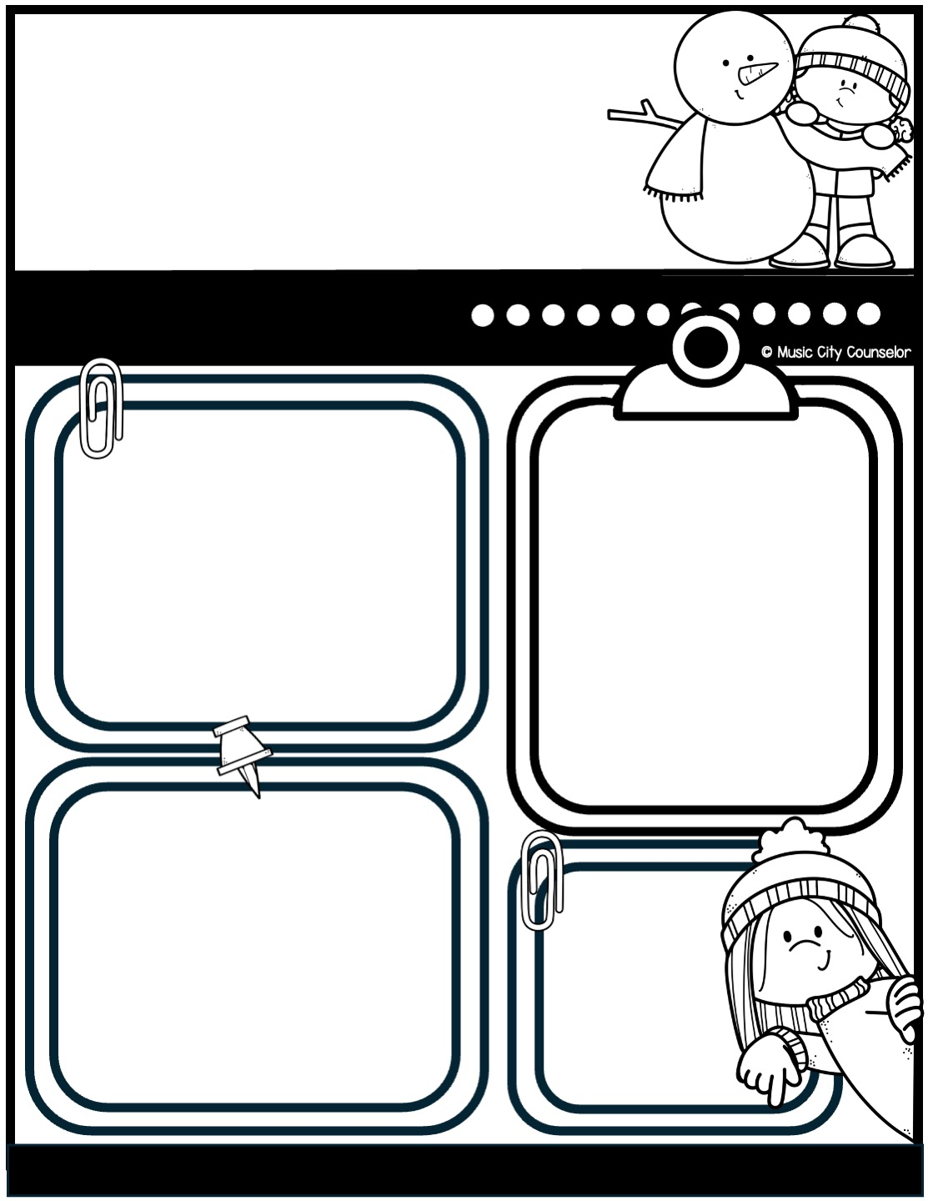
Counseling
newsletter
january 2025
Monthly focus
Upcoming events
Type here
Type here
Happy kids tip
The new year is a great time to teach kids about goal setting and personal growth! Sit down as a family and talk about what your child hopes to accomplish, whether it’s learning a new skill, improving in school, or being more helpful at home. Keep goals simple, specific, and achievable to help build their confidence. Write them down and celebrate progress along the way.
reminders
Type here
Mrs. Laura Oathout
615-392-5930, ext. 102
laura.oathout@wcs.edu

Slide 26
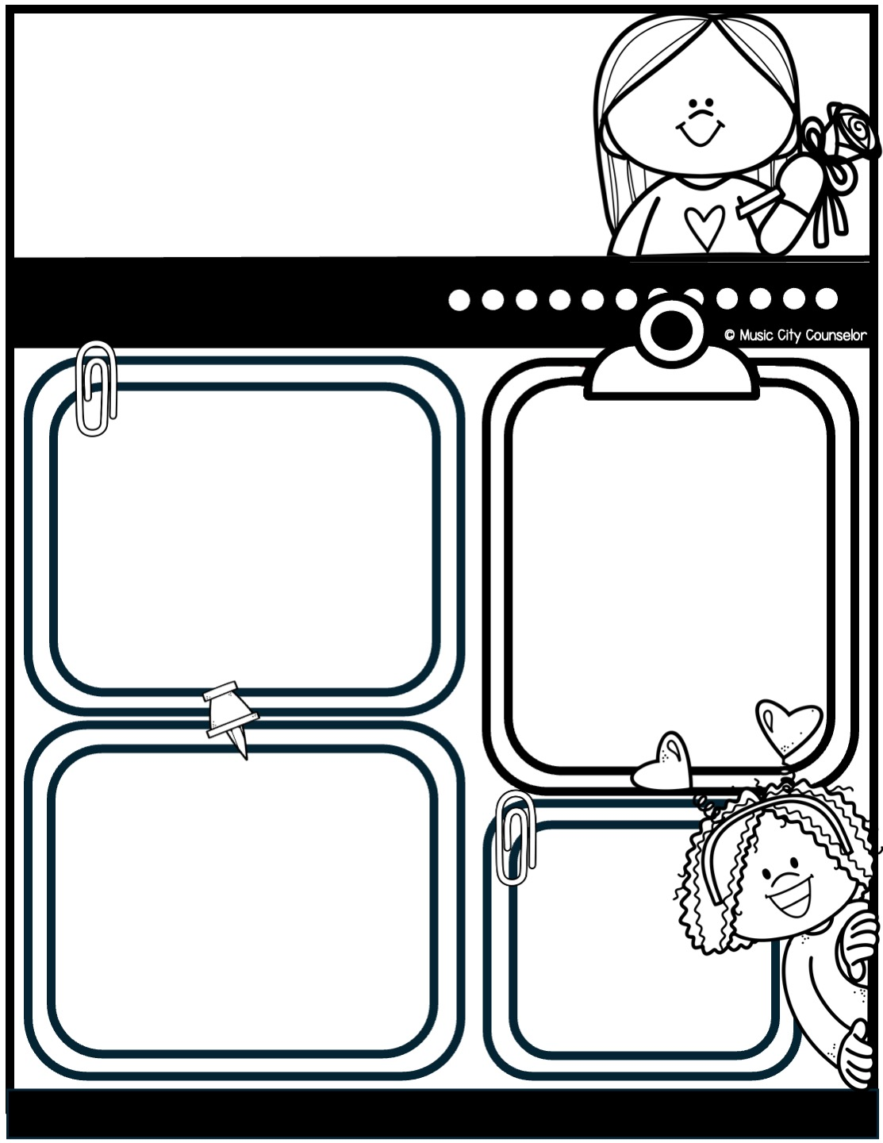
Counseling
newsletter
february 2025
Monthly focus
Upcoming events
Type here
Type here
Happy kids tip
Mindfulness can be a powerful tool to help children manage stress and stay focused. Encourage your child to take a few deep breaths when they’re feeling overwhelmed or to pay attention to the sounds, smells, and sights around them to bring them into the moment. Simple activities like coloring, listening to calming music, or practicing gratitude can also help them stay present.
reminders
Type here
Mrs. Laura Oathout
615-392-5930, ext. 102
laura.oathout@wcs.edu

Slide 27
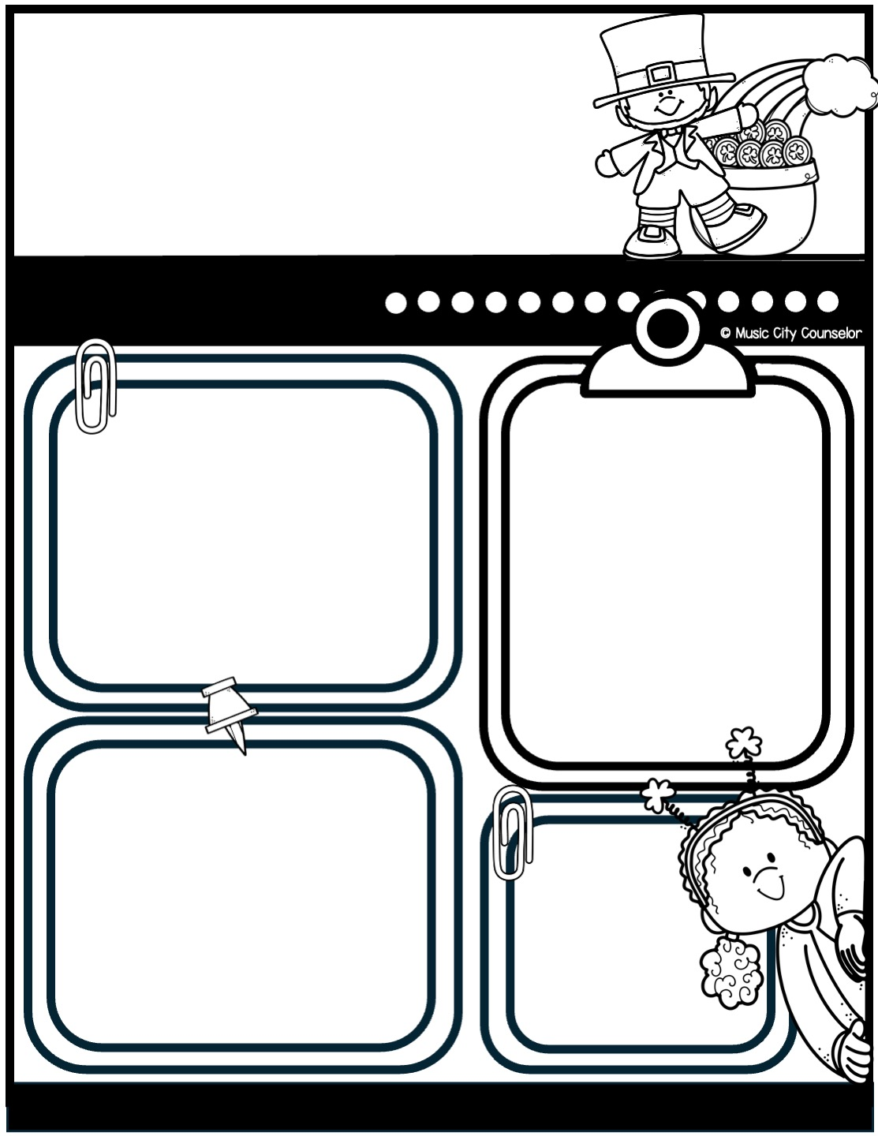
Counseling
newsletter
march 2025
Monthly focus
Upcoming events
Type here
Type here
Happy kids tip
Bullying can have a big impact on children, so it’s important to talk openly with your child about kindness and respect. Encourage them to share their feelings and let them know they can always come to you if they’re having a problem. Teach them how to stand up for themselves and others in a safe, confident way. If bullying happens, work closely with teachers and school staff to address the situation.
reminders
Type here
Mrs. Laura Oathout
615-392-5930, ext. 102
laura.oathout@wcs.edu

Slide 28
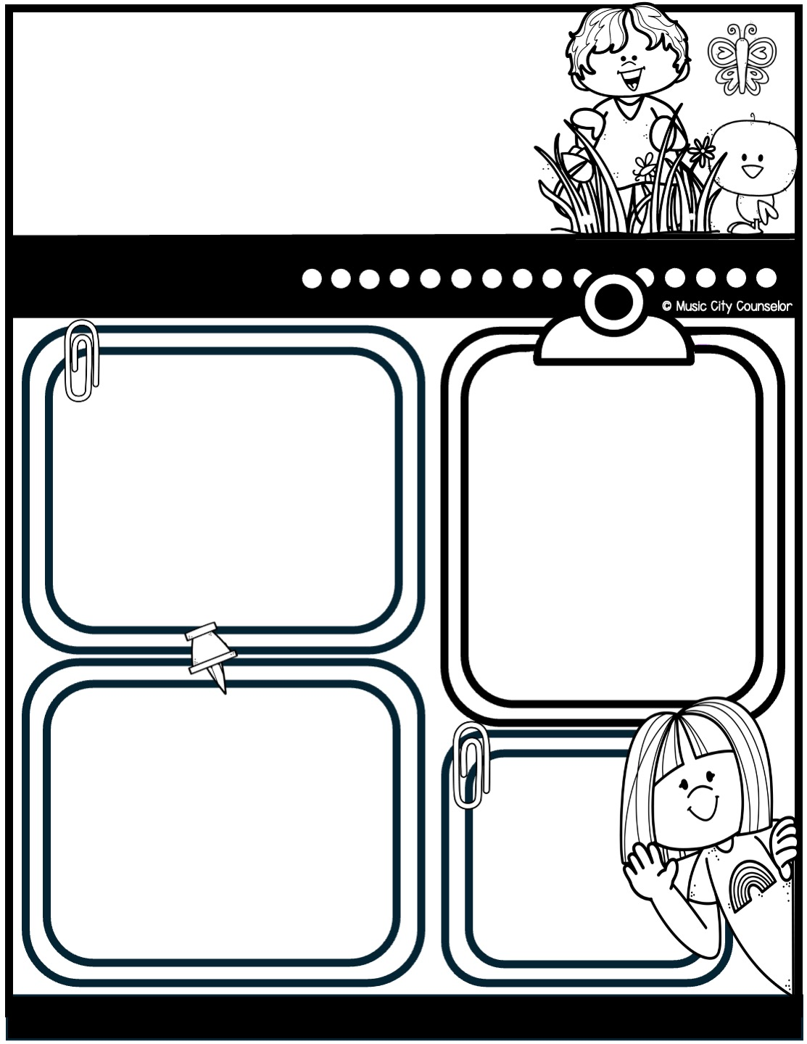
Counseling
newsletter
april 2025
Monthly focus
Upcoming events
Type here
Type here
Happy kids tip
Helping your child make friends is an important part of their social and emotional growth. Encourage them to be kind, share, and show interest in others to build connections. Role-play conversations or ways to join group activities to boost their confidence. Remind them that making friends takes time and that being a good friend is just as important as finding one.
reminders
Type here
Mrs. Laura Oathout
615-392-5930, ext. 102
laura.oathout@wcs.edu

Slide 29
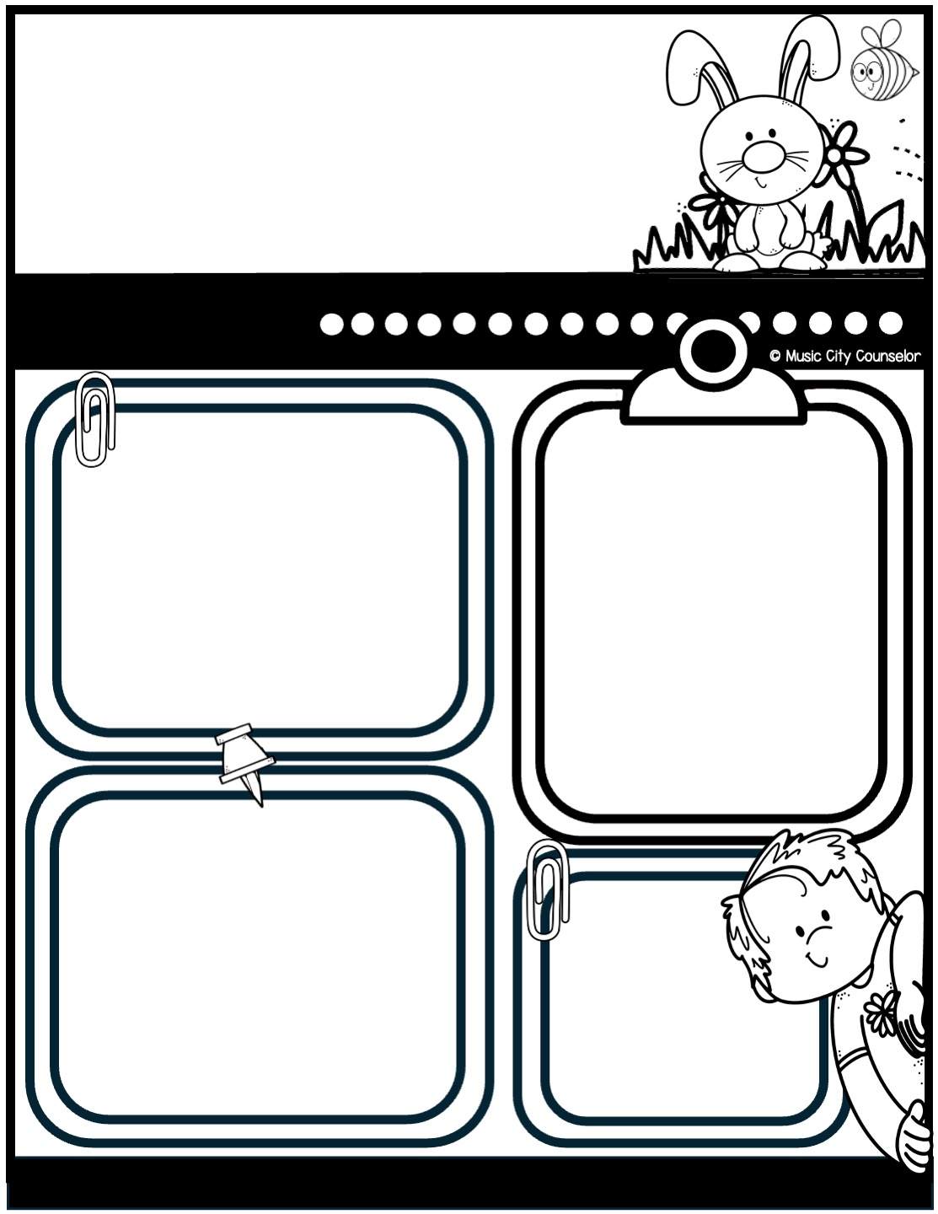
Counseling
newsletter
may 2025
Monthly focus
Upcoming events
Type here
Type here
Happy kids tip
Anxiety is a common experience for children as they navigate new challenges and emotions. If your child seems anxious, listen to their feelings without judgment and reassure them that it’s okay to feel this way. Teach coping skills like deep breathing, drawing, or taking small breaks to calm their mind. Consistent routines and open communication can also help them feel secure. If their anxiety feels overwhelming, don’t hesitate to reach out for support.
reminders
Type here
Mrs. Laura Oathout
615-392-5930, ext. 102
laura.oathout@wcs.edu

Slide 30
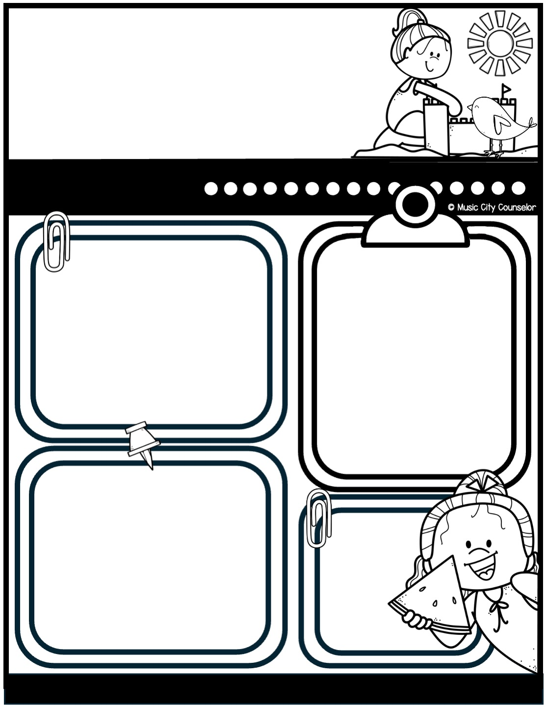
Counseling
newsletter
june 2025
Monthly focus
Upcoming events
Type here
Type here
Happy kids tip
Summer is a time for fun, but safety always comes first! Remind your child to drink plenty of water, wear sunscreen, and take breaks in the shade to stay cool. Supervise water activities closely, ensuring your child knows basic water safety rules. When biking or skating, make sure they wear a helmet. Encourage your child to stay aware of their surroundings and practice safety wherever they go.
reminders
Type here
Mrs. Laura Oathout
615-392-5930, ext. 102
laura.oathout@wcs.edu

Slide 31
