Slide 1
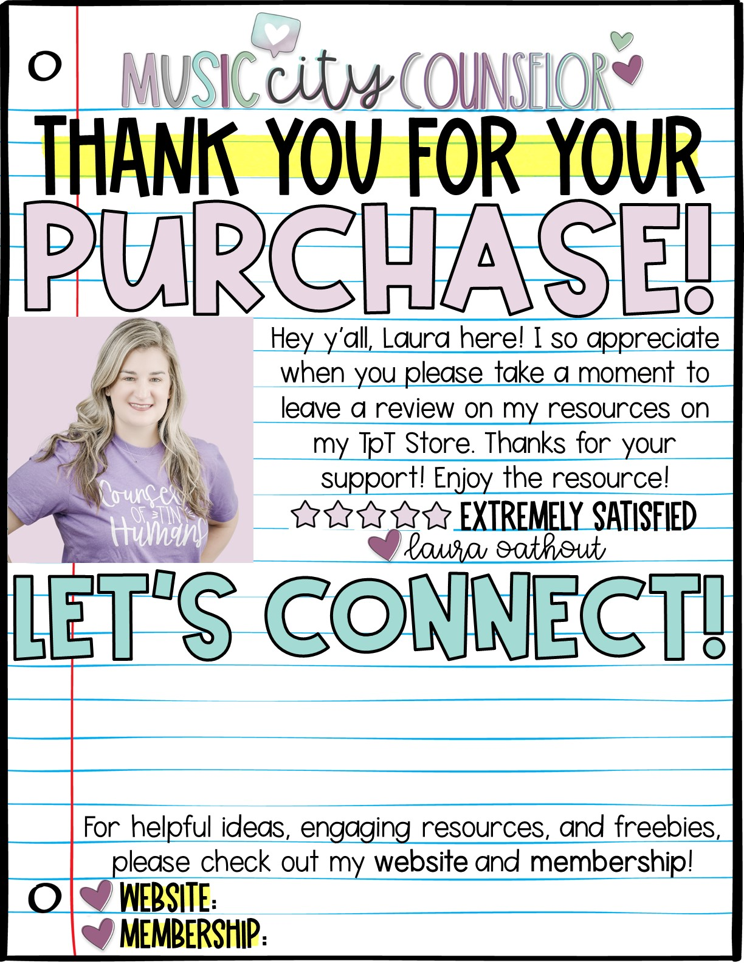





www.musiccitycounselor.com
www.counselorcollab.com

Slide 2
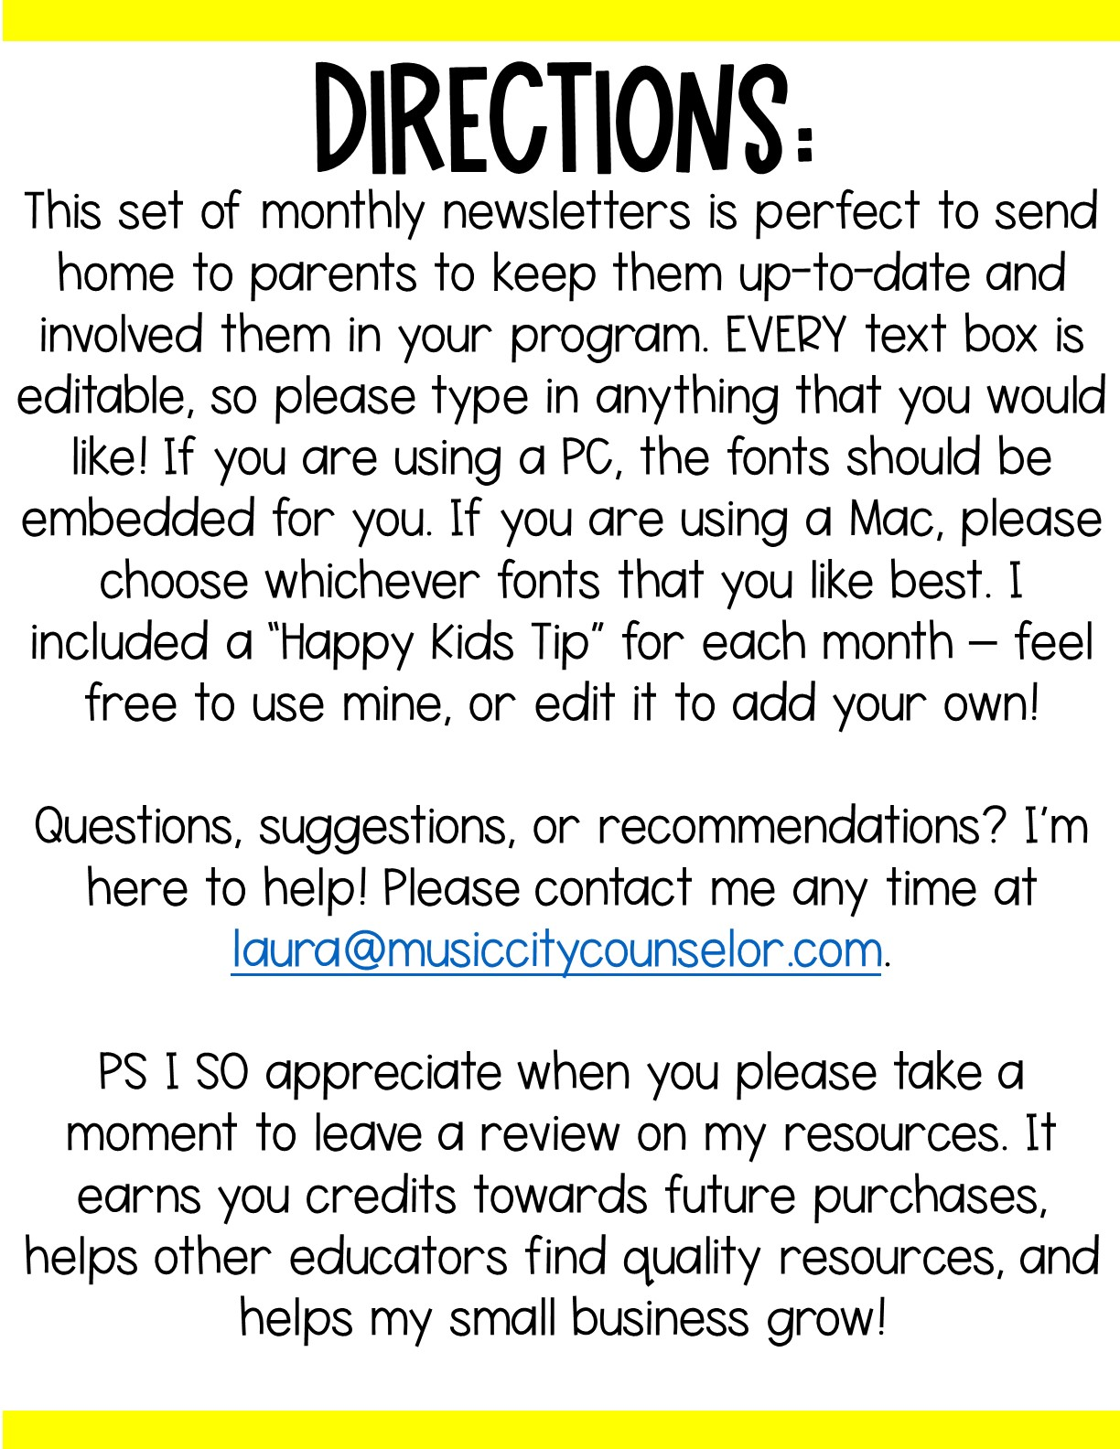

Slide 3


Slide 4
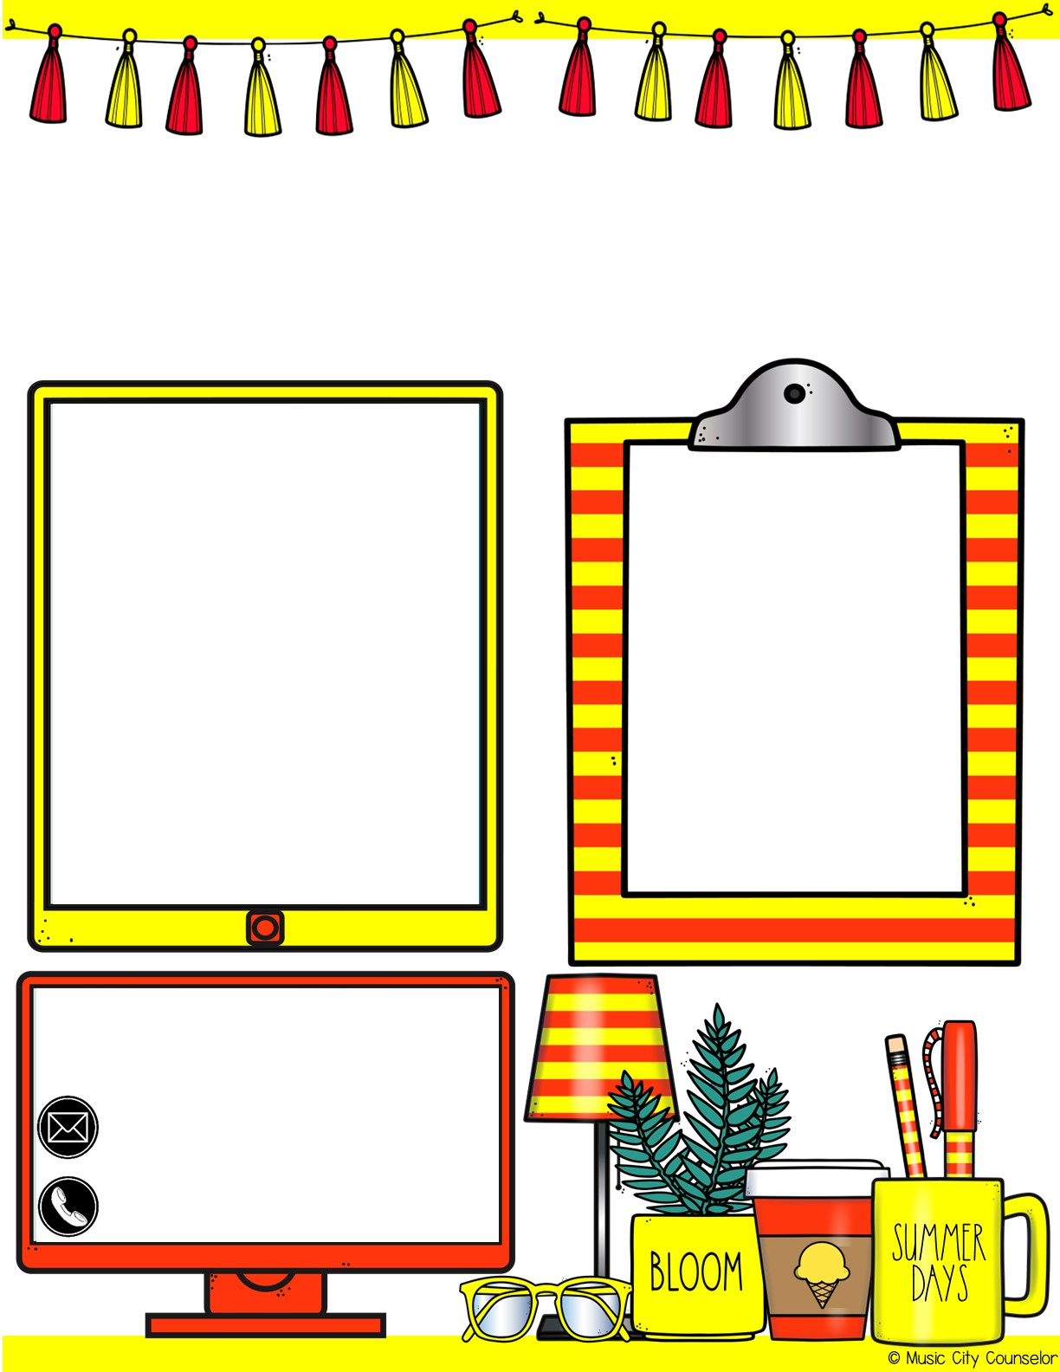
Counselor’s Corner
August 2023
Monthly focus:
Type here
happy kids tip:
Staying involved in your child’s schooling has a positive impact on their grades, social skills, and attendance! You can get involved by communicating regularly with their teacher, checking their folder each night, volunteering at school, attending school events, or joining our PTO!
Let’s connect!
Mrs. Laura Oathout
Type here
Type here

Slide 5

Counselor’s Corner
September 2023
Monthly focus:
Type here
happy kids tip:
Here are some after-school questions to spark conversation with your child:
What was the best part of your day?
What was the hardest part of your day?
Who did you play with at recess?
What made you laugh?
Let’s connect!
Mrs. Laura Oathout
Type here
Type here

Slide 6
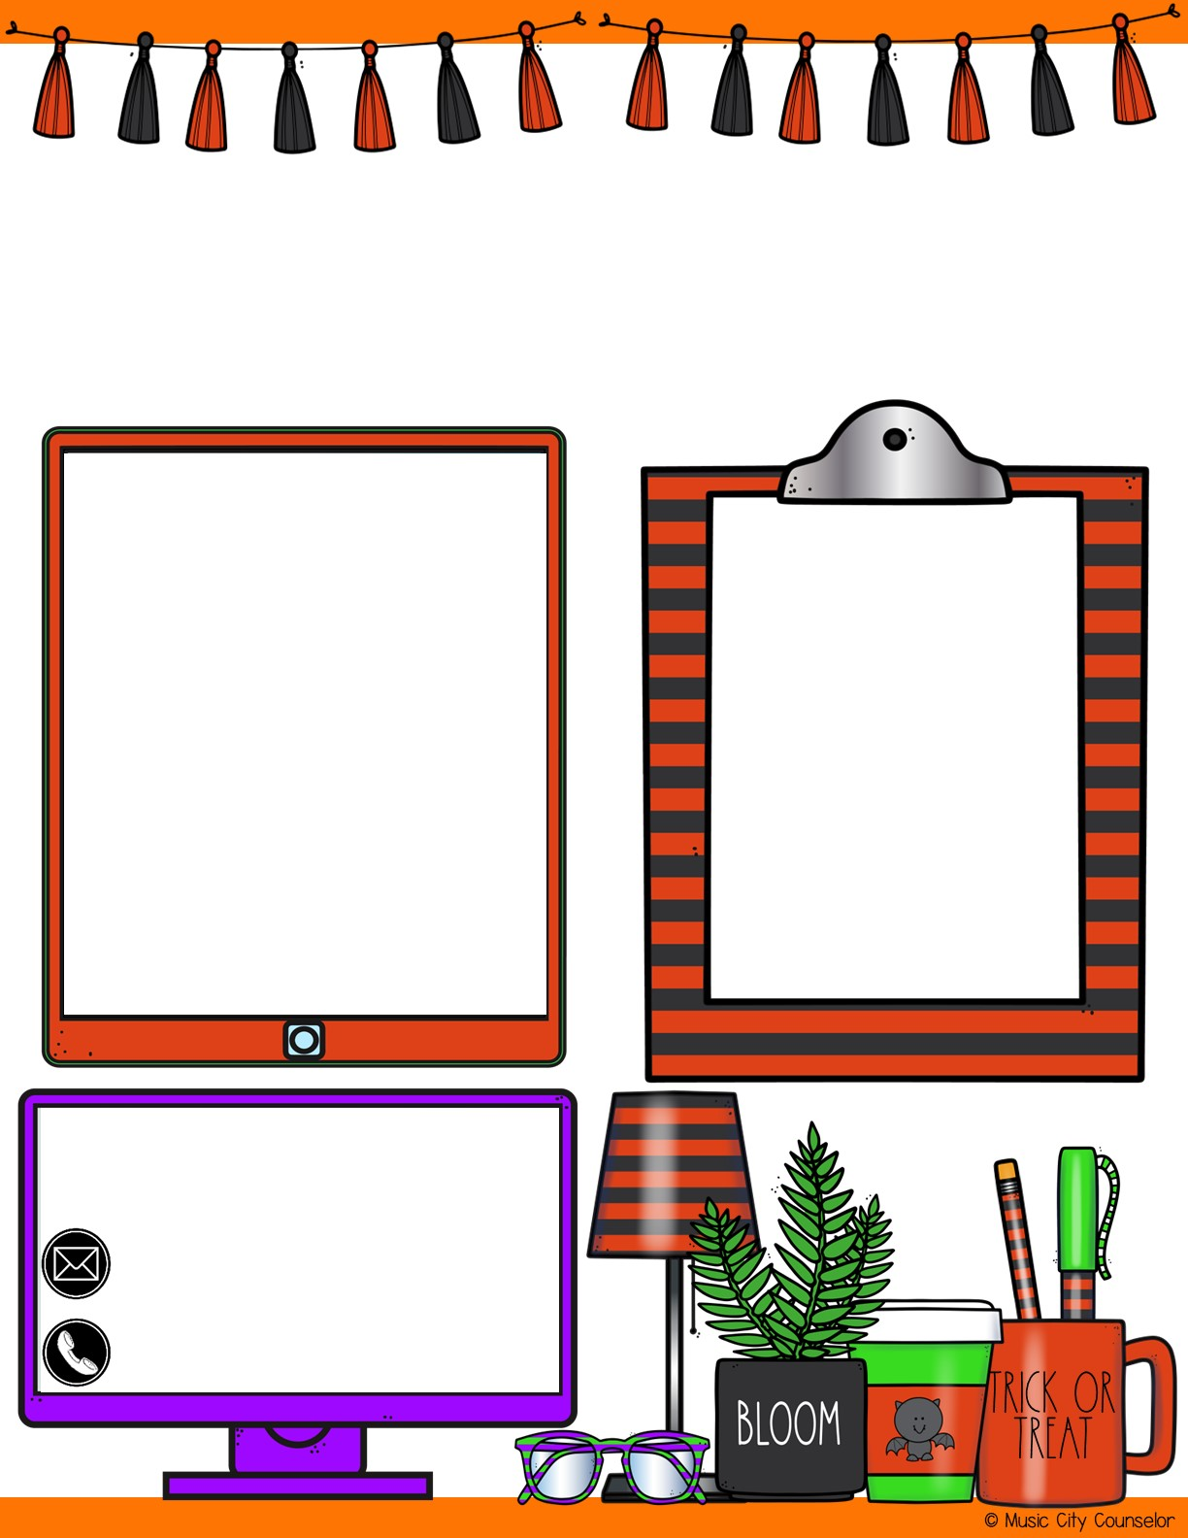
Counselor’s Corner
October 2023
Monthly focus:
Type here
happy kids tip:
Here are some Halloween Safety Tips:
Accompany children under 12
Wear glowsticks or bring flashlights
Hold hands when crossing the street
Avoid masks – they can lead to falls
Let’s connect!
Mrs. Laura Oathout
Type here
Type here

Slide 7
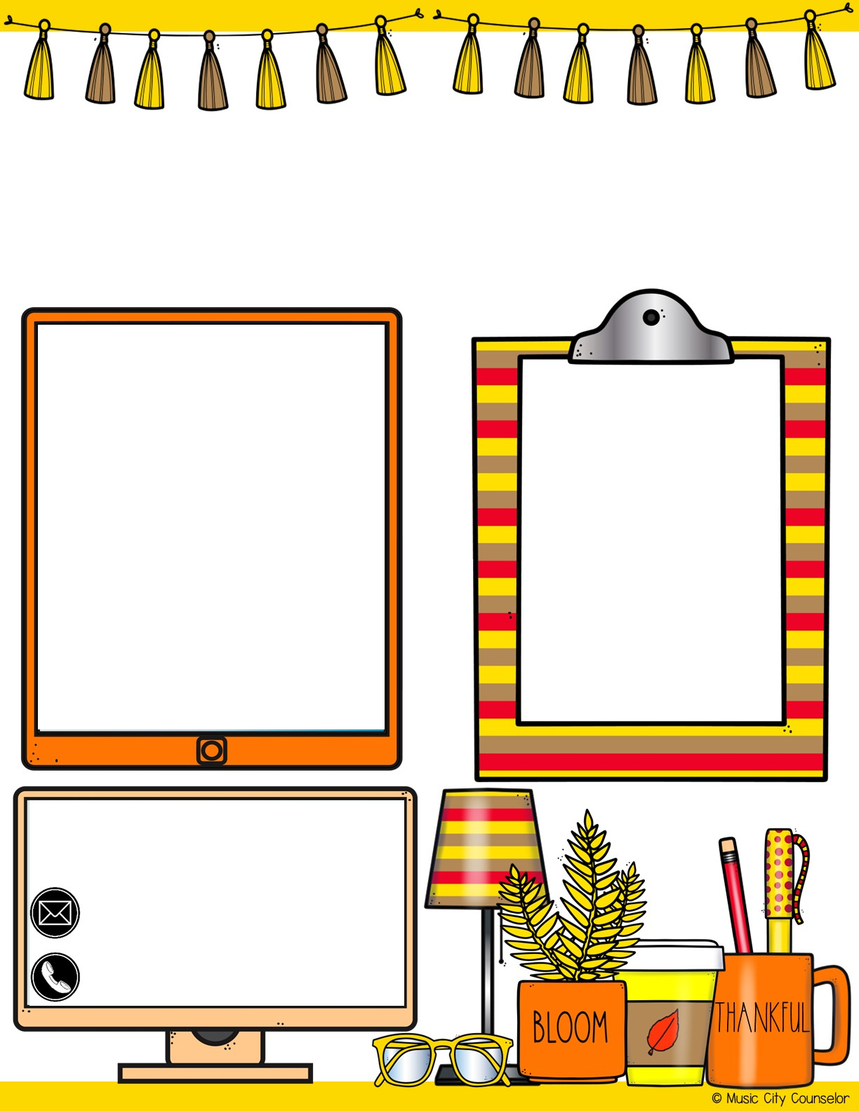
Counselor’s Corner
November 2023
Monthly focus:
Type here
happy kids tip:
Here are tips for teaching gratitude to your child:
Thank community helpers
Participate in a family or community service project
Read “Gratitude is my Superpower” by Alicia Ortego
Let’s connect!
Mrs. Laura Oathout
Type here
Type here

Slide 8
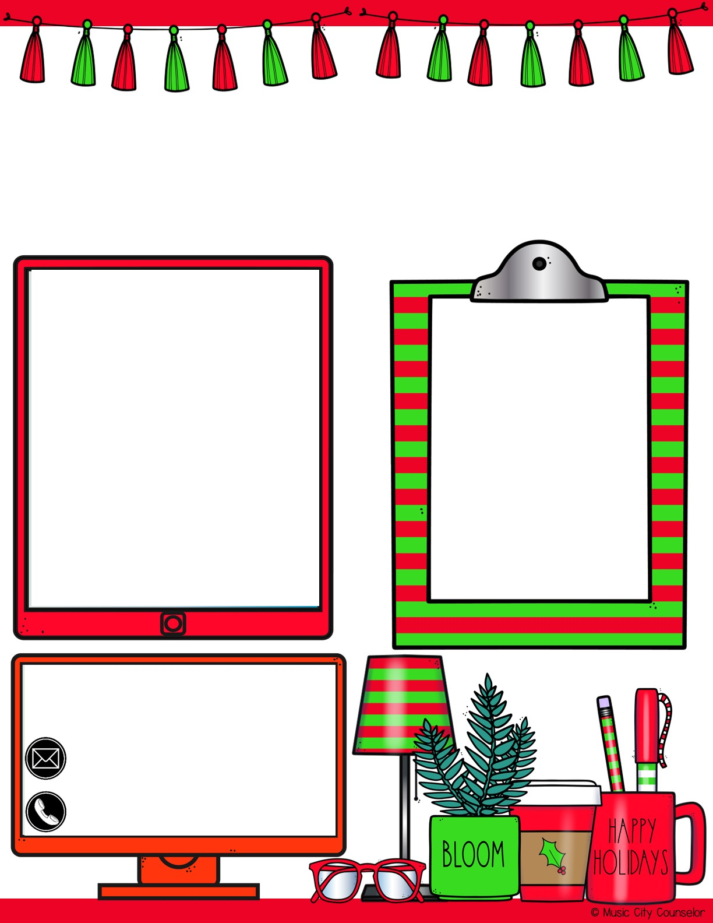
Counselor’s Corner
December 2023
Monthly focus:
Healthy kids tip:
Type here
Did you know that music lessons, especially when started before age 7, can change the structure of the brain for the better? Learning to play an instrument can improve long-term memory, reading, alertness, and hearing.
Let’s connect!
Mrs. Laura Oathout
Type here
Type here

Slide 9
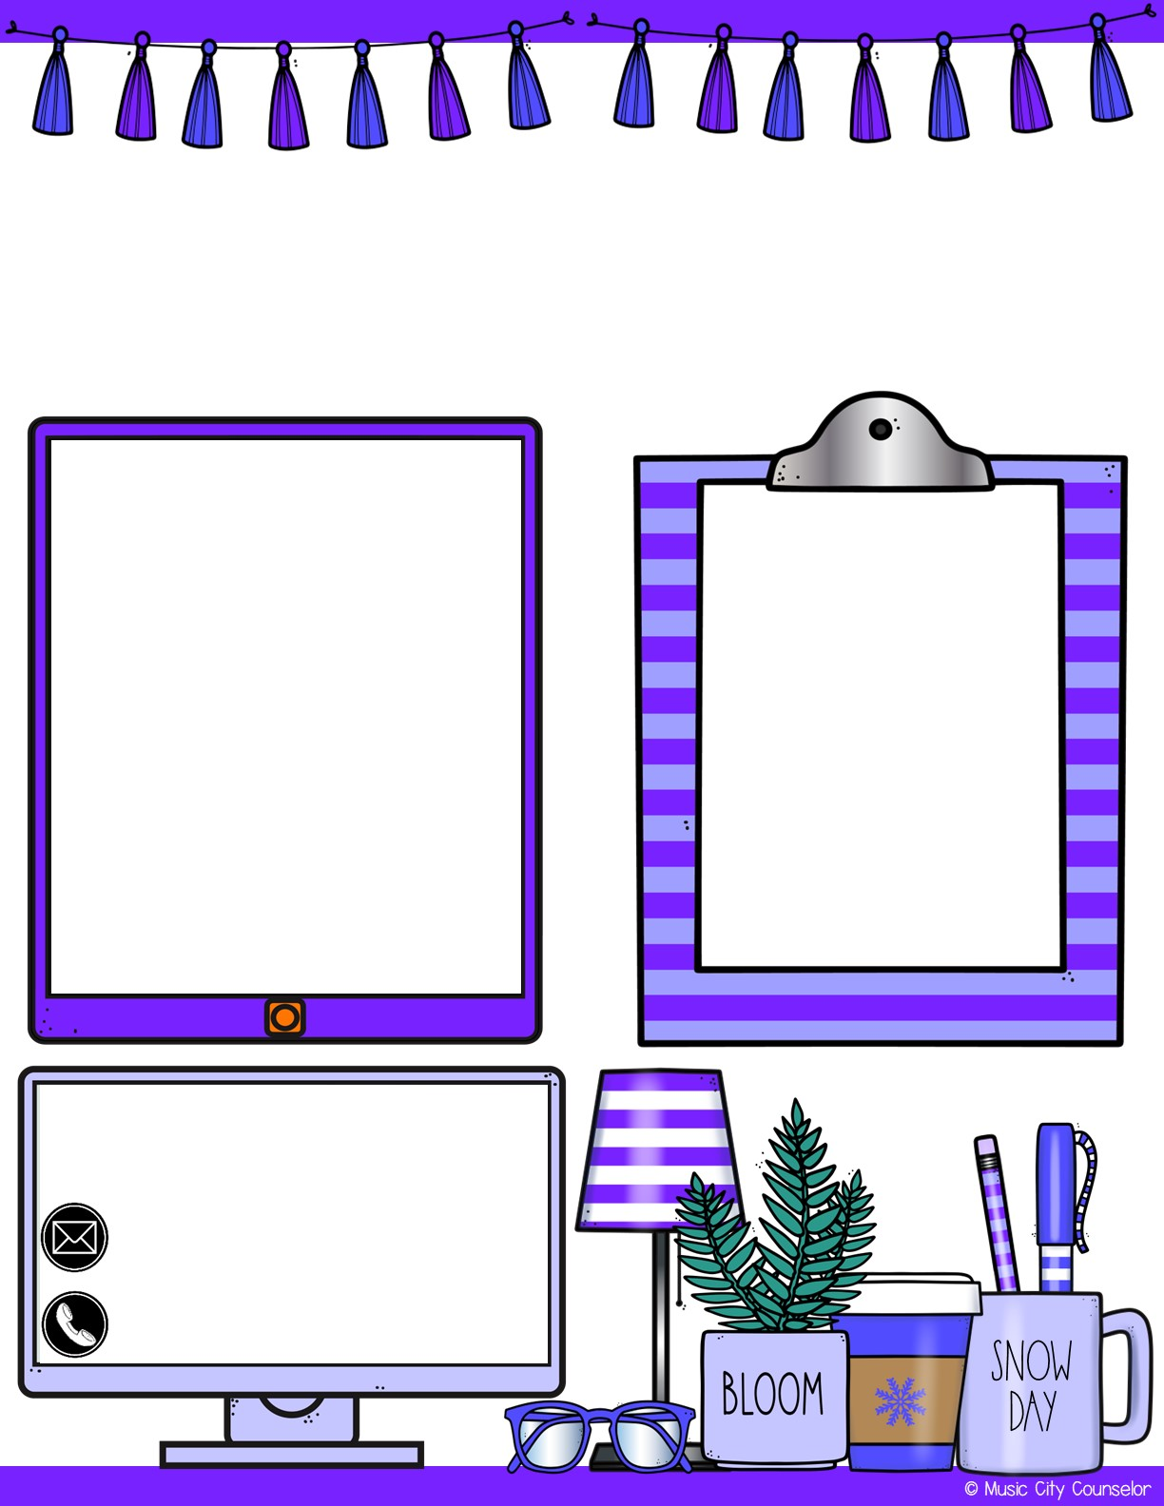
Counselor’s Corner
January 2024
Monthly focus:
Type here
Healthy kids tip:
The new year is the perfect time to set goals with your children! What do they hope to learn, do, accomplish, and improve this year? Write down your goals as a family, and take actionable steps towards them!
Let’s connect!
Mrs. Laura Oathout
Type here
Type here

Slide 10
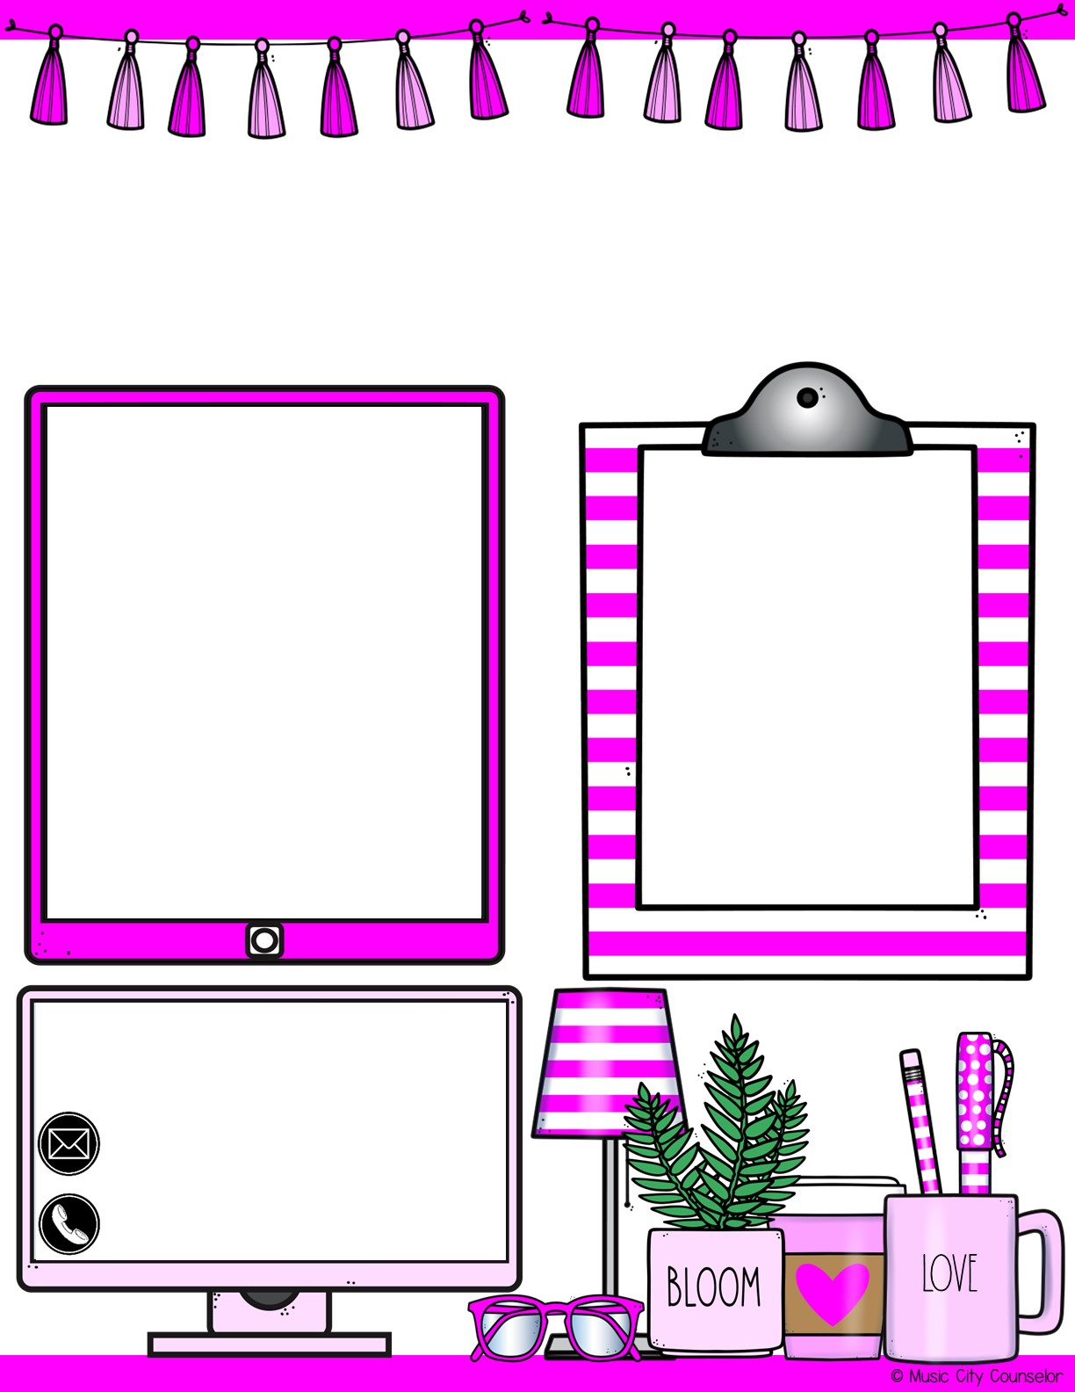
Counselor’s Corner
February 2024
Monthly focus:
Healthy kids tip:
Type here
Here’s a fun way to express love for your child this Valentine’s Day! Cut out a bunch of paper hearts. Each day this month, write 1 thing that you love about your child and tape it to their bedroom door. By the end of the month, their door will be full of love!
Let’s connect!
Mrs. Laura Oathout
Type here
Type here

Slide 11
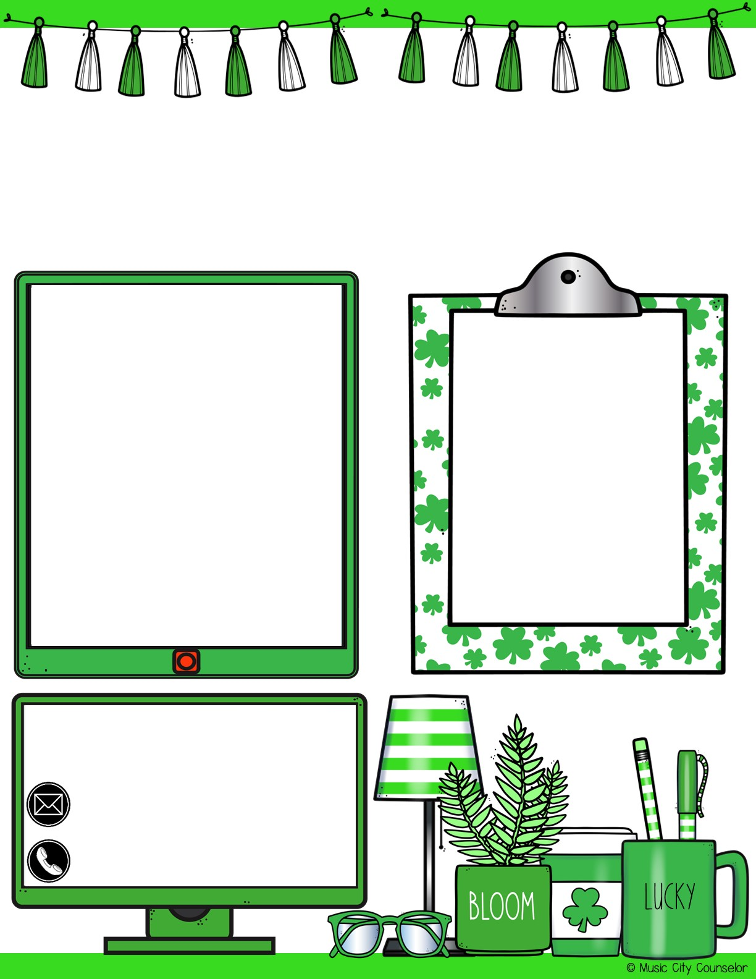
Counselor’s Corner
March 2024
Monthly focus:
Type here
Healthy kids tip:
Did you know that children whose caregivers read to them during their first five years of life have learned 1.4 million more words than a child who is not read to at home? Reading together is one of the absolute best things you can do for your child!
Let’s connect!
Mrs. Laura Oathout
Type here
Type here

Slide 12
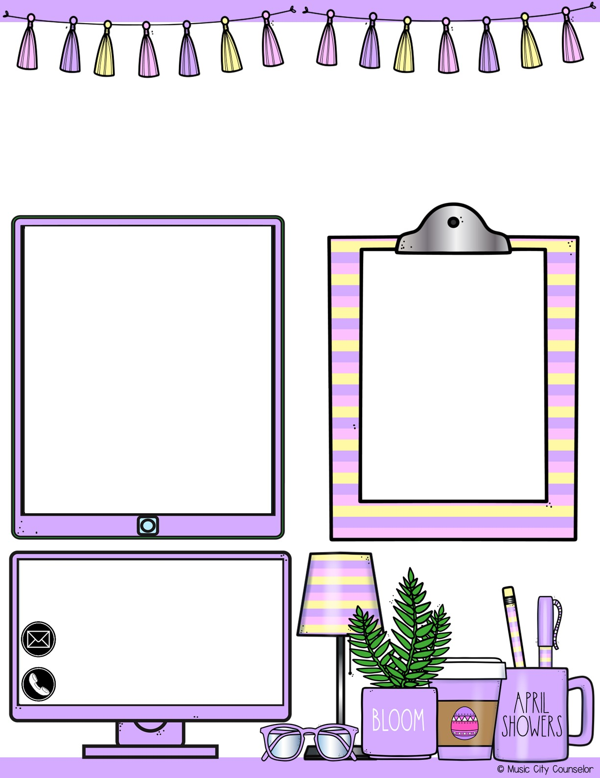
Counselor’s Corner
April 2024
Monthly focus:
Type here
Healthy kids tip:
Try to incorporate learning into everyday activities and chores! When cooking dinner, let your child help you measure ingredients. When doing laundry, let your child sort the clothes. When at the store, let your child count the money and pay the cashier. Learning these life skills early on really goes a long way!
Let’s connect!
Mrs. Laura Oathout
Type here
Type here

Slide 13
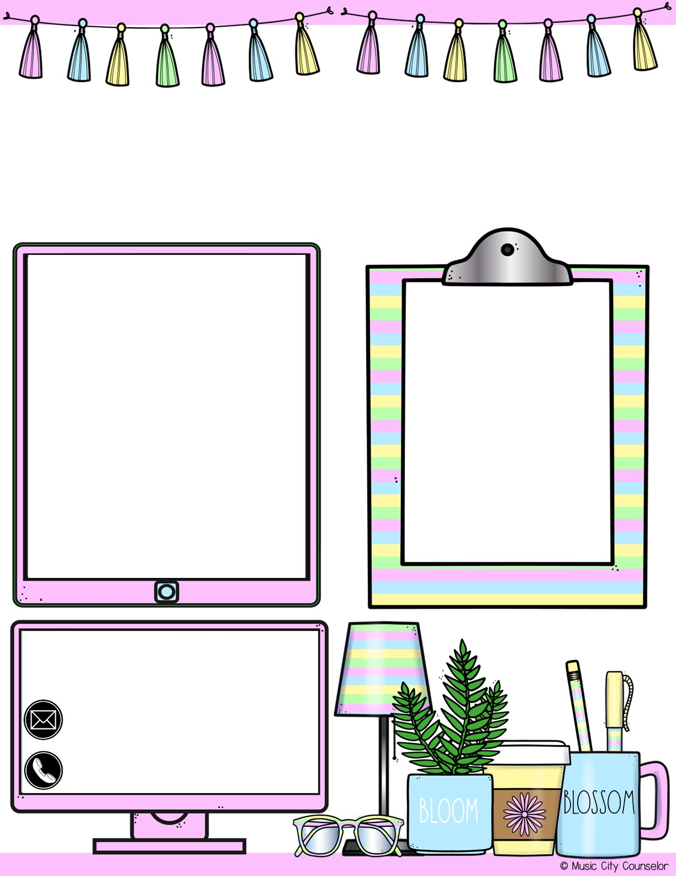
Counselor’s Corner
May 2024
Monthly focus:
Type here
Healthy kids tip:
Foster independence in your child by never doing anything for them that they can do themselves. When we let them pick out their clothes, choose the jacket they need for the day, pack their lunch, and complete their homework, we show them that they’re capable of doing so much on their own!
Let’s connect!
Mrs. Laura Oathout
Type here
Type here

Slide 14
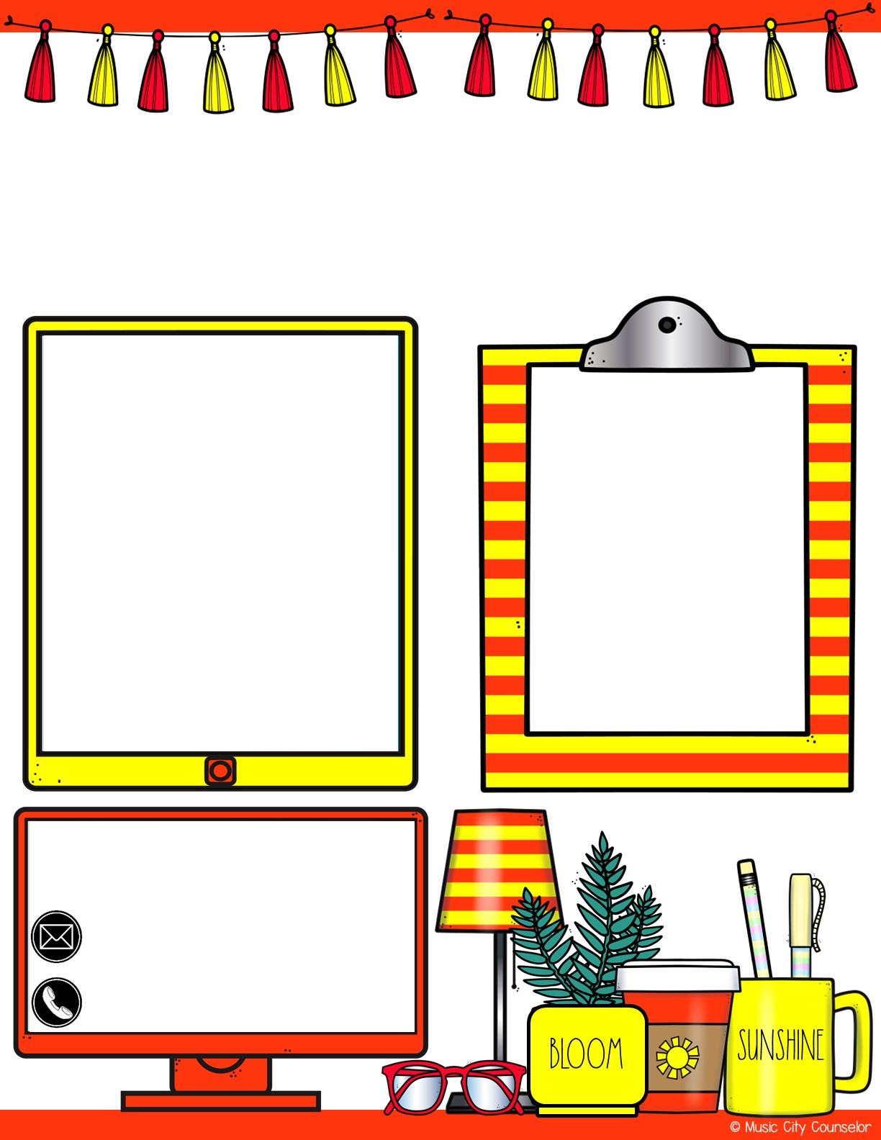
Counselor’s Corner
June 2024
Monthly focus:
Type here
Healthy kids tip:
Here are summer safety tips for your child:
Wear helmets when biking or scootering
Wear sunscreen – especially midday
Teach water safety and supervise swimmers
Stay hydrated
Let’s connect!
Mrs. Laura Oathout
Type here
Type here

Slide 15


Slide 16
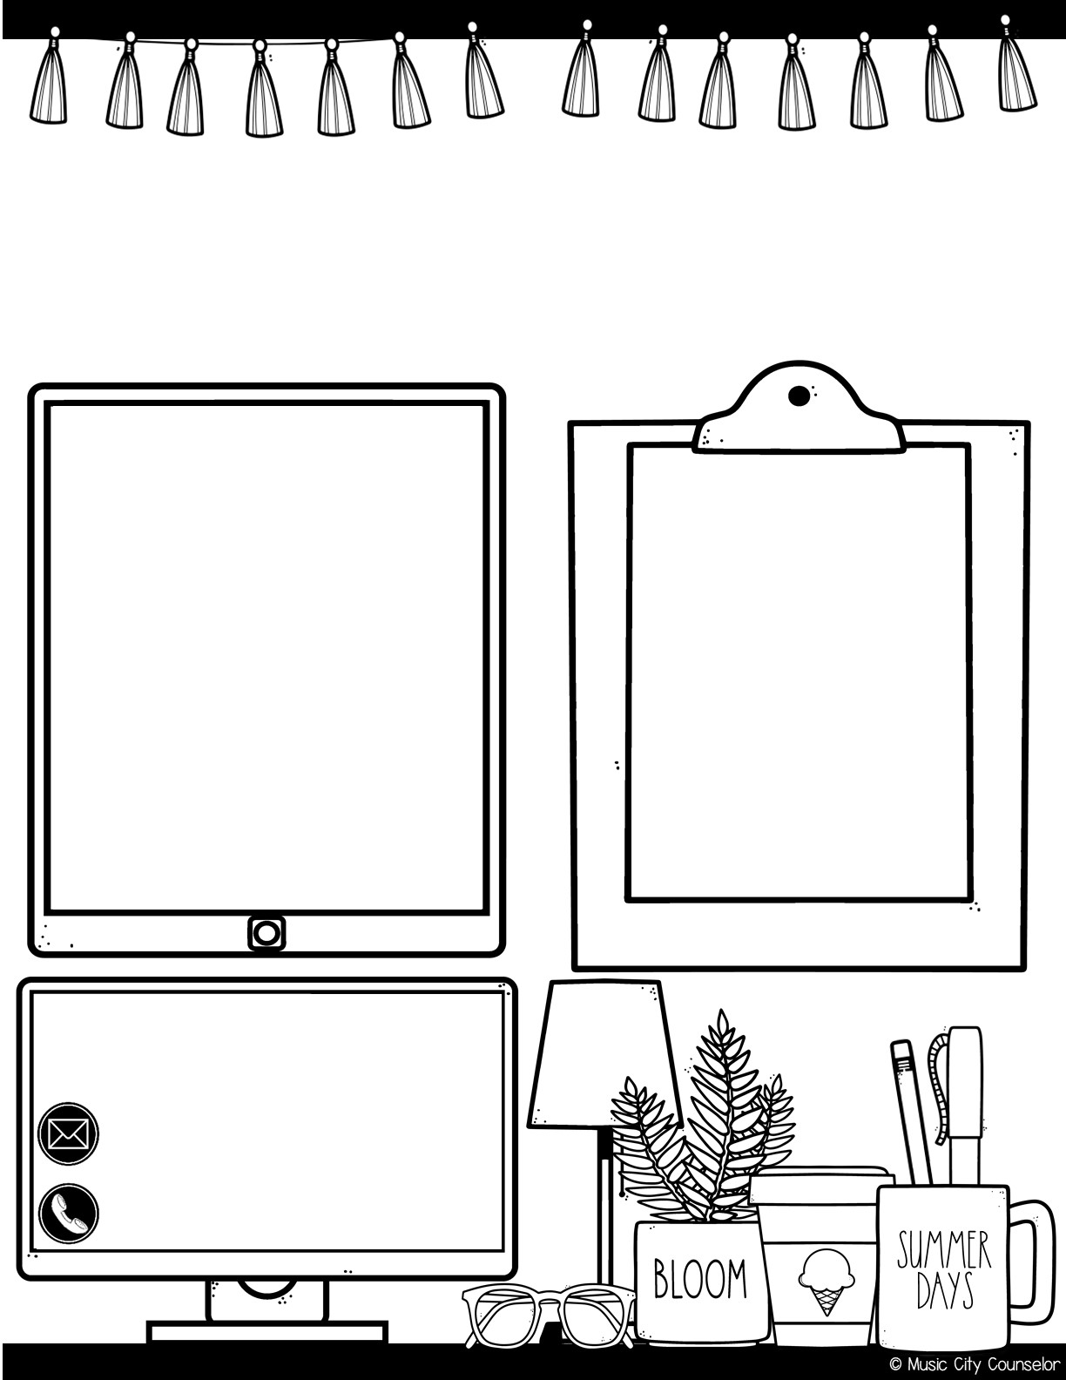
Counselor’s Corner
August 2023
Monthly focus:
happy kids tip:
Type here
Staying involved in your child’s schooling has a positive impact on their grades, social skills, and attendance! You can get involved by communicating regularly with their teacher, checking their folder each night, volunteering at school, attending school events, or joining our PTO!
Let’s connect!
Mrs. Laura Oathout
Type here
Type here

Slide 17
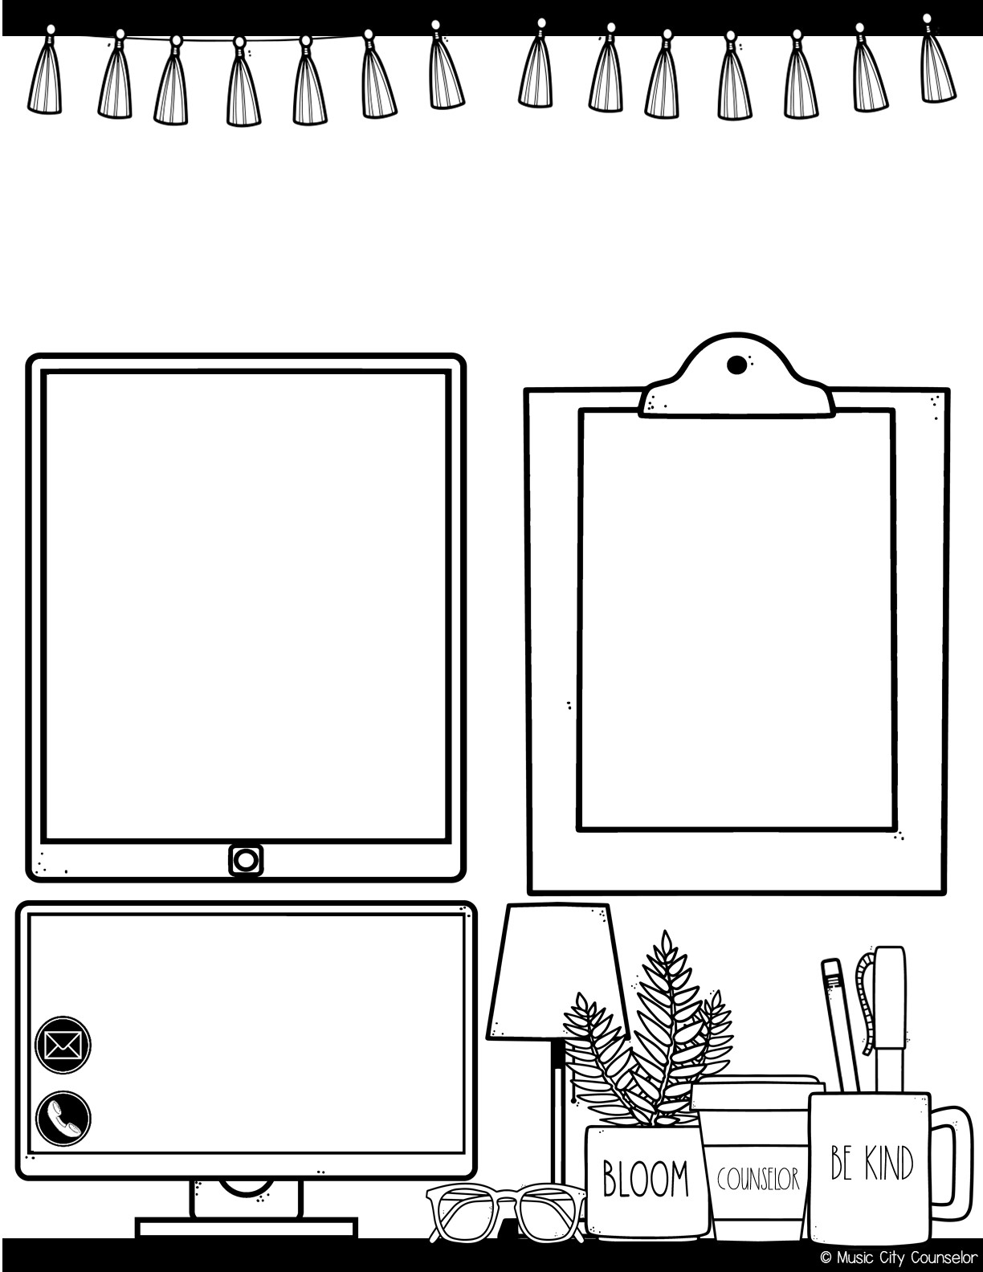
Counselor’s Corner
September 2023
Monthly focus:
Type here
happy kids tip:
Here are some after-school questions to spark conversation with your child:
What was the best part of your day?
What was the hardest part of your day?
Who did you play with at recess?
What made you laugh?
Let’s connect!
Mrs. Laura Oathout
Type here
Type here

Slide 18

Counselor’s Corner
October 2023
Monthly focus:
Type here
happy kids tip:
Here are some Halloween Safety Tips:
Accompany children under 12
Wear glowsticks or bring flashlights
Hold hands when crossing the street
Avoid masks – they can lead to falls
Let’s connect!
Mrs. Laura Oathout
Type here
Type here

Slide 19

Counselor’s Corner
November 2023
Monthly focus:
Type here
happy kids tip:
Here are tips for teaching gratitude to your child:
Thank community helpers
Participate in a family or community service project
Read “Gratitude is my Superpower” by Alicia Ortego
Let’s connect!
Mrs. Laura Oathout
Type here
Type here

Slide 20
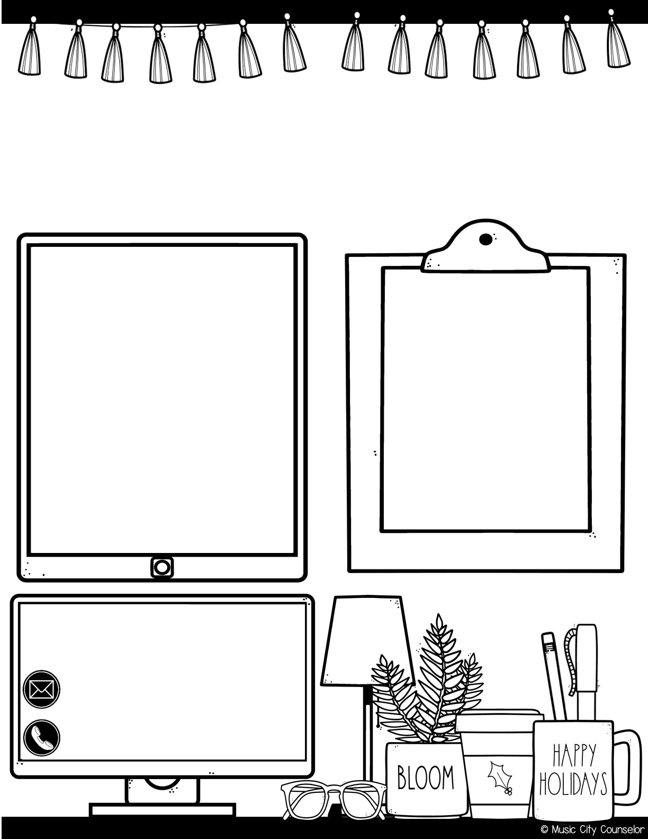
Counselor’s Corner
December 2023
Monthly focus:
happy kids tip:
Type here
Did you know that music lessons, especially when started before age 7, can change the structure of the brain for the better? Learning to play an instrument can improve long-term memory, reading, alertness, and hearing.
Let’s connect!
Mrs. Laura Oathout
Type here
Type here

Slide 21
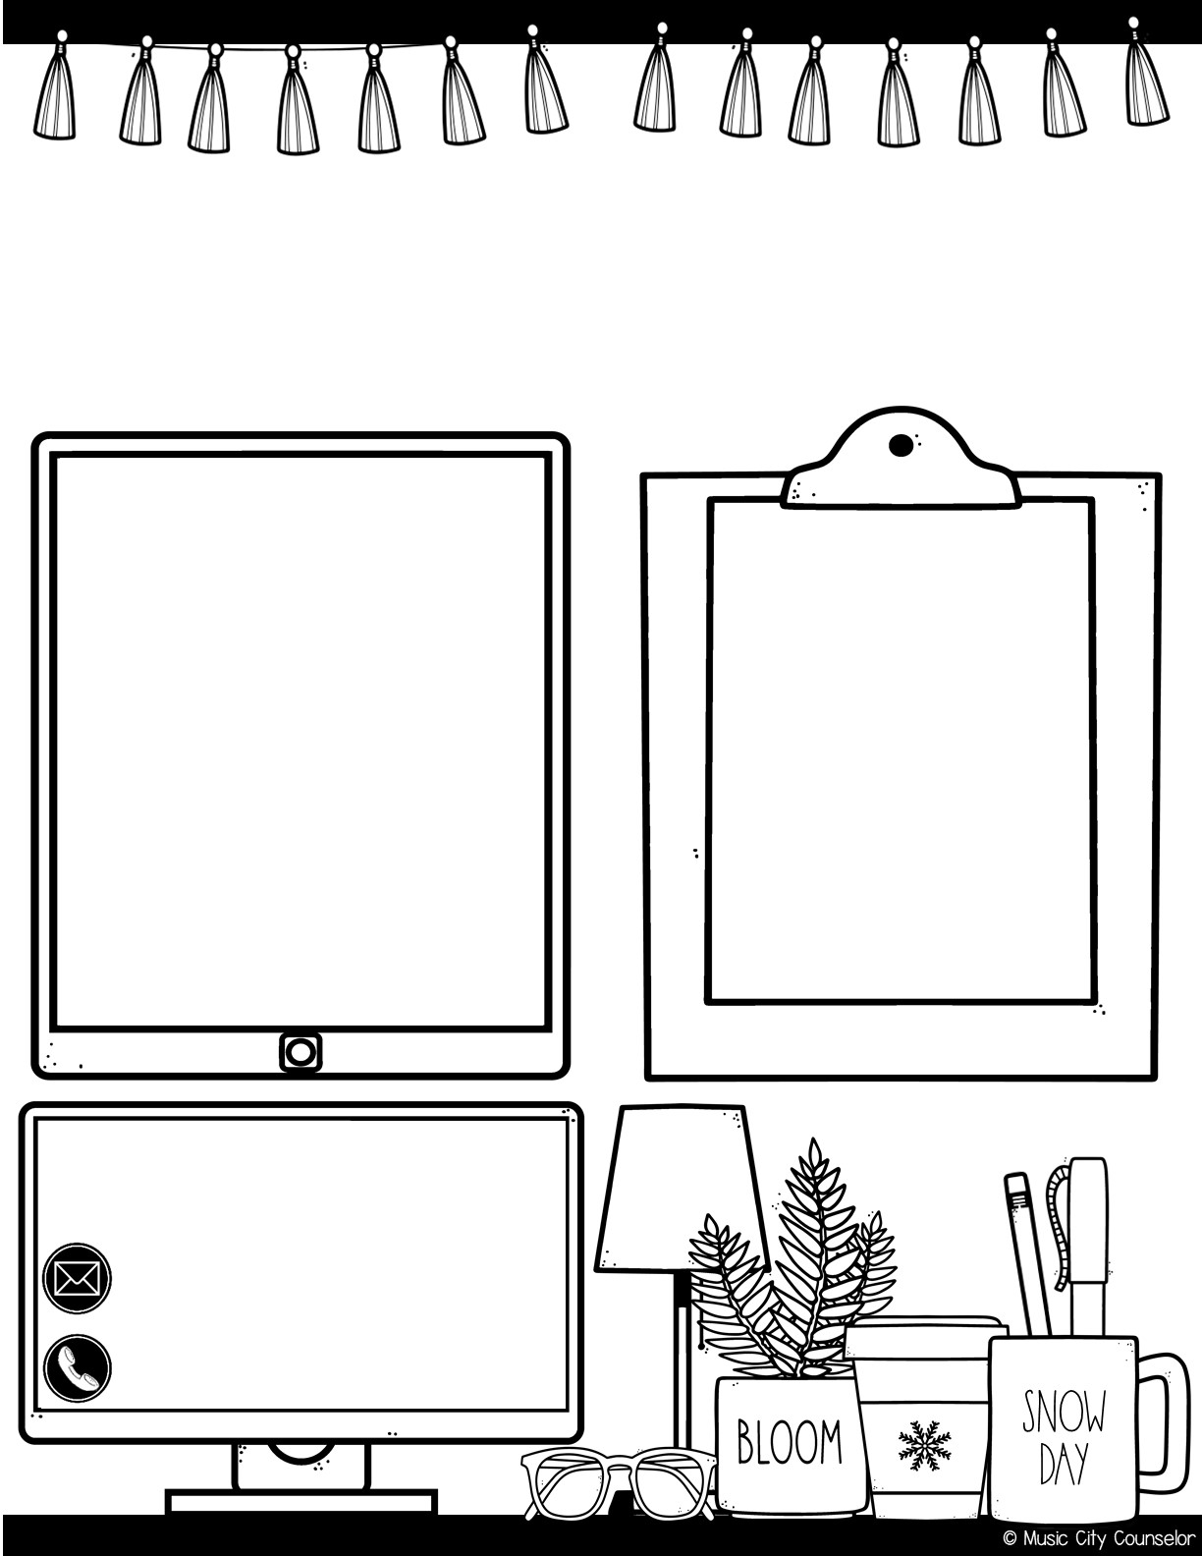
Counselor’s Corner
January 2024
Monthly focus:
Type here
Healthy kids tip:
The new year is the perfect time to set goals with your children! What do they hope to learn, do, accomplish, and improve this year? Write down your goals as a family, and take actionable steps towards them!
Let’s connect!
Mrs. Laura Oathout
Type here
Type here

Slide 22

Counselor’s Corner
February 2024
Monthly focus:
Type here
Healthy kids tip:
Here’s a fun way to express love for your child this Valentine’s Day! Cut out a bunch of paper hearts. Each day this month, write 1 thing that you love about your child and tape it to their bedroom door. By the end of the month, their door will be full of love!
Let’s connect!
Mrs. Laura Oathout
Type here
Type here

Slide 23

Counselor’s Corner
March 2024
Monthly focus:
Type here
happy kids tip:
Did you know that children whose caregivers read to them during their first five years of life have learned 1.4 million more words than a child who is not read to at home? Reading together is one of the absolute best things you can do for your child!
Let’s connect!
Mrs. Laura Oathout
Type here
Type here

Slide 24
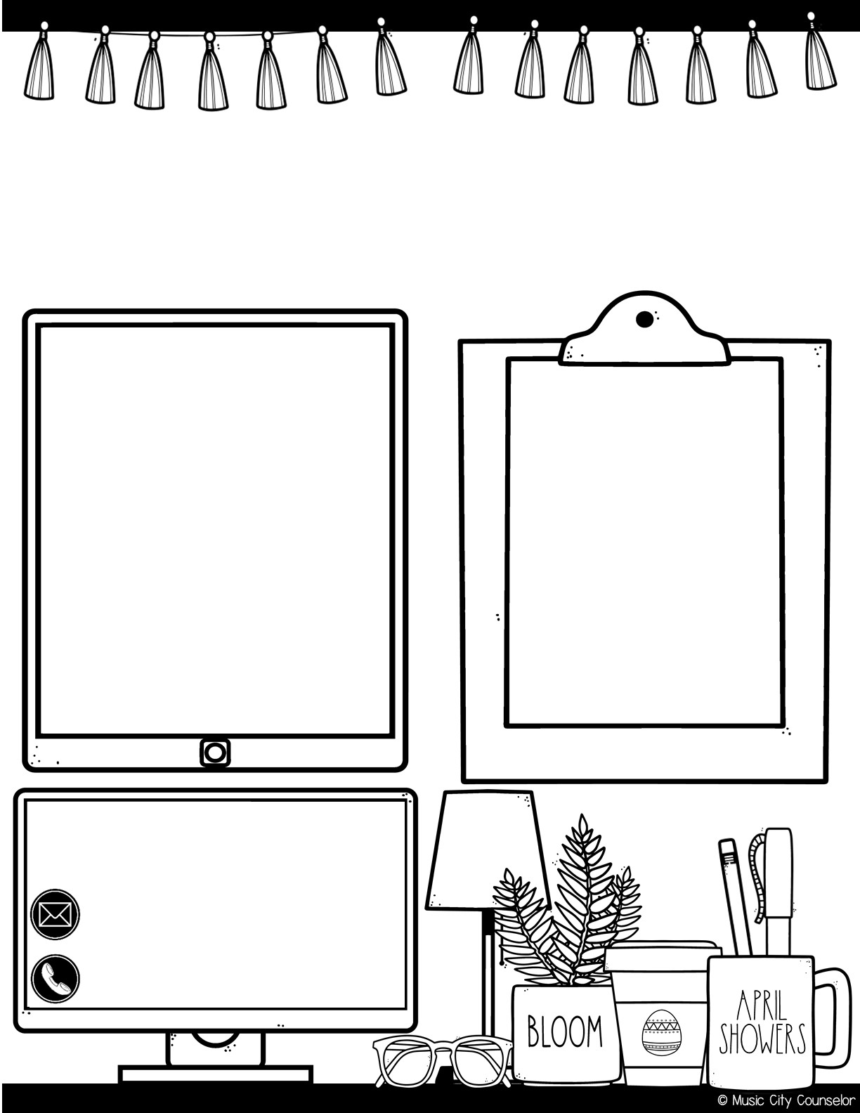
Counselor’s Corner
April 2024
Monthly focus:
Type here
happy kids tip:
Try to incorporate learning into everyday activities and chores! When cooking dinner, let your child help you measure ingredients. When doing laundry, let your child sort the clothes. When at the store, let your child count the money and pay the cashier. Learning these life skills early on really goes a long way!
Let’s connect!
Mrs. Laura Oathout
Type here
Type here

Slide 25
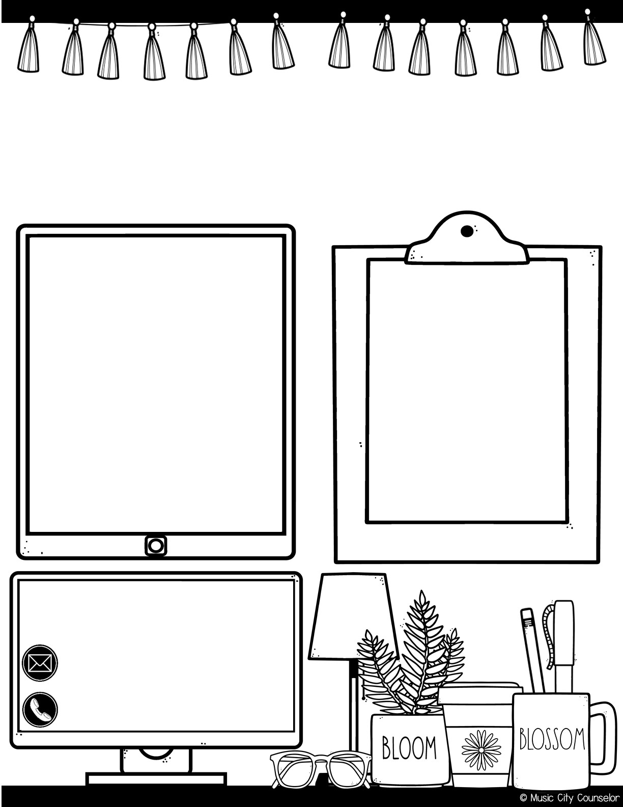
Counselor’s Corner
May 2024
Monthly focus:
Type here
happy kids tip:
Foster independence in your child by never doing anything for them that they can do themselves. When we let them pick out their clothes, choose the jacket they need for the day, pack their lunch, and complete their homework, we show them that they’re capable of doing so much on their own!
Let’s connect!
Mrs. Laura Oathout
Type here
Type here

Slide 26

Counselor’s Corner
June 2024
Monthly focus:
Type here
happy kids tip:
Here are summer safety tips for your child:
Wear helmets when biking or scootering
Wear sunscreen – especially midday
Teach water safety and supervise swimmers
Stay hydrated
Let’s connect!
Mrs. Laura Oathout
Type here
Type here

Slide 27
