Slide 1







Slide 2

DIRECTIONS:

Slide 3

FULL COLOR MONTHLY NEWSLETTERS

Slide 4

Counselor’s Corner
AUGUST 2022
Mrs. Laura Oathout
Dates:
Counseling
Monthly Focus:
Type here
Type here
Let’s CONNECT!
laura.oathout@wcs.edu
615-934-2454, ext. 201
Happy, Healthy Kids TIP:
Prepare children to transition back to school by having frequent, open conversations about it – long before the first day! Answer their questions, set expectations, and get excited together!

Slide 5

Counselor’s Corner
SEPTEMBER 2022
Mrs. Laura Oathout
Dates:
Counseling
Monthly Focus:
Type here
Type here
Let’s CONNECT!
laura.oathout@wcs.edu
615-934-2454, ext. 201
Happy, Healthy Kids TIP:
To ease students’ back to school worries, offer them a sense of control. Let them choose their first day of school outfit, add their favorite treat to their lunch, or pick out special school supplies.

Slide 6

Counselor’s Corner
OCTOBER 2022
Mrs. Laura Oathout
Dates:
Counseling
Monthly Focus:
Type here
Type here
Let’s CONNECT!
laura.oathout@wcs.edu
615-934-2454, ext. 201
Happy, Healthy Kids TIP:
When your child is experiencing BIG, upset feelings, their brain cannot listen or learn in that moment. Rather than negotiating with or punishing them, help the child name their feelings. Then, practice a coping skill.

Slide 7
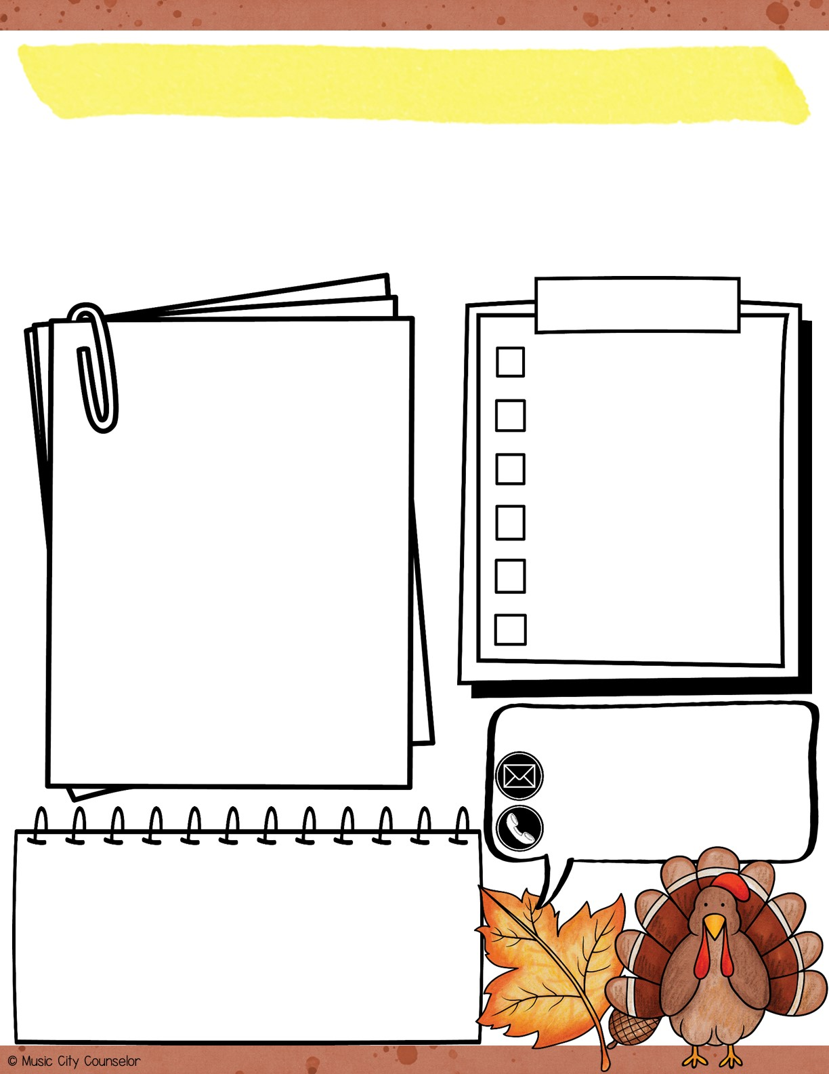
Counselor’s Corner
NOVEMBER 2022
Mrs. Laura Oathout
Dates:
Counseling
Monthly Focus:
Type here
Type here
Let’s CONNECT!
laura.oathout@wcs.edu
615-934-2454, ext. 201
Happy, Healthy Kids TIP:
One of the best things a parent can do for their child is to read to them for 20 minutes each day. Reading together grows your bond, sparks their imagination, expands their vocabulary, improves their emotional intelligence, and more!

Slide 8
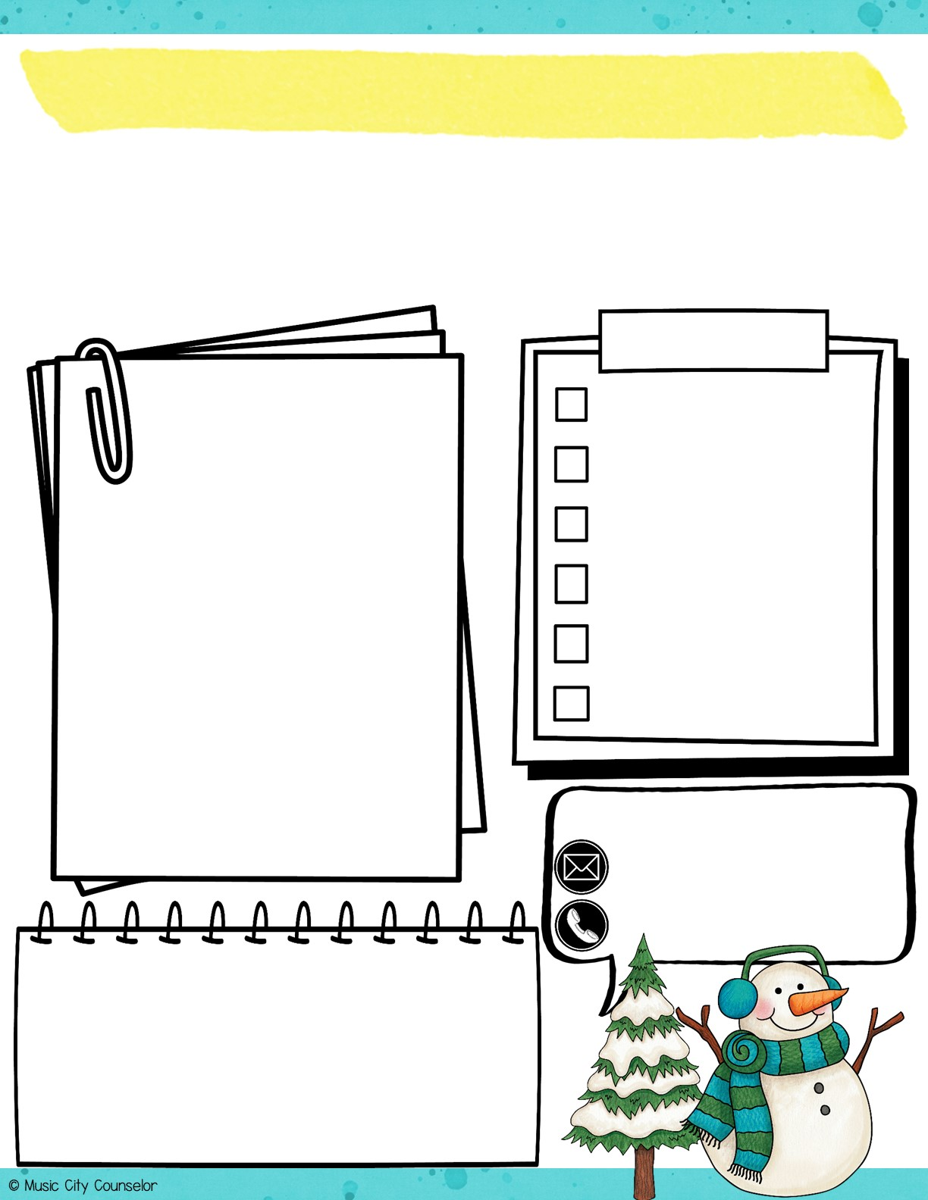
Counselor’s Corner
DECEMBER 2022
Mrs. Laura Oathout
Dates:
Counseling
Monthly Focus:
Type here
Type here
Let’s CONNECT!
laura.oathout@wcs.edu
615-934-2454, ext. 201
Happy, Healthy Kids TIP:
Children thrive on consistency, structure, and predictability. Develop a morning routine that looks the same each day to help get you and your kids out the door with a smile!

Slide 9

Counselor’s Corner
JANUARY 2023
Mrs. Laura Oathout
Dates:
Counseling
Monthly Focus:
Type here
Type here
Let’s CONNECT!
laura.oathout@wcs.edu
615-934-2454, ext. 201
Happy, Healthy Kids TIP:
Research suggests that 20 minutes of uninterrupted, quality time with your child is more valuable than hours spent together multi-tasking. This short burst of focused time together builds your connection and makes your child feel valued, important, and loved.

Slide 10

Counselor’s Corner
FEBRUARY 2023
Mrs. Laura Oathout
Dates:
Counseling
Monthly Focus:
Type here
Type here
Let’s CONNECT!
laura.oathout@wcs.edu
615-934-2454, ext. 201
Happy, Healthy Kids TIP:
Teaching your child body safety rules is a critical preventative measure against child abuse. Teach them the difference between safe and unsafe touch, safe and unsafe secrets, and who are safe people they can go to for help and support.

Slide 11
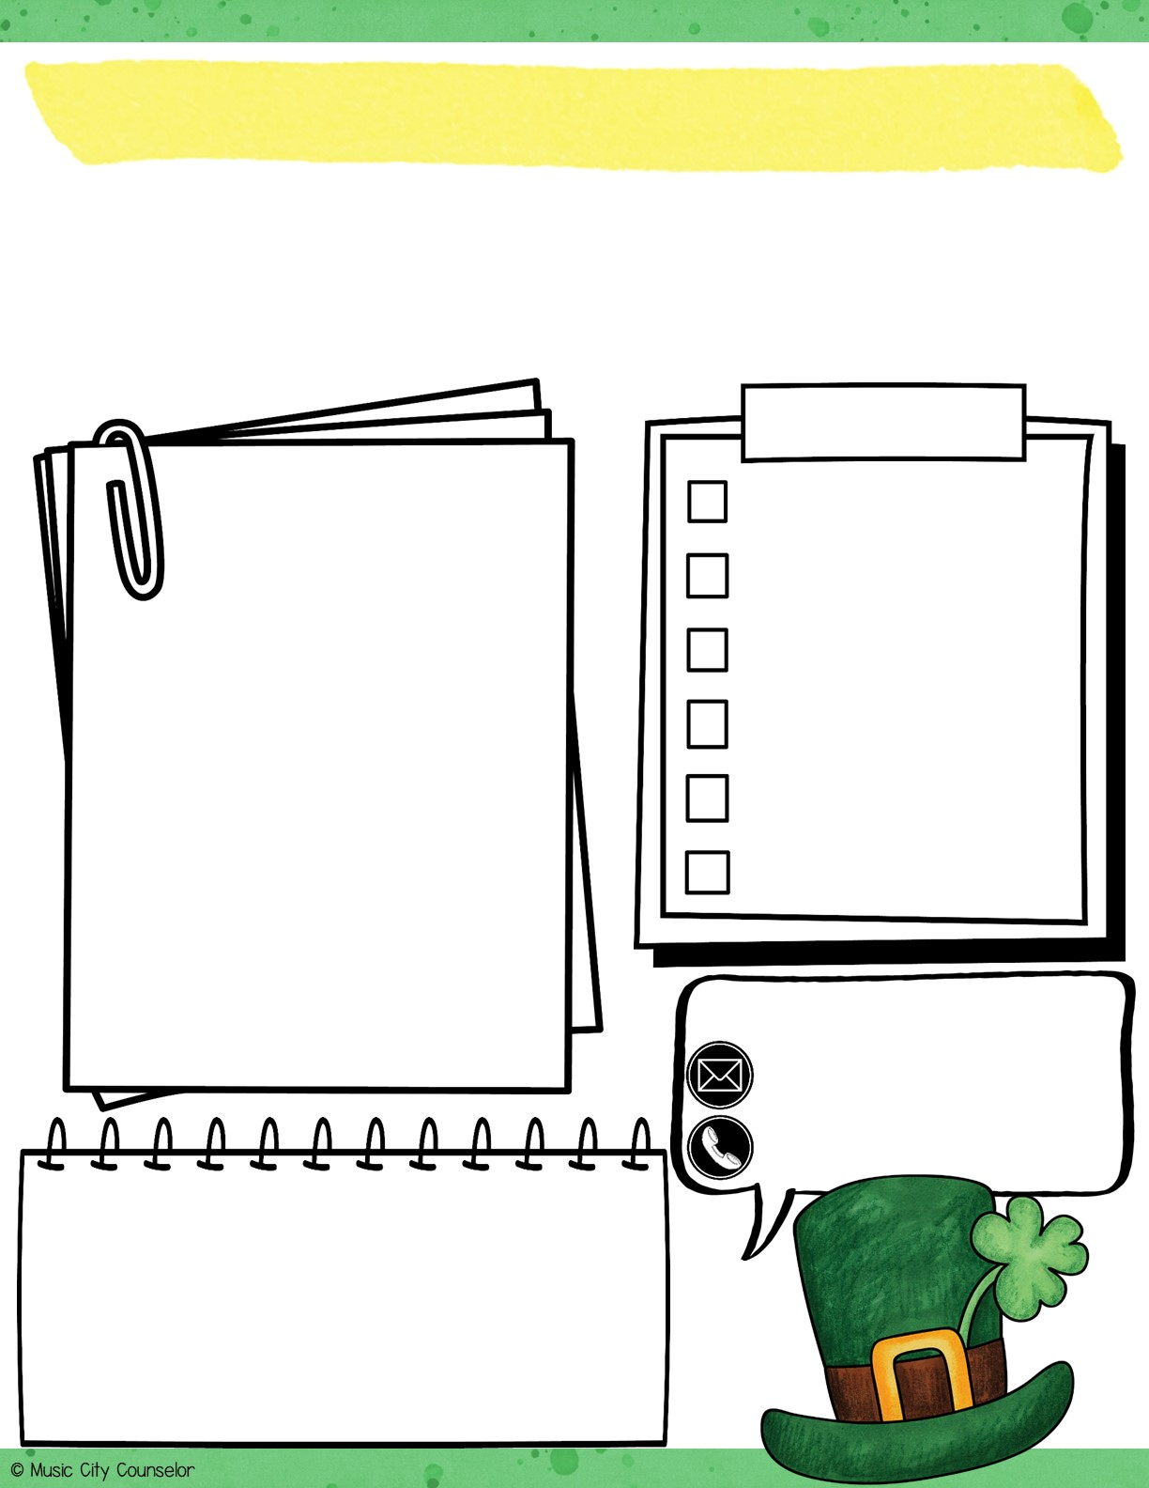
Counselor’s Corner
MARCH 2023
Mrs. Laura Oathout
Dates:
Counseling
Monthly Focus:
Type here
Type here
Let’s CONNECT!
laura.oathout@wcs.edu
615-934-2454, ext. 201
Happy, Healthy Kids TIP:
Siblings fighting again? Stay calm and take control of the situation. Let each child share their concern without being interrupted. Create a solution or compromise together that makes each child feel seen and heard.

Slide 12

Counselor’s Corner
APRIL 2023
Mrs. Laura Oathout
Dates:
Counseling
Monthly Focus:
Type here
Type here
Let’s CONNECT!
laura.oathout@wcs.edu
615-934-2454, ext. 201
Happy, Healthy Kids TIP:
Rather than asking your child, “How was your day?” and them replying again with, “good.” Try asking, “What was the best part of your day?” “What did you learn?” “Who did you play with?” “Who did you sit with at lunch?”

Slide 13

Counselor’s Corner
MAY 2023
Mrs. Laura Oathout
Dates:
Counseling
Monthly Focus:
Type here
Type here
Let’s CONNECT!
laura.oathout@wcs.edu
615-934-2454, ext. 201
Happy, Healthy Kids TIP:
When your child makes a good choice, no matter how small, make a BIG deal out of it! Cheer for them, encourage them, and reinforce this behavior. When your child makes a mistake, guide them towards a better choice. But, try not to dwell on it and move forward together.

Slide 14

Counselor’s Corner
JUNE 2023
Mrs. Laura Oathout
Dates:
Counseling
Monthly Focus:
Type here
Type here
Let’s CONNECT!
laura.oathout@wcs.edu
615-934-2454, ext. 201
Happy, Healthy Kids TIP:
To prevent the “summer slide” and keep students learning this summer, enroll them in a summer reading program at your local library! They can work towards a summer reading goal and earn prizes as they go!

Slide 15
BLACK & WHITE MONTHLY NEWSLETTERS

Slide 16

Counselor’s Corner
AUGUST 2022
Mrs. Laura Oathout
Dates:
Counseling
Monthly Focus:
Type here
Type here
Let’s CONNECT!
laura.oathout@wcs.edu
615-934-2454, ext. 201
Happy, Healthy Kids TIP:
Prepare children to transition back to school by having frequent, open conversations about it – long before the first day! Answer their questions, set expectations, and get excited together!

Slide 17
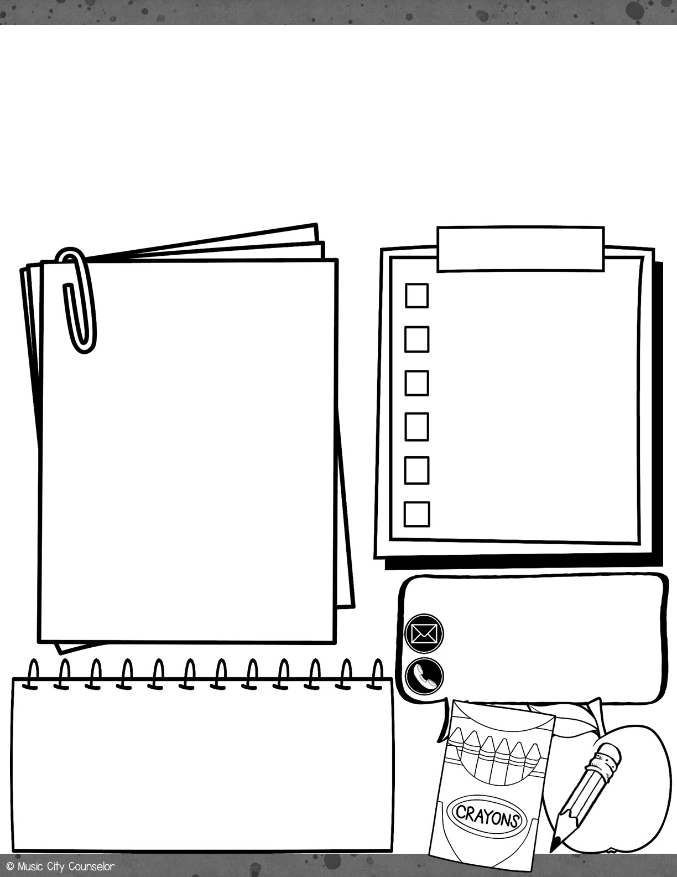
Counselor’s Corner
SEPTEMBER 2022
Mrs. Laura Oathout
Dates:
Counseling
Monthly Focus:
Type here
Type here
Let’s CONNECT!
laura.oathout@wcs.edu
615-934-2454, ext. 201
Happy, Healthy Kids TIP:
To ease students’ back to school worries, offer them a sense of control. Let them choose their first day of school outfit, add their favorite treat to their lunch, or pick out special school supplies.

Slide 18

Counselor’s Corner
OCTOBER 2022
Mrs. Laura Oathout
Dates:
Counseling
Monthly Focus:
Type here
Type here
Let’s CONNECT!
laura.oathout@wcs.edu
615-934-2454, ext. 201
Happy, Healthy Kids TIP:
When your child is experiencing BIG, upset feelings, their brain cannot listen or learn in that moment. Rather than negotiating with or punishing them, help the child name their feelings. Then, practice a coping skill.

Slide 19
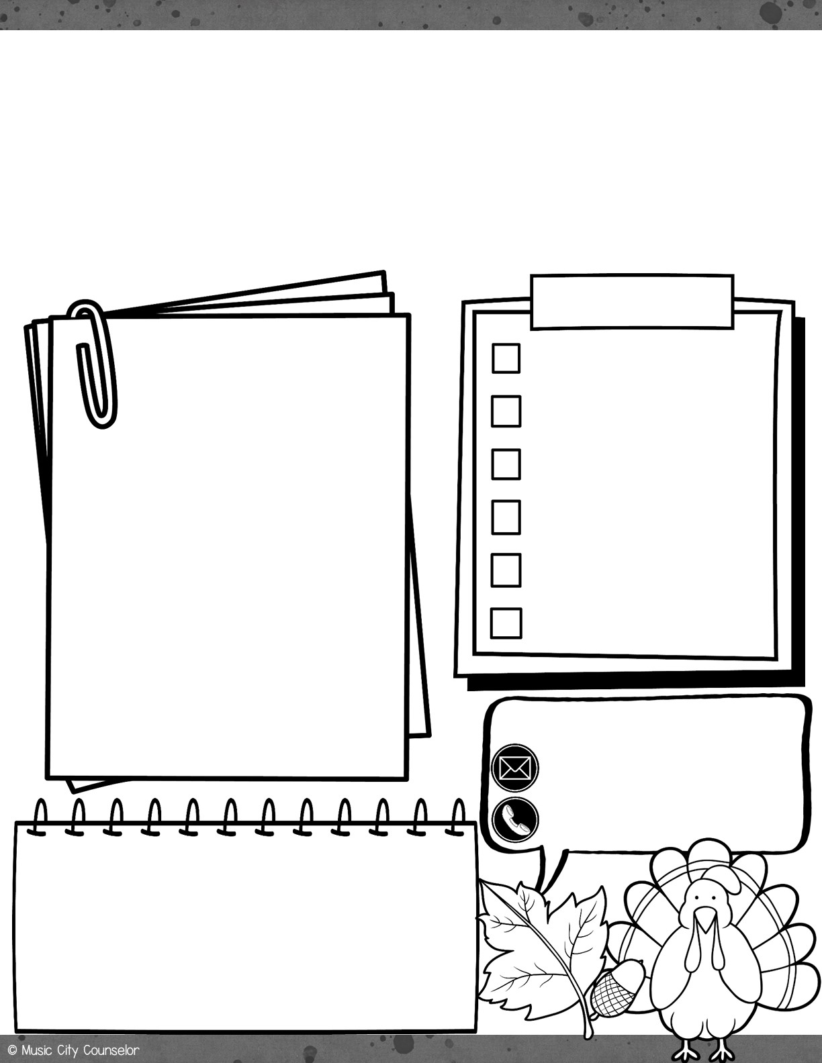
Counselor’s Corner
NOVEMBER 2022
Mrs. Laura Oathout
Dates:
Counseling
Monthly Focus:
Type here
Type here
Let’s CONNECT!
laura.oathout@wcs.edu
615-934-2454, ext. 201
Happy, Healthy Kids TIP:
One of the best things a parent can do for their child is to read to them for 20 minutes each day. Reading together grows your bond, sparks their imagination, expands their vocabulary, improves their emotional intelligence, and more!

Slide 20
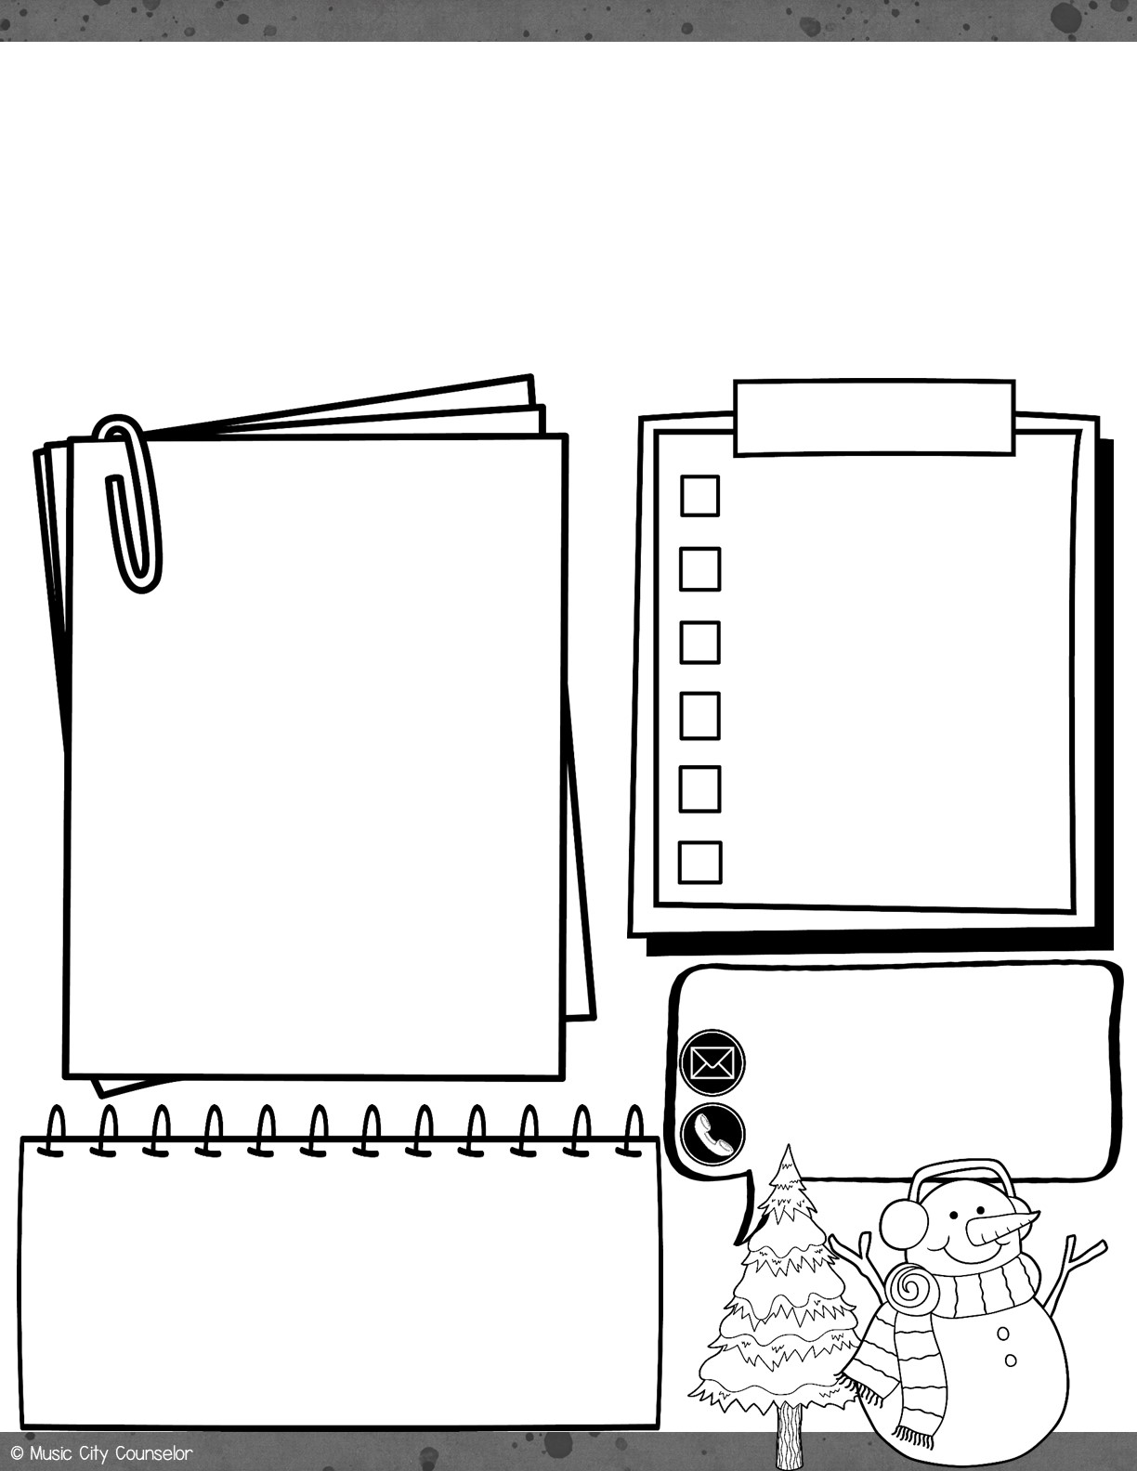
Counselor’s Corner
DECEMBER 2022
Mrs. Laura Oathout
Dates:
Counseling
Monthly Focus:
Type here
Type here
Let’s CONNECT!
laura.oathout@wcs.edu
615-934-2454, ext. 201
Happy, Healthy Kids TIP:
Children thrive on consistency, structure, and predictability. Develop a morning routine that looks the same each day to help get you and your kids out the door with a smile!

Slide 21

Counselor’s Corner
JANUARY 2023
Mrs. Laura Oathout
Dates:
Counseling
Monthly Focus:
Type here
Type here
Let’s CONNECT!
laura.oathout@wcs.edu
615-934-2454, ext. 201
Happy, Healthy Kids TIP:
Research suggests that 20 minutes of uninterrupted, quality time with your child is more valuable than hours spent together multi-tasking. This short burst of focused time together builds your connection and makes your child feel valued, important, and loved.

Slide 22

Counselor’s Corner
FEBRUARY 2023
Mrs. Laura Oathout
Dates:
Counseling
Monthly Focus:
Type here
Type here
Let’s CONNECT!
laura.oathout@wcs.edu
615-934-2454, ext. 201
Happy, Healthy Kids TIP:
Teaching your child body safety rules is a critical preventative measure against child abuse. Teach them the difference between safe and unsafe touch, safe and unsafe secrets, and who are safe people they can go to for help and support.

Slide 23
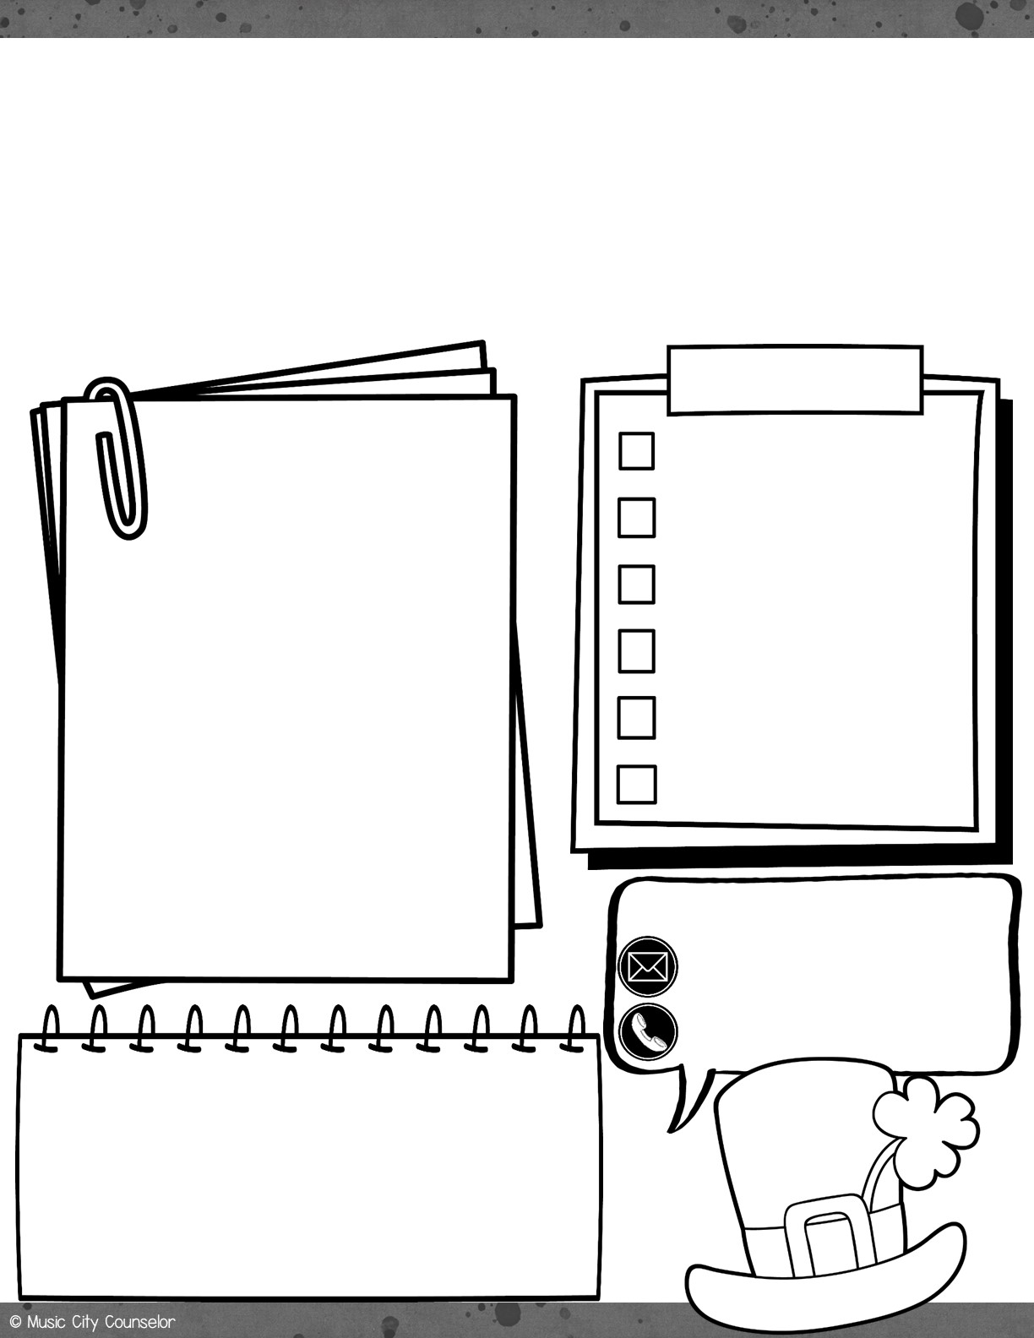
Counselor’s Corner
MARCH 2023
Mrs. Laura Oathout
Dates:
Counseling
Monthly Focus:
Type here
Type here
Let’s CONNECT!
laura.oathout@wcs.edu
615-934-2454, ext. 201
Happy, Healthy Kids TIP:
Siblings fighting again? Stay calm and take control of the situation. Let each child share their concern without being interrupted. Create a solution or compromise together that makes each child feel seen and heard.

Slide 24

Counselor’s Corner
APRIL 2023
Mrs. Laura Oathout
Dates:
Counseling
Monthly Focus:
Type here
Type here
Let’s CONNECT!
laura.oathout@wcs.edu
615-934-2454, ext. 201
Happy, Healthy Kids TIP:
Rather than asking your child, “How was your day?” and them replying again with, “good.” Try asking, “What was the best part of your day?” “What did you learn?” “Who did you play with?” “Who did you sit with at lunch?”

Slide 25

Counselor’s Corner
MAY 2023
Mrs. Laura Oathout
Dates:
Counseling
Monthly Focus:
Type here
Type here
Let’s CONNECT!
laura.oathout@wcs.edu
615-934-2454, ext. 201
Happy, Healthy Kids TIP:
When your child makes a good choice, no matter who small, make a BIG deal out of it! Cheer for them, encourage them, and reinforce this behavior. When your child makes a mistake, guide them towards a better choice. But, try not to dwell on it and move forward together.

Slide 26
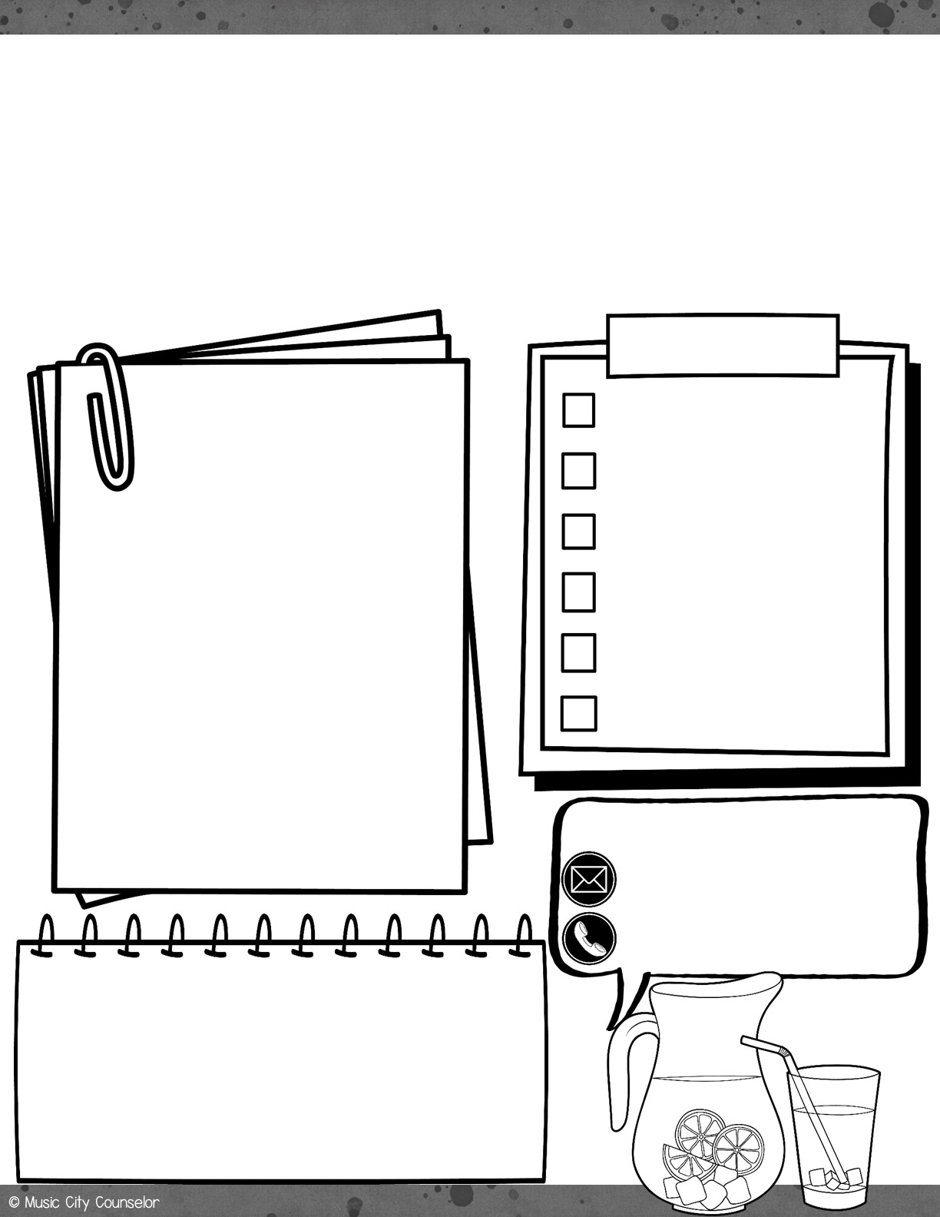
Counselor’s Corner
JUNE 2023
Mrs. Laura Oathout
Dates:
Counseling
Monthly Focus:
Type here
Type here
Let’s CONNECT!
laura.oathout@wcs.edu
615-934-2454, ext. 201
Happy, Healthy Kids TIP:
To prevent the “summer slide” and keep students learning this summer, enroll them in a summer reading program at your local library! They can work towards a summer reading goal and earn prizes as they go!

Slide 27
