Slide 1






www.musiccitycounselor.com
www.counselorcollab.com

Slide 2
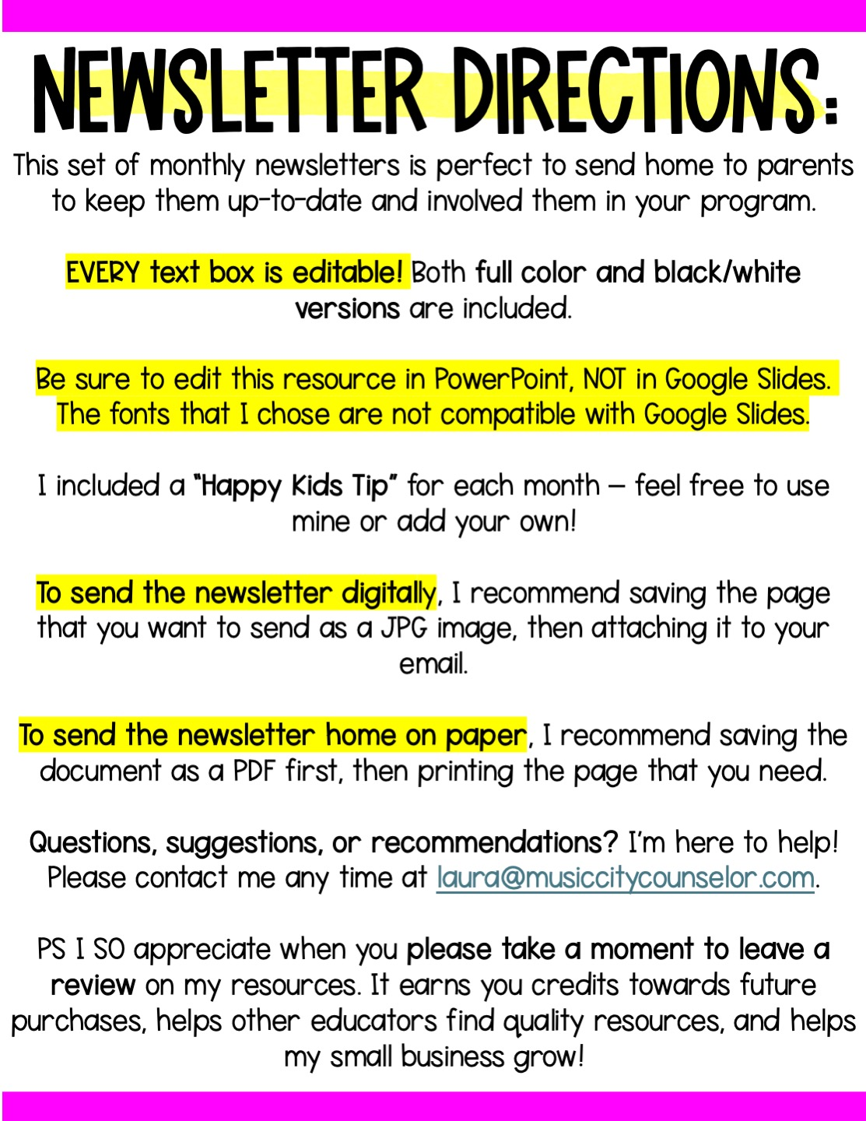

Slide 3


Slide 4



School counseling
AUGUST NEWS
Monthly
focus
important
DATES
Type here
Type here
Happy kids
tip
Try these simple tips for back to school success:
Establish a consistent bedtime and morning routine.
Prepare clothes, lunches, and backpacks the night before.
Offer a healthy breakfast.
Talk with your child about what to expect in the classroom, on the bus, at lunch, at recess, etc.
Stay connected—communicate with teachers, check in on homework, and celebrate their progress!
Mrs. Laura Oathout
615-392-5930, ext. 102
laura.oathout@wcs.edu

Slide 5
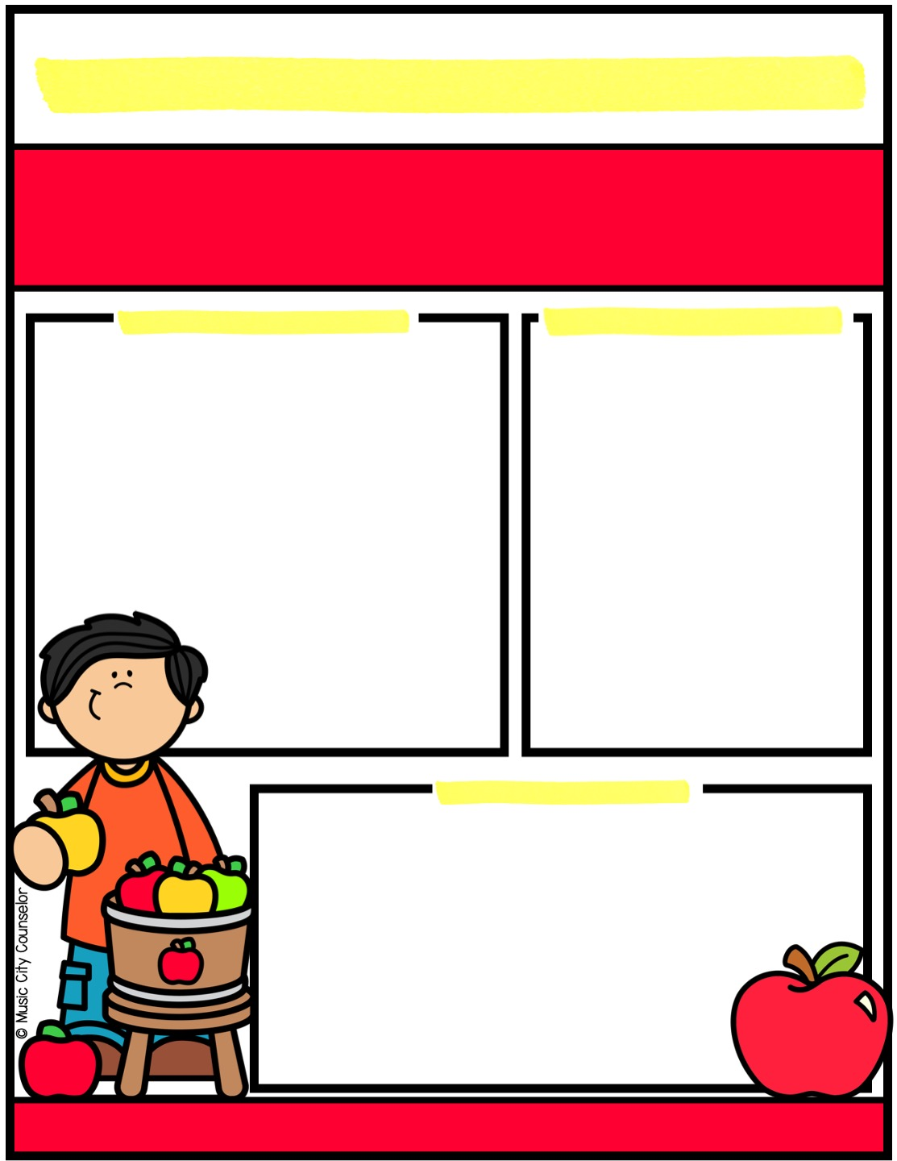
School counseling
SEPTEMBER NEWS
Monthly
focus
important
DATES
Type here
Type here
Happy kids
tip
Did you know that reading at home is one of the most powerful ways to support your child’s learning? It strengthens vocabulary, improves comprehension, and builds confidence. Just 15-20 minutes a day can spark imagination, boost academic success, and create a
lifelong love of books. Reading together also provides a special
bonding time for you and your child. Whether it’s a
bedtime story, taking turns reading aloud, or exploring
a favorite book series, make reading a daily habit!
Mrs. Laura Oathout
615-392-5930, ext. 102
laura.oathout@wcs.edu

Slide 6
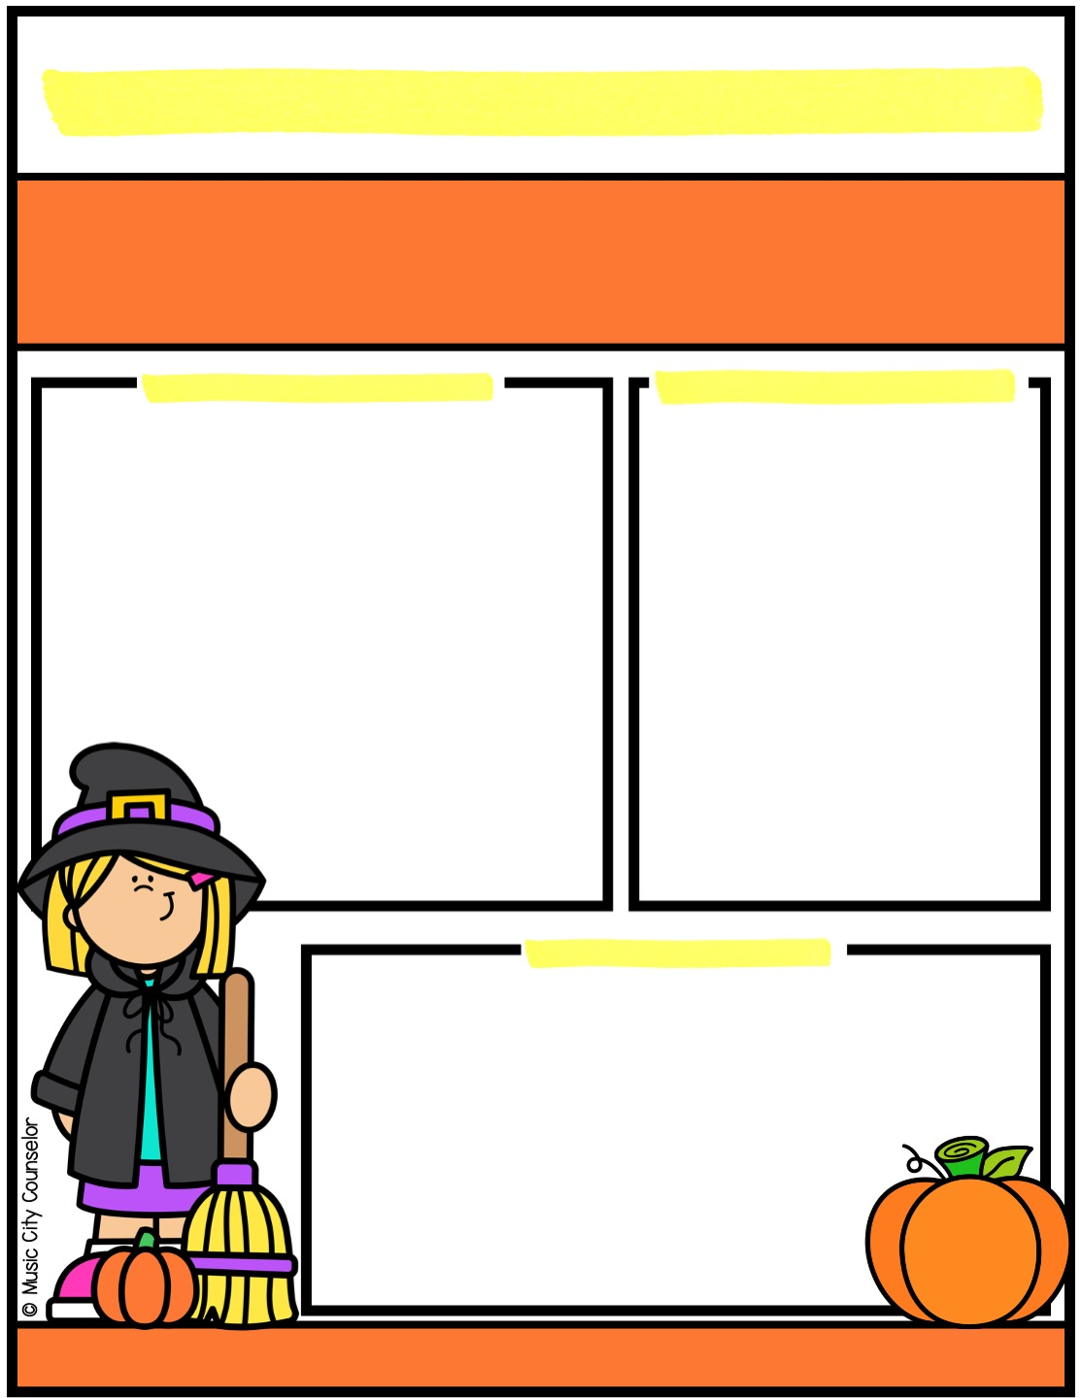
School counseling
OCTOBER NEWS
Monthly
focus
important
DATES
Type here
Type here
Happy kids
tip
If your family celebrates Halloween, here are some safety tips:
Wear bright and reflective costumes. Use glow sticks and flashlights.
Older kids can stay in a group and stick to a planned route.
Young children must stay with a trusted adult.
Stick to well-lit areas.
Set a meeting spot in case you get separated.
Inspect all treats first. Watch for allergies.
Mrs. Laura Oathout
615-392-5930, ext. 102
laura.oathout@wcs.edu

Slide 7
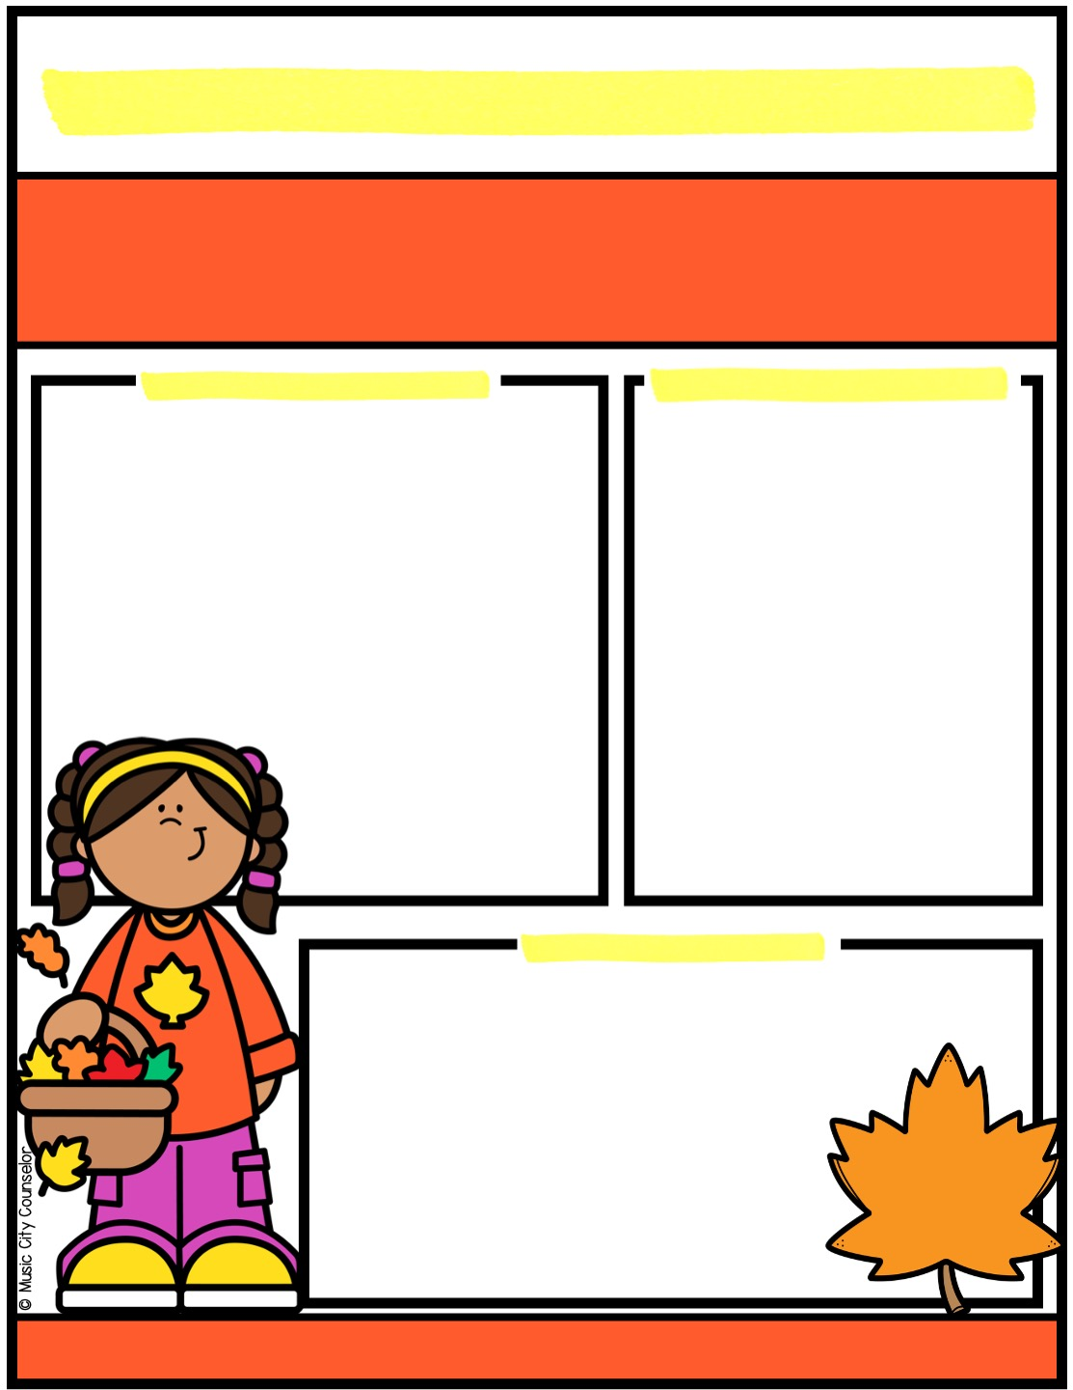
School counseling
november NEWS
Monthly
focus
important
DATES
Type here
Type here
Happy kids
tip
Learning to recognize and express emotions is key to children’s healthy development. Teach them to recognize physiological signs of emotions in
their bodies and brains: (i.e. “My hands are in fists, My
cheeks are hot), then name their feelings (”I feel
angry”). Model appropriate emotional expression
by sharing your own feelings and managing them
in a healthy way. Teach your child that all feelings
are okay - as long as we express them safely.
Mrs. Laura Oathout
615-392-5930, ext. 102
laura.oathout@wcs.edu

Slide 8
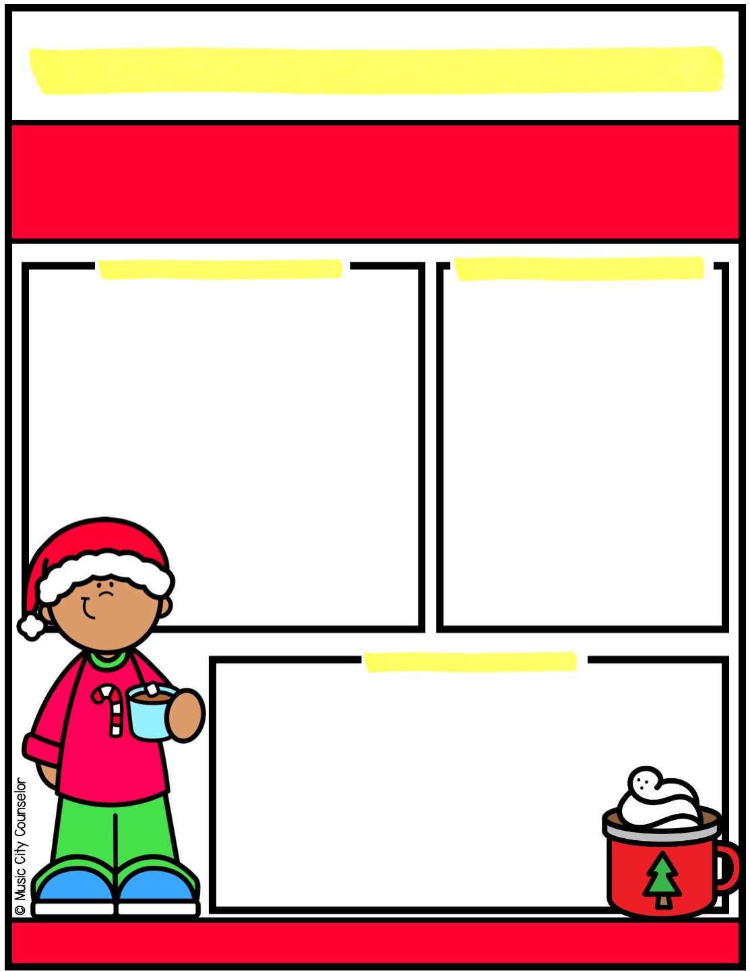
School counseling
december NEWS
Monthly
focus
important
DATES
Type here
Type here
Happy kids
tip
Once kids can name their feelings, they are ready to develop coping skills. Encourage your child to use simple strategies like taking deep breaths, counting to ten, or using a Calm Corner when they feel overwhelmed. Physical activities like stretching or squeezing
a stress ball can also help release tension. Using positive
self-talk (i.e. “I can handle this!”) builds emotional
resilience. Coping skills help kids navigate challenges
and develop confidence!
Mrs. Laura Oathout
615-392-5930, ext. 102
laura.oathout@wcs.edu

Slide 9
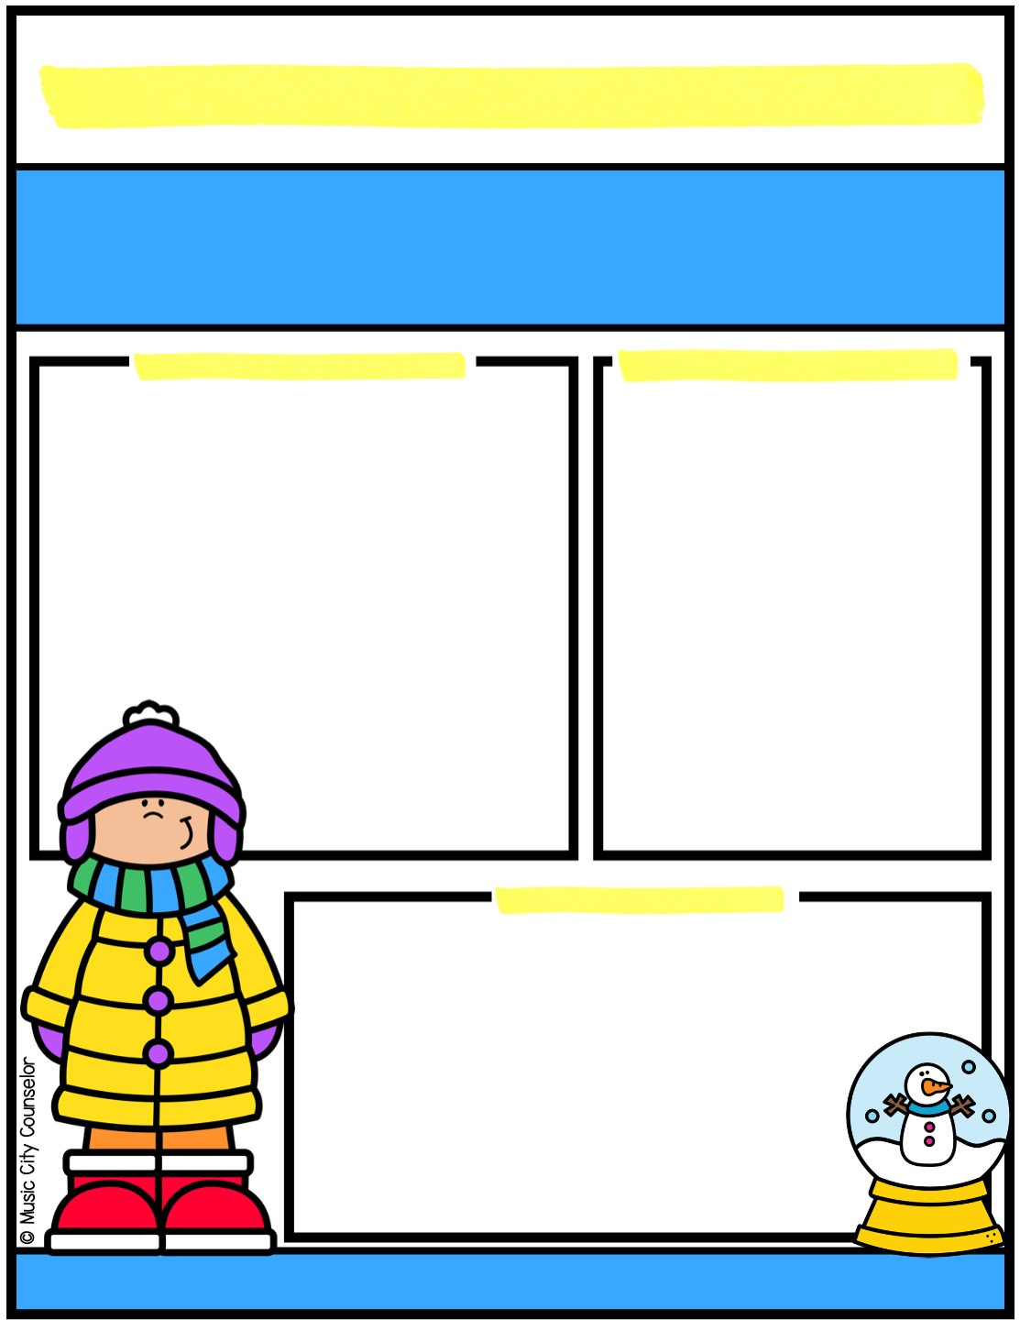
School counseling
january NEWS
Monthly
focus
important
DATES
Type here
Type here
Happy kids
tip
Winter break is a great time to rest, recharge, and create memories with family. Balance fun and relaxation by planning a mix of activities - from outdoor play, to movie nights, to simple crafts, to baking together. Encourage downtime too, so kids can
unwind and reset before school starts again. Most
importantly, enjoy the time together and make the
break feel special with family traditions and meaningful
moments of connection!
Mrs. Laura Oathout
615-392-5930, ext. 102
laura.oathout@wcs.edu

Slide 10
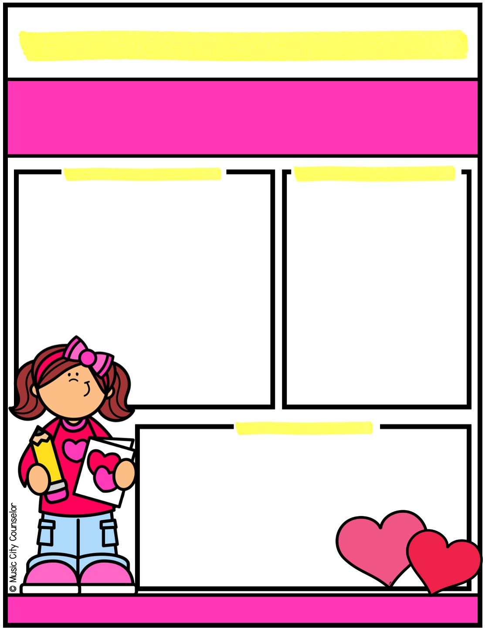
School counseling
february NEWS
Monthly
focus
important
DATES
Type here
Type here
Happy kids
tip
February is the perfect time to remind your child how much they are loved! Small gestures like leaving a sweet note in their lunchbox, having special one-on-one time, giving extra hugs, and sharing words of encouragement can make a big impact. Show love through actions - listen to their stories, join in their favorite
activities, or create a fun Valentine’s craft
together. Remind kids daily that they are
loved, not just this month, but always!
Mrs. Laura Oathout
615-392-5930, ext. 102
laura.oathout@wcs.edu

Slide 11
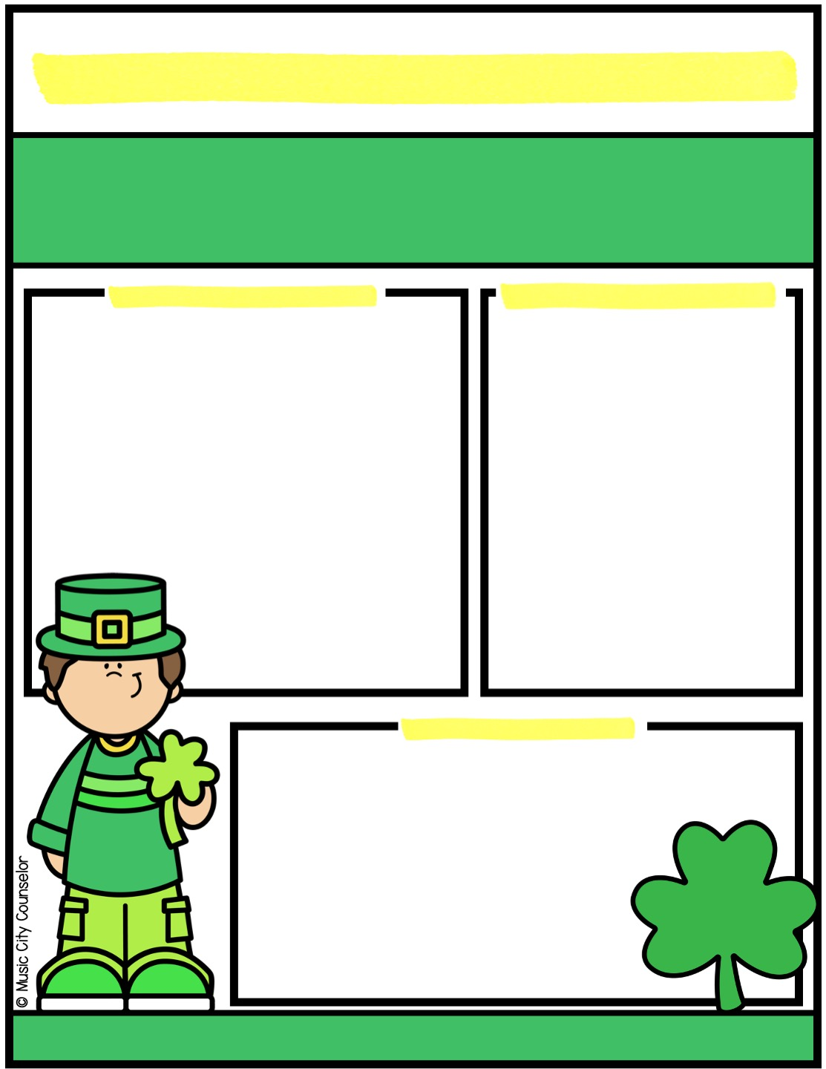
School counseling
march NEWS
Monthly
focus
important
DATES
Type here
Type here
Happy kids
tip
I-Messages help kids express their feelings in a respectful way without blaming others. Teach your child this simple formula: “I feel (emotion)
when (what happened). Can you please (solution)? For
example, “I feel sad when you take my toy. Can you
please ask before taking it?” Practice with real-life
situations and encourage them to use “I” instead of
“you” to focus on their own feelings. This helps kids
communicate clearly and solve conflicts peacefully!
Mrs. Laura Oathout
615-392-5930, ext. 102
laura.oathout@wcs.edu

Slide 12
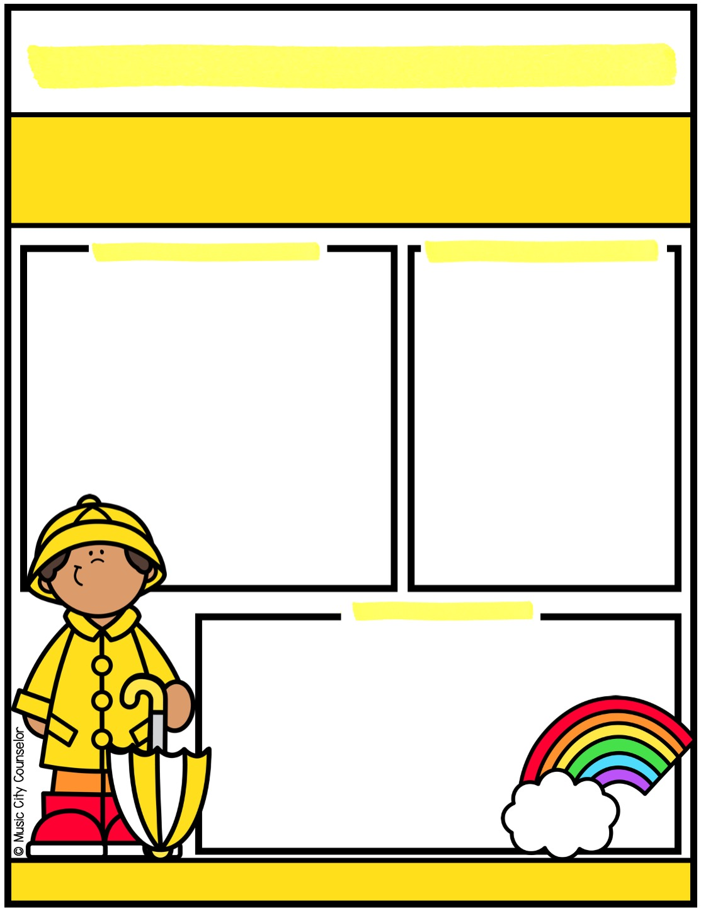
School counseling
APRIL NEWS
Monthly
focus
important
DATES
Type here
Type here
Happy kids
tip
Here are tips to help your child make and keep friends:
Model and practice key skills like introducing yourself, taking turns, and asking questions to show interest in others.
Set up playdates with classmates and neighbors to build friendships in a comfortable setting.
Role-play ways to start conversations, include others, and join group activities.
Encourage group activities like sports teams, clubs, and after-school programs.
Mrs. Laura Oathout
615-392-5930, ext. 102
laura.oathout@wcs.edu

Slide 13
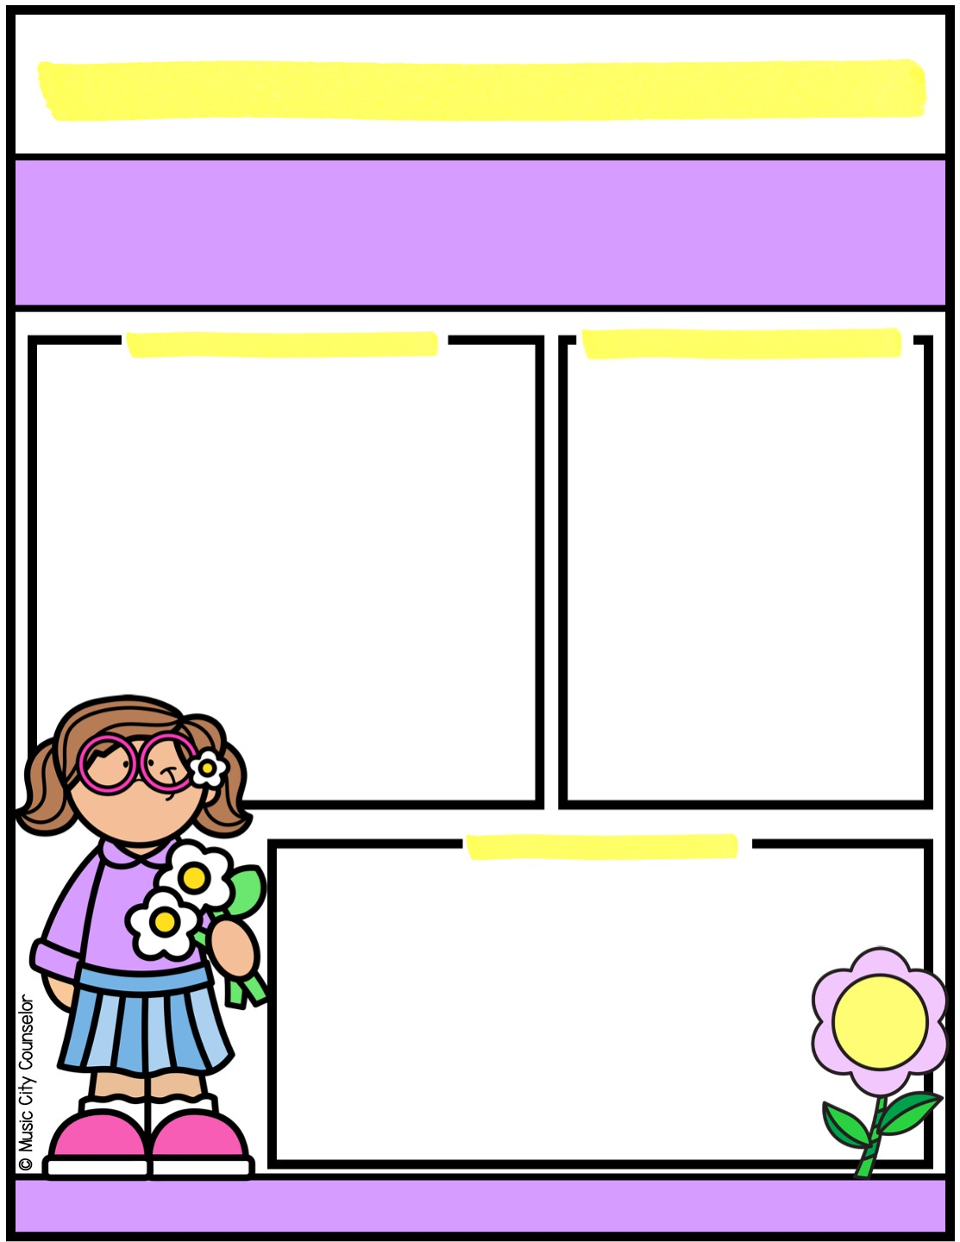
School counseling
MAY NEWS
Monthly
focus
important
DATES
Type here
Type here
Happy kids
tip
Did you know that anxiety is the most common mental illness in children? Here are some tips to help your child cope.
Validate your child’s feelings. Let them know it’s okay
to feel nervous and worried sometimes.
Teach skills like deep breathing, counting to 10, and
using positive self-talk like, “I can handle this!”
Help your child break big challenges into smaller steps.
Create a calm and predictable home routine.
Mrs. Laura Oathout
615-392-5930, ext. 102
laura.oathout@wcs.edu

Slide 14

School counseling
june NEWS
Monthly
focus
important
DATES
Type here
Type here
Happy kids
tip
Here are tips for a safe and fun summer!
Stay hydrated by drinking plenty of water.
Apply sunscreen with at least SPF 30 and reapply every 2 hours.
Wear helmets while biking, skating, and scootering.
Supervise swimming, even in shallow water.
Teach kids to recognize safe places and to never talk to strangers when playing outside.
Set limits on screen time and encourage outdoor fun. fun while
Mrs. Laura Oathout
615-392-5930, ext. 102
laura.oathout@wcs.edu

Slide 15
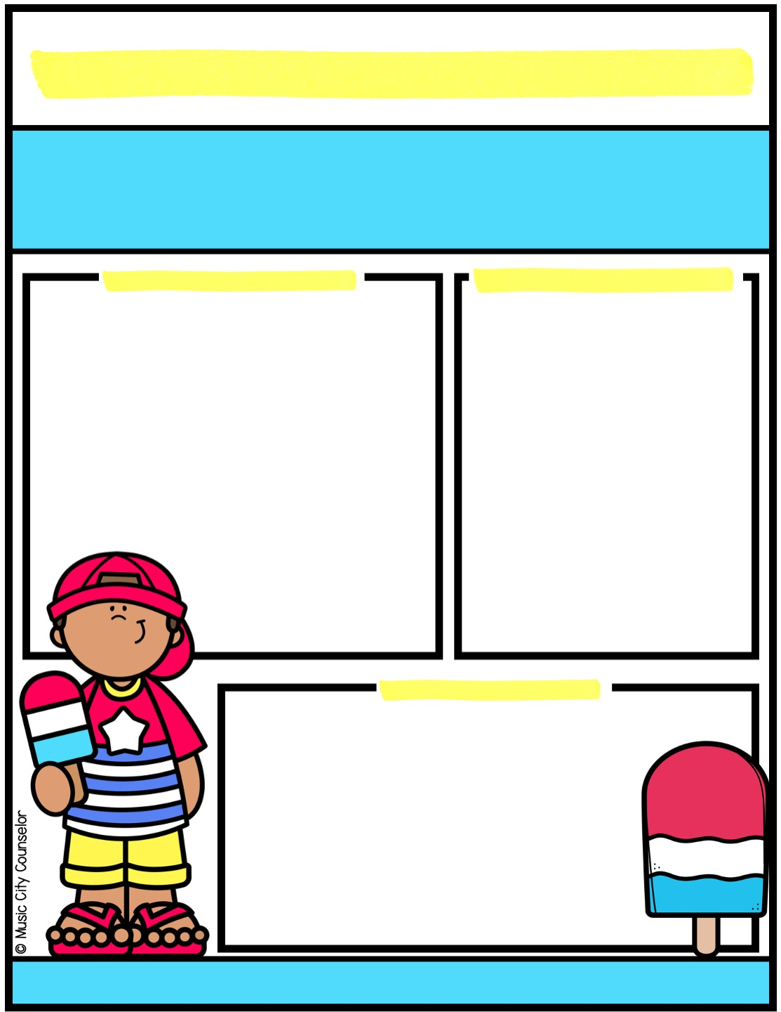
School counseling
july NEWS
Monthly
focus
important
DATES
Type here
Type here
Happy kids
tip
Anger is a normal emotion, but young children need guidance to express it in healthy ways. Teach your child to recognize
their anger by naming their feelings: “I see you’re feeling
mad right now.” Encourage calming strategies like deep
breathing, counting to ten, or squeezing a stress ball.
Teach kids to use words instead of actions to express
frustration. Model patience and healthy ways to handle
anger so they can learn from you!
Mrs. Laura Oathout
615-392-5930, ext. 102
laura.oathout@wcs.edu

Slide 16


Slide 17
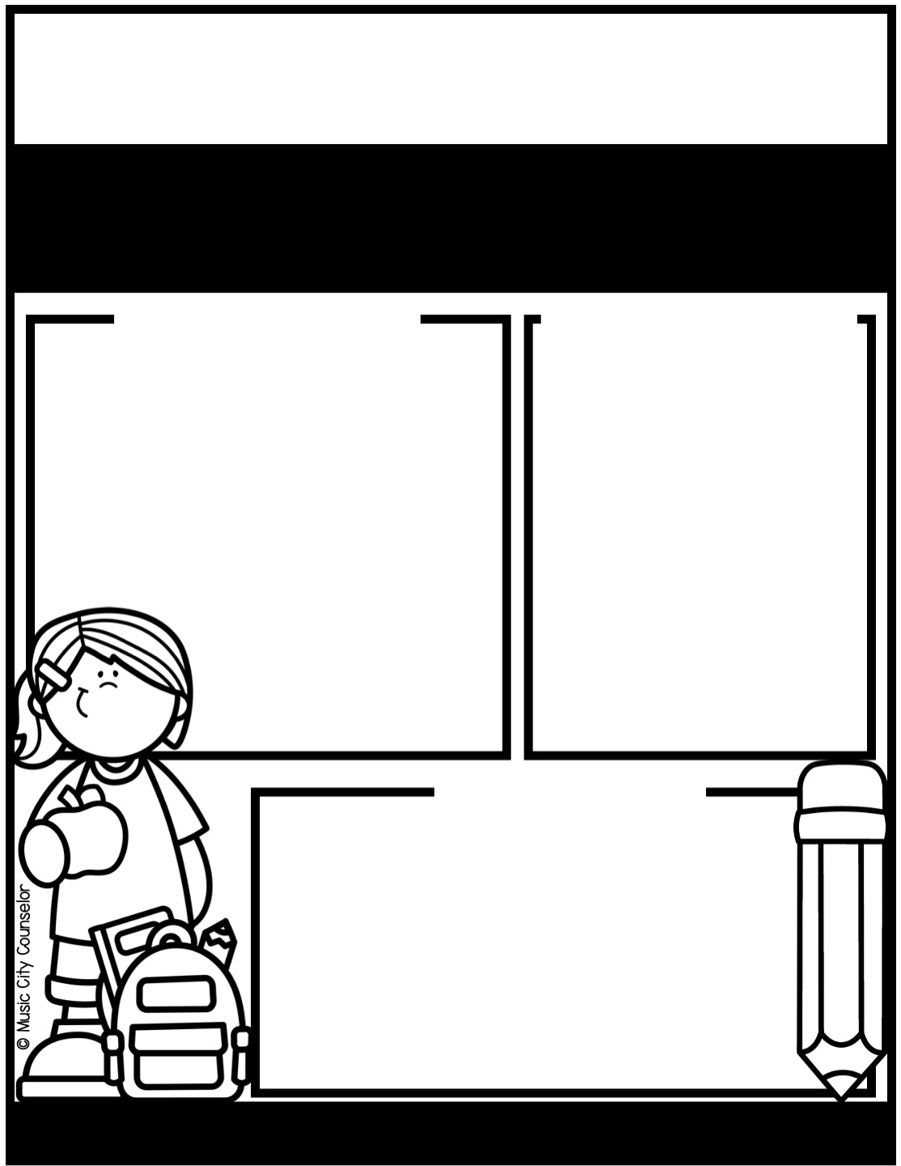


School counseling
AUGUST NEWS
Monthly
focus
important
DATES
Type here
Type here
Happy kids
tip
Try these simple tips for back to school success:
Establish a consistent bedtime and morning routine.
Prepare clothes, lunches, and backpacks the night before.
Offer a healthy breakfast.
Talk with your child about what to expect in the classroom, on the bus, at lunch, at recess, etc.
Stay connected—communicate with teachers, check in on homework, and celebrate their progress!
Mrs. Laura Oathout
615-392-5930, ext. 102
laura.oathout@wcs.edu

Slide 18
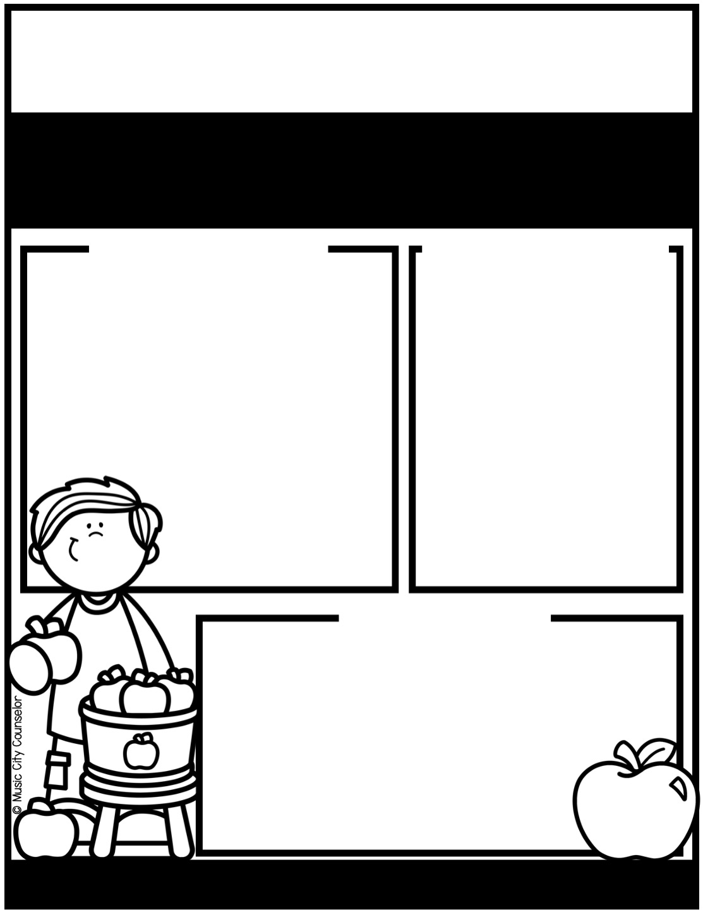
School counseling
SEPTEMBER NEWS
Monthly
focus
important
DATES
Type here
Type here
Happy kids
tip
Did you know that reading at home is one of the most powerful ways to support your child’s learning? It strengthens vocabulary, improves comprehension, and builds confidence. Just 15-20 minutes a day can spark imagination, boost academic success, and create a
lifelong love of books. Reading together also provides a special
bonding time for you and your child. Whether it’s a
bedtime story, taking turns reading aloud, or exploring
a favorite book series, make reading a daily habit!
Mrs. Laura Oathout
615-392-5930, ext. 102
laura.oathout@wcs.edu

Slide 19
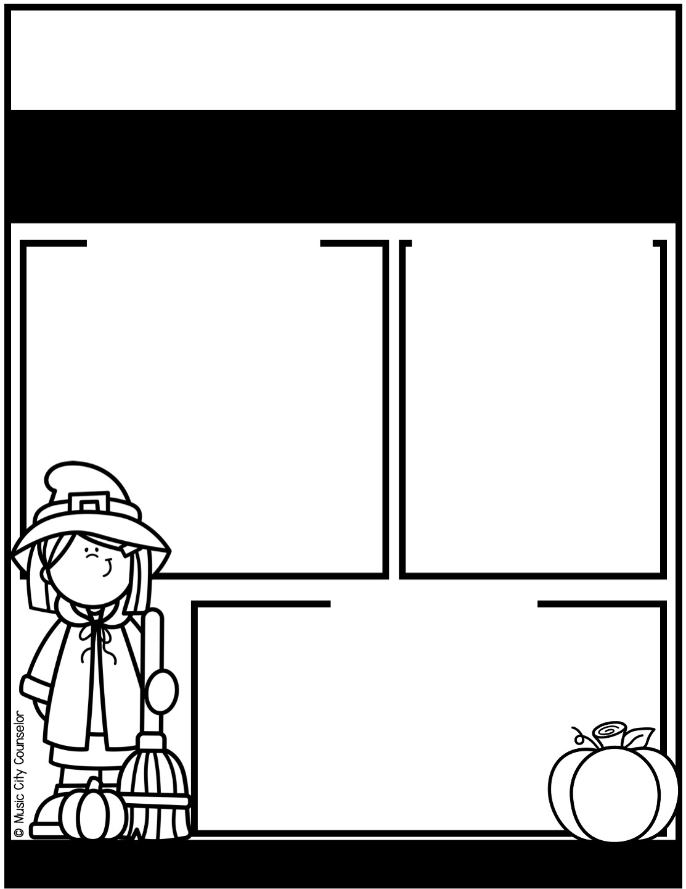
School counseling
OCTOBER NEWS
Monthly
focus
important
DATES
Type here
Type here
Happy kids
tip
If your family celebrates Halloween, here are some safety tips:
Wear bright and reflective costumes. Use glow sticks and flashlights.
Older kids can stay in a group and stick to a planned route.
Young children must stay with a trusted adult.
Stick to well-lit areas.
Set a meeting spot in case you get separated.
Inspect all treats first. Watch for allergies.
Mrs. Laura Oathout
615-392-5930, ext. 102
laura.oathout@wcs.edu

Slide 20
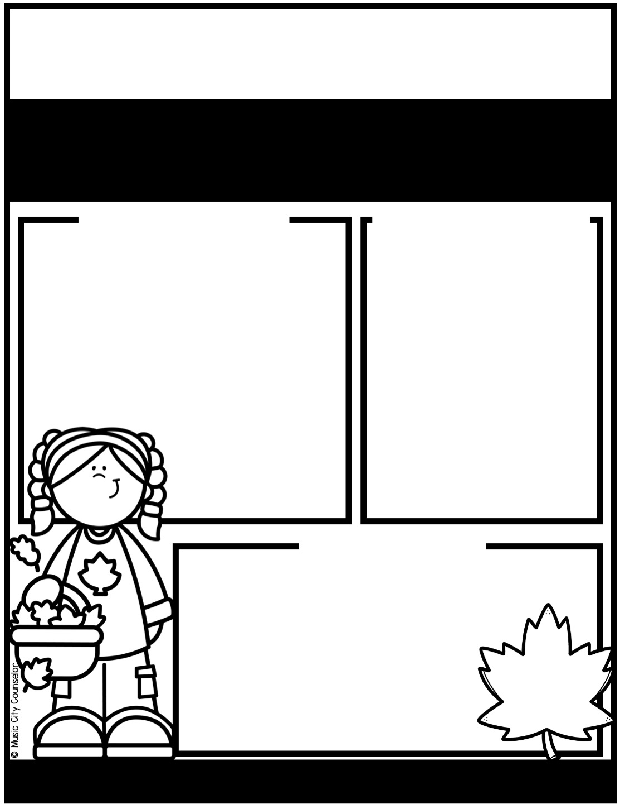
School counseling
november NEWS
Monthly
focus
important
DATES
Type here
Type here
Happy kids
tip
Learning to recognize and express emotions is key to children’s healthy development. Teach them to recognize physiological signs of emotions in
their bodies and brains: (i.e. “My hands are in fists, My
cheeks are hot), then name their feelings (”I feel
angry”). Model appropriate emotional expression
by sharing your own feelings and managing them
in a healthy way. Teach your child that all feelings
are okay - as long as we express them safely.
Mrs. Laura Oathout
615-392-5930, ext. 102
laura.oathout@wcs.edu

Slide 21
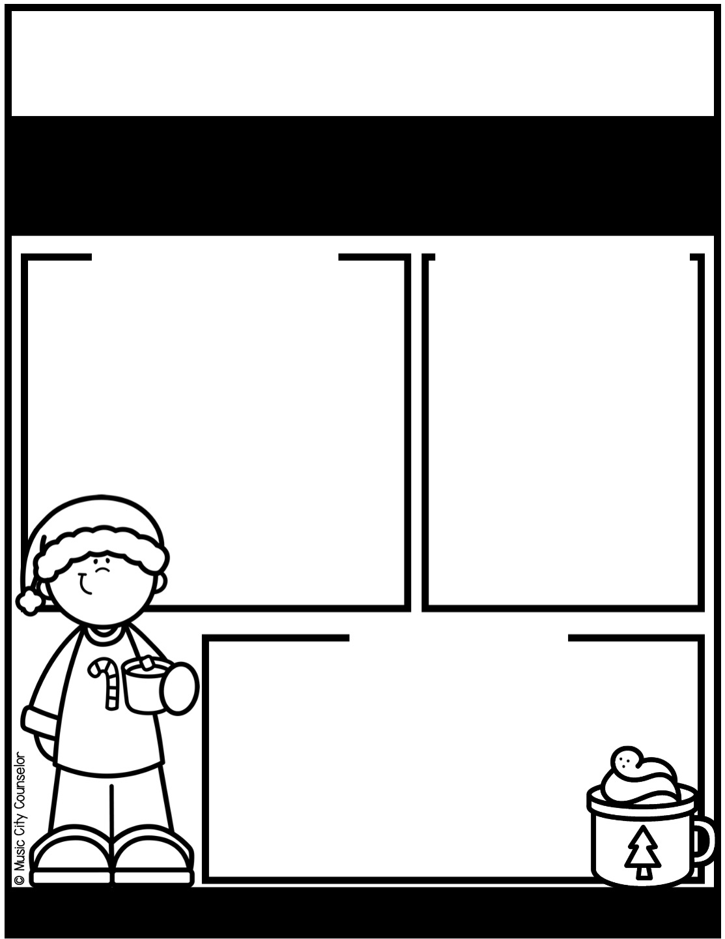
School counseling
december NEWS
Monthly
focus
important
DATES
Type here
Type here
Happy kids
tip
Once kids can name their feelings, they are ready to develop coping skills. Encourage your child to use simple strategies like taking deep breaths, counting to ten, or using a Calm Corner when they feel overwhelmed. Physical activities like stretching or squeezing
a stress ball can also help release tension. Using positive
self-talk (i.e. “I can handle this!”) builds emotional
resilience. Coping skills help kids navigate challenges
and develop confidence!
Mrs. Laura Oathout
615-392-5930, ext. 102
laura.oathout@wcs.edu

Slide 22
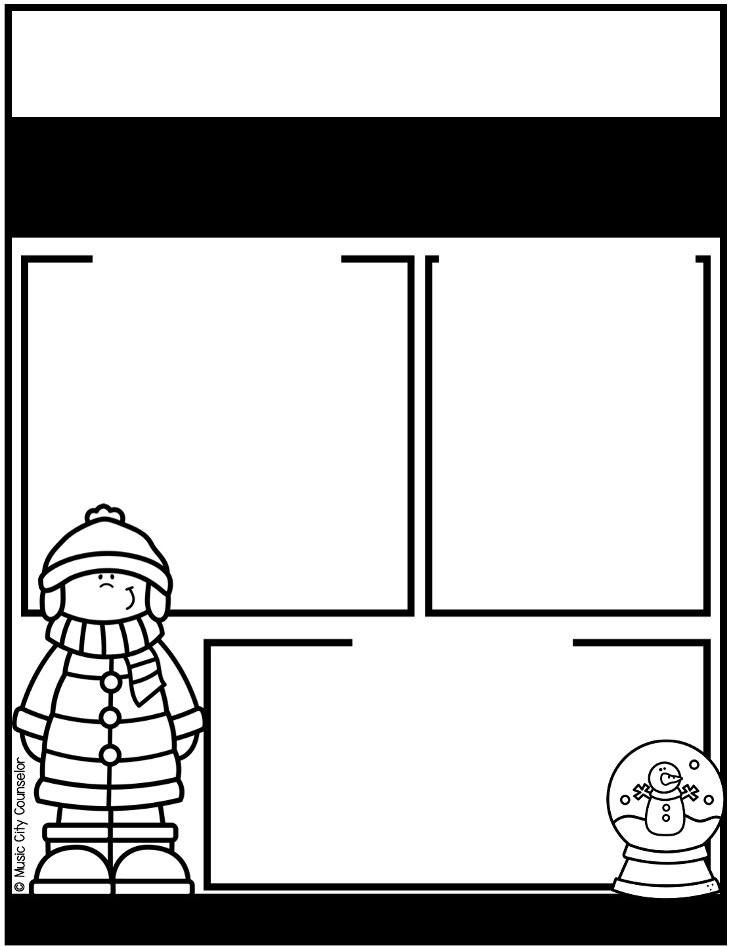
School counseling
january NEWS
Monthly
focus
important
DATES
Type here
Type here
Happy kids
tip
Winter break is a great time to rest, recharge, and create memories with family. Balance fun and relaxation by planning a mix of activities - from outdoor play, to movie nights, to simple crafts, to baking together. Encourage downtime too, so kids can
unwind and reset before school starts again. Most
importantly, enjoy the time together and make the
break feel special with family traditions and meaningful
moments of connection!
Mrs. Laura Oathout
615-392-5930, ext. 102
laura.oathout@wcs.edu

Slide 23
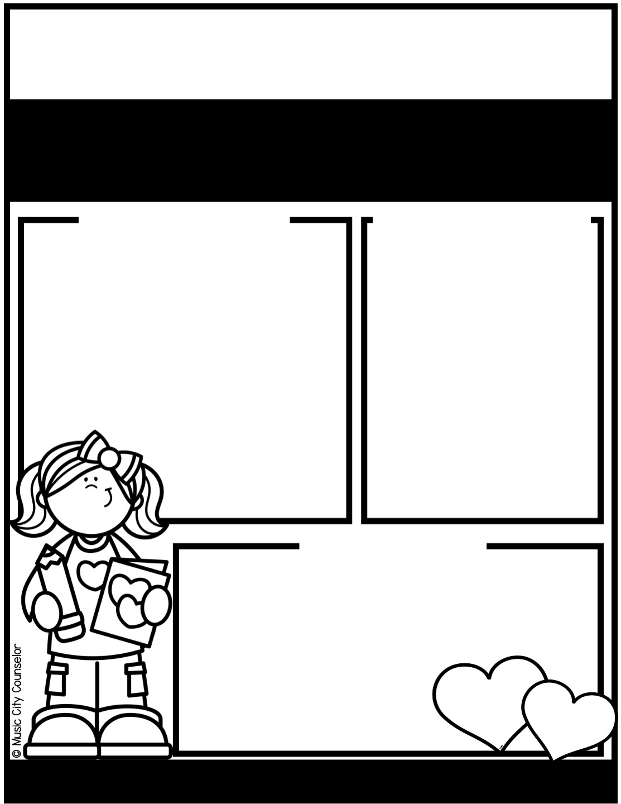
School counseling
february NEWS
Monthly
focus
important
DATES
Type here
Type here
Happy kids
tip
February is the perfect time to remind your child how much they are loved! Small gestures like leaving a sweet note in their lunchbox, having special one-on-one time, giving extra hugs, and sharing words of encouragement can make a big impact. Show love through actions - listen to their stories, join in their favorite
activities, or create a fun Valentine’s craft
together. Remind kids daily that they are
loved, not just this month, but always!
Mrs. Laura Oathout
615-392-5930, ext. 102
laura.oathout@wcs.edu

Slide 24
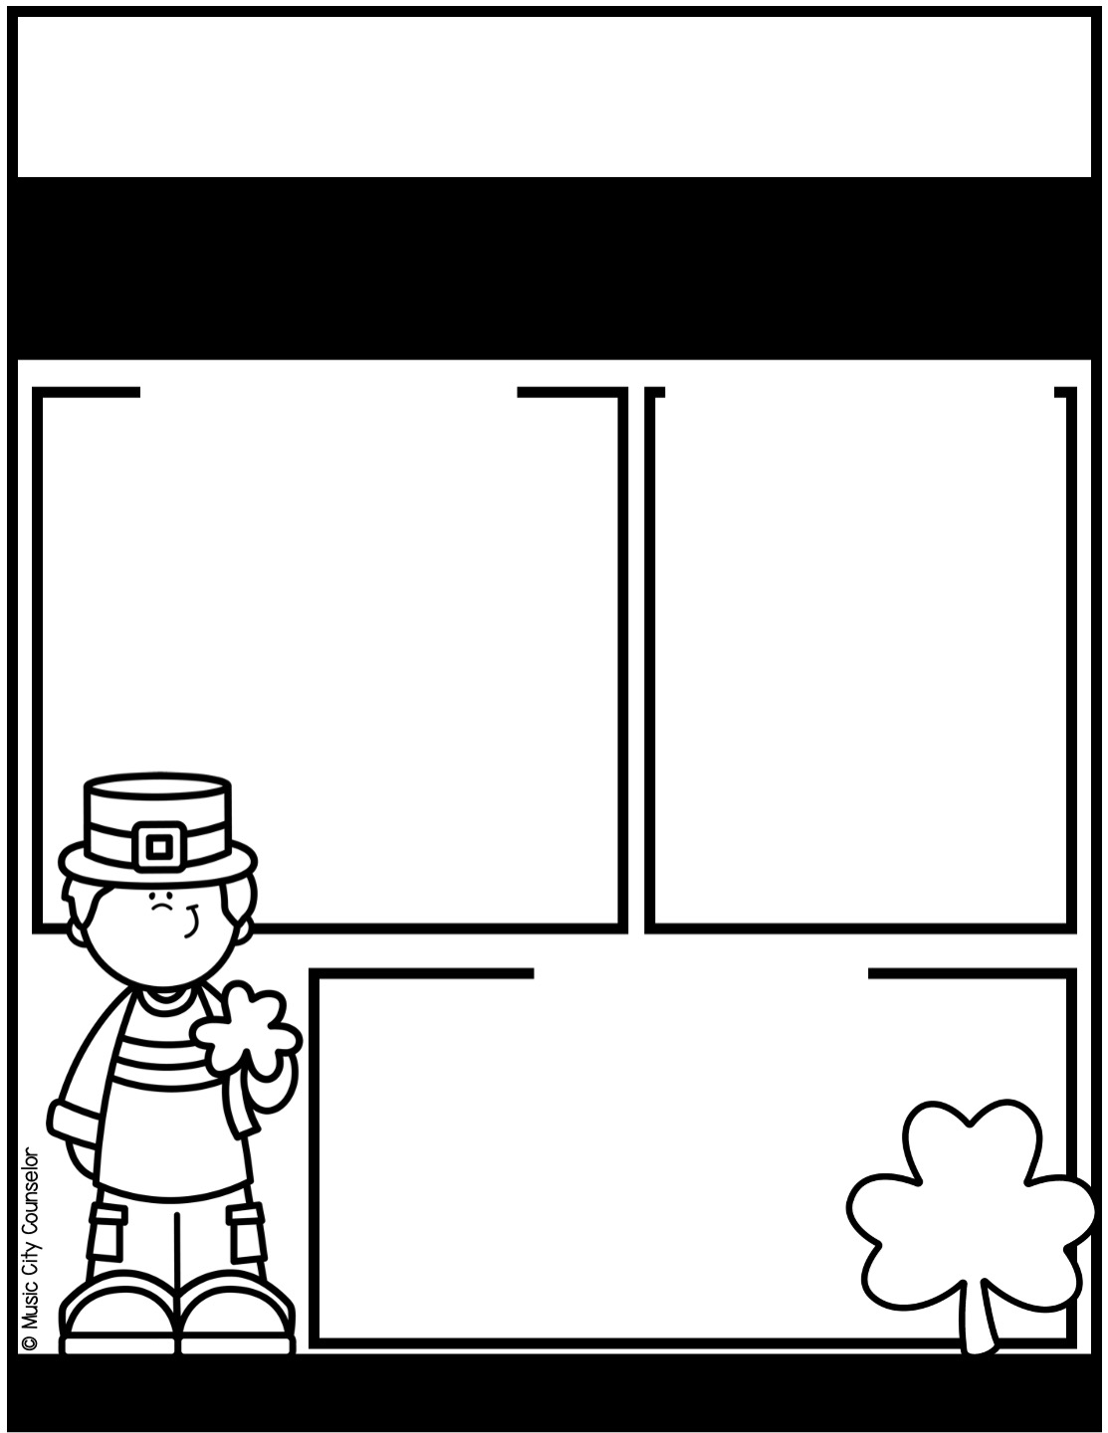
School counseling
march NEWS
Monthly
focus
important
DATES
Type here
Type here
Happy kids
tip
I-Messages help kids express their feelings in a respectful way without blaming others. Teach your child this simple formula: “I feel (emotion)
when (what happened). Can you please (solution)? For
example, “I feel sad when you take my toy. Can you
please ask before taking it?” Practice with real-life
situations and encourage them to use “I” instead of
“you” to focus on their own feelings. This helps kids
communicate clearly and solve conflicts peacefully!
Mrs. Laura Oathout
615-392-5930, ext. 102
laura.oathout@wcs.edu

Slide 25
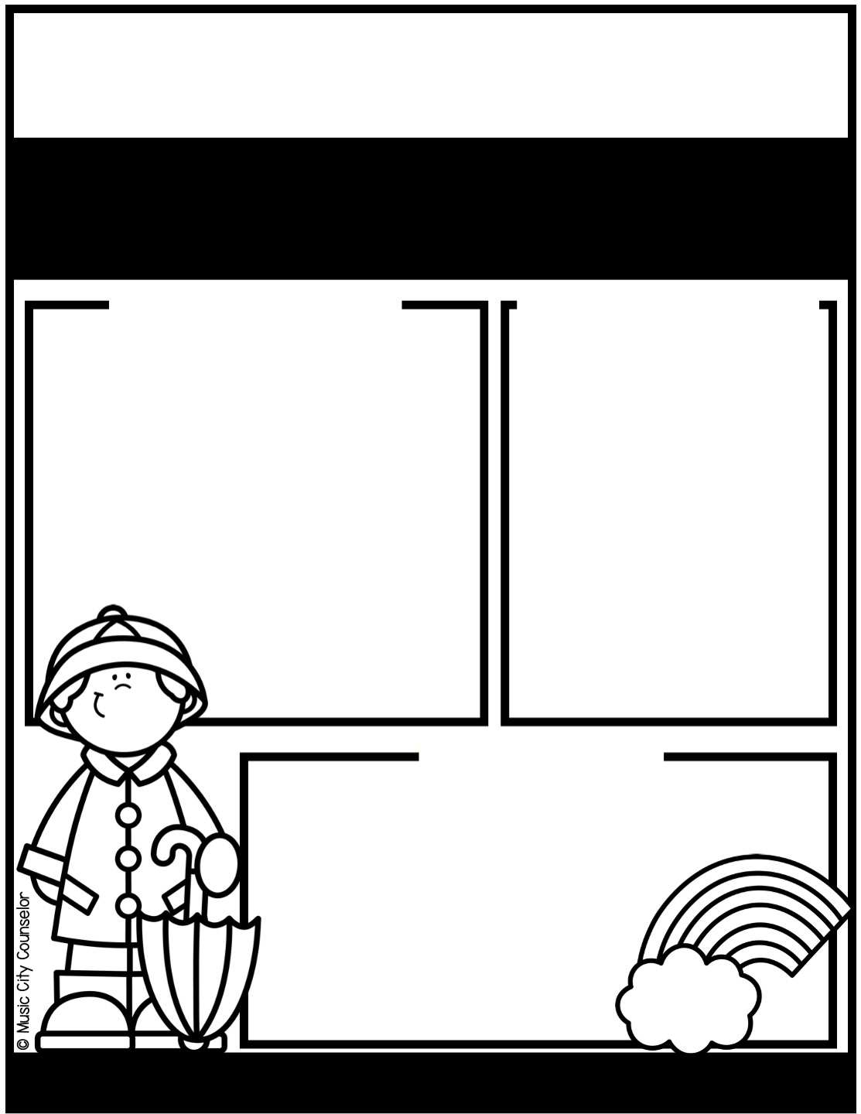
School counseling
APRIL NEWS
Monthly
focus
important
DATES
Type here
Type here
Happy kids
tip
Here are tips to help your child make and keep friends:
Model and practice key skills like introducing yourself, taking turns, and asking questions to show interest in others.
Set up playdates with classmates and neighbors to build friendships in a comfortable setting.
Role-play ways to start conversations, include others, and join group activities.
Encourage group activities like sports teams, clubs, and after-school programs.
Mrs. Laura Oathout
615-392-5930, ext. 102
laura.oathout@wcs.edu

Slide 26
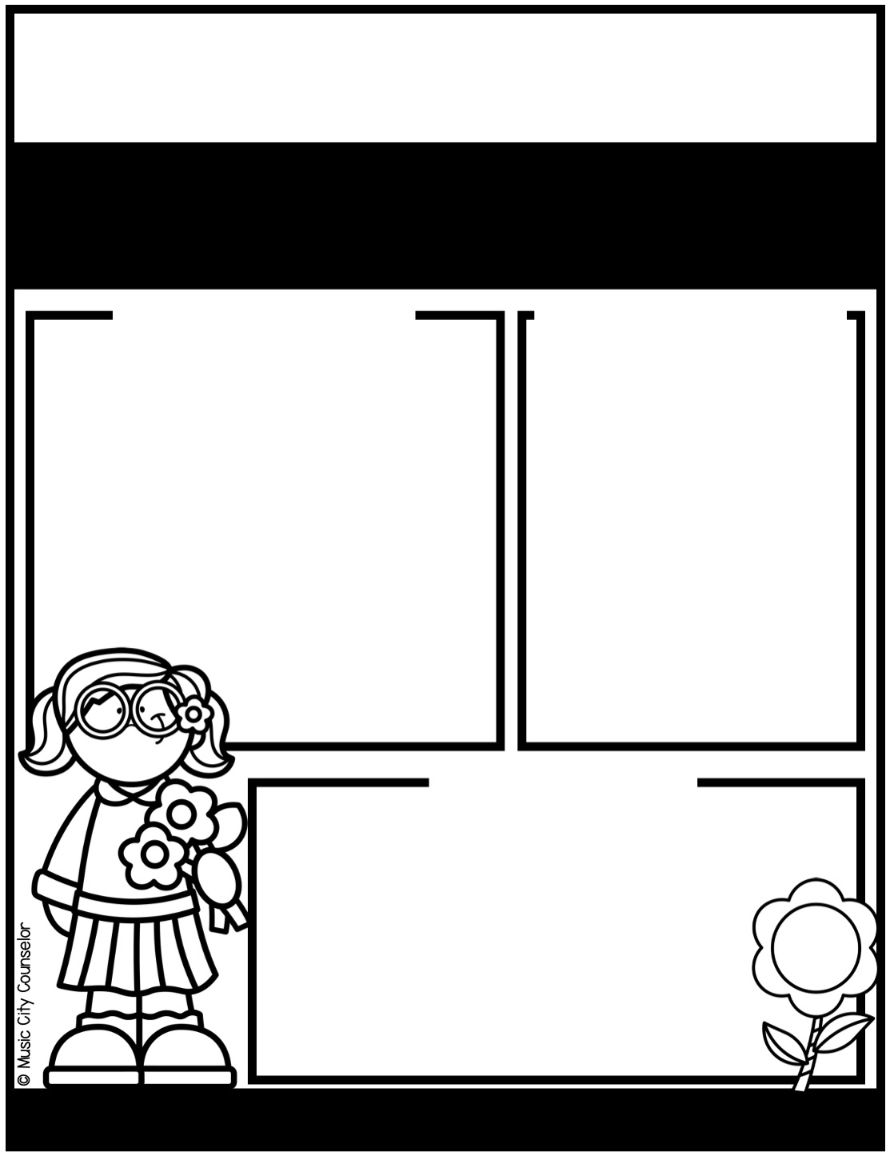
School counseling
MAY NEWS
Monthly
focus
important
DATES
Type here
Type here
Happy kids
tip
Did you know that anxiety is the most common mental illness in children? Here are some tips to help your child cope.
Validate your child’s feelings. Let them know it’s okay
to feel nervous and worried sometimes.
Teach skills like deep breathing, counting to 10, and
using positive self-talk like, “I can handle this!”
Help your child break big challenges into smaller steps.
Create a calm and predictable home routine.
Mrs. Laura Oathout
615-392-5930, ext. 102
laura.oathout@wcs.edu

Slide 27

School counseling
june NEWS
Monthly
focus
important
DATES
Type here
Type here
Happy kids
tip
Here are tips for a safe and fun summer!
Stay hydrated by drinking plenty of water.
Apply sunscreen with at least SPF 30 and reapply every 2 hours.
Wear helmets while biking, skating, and scootering.
Supervise swimming, even in shallow water.
Teach kids to recognize safe places and to never talk to strangers when playing outside.
Set limits on screen time and encourage outdoor fun.
Mrs. Laura Oathout
615-392-5930, ext. 102
laura.oathout@wcs.edu

Slide 28
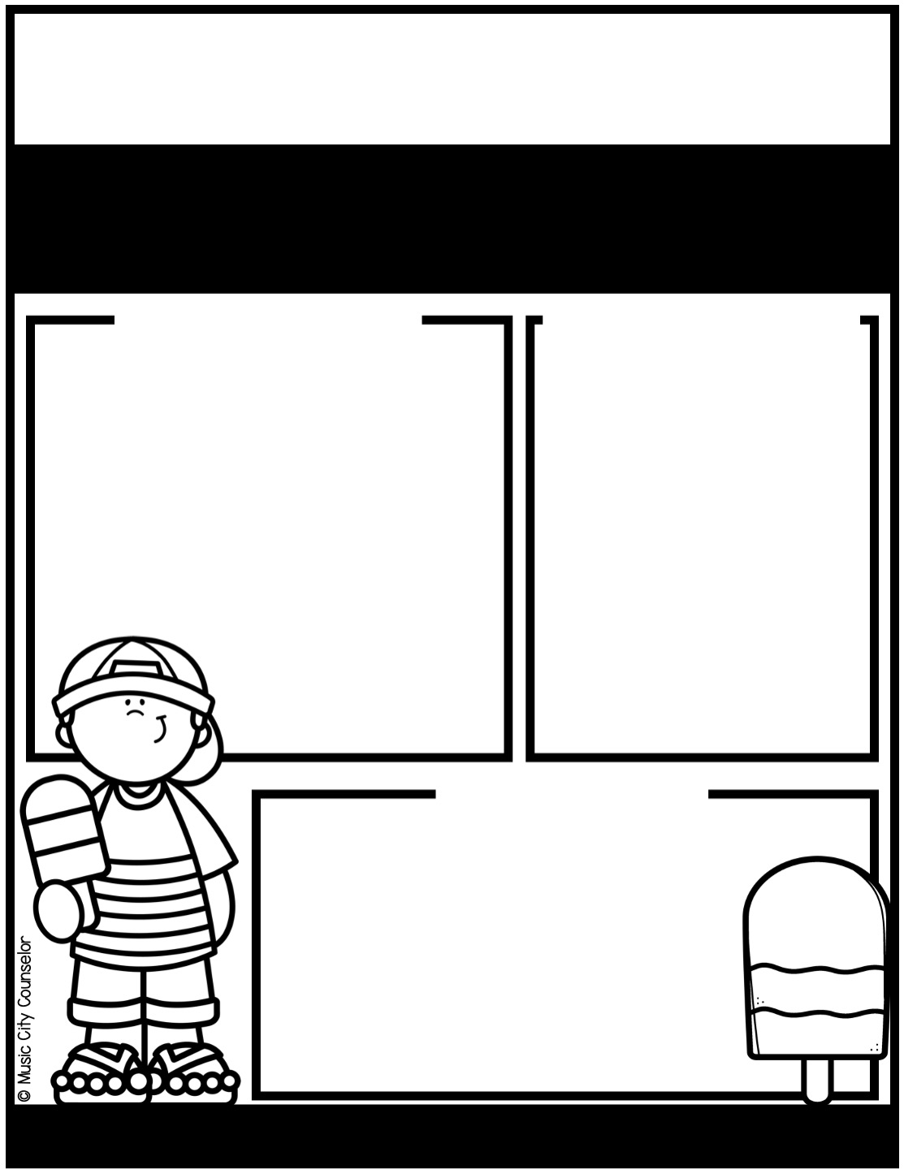
School counseling
july NEWS
Monthly
focus
important
DATES
Type here
Type here
Happy kids
tip
Anger is a normal emotion, but young children need guidance to express it in healthy ways. Teach your child to recognize
their anger by naming their feelings: “I see you’re feeling
mad right now.” Encourage calming strategies like deep
breathing, counting to ten, or squeezing a stress ball.
Teach kids to use words instead of actions to express
frustration. Model patience and healthy ways to handle
anger so they can learn from you!
Mrs. Laura Oathout
615-392-5930, ext. 102
laura.oathout@wcs.edu

Slide 29
