Slide 1






www.musiccitycounselor.com
www.counselorcollab.com

Slide 2
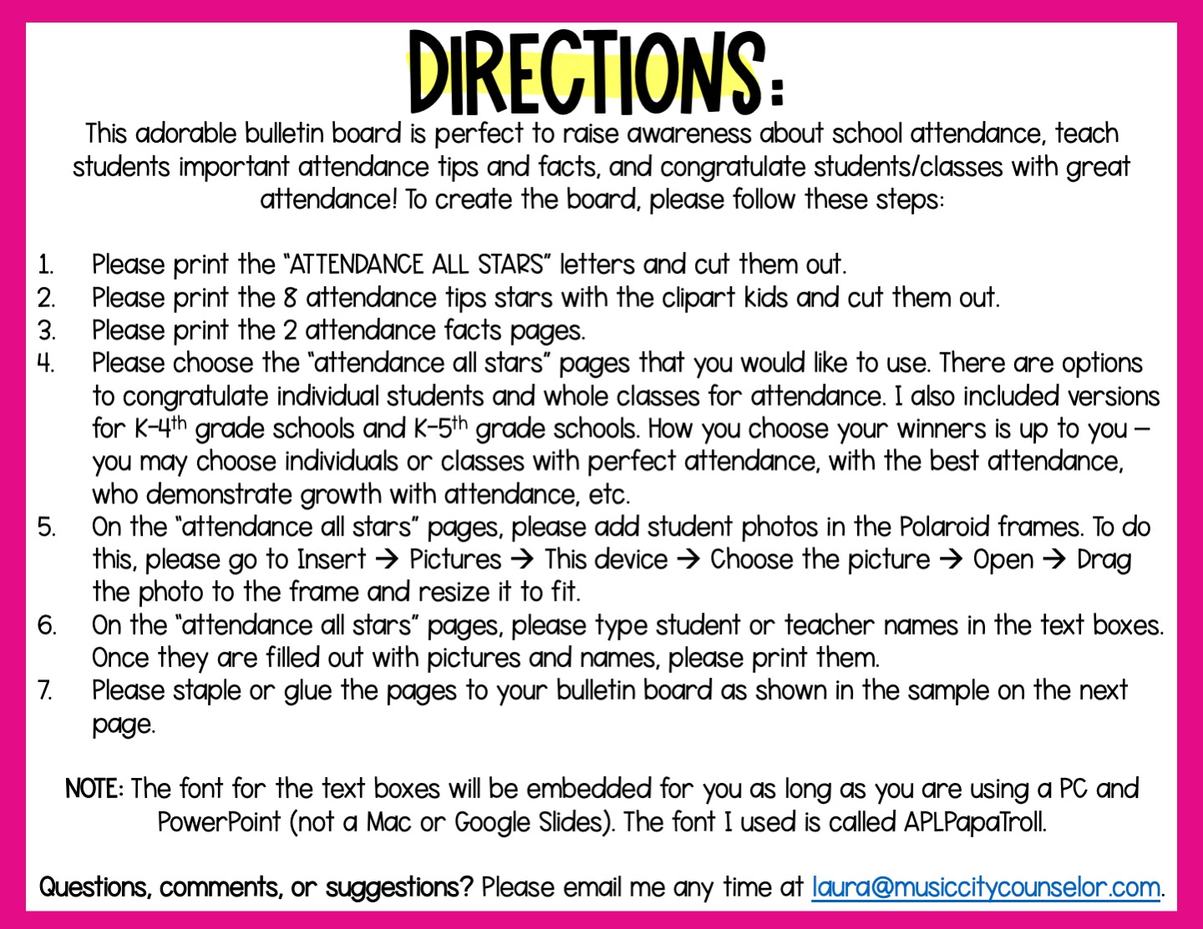

Slide 3
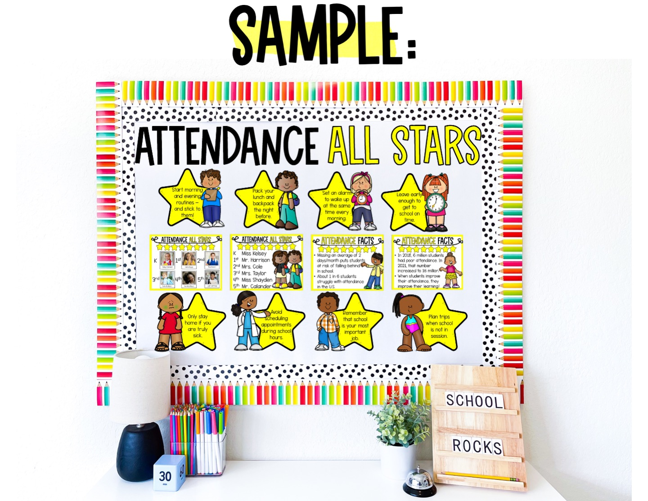

Slide 4


Slide 5


Slide 6


Slide 7


Slide 8


Slide 9


Slide 10


Slide 11


Slide 12


Slide 13


Slide 14


Slide 15


Slide 16


Slide 17
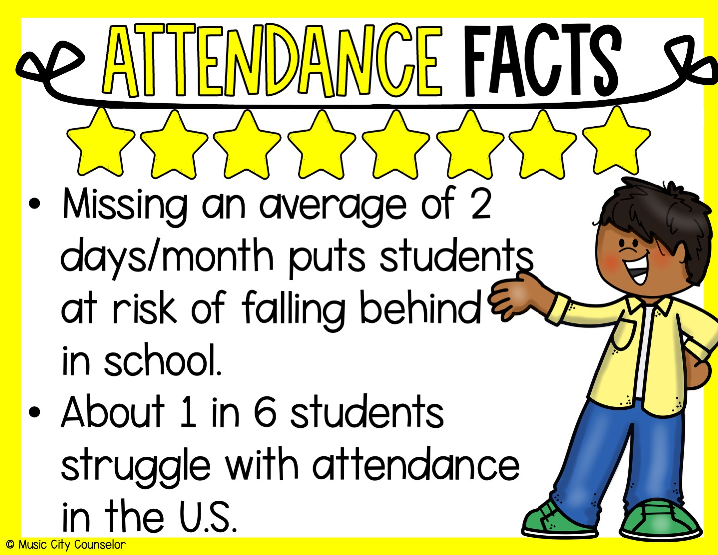

Slide 18


Slide 19


Slide 20
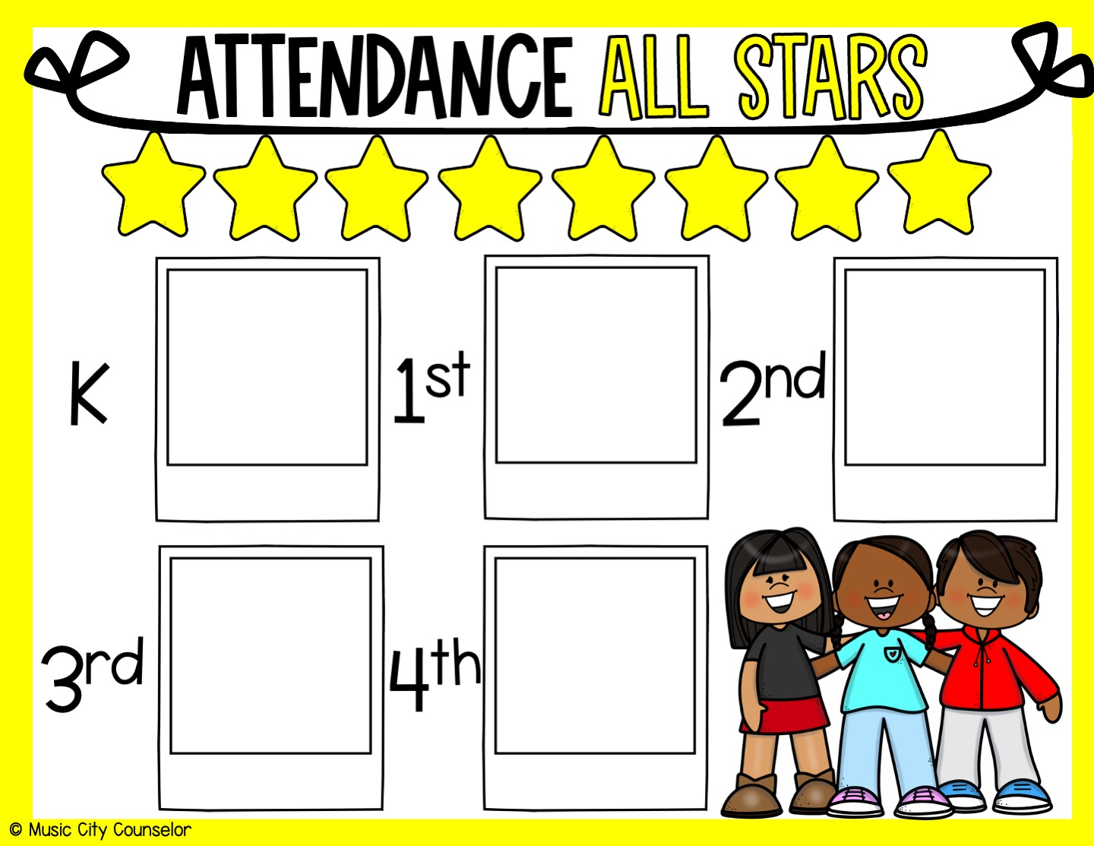
Type student name
Type student name
Type student name
Type student name
Type student name

Slide 21
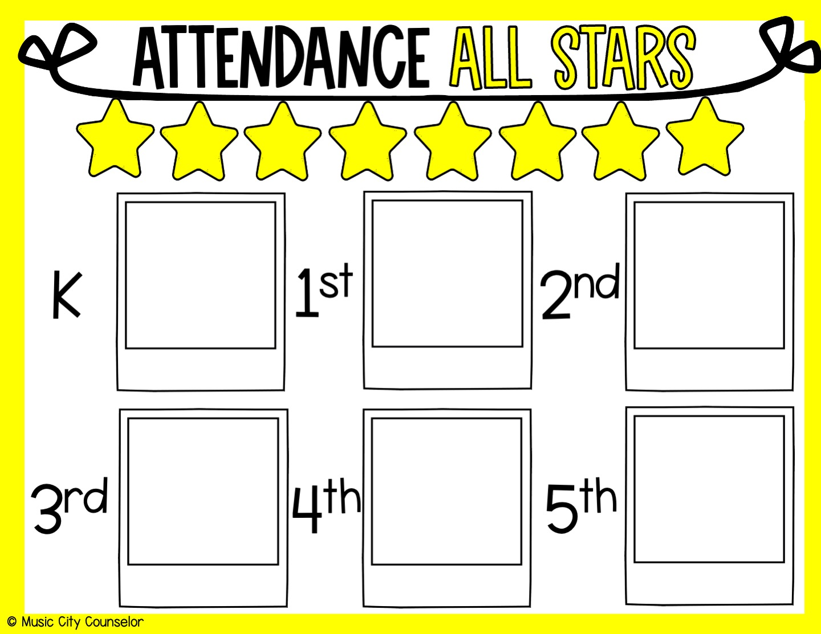
Type Student Name
Type Student Name
Type Student Name
Type Student Name
Type Student Name
Type Student Name

Slide 22


Slide 23
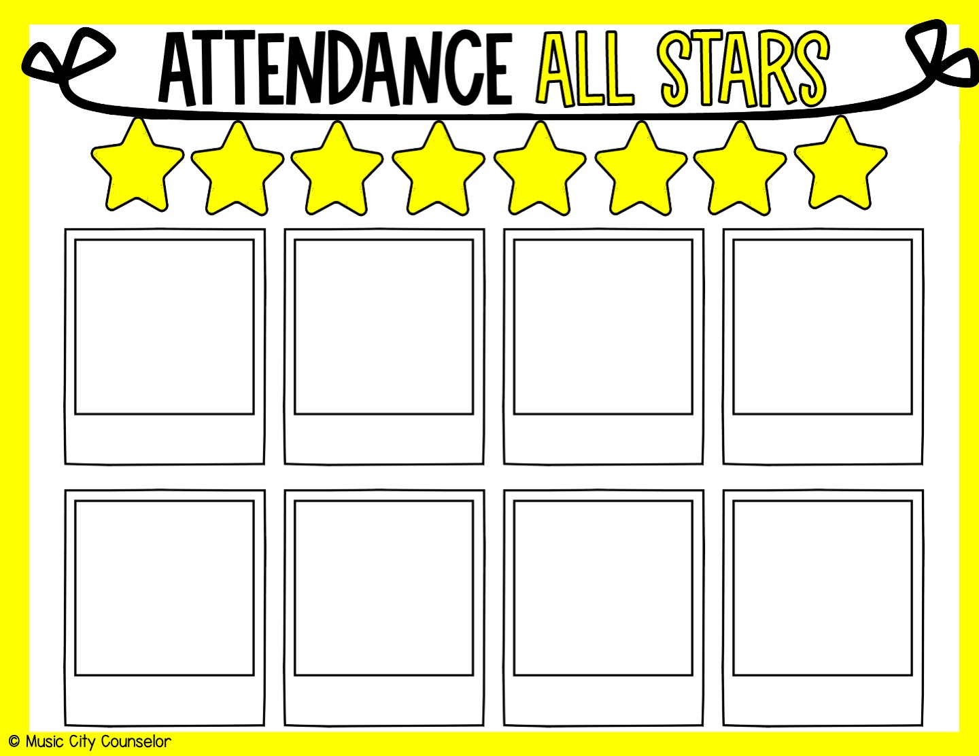
Type Student Name
Type Student Name
Type Student Name
Type Student Name
Type Student Name
Type Student Name
Type Student Name
Type Student Name

Slide 24
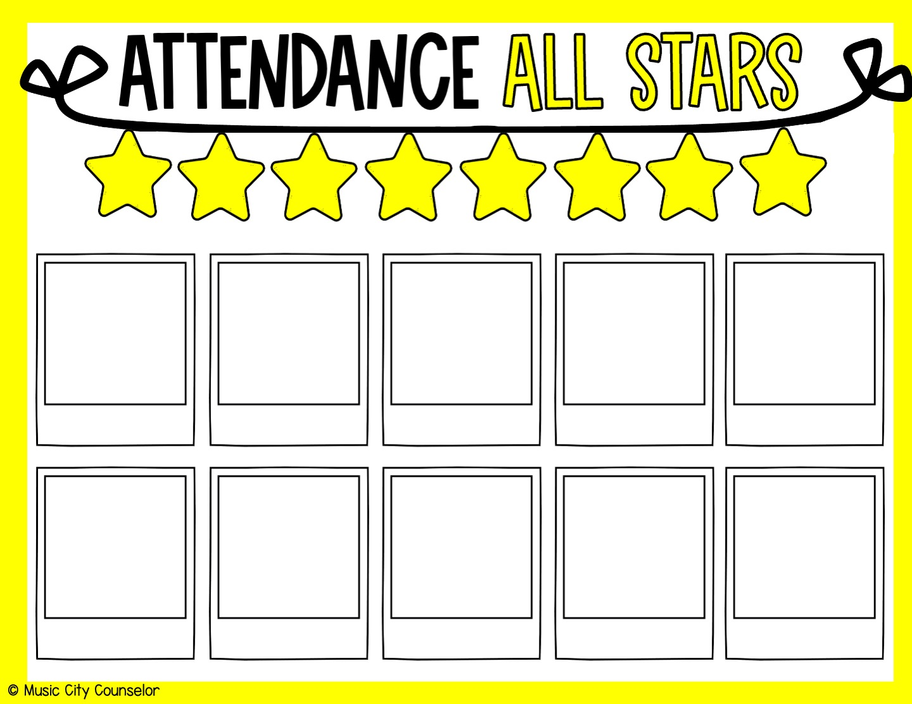
Type student name
Type student name
Type student name
Type student name
Type student name
Type student name
Type student name
Type student name
Type student name
Type student name

Slide 25
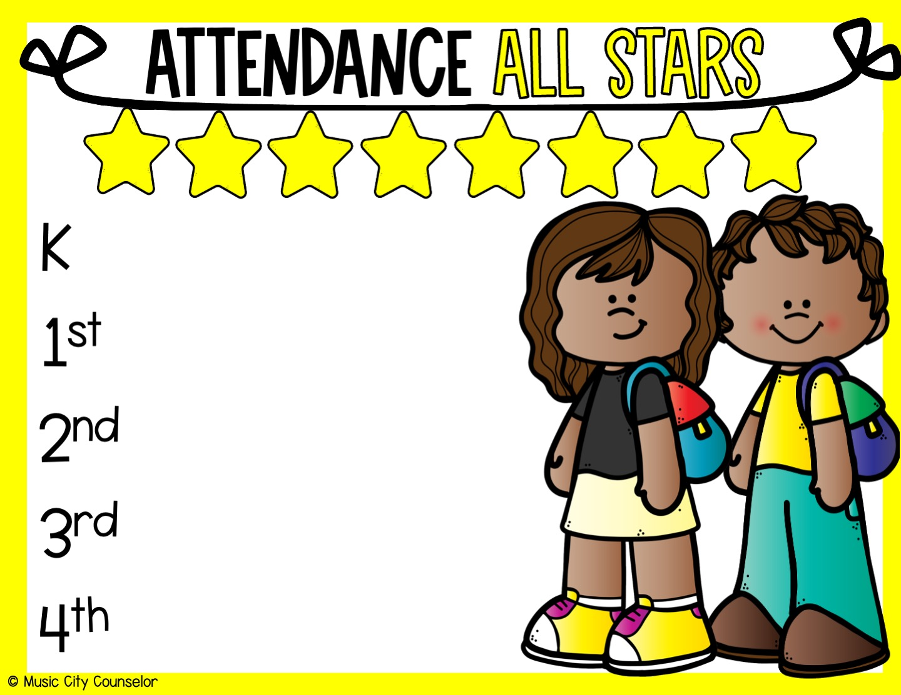
Type Teacher
Type Teacher
Type Teacher
Type Teacher
Type Teacher

Slide 26

Type Teacher
Type Teacher
Type Teacher
Type Teacher
Type Teacher
Type Teacher

Slide 27



