Slide 1






www.musiccitycounselor.com
www.counselorcollab.com

Slide 2


Slide 3
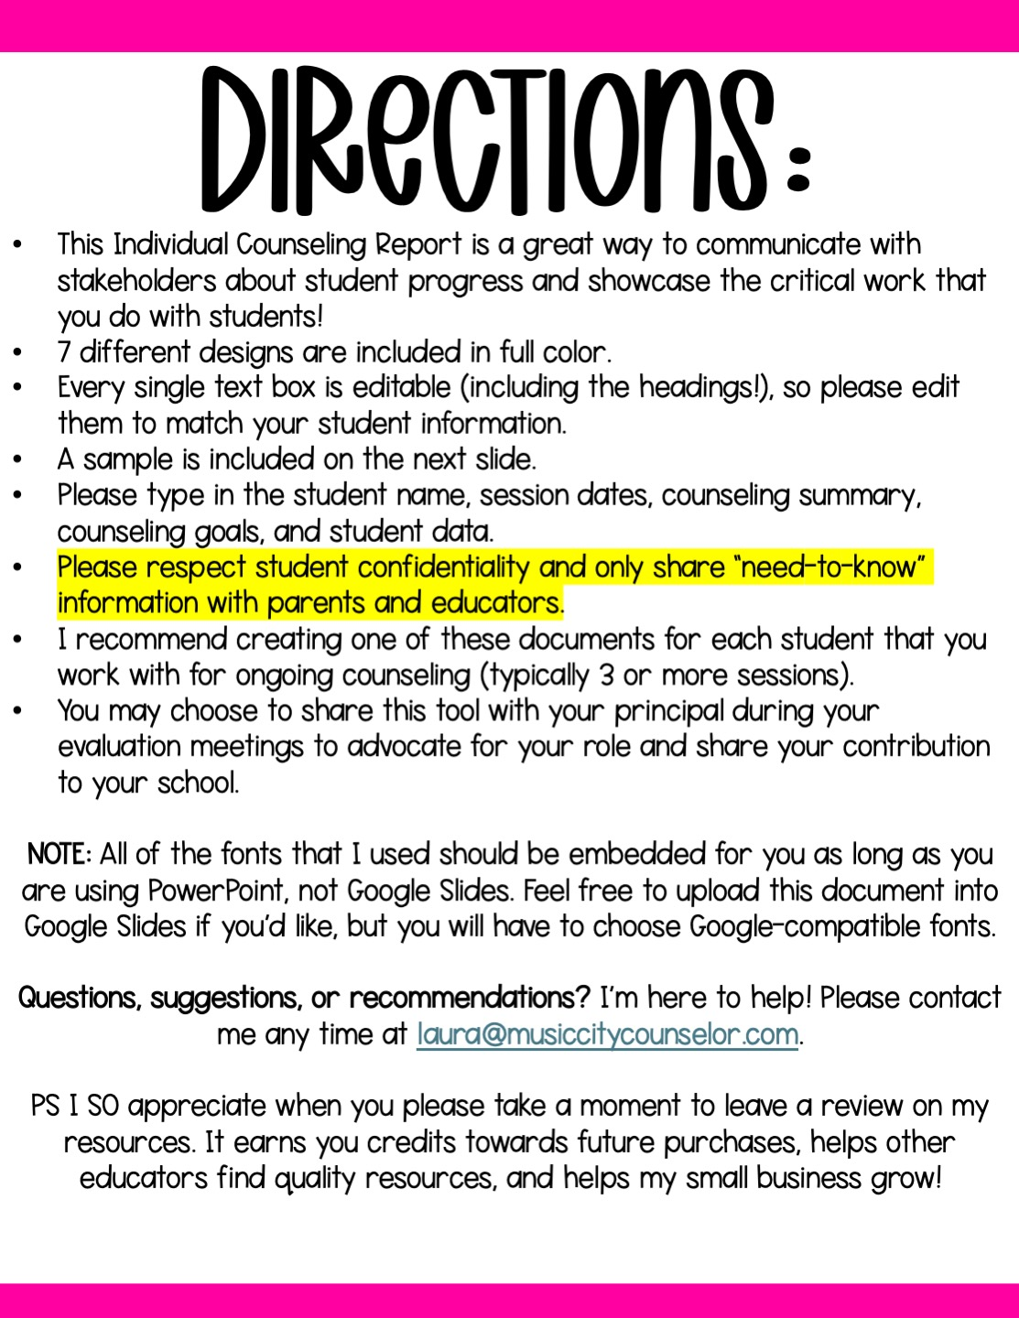

Slide 4

school counseling
INDIVIDUAL REPORT
Juana Hernandez-Lopez
SESSION DATES:
Goals:
1/7/25, 1/17/25, 1/30/25, 2/6/25, 2/28/25
Juana will have 25% less discipline referrals in Quarter 3.
Juana will learn
to name her feelings.
Juana will be able to choose and use a coping skill when escalated.
Summary:
I am so proud of Juana’s progress! We are exploring her triggers and working on naming her feelings. We have practiced several coping skills, and our next goal is for her to choose (and use) a coping strategy when she is escalated.
Student Data summary:
95% attendance rate
Above grade level in reading, below benchmark in math
Grades: C’s and D’s
6 discipline referrals Quarter 2
Support Team meeting February 26th

Slide 5

school counseling
INDIVIDUAL REPORT
Type Student Name Here
SESSION DATES:
Goals:
Type here
Type here
Summary:
Type here
Student Data summary:
Type here

Slide 6

school counseling
INDIVIDUAL REPORT
Type Student Name Here
SESSION DATES:
Goals:
Type here
Type here
Summary:
Type here
Student Data summary:
Type here

Slide 7

school counseling
INDIVIDUAL REPORT
Type Student Name Here
SESSION DATES:
Goals:
Type here
Type here
Summary:
Type here
Student Data summary:
Type here

Slide 8

school counseling
INDIVIDUAL REPORT
Type Student Name Here
SESSION DATES:
Goals:
Type here
Type here
Summary:
Type here
Student Data summary:
Type here

Slide 9

school counseling
INDIVIDUAL REPORT
Type Student Name Here
SESSION DATES:
Goals:
Type here
Type here
Summary:
Type here
Student Data summary:
Type here

Slide 10

school counseling
INDIVIDUAL REPORT
Type Student Name Here
SESSION DATES:
Goals:
Type here
Type here
Summary:
Type here
Student Data summary:
Type here

Slide 11
