Slide 1






www.musiccitycounselor.com
www.counselorcollab.com

Slide 2


Slide 3
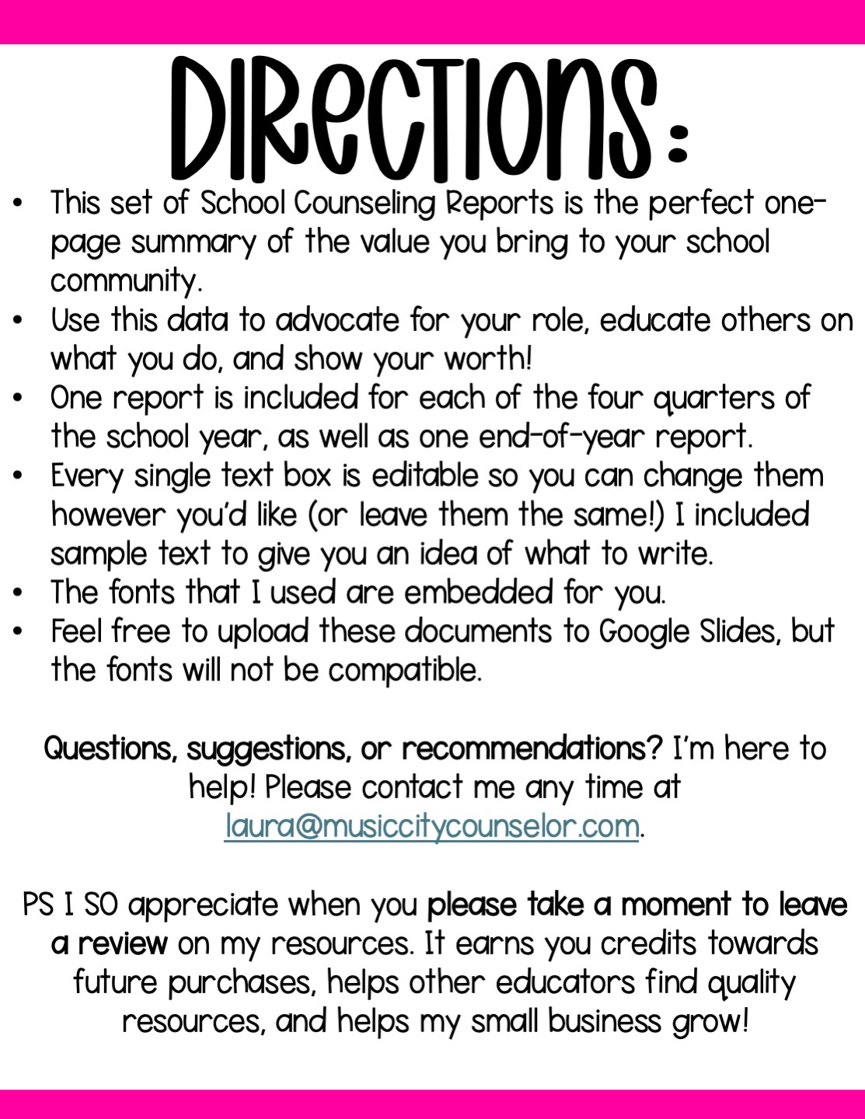

Slide 4

school counseling
DATA REPORT
Fairview Elementary Quarter 1: 2025
Mission & summary of services:
Mission Statement: To maximize the personal, social, academic, and career potential of all students.
Summary of Services: This quarter, we focused on building students’ feelings identification and social skills through a series of classroom lessons delivered to all students. We targeted attendance and discipline data and served students individually and in small group settings.
School counseling by the numbers:
XX XX XX XX XX XX XX
Referrals
Received
Individual
Sessions
Delivered
Small
Group
Sessions
Classroom
Lessons
Taught
Support
Meetings
Led
Parent
Contacts Made
% of
Students
Served
Program highlights:
Individual Counseling Needs: Anxiety, friendship issues, anger, self-regulation, grief
Small Groups: Changing families, anger, anxiety
Career Day
Coffee with the Counselor
Red Ribbon Week October 25th – 29th

Slide 5

school counseling
DATA REPORT
Fairview Elementary Quarter 2: 2025
Mission & summary of services:
Mission Statement: To maximize the personal, social, academic, and
career potential of all students.
Summary of Services: This quarter, we focused on building students’
coping skills, career awareness, and resilience through a series of classroom lessons delivered to all K-5th grade students. We targeted attendance and discipline data and served students in individual and
small group settings.
School counseling by the numbers:
XX XX XX XX XX XX XX
Referrals
Received
Individual
Sessions
Delivered
Small
Group
Sessions
Classroom
Lessons
Taught
Support
Meetings
Led
Parent
Contacts Made
% of
Students
Served
Program highlights:
Individual Counseling Needs: Anxiety, friendship issues, anger, self-regulation, grief and loss
Small Groups: Changing Families, Coping with Anger, & Coping with Anxiety
Thanksgiving Food Drive
Holiday Gift Drive

Slide 6

school counseling
DATA REPORT
Fairview Elementary Quarter 3: 2026
Mission & summary of services:
Mission Statement: To maximize the personal, social, academic, and career potential of all students.
Summary of Services: This quarter, we focused on building students’ friendship skills, school success skills, and goal-setting through a series of classroom lessons delivered to all K-5th grade students. We targeted attendance and discipline data and served students in individual and small group settings.
School counseling by the numbers:
XX XX XX XX XX XX XX
Referrals
Received
Individual
Sessions
Delivered
Small
Group
Sessions
Classroom
Lessons
Taught
Support
Meetings
Led
Parent
Contacts Made
% of
Students
Served
Program highlights:
Individual Counseling Needs: Anxiety, friendship issues, anger, self-regulation, grief and loss
Small Groups: Changing families, coping with anger, & coping with anxiety
Positive Parenting Zoom Class
Puberty Workshop

Slide 7

school counseling
DATA REPORT
Fairview Elementary Quarter 4: 2026
Mission & summary of services:
Mission Statement: To maximize the personal, social, academic, and career potential of all students.
Summary of Services: This quarter, we focused on building students’
conflict resolution skills and problem-solving skills through a series of classroom lessons delivered to all K-5th grade students. We targeted attendance and discipline data and served students in individual and small group settings.
School counseling by the numbers:
XX XX XX XX XX XX XX
Referrals
Received
Individual
Sessions
Delivered
Small
Group
Sessions
Classroom
Lessons
Taught
Support
Meetings
Led
Parent
Contacts Made
% of
Students
Served
Program highlights:
Individual Counseling Needs: Anxiety, friendship issues, anger, self-regulation, grief and loss
Small Groups: Changing Families, Coping with Anger, & Coping with Anxiety
Middle School Transition Tours
Summer Safety Assembly

Slide 8

school counseling
DATA REPORT
Fairview Elementary 2025 - 2026
Mission & summary of services:
Mission Statement: To maximize the personal, social, academic, and career potential of all students.
Summary of Services: This year, we focused on building students’ feelings identification, social skills, career development, resilience, coping skills, academic success skills, and friendship skills through a series of
classroom lessons delivered to all K-5th grade students. We targeted
attendance and discipline data and served students in individual and small group settings.
School counseling by the numbers:
XX XX XX XX XX XX XX
Referrals
Received
Individual
Sessions
Delivered
Small
Group
Sessions
Classroom
Lessons
Taught
Support
Meetings
Led
Parent
Contacts Made
% of
Students
Served
Program highlights:
Individual Counseling Needs: Anxiety, friendship issues, anger, self-regulation, grief and loss
Small Groups: Changing families, coping with anger, & coping with anxiety
Coffee with the Counselor, Parenting Workshops, Career Day, Holiday Support

Slide 9
