Slide 1

Smithville Elementary
Mrs. Laura Oathout

Slide 2
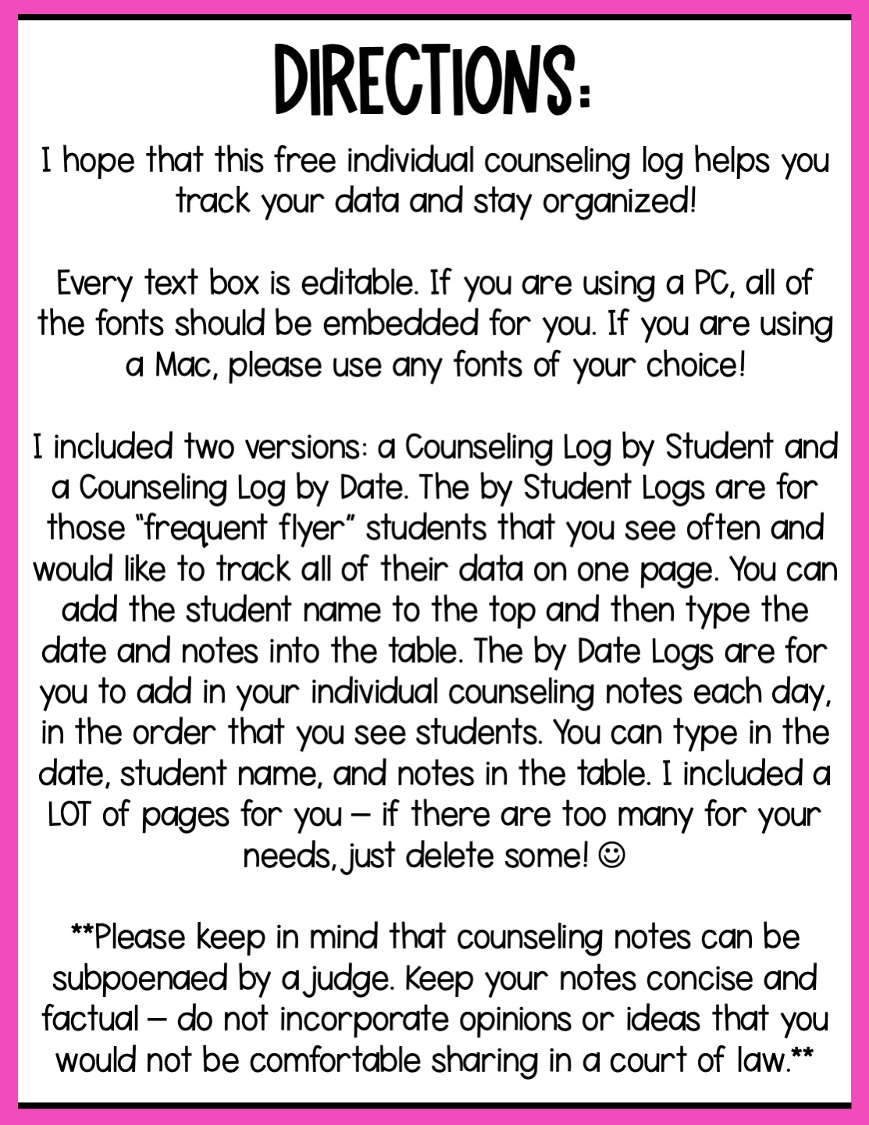

Slide 3


Slide 4

Type Student Name Here
Date: | Session Notes:

Slide 5

Type Student Name Here
Date: | Session Notes:

Slide 6

Type Student Name Here
Date: | Session Notes:

Slide 7

Type Student Name Here
Date: | Session Notes:

Slide 8
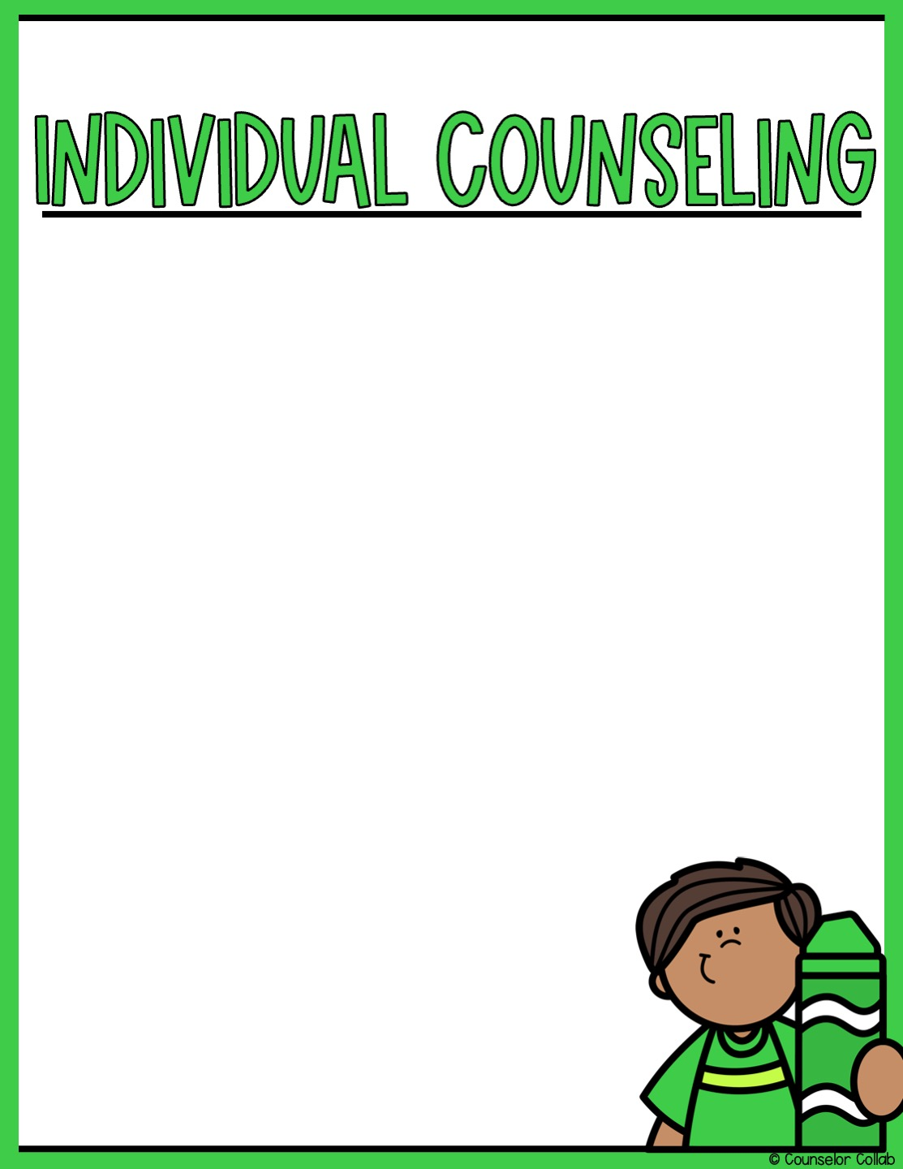
Type Student Name Here
Date: | Session Notes:

Slide 9

Type Student Name Here
Date: | Session Notes:

Slide 10
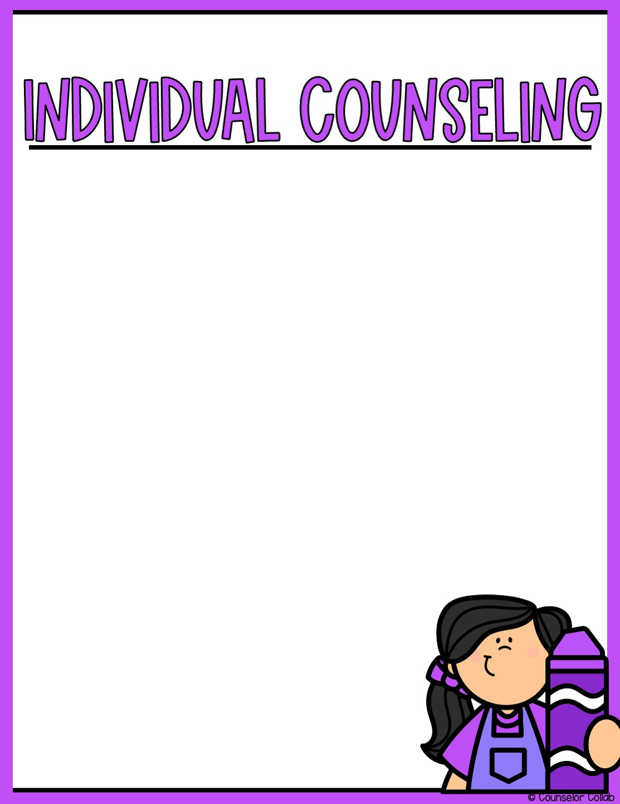
Type Student Name Here
Date: | Session Notes:

Slide 11
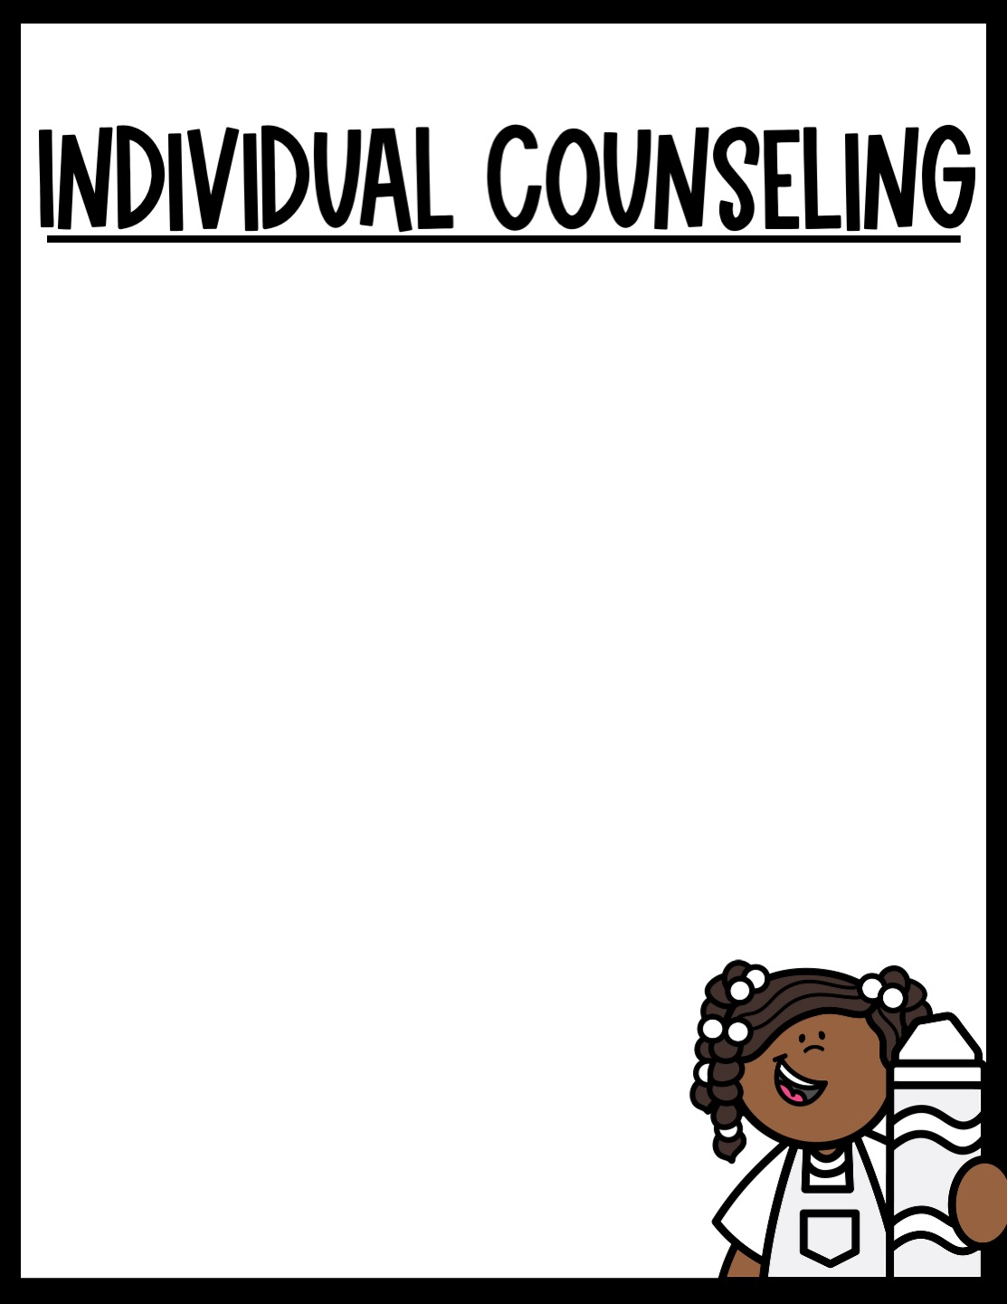
Type Student Name Here
Date: | Session Notes:

Slide 12
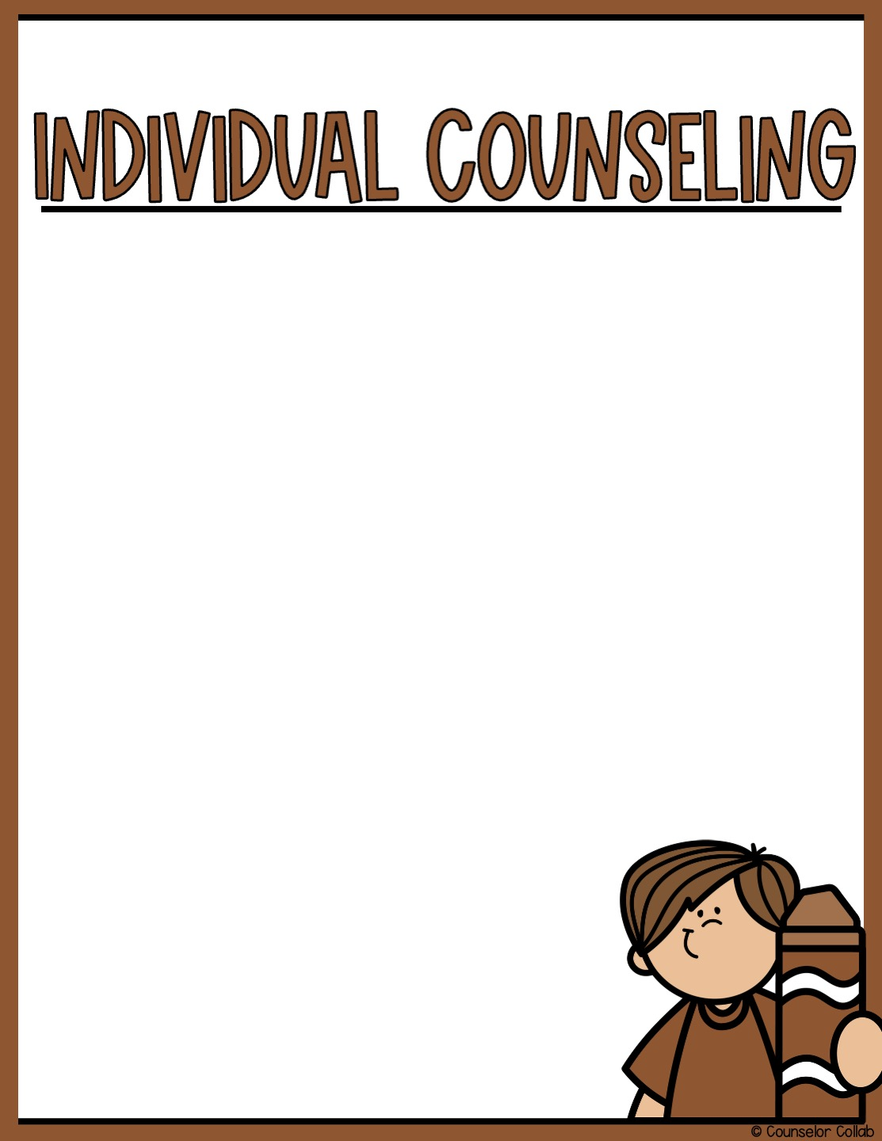
Type Student Name Here
Date: | Session Notes:

Slide 13

Type Student Name Here
Date: | Session Notes:

Slide 14
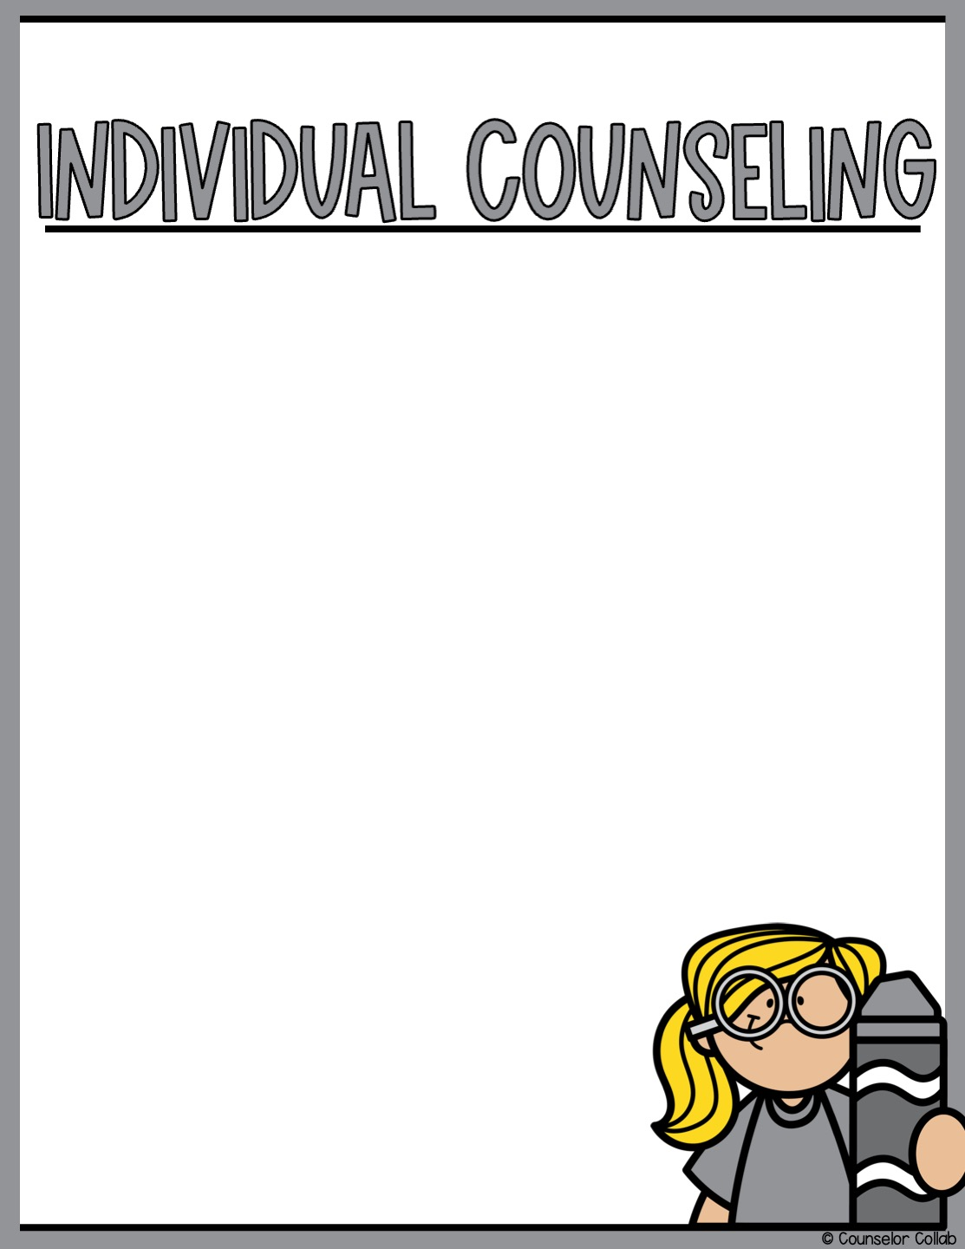
Type Student Name Here
Date: | Session Notes:

Slide 15


Slide 16
Type Counselor Name Here
Date: | Student Name: | Session Notes:

Slide 17

Type Counselor Name Here
Date: | Student Name: | Session Notes:

Slide 18

Type Counselor Name Here
Date: | Student Name: | Session Notes:

Slide 19

Type Counselor Name Here
Date: | Student Name: | Session Notes:

Slide 20

Type Counselor Name Here
Date: | Student Name: | Session Notes:

Slide 21

Type Counselor Name Here
Date: | Student Name: | Session Notes:

Slide 22
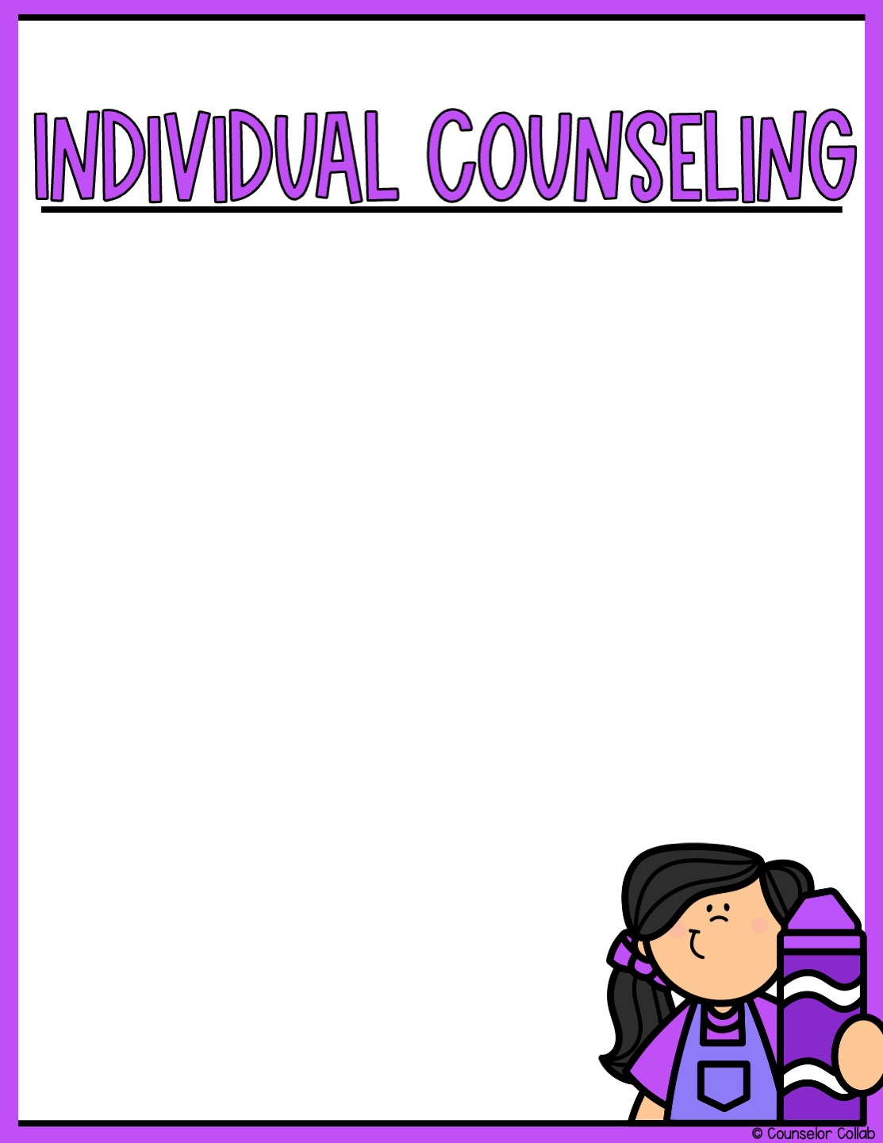
Type Counselor Name Here
Date: | Student Name: | Session Notes:

Slide 23
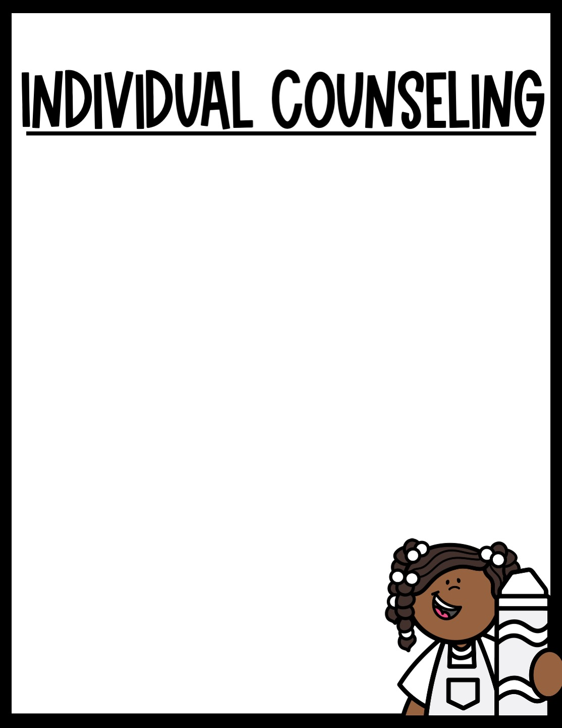
Type Counselor Name Here
Date: | Student Name: | Session Notes:

Slide 24
Type Counselor Name Here
Date: | Student Name: | Session Notes:

Slide 25

Type Counselor Name Here
Date: | Student Name: | Session Notes:

Slide 26
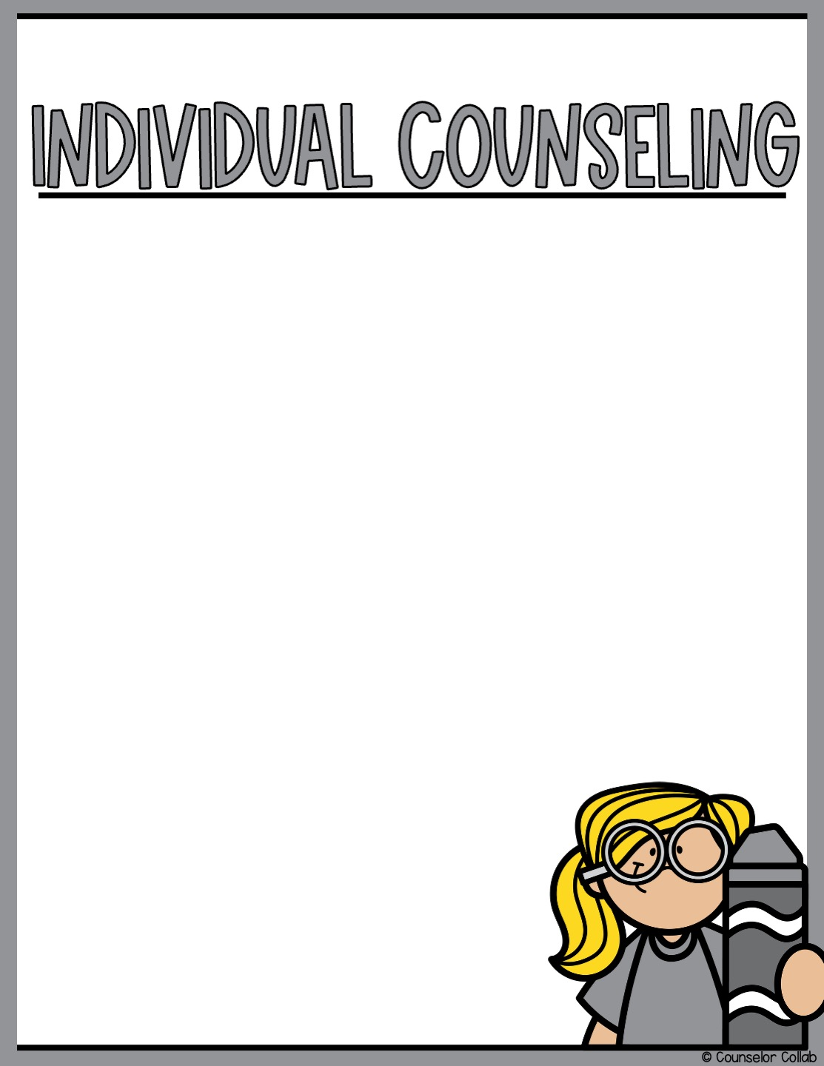
Type Counselor Name Here
Date: | Student Name: | Session Notes:

Slide 27




