Slide 1






www.musiccitycounselor.com
www.counselorcollab.com

Slide 2
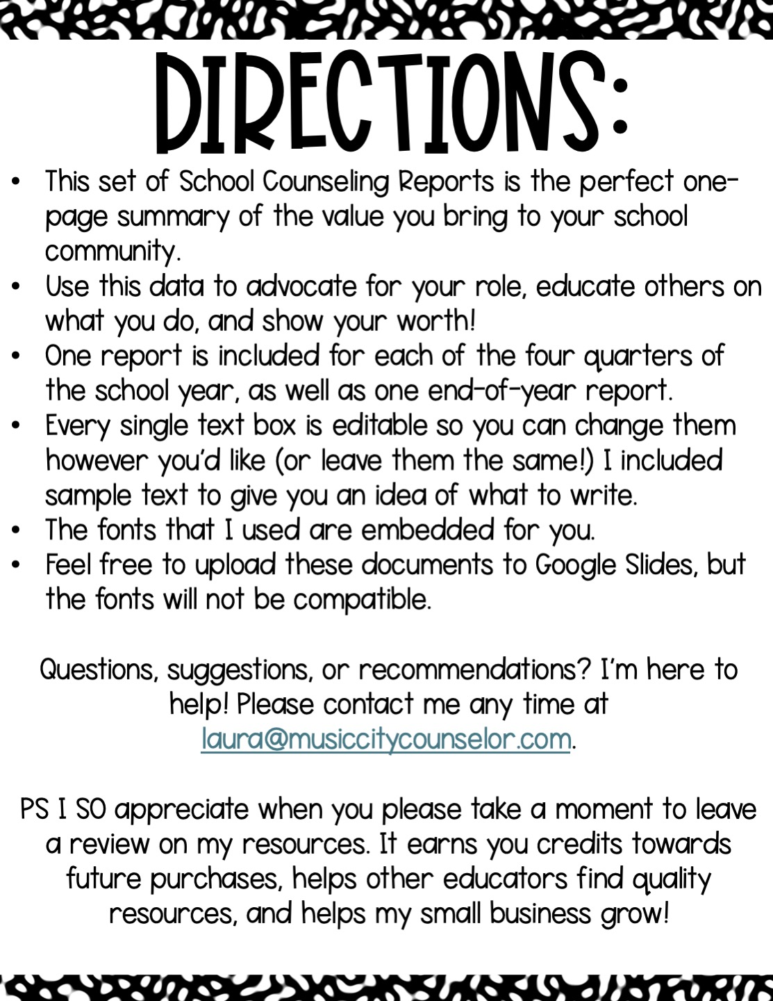

Slide 3

School counseling
Data report
Fairview Elementary Quarter 1 2024
Mission & Summary of services:
Mission Statement: To maximize the personal, social, academic, and career potential of all students.
Summary of Services: This quarter, we focused on building
students’ feelings identification and social skills through a series
of classroom lessons delivered to all K-5th grade students. We
targeted attendance and discipline data and served students
in individual and small group settings.
school counseling bY the numbers:
XX XX XX XX XX XX XX XX
Referrals
Received
Individual
Sessions
Delivered
Small
Group
Sessions
Classroom
Lessons
Taught
Support
Meetings
Led
Parent
Contacts Made
504
Meetings Led
% of
Students
Served
Program highlights:
Individual Counseling Needs: Anxiety, friendship issues, anger, self-regulation, grief and loss
Small Groups: Changing Families, Anger, & Anxiety
Coffee with the Counselor
Red Ribbon Week October 25th – 29th
New Student Mentorship Program
Positive Parenting Workshop Series
Fall Festival Coordination

Slide 4

School counseling
Data report
Fairview Elementary Quarter 2 2024
Mission & Summary of services:
Mission Statement: To maximize the personal, social, academic, and career potential of all students.
Summary of Services: This quarter, we focused on building students’ coping skills, career awareness, and resilience through a series of classroom lessons delivered to all K-5th grade students. We targeted attendance and discipline data and served students in individual
and small group settings.
school counseling bY the numbers:
XX XX XX XX XX XX XX XX
Referrals
Received
Individual
Sessions
Delivered
Small
Group
Sessions
Classroom
Lessons
Taught
Support
Meetings
Led
Parent
Contacts Made
504
Meetings Led
% of
Students
Served
Program highlights:
Individual Counseling Needs: Anxiety, friendship issues, anger, self-regulation, grief and loss
Small Groups: Changing Families, Coping with Anger, & Coping with Anxiety
Thanksgiving Food Drive
Career Day December 1st
Holiday Gift Drive

Slide 5

School counseling
Data report
Fairview Elementary Quarter 3 2025
Mission & Summary of services:
Mission Statement: To maximize the personal, social, academic, and career potential of all students.
Summary of Services: This quarter, we focused on building students’ friendship skills, school success skills, and goal-setting through a
series of classroom lessons delivered to all K-5th grade students.
We targeted attendance and discipline data and served
students in individual and small group settings.
school counseling bY the numbers:
XX XX XX XX XX XX XX XX
Referrals
Received
Individual
Sessions
Delivered
Small
Group
Sessions
Classroom
Lessons
Taught
Support
Meetings
Led
Parent
Contacts Made
504
Meetings Led
% of
Students
Served
Program highlights:
Individual Counseling Needs: Anxiety, friendship issues, anger, self-regulation, grief and loss
Small Groups: Changing Families, Coping with Anger, & Coping with Anxiety
Positive Parenting Zoom Class
Puberty Workshop
State Standardized Testing

Slide 6

School counseling
Data report
Fairview Elementary Quarter 4 2025
Mission & Summary of services:
Mission Statement: To maximize the personal, social, academic, and career potential of all students.
Summary of Services: This quarter, we focused on building students’ conflict resolution skills and problem-solving skills through a
series of classroom lessons delivered to all K-5th grade
students. We targeted attendance and discipline data and
served students in individual and small group settings.
school counseling bY the numbers:
XX XX XX XX XX XX XX XX
Referrals
Received
Individual
Sessions
Delivered
Small
Group
Sessions
Classroom
Lessons
Taught
Support
Meetings
Led
Parent
Contacts Made
504
Meetings Led
% of
Students
Served
Program highlights:
Individual Counseling Needs: Anxiety, friendship issues, anger, self-regulation, grief and loss
Small Groups: Changing Families, Coping with Anger, & Coping with Anxiety
Middle School Transition Tours
Summer Safety Assembly
Optional Schools Fair

Slide 7

School counseling
Data report
2024 – 2025 School Year
Mission & Summary of services:
Mission Statement: To maximize the personal, social, academic, and career potential of all students.
Summary of Services: This year, we focused on building students’ feelings identification, social skills, career development, resilience, coping skills, academic success skills, and friendship skills through a series of classroom lessons delivered to all K-5th grade students. We targeted
attendance and discipline data and served students in
individual and small group settings.
school counseling bY the numbers:
XX XX XX XX XX XX XX XX
Referrals
Received
Individual
Sessions
Delivered
Small
Group
Sessions
Classroom
Lessons
Taught
Support
Meetings
Led
Parent
Contacts Made
504
Meetings Led
% of
Students
Served
Program highlights:
Individual Counseling Needs: Anxiety, friendship issues, anger, self-regulation, grief and loss
Small Groups: Changing Families, Coping with Anger, & Coping with Anxiety
Coffee with the Counselor, Parenting
Workshops, Career Day, Holiday Support,
Safety & SEL Assemblies, Middle School Tours

Slide 8
