Slide 1
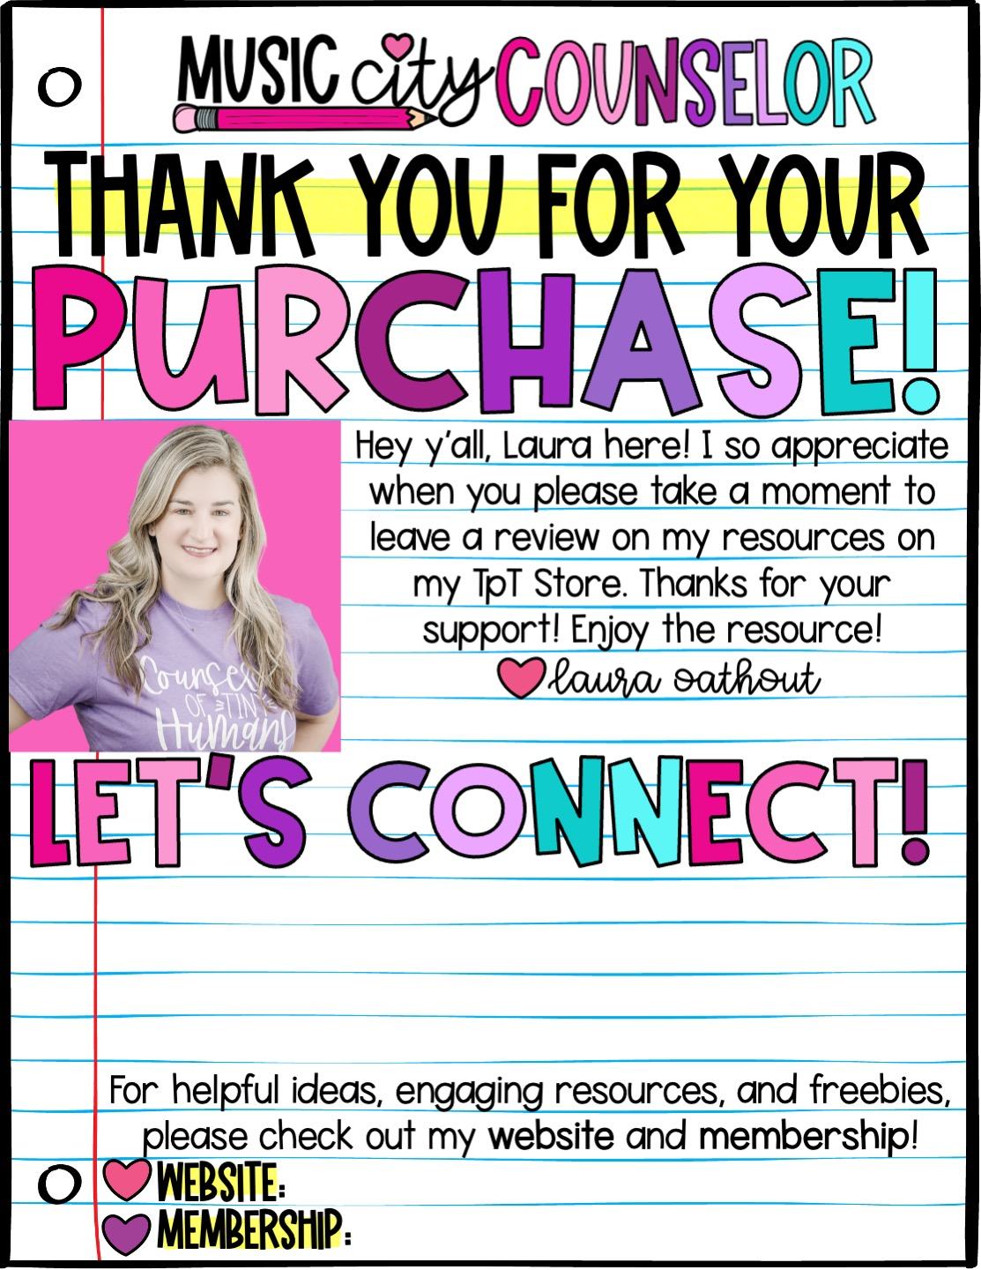





www.musiccitycounselor.com
www.counselorcollab.com

Slide 2
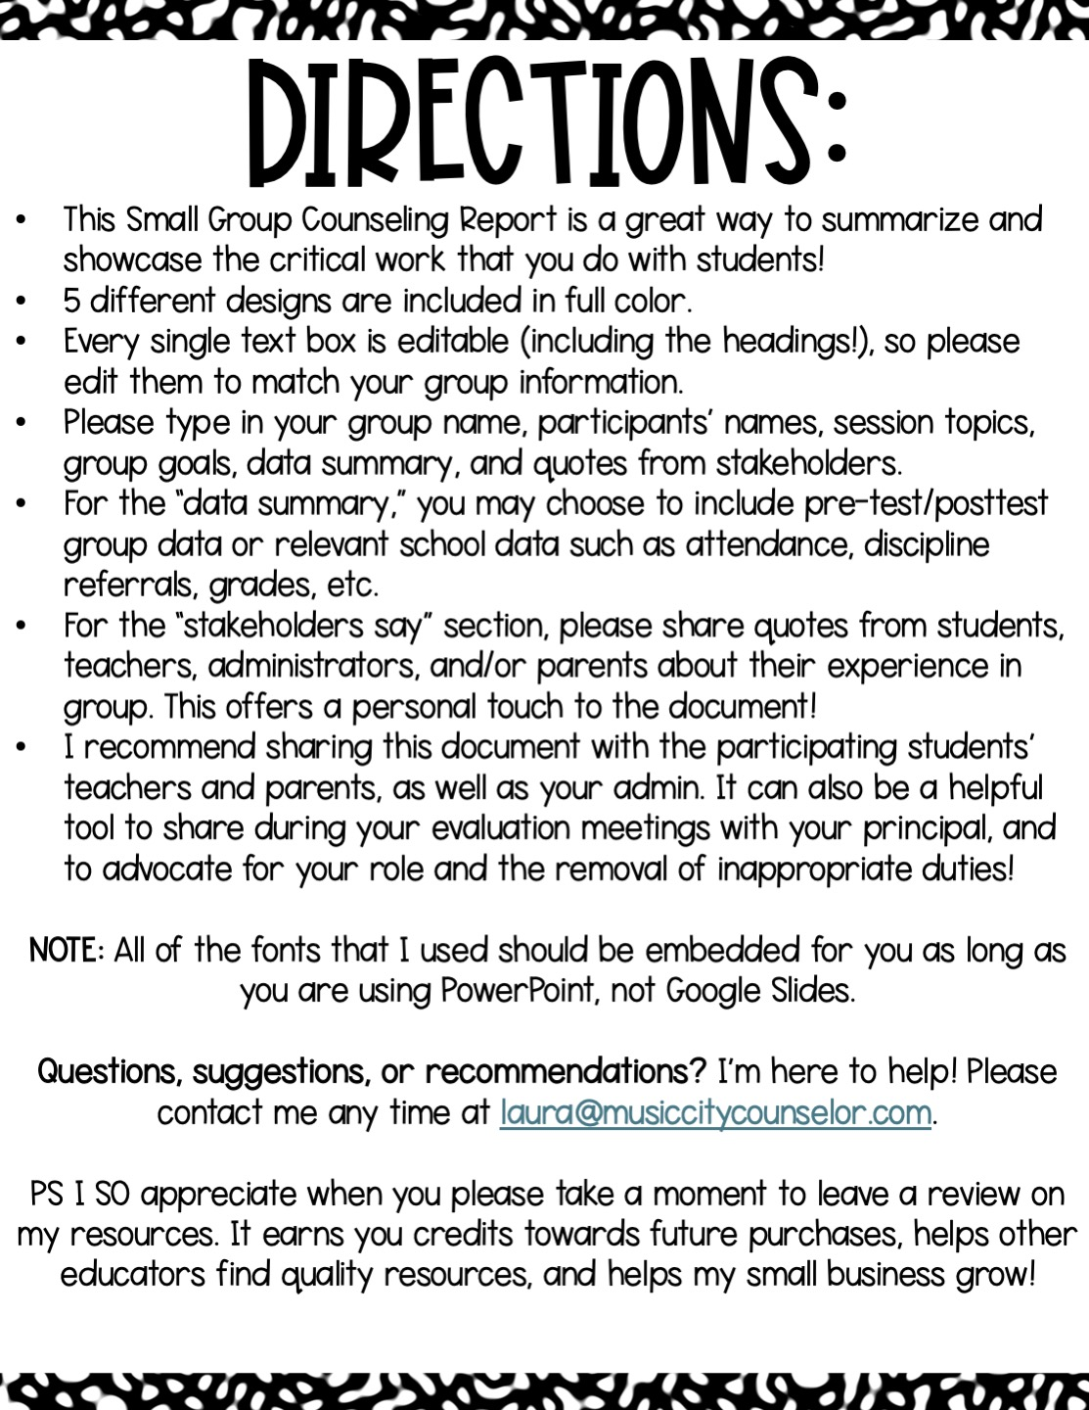

Slide 3
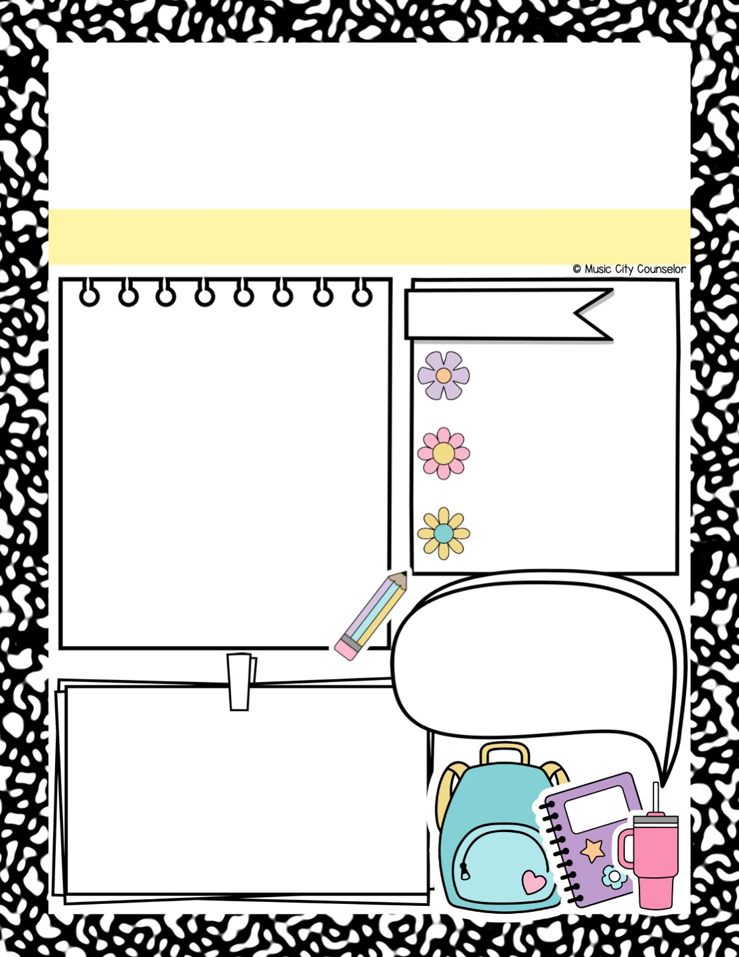
School counseling
Group report
Family Changes Group
Participants:
Goals:
Jose Martin, Alejandra Gutierrez, Jay’Quan Gibbs, Everett Finn, Jack Williams, & Shawn Smalls
Students will process their feelings.
Students will understand their family changes.
Students will learn their rights in a divorce.
Session topics:
Definition of divorce and separation, processing feelings, understanding new living arrangements, holiday changes, accepting new family members, kids’ rights in a divorce,
coping skills.
Stakeholders say:
“I feel so much better about the changes in my family after being in group.”
Data summary:
Participants’ scores on the posttest were an average of 6 points higher than their scores on the pretest. Students’ self-reported feelings were also more positive at the end of group.

Slide 4
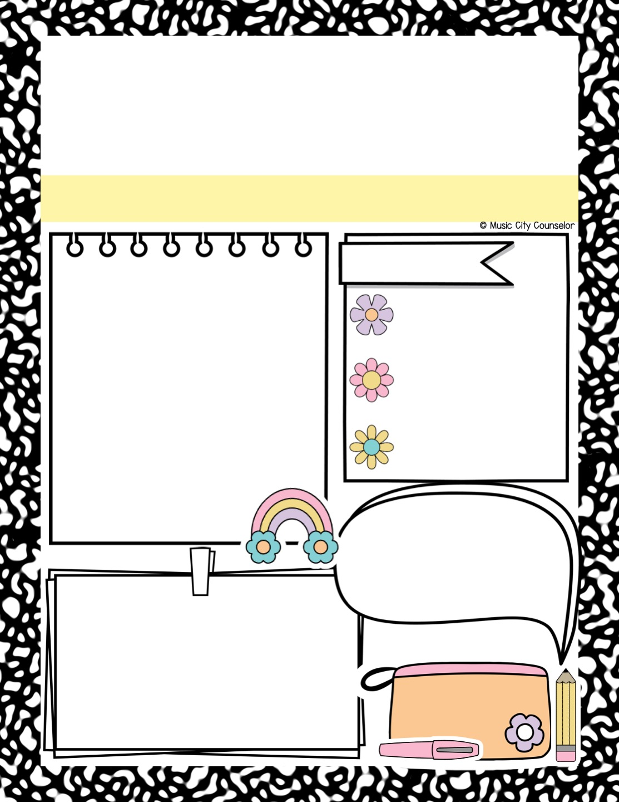
School counseling
Group report
Type Group Title Here
Participants:
Goals:
Type here
Type here
Session topics:
Type here
Stakeholders say:
Type here
Data summary:
Type here

Slide 5
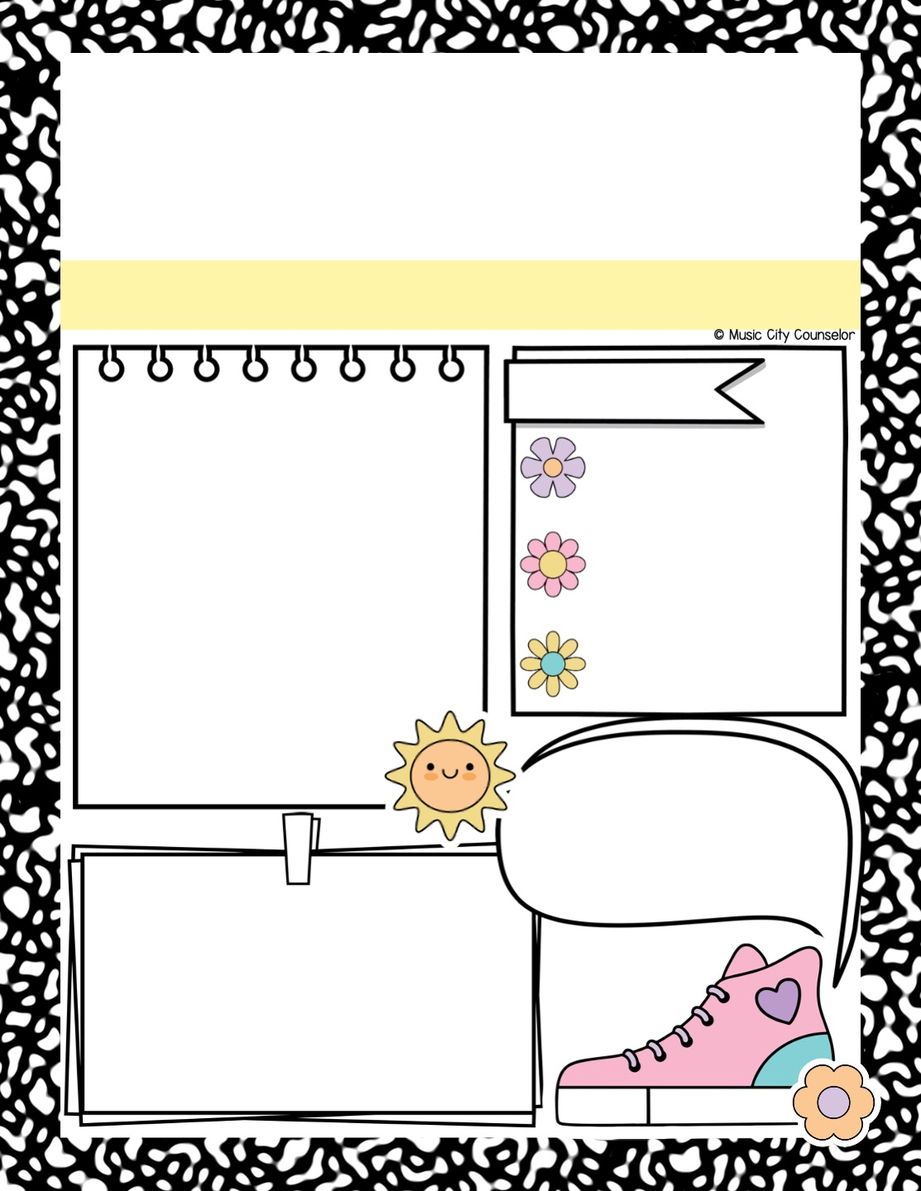
School counseling
Group report
Type Group Title Here
Participants:
Goals:
Type here
Type here
Session topics:
Type here
Stakeholders say:
Type here
Data summary:
Type here

Slide 6
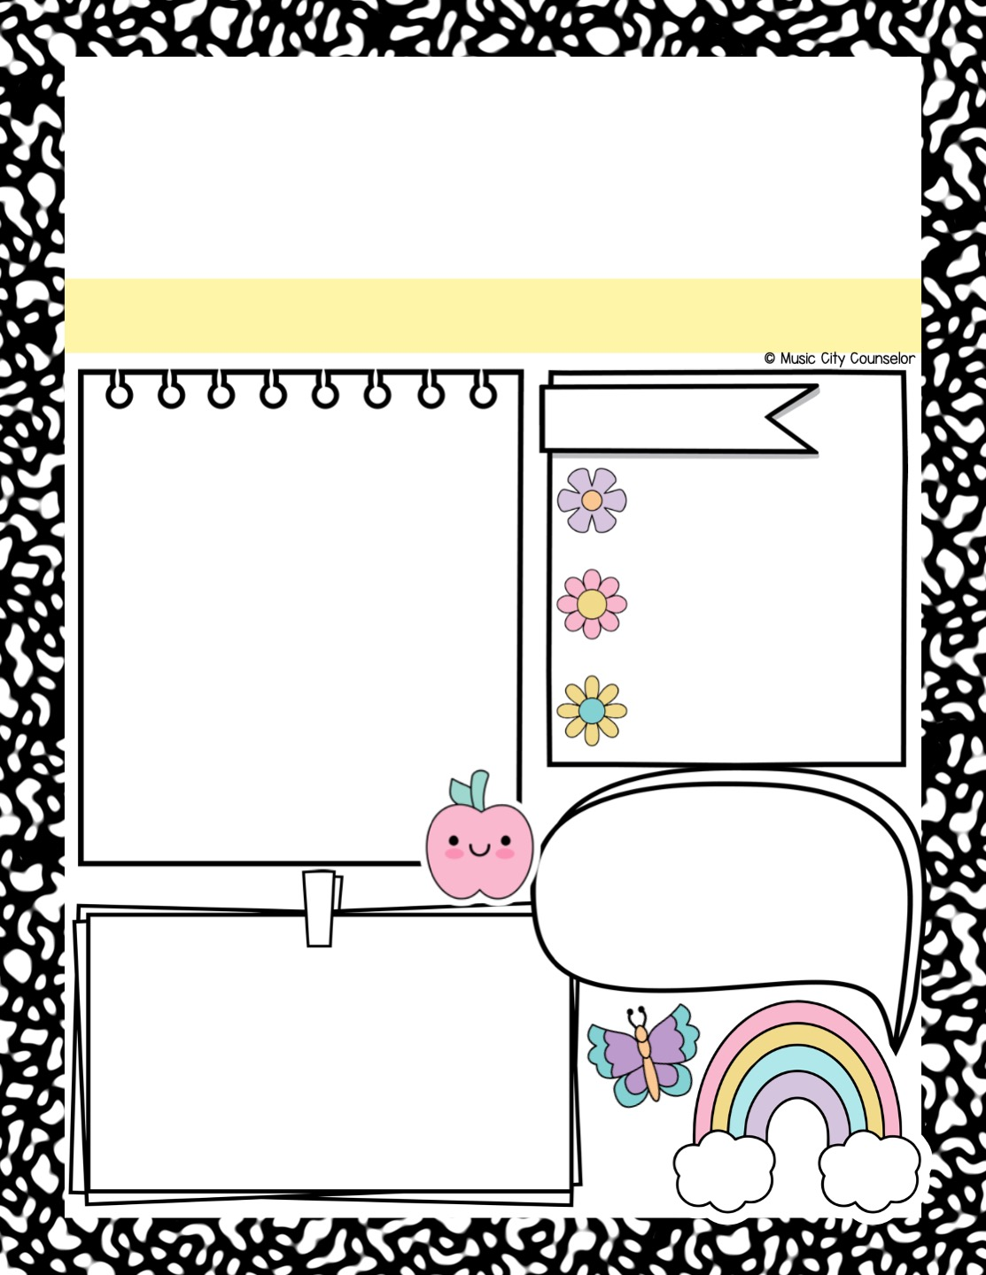
School counseling
Group report
Type Group Title Here
Participants:
Goals:
Type here
Type here
Session topics:
Type here
Stakeholders say:
Type here
Data summary:
Type here

Slide 7
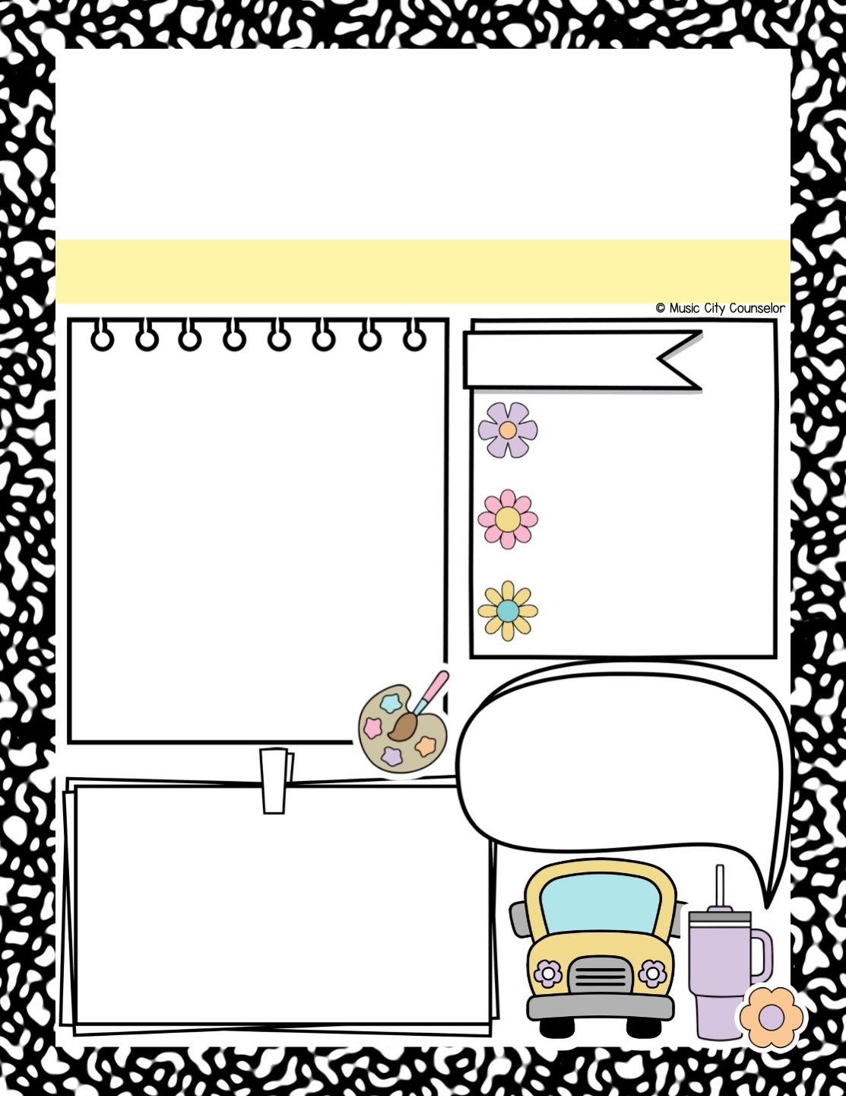
School counseling
Group report
Type Group Title Here
Participants:
Goals:
Type here
Type here
Session topics:
Type here
Stakeholders say:
Type here
Data summary:
Type here

Slide 8
