Slide 1






www.musiccitycounselor.com
www.counselorcollab.com

Slide 2
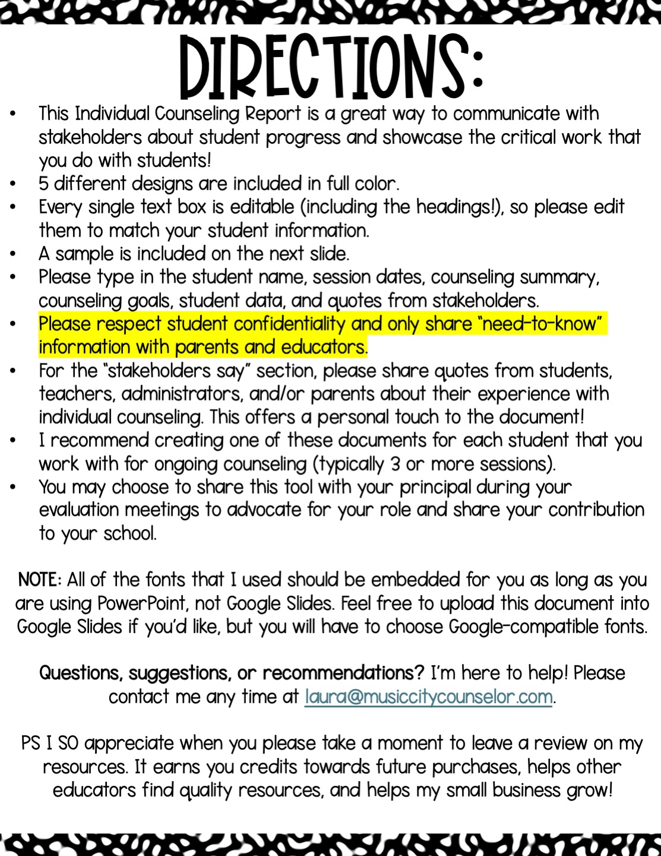

Slide 3

School counseling
Individual report
Juana Hernandez-Lopez
Session dates:
1/7/25, 1/17/25, 1/30/25, 2/6/25, 2/28/25
Counseling Goals:
Summary:
Juana will have 25% less discipline referrals in Quarter 3.
Juana will learn to name her feelings.
Juana will be able to choose and use a
coping skill when escalated.
I am so proud of Juana’s progress! We are exploring her triggers to anger and working on naming her feelings. We have practiced several coping skills (candle breathing is her favorite!) and our next goal is for her to choose (and use) a coping strategy when
she is escalated.
Stakeholders say:
Student data:
“Juana has been made great progress on her behavior since working with Mrs. Oathout!”
– Mrs. Nichols
95% attendance rate
Above grade level in reading, below benchmark in math
Grades: C’s and D’s
6 discipline referrals Quarter 2
Support Team meeting scheduled for February 26th

Slide 4
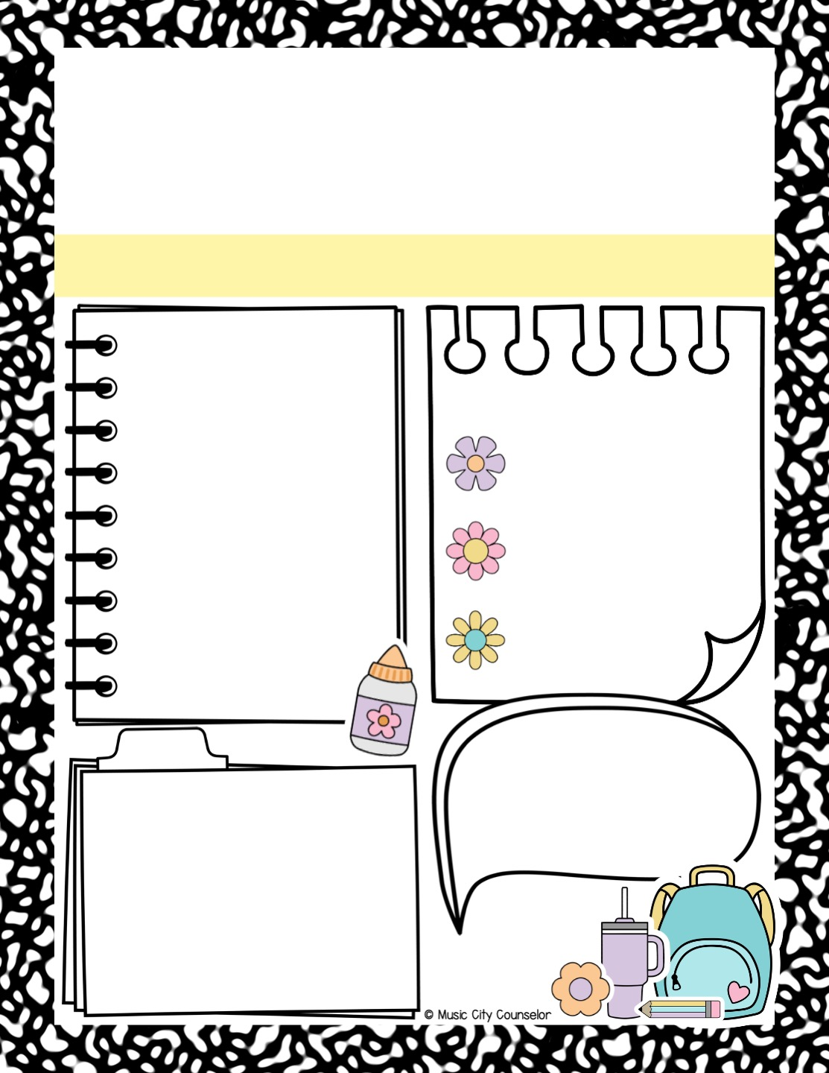
School counseling
Individual report
Type Student Name
Session dates:
Type here
Counseling Goals:
Summary:
Type here
Type here
Stakeholders say:
Student data:
Type here
Type here

Slide 5
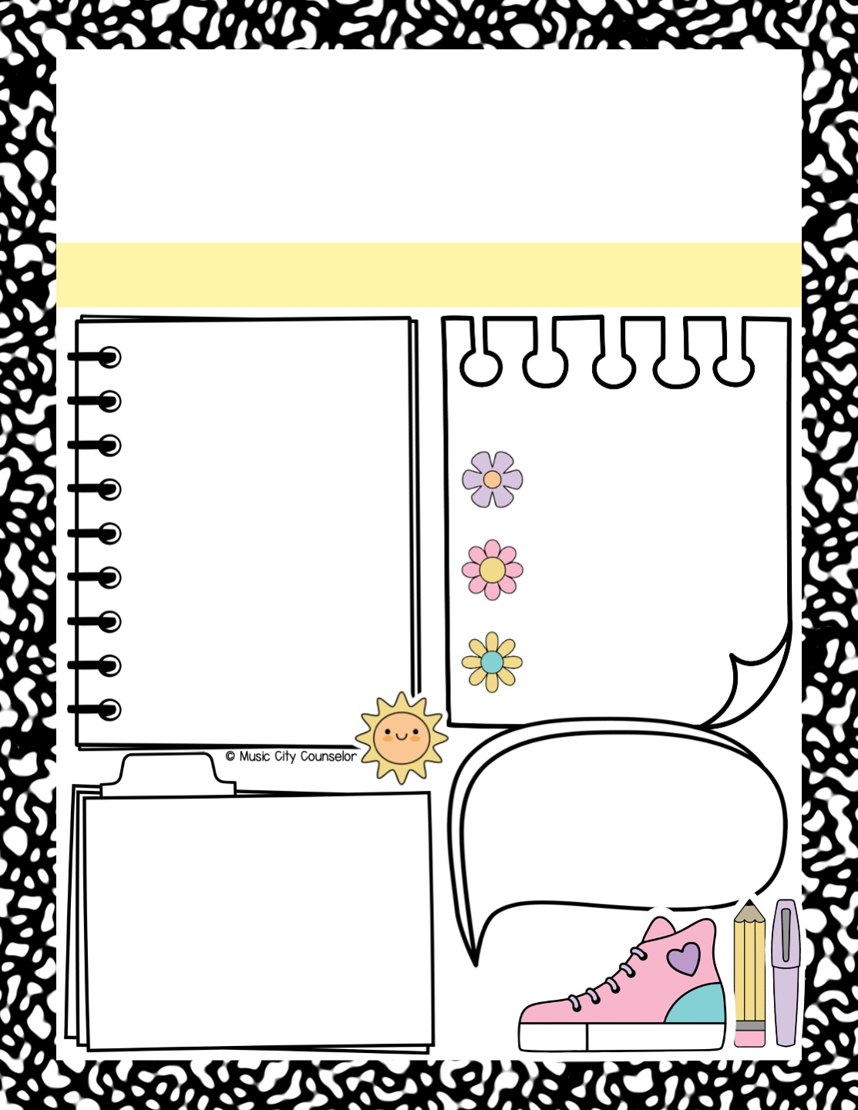
School counseling
Individual report
Type Student Name
Session dates:
Type here
Counseling Goals:
Summary:
Type here
Type here
Stakeholders say:
Student data:
Type here
Type here

Slide 6
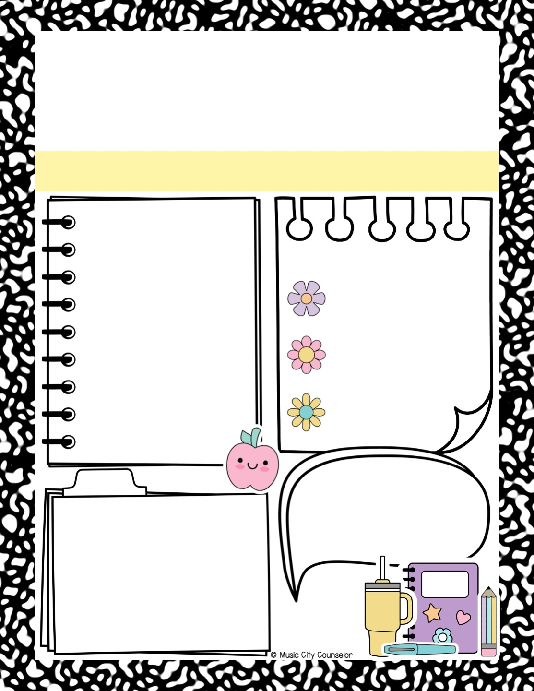
School counseling
Individual report
Type Student Name
Session dates:
Type here
Counseling Goals:
Summary:
Type here
Type here
Stakeholders say:
Student data:
Type here
Type here

Slide 7

School counseling
Individual report
Type Student Name
Session dates:
Type here
Counseling Goals:
Summary:
Type here
Type here
Stakeholders say:
Student data:
Type here
Type here

Slide 8
